Slide 1

Music Recommendation System
Date: 21/03/2023
International Institute of Information Technology, Naya Raipur

Slide 2
Content
Introduction
Overview
Algorithm overview
Algorithm
Objectives
Proposed framework/Model/System/Methodology (explain with block diagram and others)
Experimental results and discussion
Plan of action for project
Conclusion and Future directions
International Institute of Information Technology, Naya Raipur

Slide 3
What should be a good music recommendation system?
User liked songs should get repeated on regular interval.
If user has searched songs from particular era, with good probability the recommendation system should recommend songs of that era.
Let’s say user was used to listen some songs sometime ago and then he stopped listening them. Now if user searches for one of those songs, recommendation system should be able to recommend all those songs.
International Institute of Information Technology, Naya Raipur

Slide 4
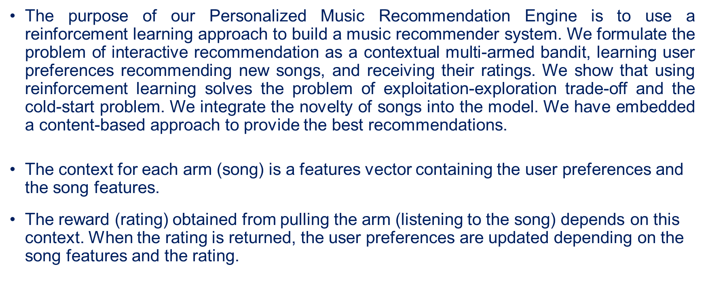
Overview
International Institute of Information Technology, Naya Raipur

Slide 5
Algorithm Overview
Initially we are asking a new user to give ratings to the songs we are providing.
Then we are providing him 10 songs one by one.
After each song the listener will rate the song and accordingly the feature vector (theta) of the user will get updated.
After each iteration our feature vector (theta) is getting updated.
Now our next recommendation will be the song whose utility is maximum.
International Institute of Information Technology, Naya Raipur

Slide 6

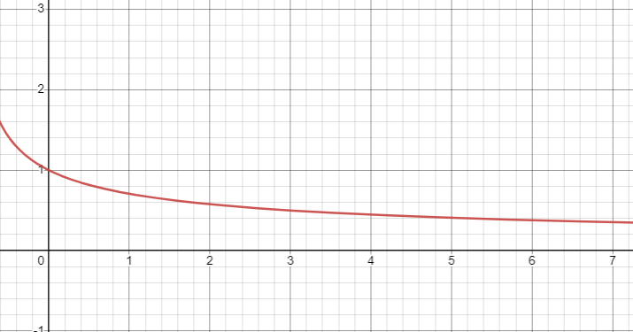
Algorithm in depth (Exploration – Exploitation)
If t > 10 => = 0.3
Exploration : Random unrated song
Exploitation : Song with max utility
International Institute of Information Technology, Naya Raipur

Slide 7

Algorithm in depth (Utility)
Utility = (userFeature).(musicFeature) x (1- e^{-T/s})
T = t - last_t
last _t : Last time when the song was recommended
s: Hyper Parameter (Here, s = 50)
International Institute of Information Technology, Naya Raipur

Slide 8
Algorithm in depth (User Feature Updation)
Initially, t = 10
To reduce heavy penalty at early phase
New User Feature = (t - 1) / t * (Old User Feature) +
1 / t * (Song Feature * Song rating)
International Institute of Information Technology, Naya Raipur

Slide 9
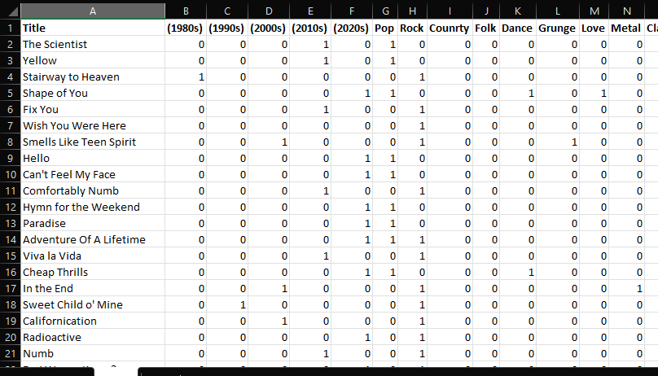
Dataset
Dataset contains 1000 tracks and year.
All songs are divided in their respective genres.
International Institute of Information Technology, Naya Raipur

Slide 10

Thank You
..
Dr. Shyama Prasad Mukherjee International Institute of Information Technology, Naya Raipur
International Institute of Information Technology, Naya Raipur

