Slide 1
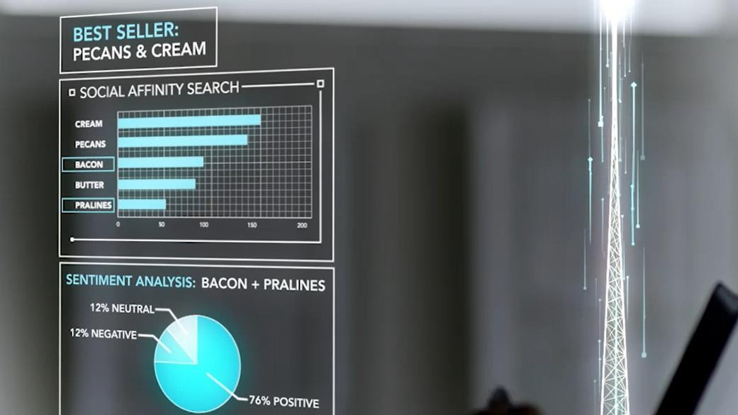



Morning TM Teams!
Mrinal Chakraborty
Data & AI Team
Domain Sol. Architect
PEAT
Microsoft India
mrchakra@microsoft.com
Programing: SAS, CNTK, TensorFlow R-Server and Scala
Big-Data: Cloudera Hadoop certification and Spark Ecosystem
Machine learning: Logistic Regression, Neural Networks, Support vector machines, XGBoost, Classification and Association rules
Allied Analytics skills: Visualisation, Marketing & Web analytics
Certifications: PMP, Design Thinking, Certified Scrum Master & Certified in Business analytics from Indian School of Business http://www.isb.edu/cba/

Slide 2
What‘s in for today ?
Our Journey into buying goods and services
Does carpet-bombing of Ads and Print media still do the job?
Lets try to up-sell and cross-sell with Cognitive services
Demo? (I’m Leaving the technical deep-dive for your enthusiasm)
Image recognition: Why is it gaining importance?
Deep-Learning: How is it shaping our world?
Demo? (Yes, I will cover the technical deep-dive)
Cognitive Services
Image Recognition:
Vision API
1 MN Prediction/Sec?
Microsoft R-Services (with SQL Server 2016)
Solution walk-through
Find all the resources @ https://github.com/Mrinal4Github/TechM-Repository

Slide 3

© 2017 Microsoft Corporation

