Slide 1


SQL Server 2016 R Services 1,000,000 Predictions/second
Mrinal Chakraborty
Data Insights Team
Microsoft India
Programing: SAS, R-Server, TensorFlow, CNTK and Scala
Big-Data: Cloudera Hadoop certification and Spark Ecosystem
Machine learning: Logistic Regression, Neural Networks, Support vector machines, XGBoost, Classification and Association rules
Allied Analytics skills: Visualisation, Marketing & Web analytics
Certifications: PMP,Design Thinking, Certified Scrum Master & Certified in Business analytics from Indian School of Business http://www.isb.edu/cba/

Slide 2

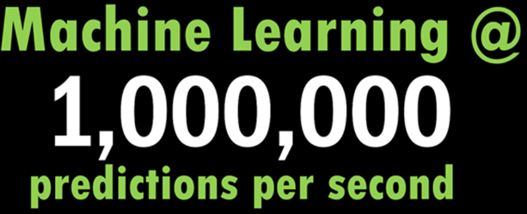
Business Case: Predicting CC Fraud
A new breed of applications that marry the latest OLTP advancements with advanced insights and machine learning.
Describe how companies can predict a million events per second with the very latest algorithms
The predictive model was based on a boosted decision tree algorithm with 50 trees and 33 features.
As the number of transactions per second (TPS) increase, so does the number of predictions per second (PPS) that organizations need to make

Slide 3
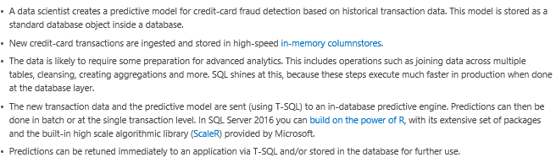
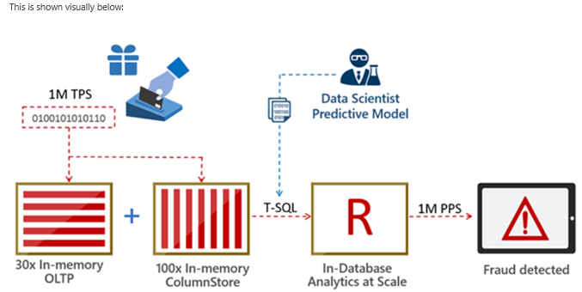
Case: Credit Card Fraud Detection
3

Slide 4
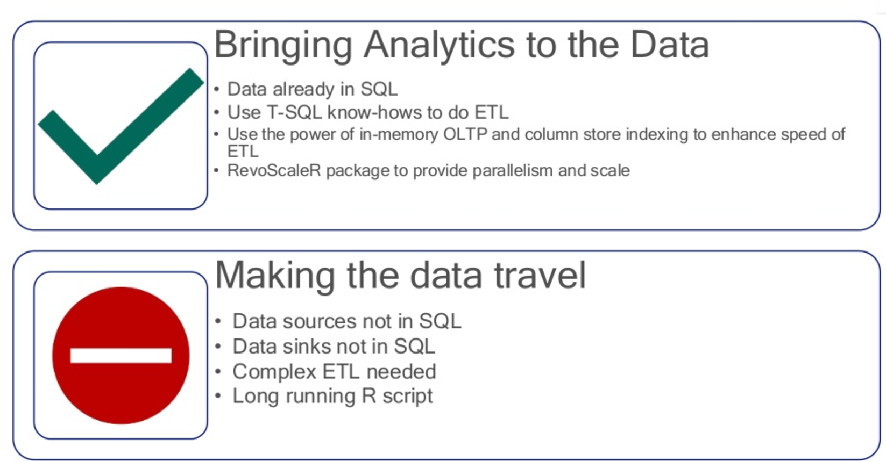
Using SQL Server R Services

Slide 5
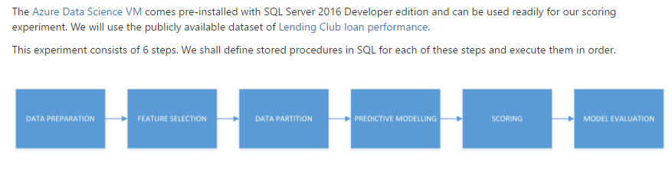
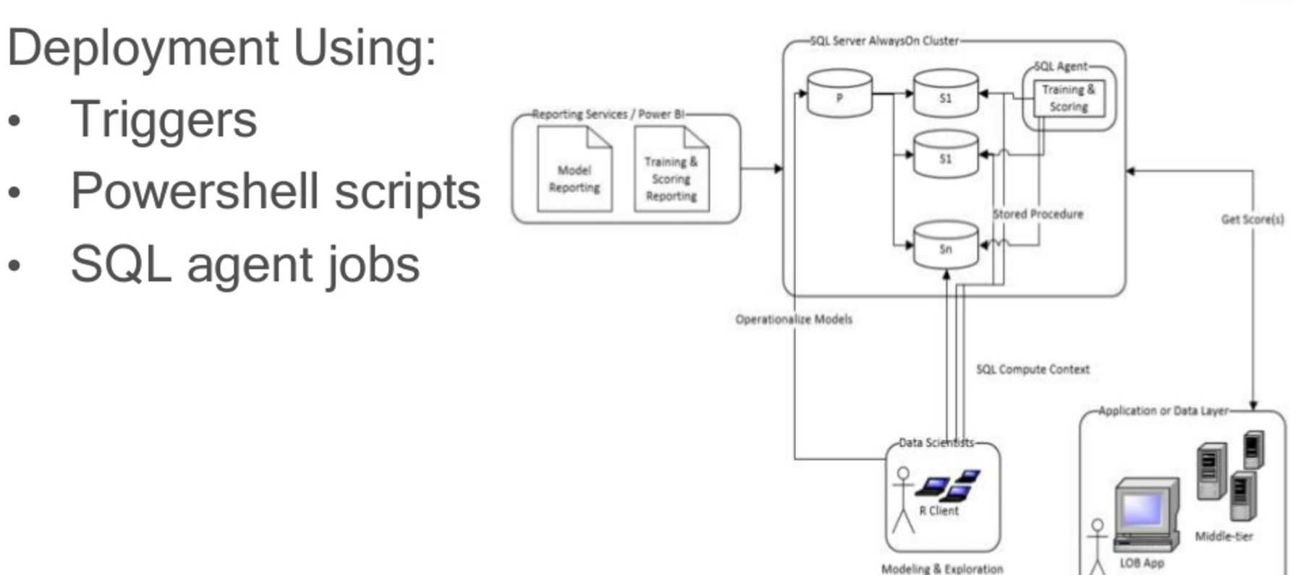
Ok! Let’s connect the system…
Change the Compute Context

Slide 6
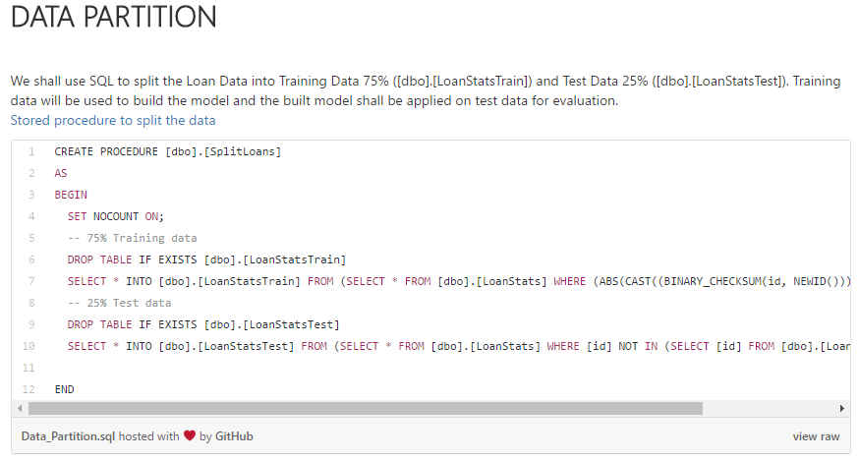
Major Steps: Data Prep & Modeling

Slide 7
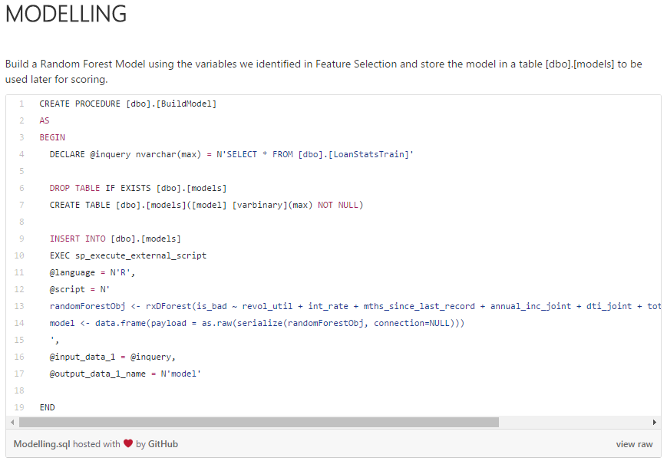
Major Steps: Data Prep & Modeling

Slide 8
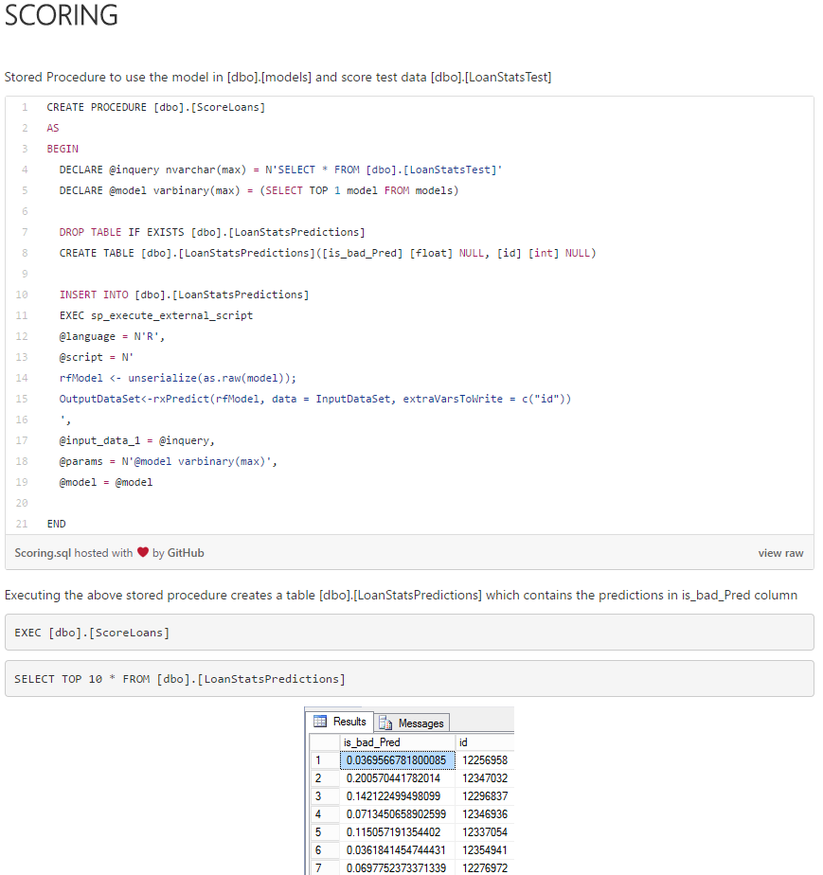
Major Steps: Data Prep & Modeling

Slide 9
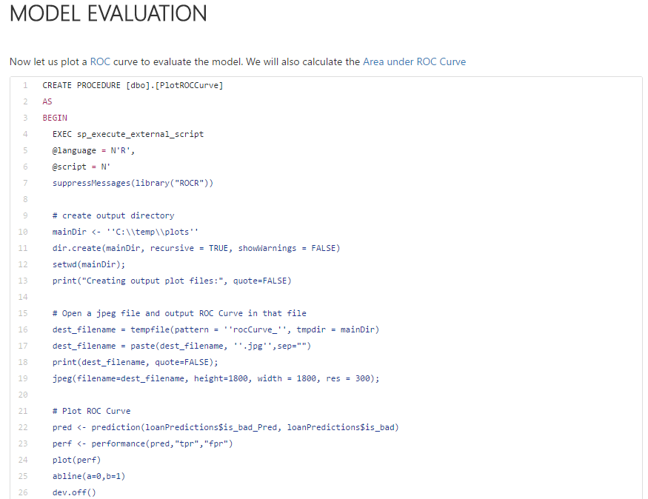
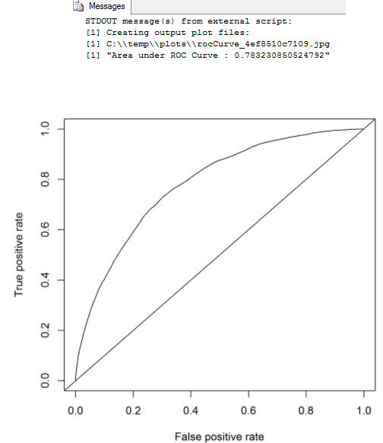
Major Steps: Data Prep & Modeling

Slide 10
Resources
Lending Club Statistics
Machine Learning for Predicting Bad Loans
Variable Importance Plot and Variable Selection
Machine Learning Templates with SQL Server 2016 R Services
SQL Server R Services Tutorials
Provision the Microsoft Data Science Virtual Machine
sp_execute_external_script (Transact-SQL)
Receiver operating characteristic
The Area Under an ROC Curve

Slide 11

https://github.com/Microsoft/sql-server-samples/tree/master/samples/features/r-services/loan-classification

