Slide 1

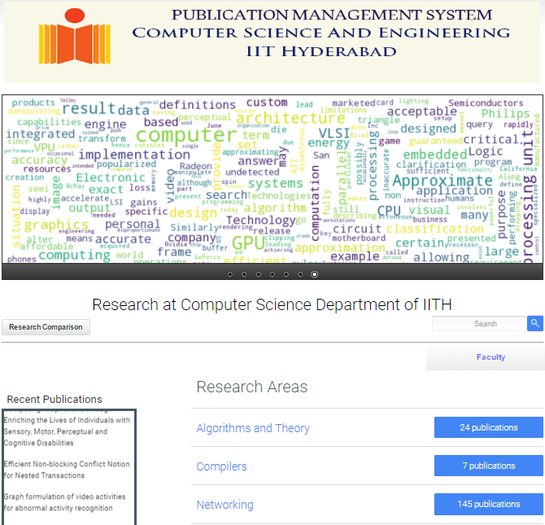
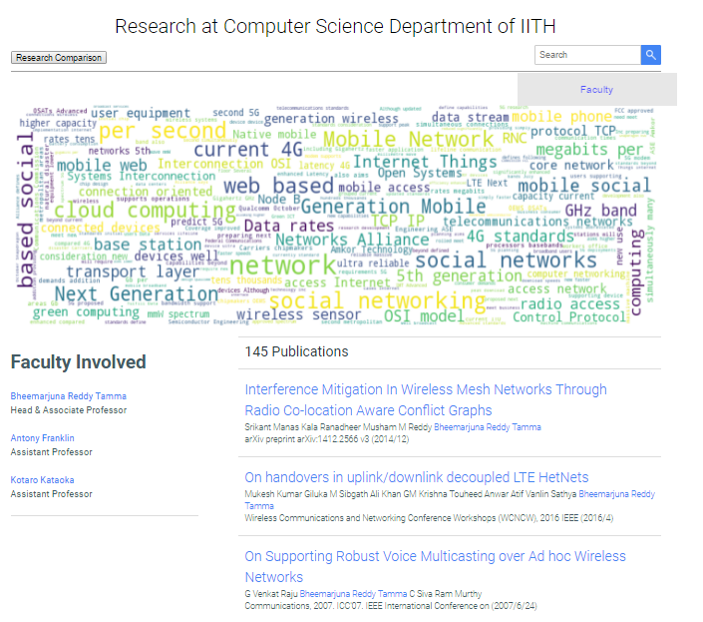
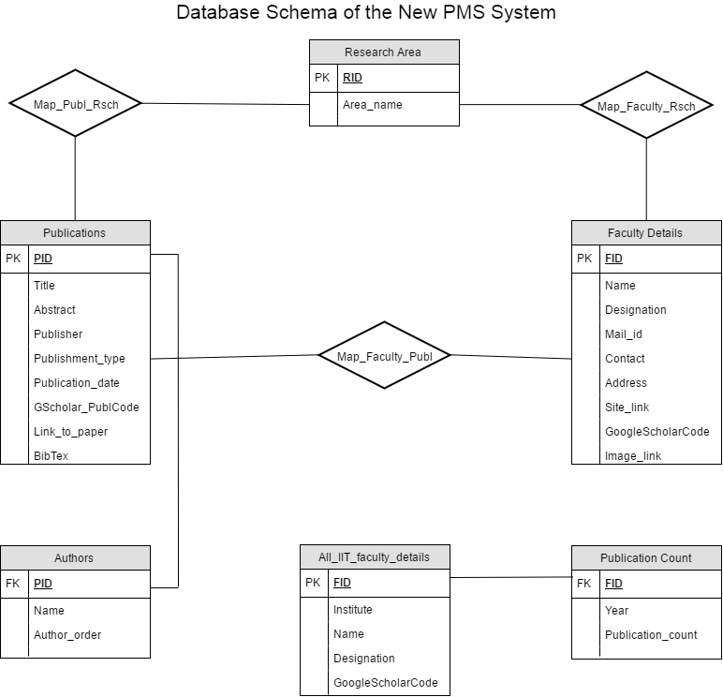
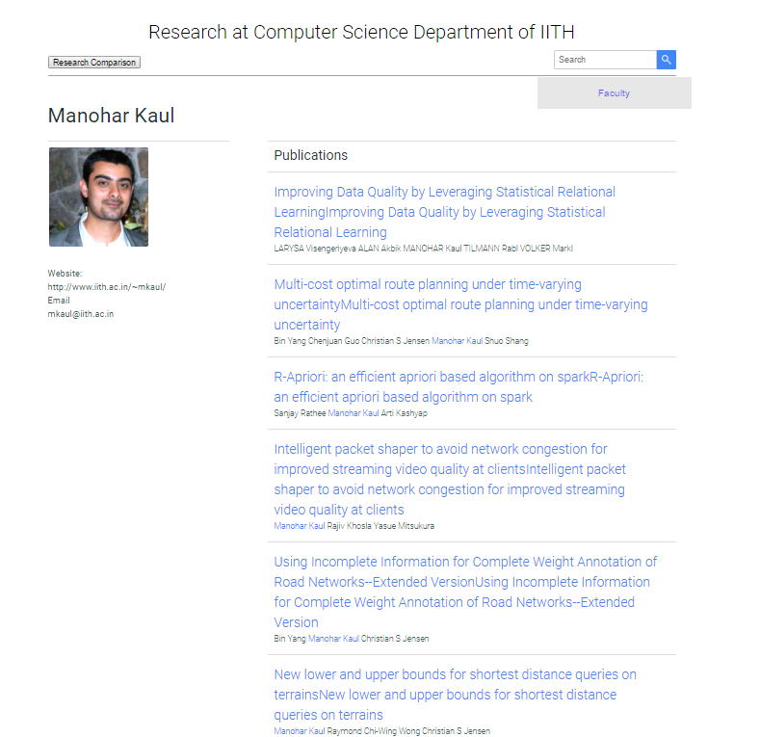
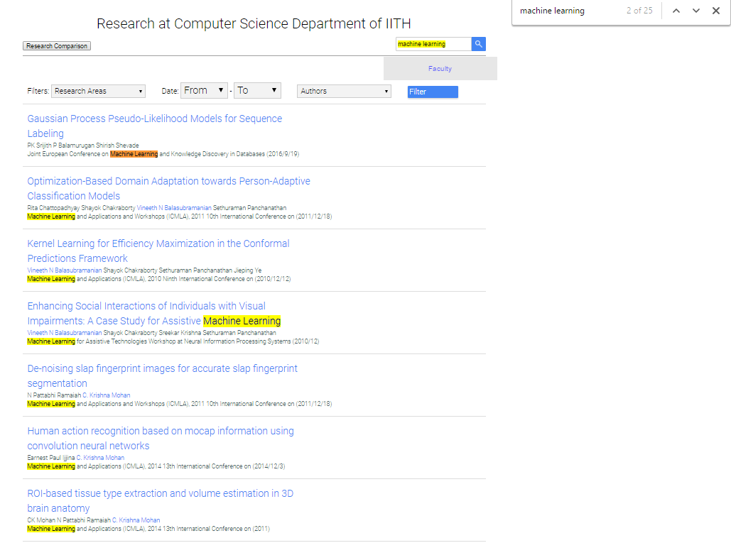
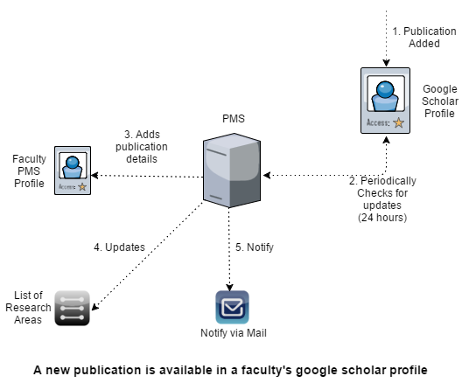
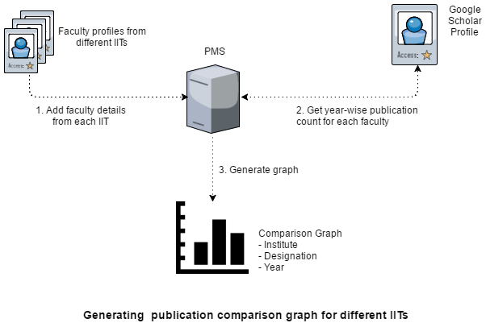
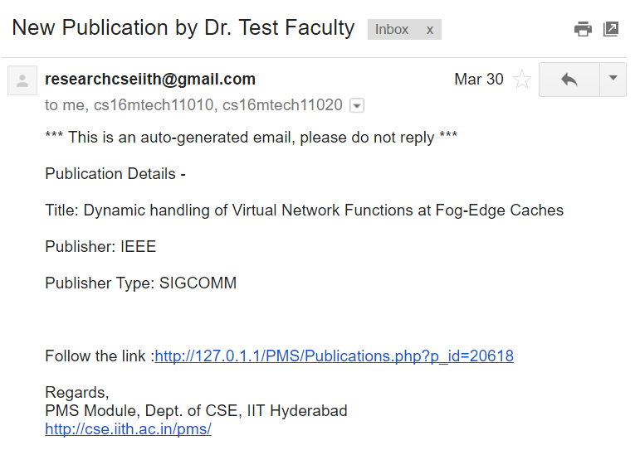
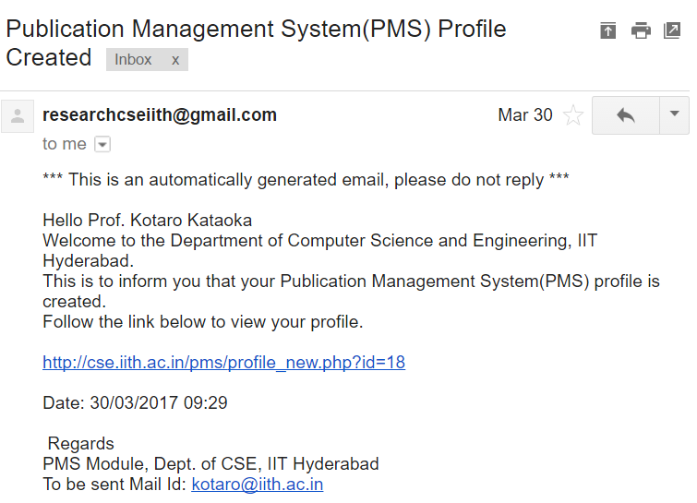
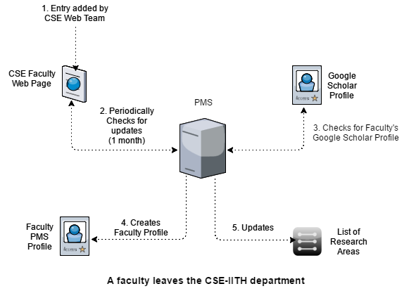
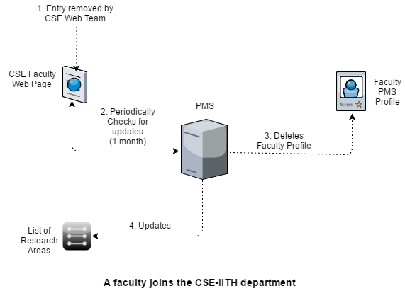
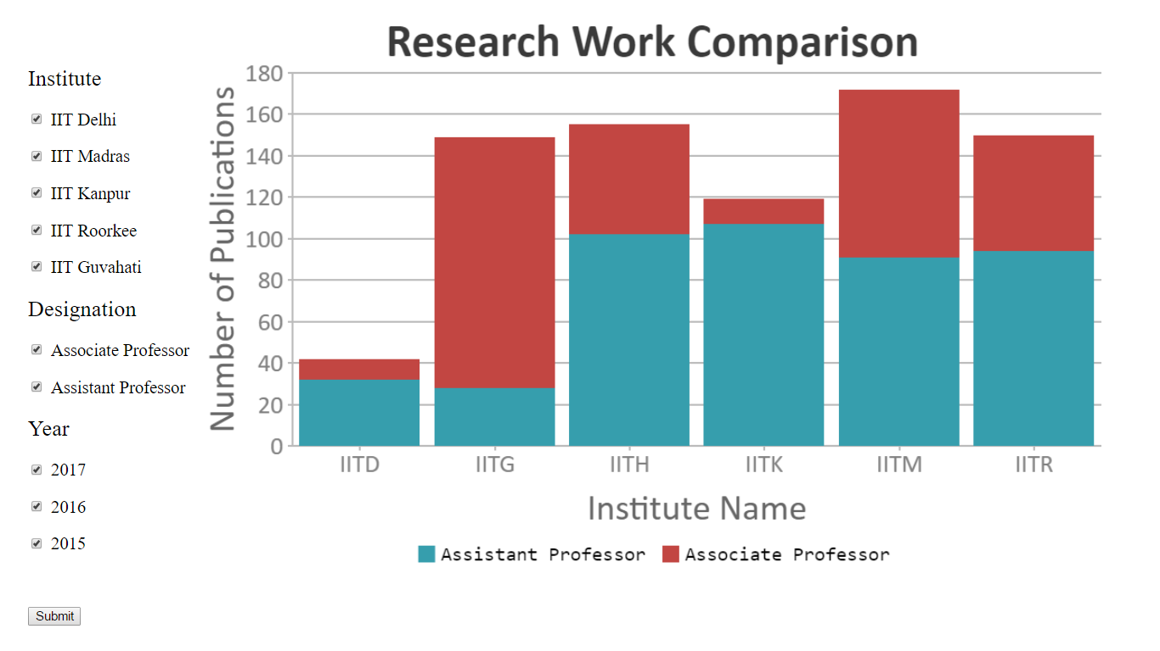
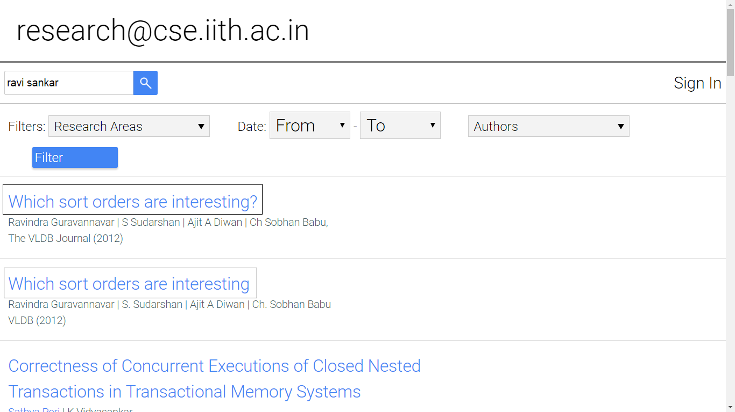
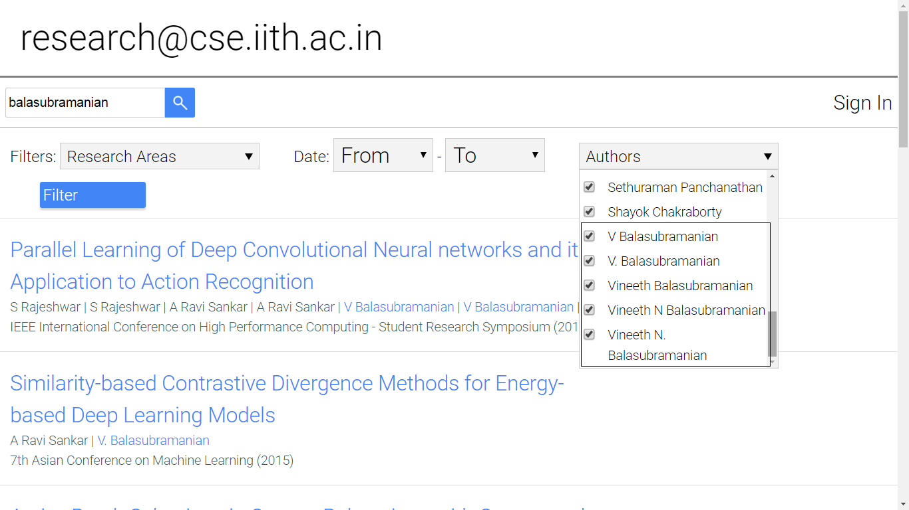
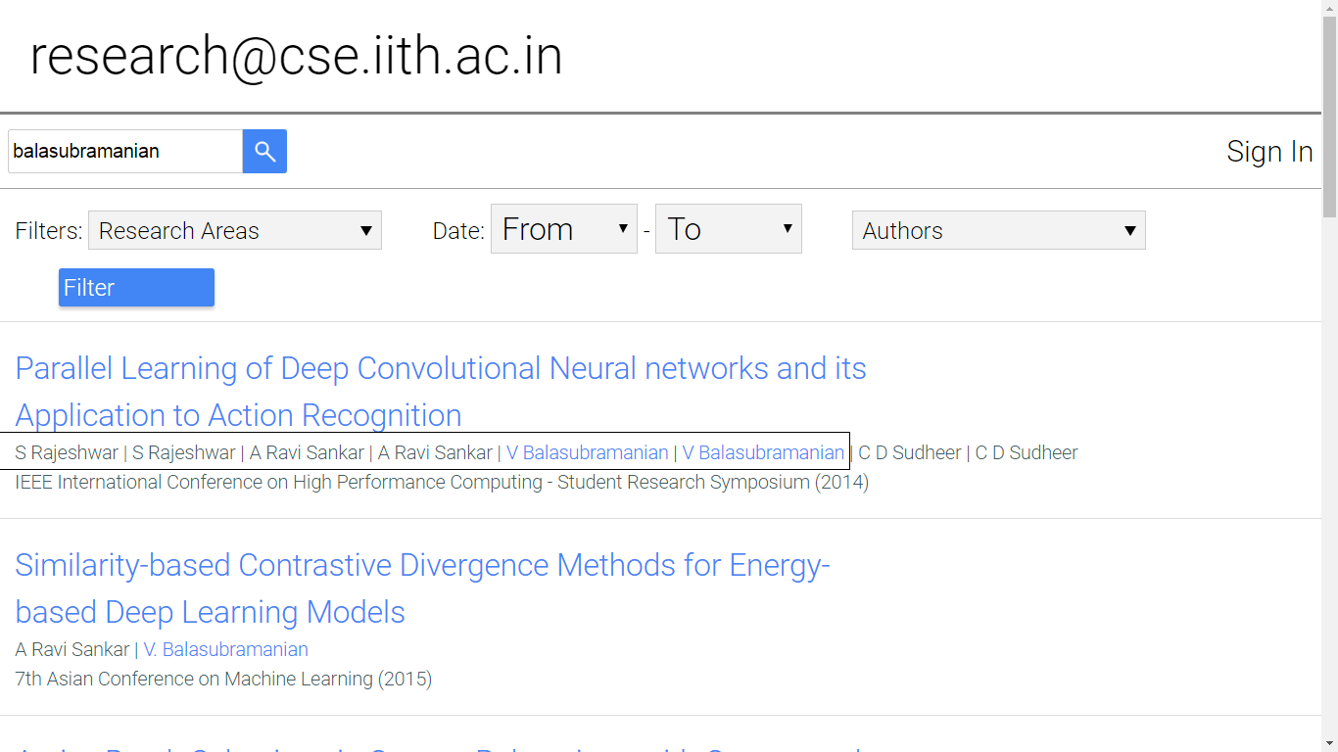
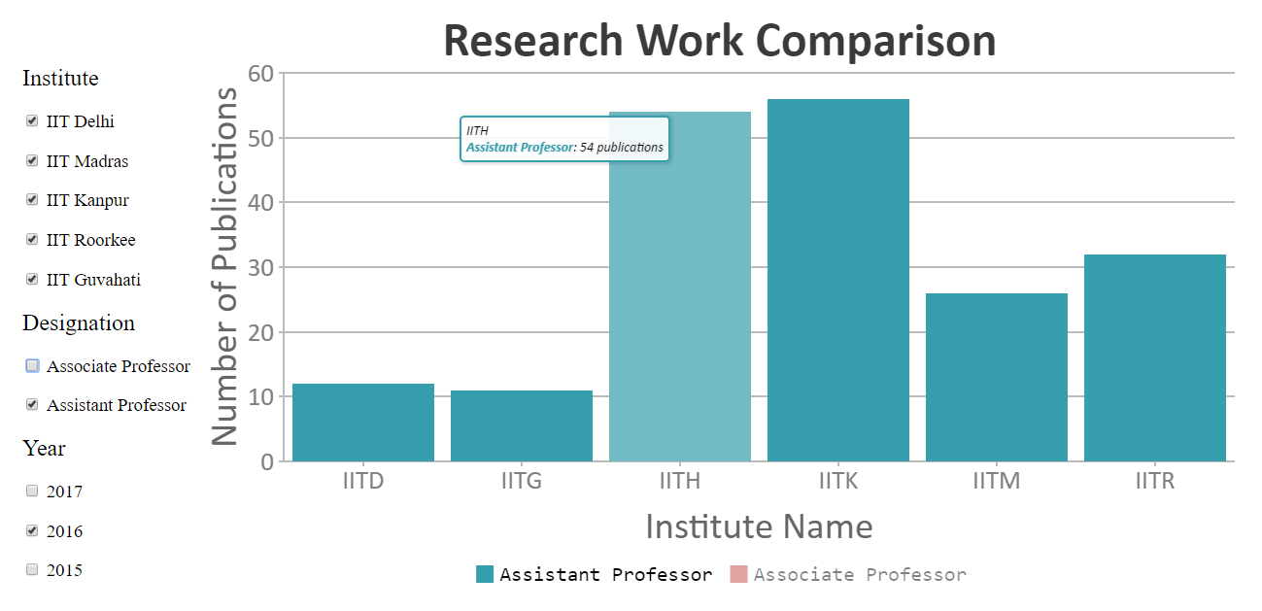
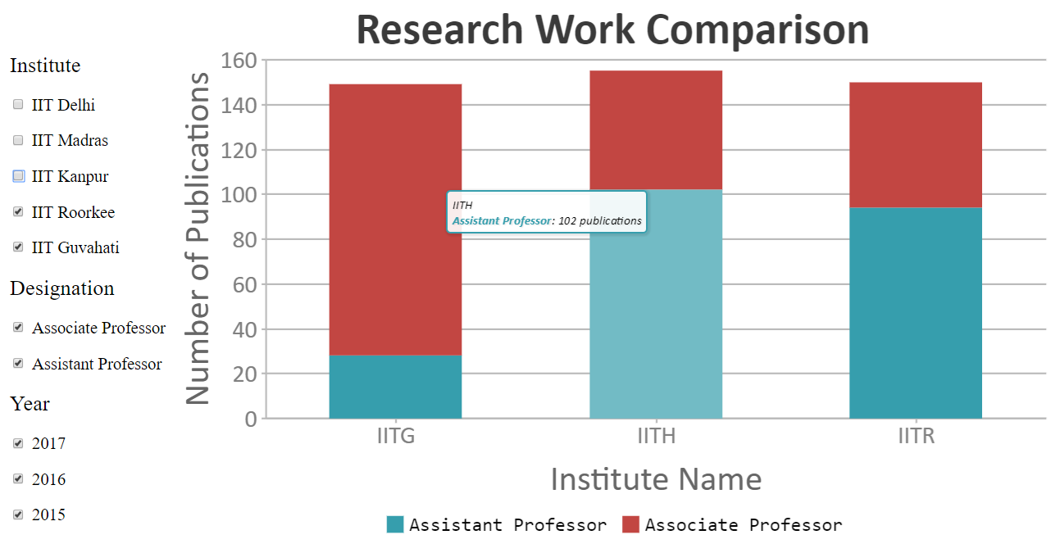
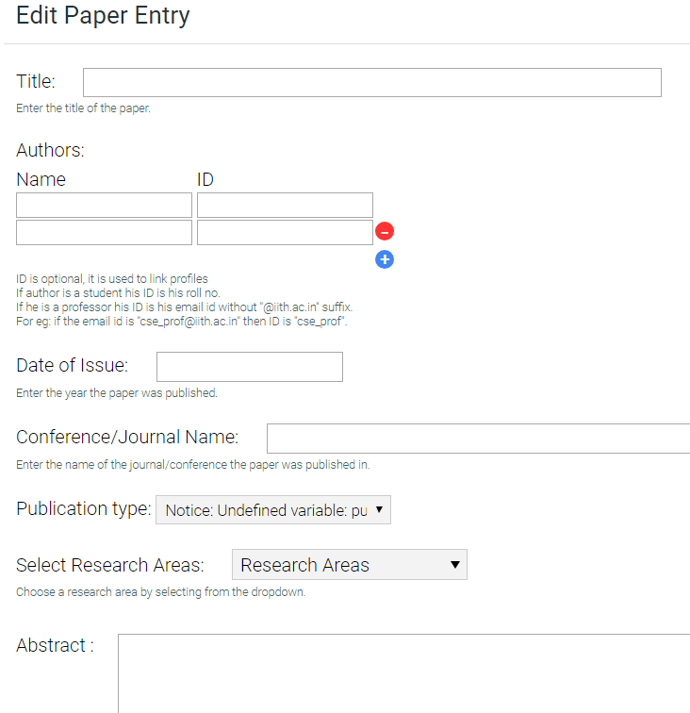
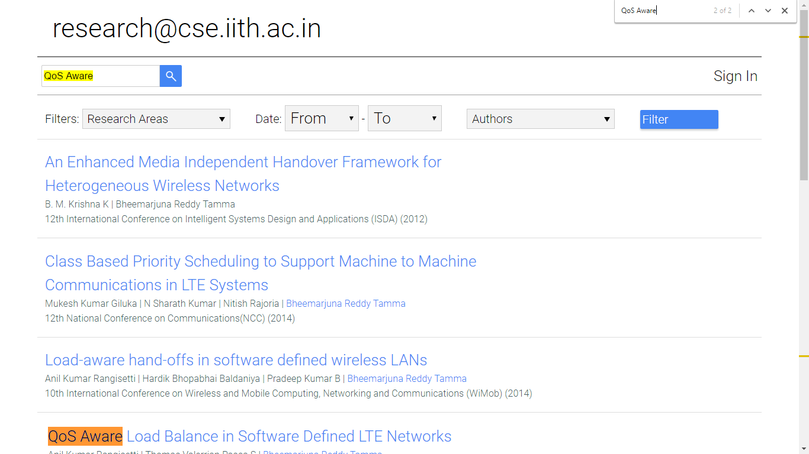
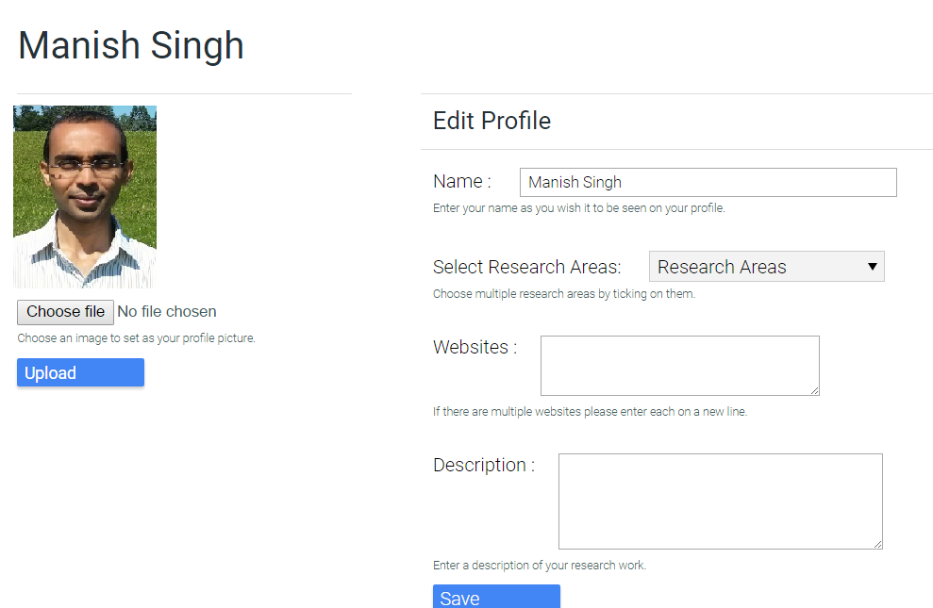
Automating Publication Management System
Mrinal Aich, Tulja Vamshi Kiran, Vinod Chhapariya, Neeraj Kumar
cs16mtech11009, cs16mtech11020, cs16mtech11019, cs16mtech11010 (@ iith.ac.in)
Indian Institute of Technology Hyderabad
Introduction
Technical Aspects
Improved Front End
The Publication Management System (PMS) of CSE department, IITH provides scientific publications from all the current faculties of the department. It also shows a comparison of Research work among various IITs.
The system is fully automated replacing the existing manual entry system.
Automation is implemented through Periodic scripts which runs in the background. (a) Google Scholar account of each faculty is crawled every 24 hours. (b) CSE Faculty Web Page is crawled once in a month.
Notification mail is sent to all members of CSE IITH community about a new publication.
A new faculty is sent a notification mail about his/her PMS profile creation.
For a leaving faculty, all publication entries along with the PMS profile will be deleted.
The frontend is improved and it goes with the CSE-IITH Homepage.
The search functionality gives almost 100% Recall with high Precision.
Maintaining of year-wise research work by current professors of various IITs, to provide a comparison of the quantity of research going-on across IITs.
The comparison can be designation-wise, year-wise and institute-wise.
Home Page
Research Area Page
Salient features
Periodically update the PMS system by checking each faculty's Google Scholar profile.
Inform the CSE community of IITH about any new publication by a current faculty.
Stores the Title, Abstract, Authors, Year and Bibtex of each research publication.
Automate the creation and deletion of faculty profiles (via CSE department’s faculty page)
Show the latest publications in a side window at the PMS system’s homepage.
Comparison of research work among various IITs in recent past.
Faculty Profile
Keyword Search
System Flow Diagrams
The new Database schema is fully normalized as compared to the existing system.
It maintains publication details of research papers by CSE-IITH faculties.
Also, it keeps publication count of research papers by various faculties across IITs.
A new publication added from Google Scholar
Comparison of research work among IITs
Notifications
Publication Comparison Graph
New Publication Mail (to CSE Community)
Profile Created (to New Faculty)
The system gives a comparison of the amount of research publications by professors among various IITs in the recent past. (Based on Institute, Designation and Year)
A new faculty joining the department
A CSE Faculty leaving the department
Dependencies and Future Work
Deployment at the CSE Web Server.
Not all faculties have their Google Scholar account.
Machine translation of foreign languages (non-ASCII characters).
Google Scholar detects crawling and temporarily blocks access.
Issues in the Existing PMS System
Research work by all Associate and Assistant Professors among various IITs during 2015-2017
Redundancy in Output
Same author with multiple names
Redundant Co-Authors
Conclusion
Research work of Assistant Professors in 2016
Research work among IITH, IITG, IITR
The new Automated PMS system can be replaced with the existing manual system at
the CSE Web server. A comparison between IITs can be done based on their research
work. It removes issues/bugs of the existing system. The system is completely robust.
Acknowledgement
Manual Paper Entry
Low precision Search
Manual Profile Creation
Prof. Manohar Kaul, Assistant Professor, Dept. of CSE, IIT Hyderabad.
Kaniche Sagar Balasaheb, B.Tech (TA), Dept. of CSE, IIT Hyderabad.
This work is done as a part of course Software Technologies CS5183 (Spring-2017) of Dept. of CSE, IIT Hyderabad.

