Slide 1


Skill Sync
Personalized Learning with Generative AI
Team Name : Team 2 (Bengaluru)
Team members: Amogh Prabhu
Mrinal Anand
Hanumanth Vardhan
Kushal Verma
Garima Singh

Slide 2

Solution Overview
This application is a web-based platform built using Streamlit, designed to integrate a personalized learning assistant powered by Generative AI.
Key Features of the application are:
User-Friendly Interface
User Authentication
Chat History Management
PDF Upload and Processing
AI-Powered Interactions
Dynamic Content Generation

Slide 3
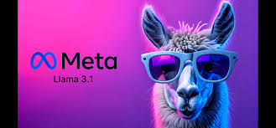
Why LLaMa 3?
State-of-the-Art Performance
Contextual Awareness
Wide Knowledge Base
Efficient Resource Use
Reduced Bias

Slide 4
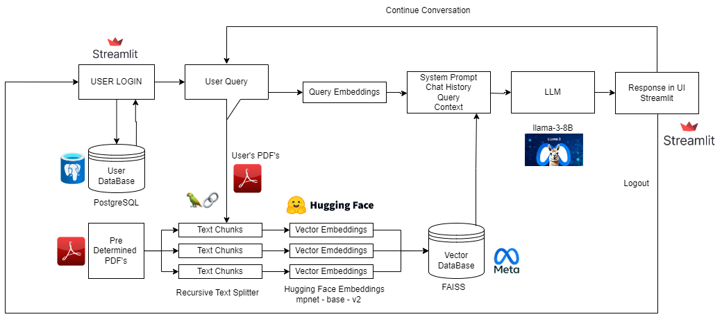
Architecture Diagram

Slide 5
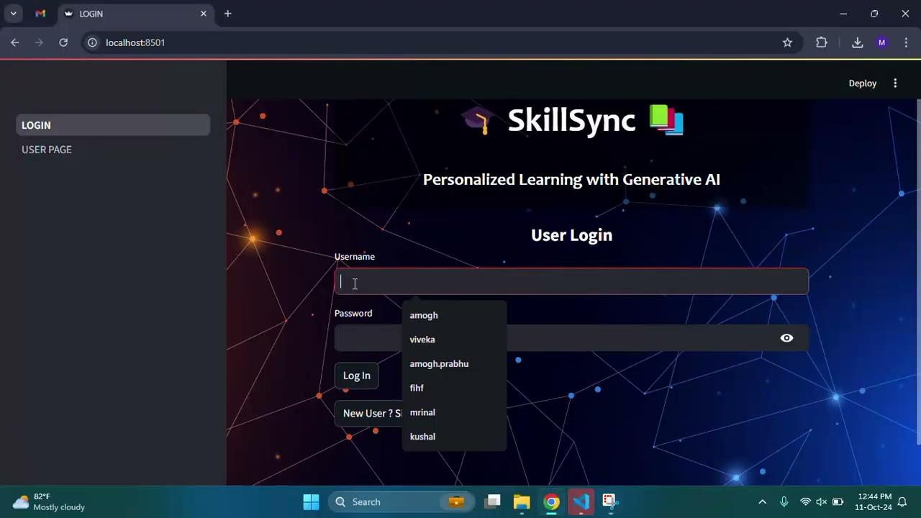
Demo Video

