Slide 1
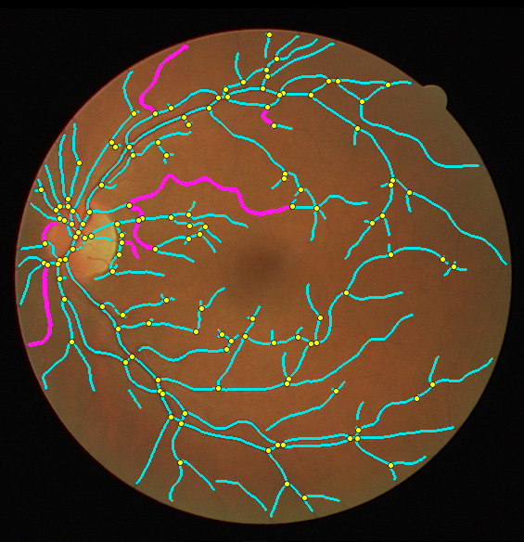
Multi-Scale Frangi Vesselness Segmentation of Retinal Blood Vessels for Explainable Diabetic Retinopathy Risk Stratification
Digital Image Processing (BCSE403L) · Fall 2026–27 · Faculty: Dr. Anisha M. Lal
Mrinali Bhardwaj
23BCE0910
S K Krithika
23BCE0908
Aviral Chaubey
23BCE0566
School of Computer Science and Engineering, VIT Vellore
Notes:
Introduce the team and the title. One-line pitch: we take a colour photo of the back of the eye, extract the blood vessel tree with classical image processing, and turn measurable properties of that tree into an explainable diabetic retinopathy risk score — with no training data and no GPU.

Slide 2
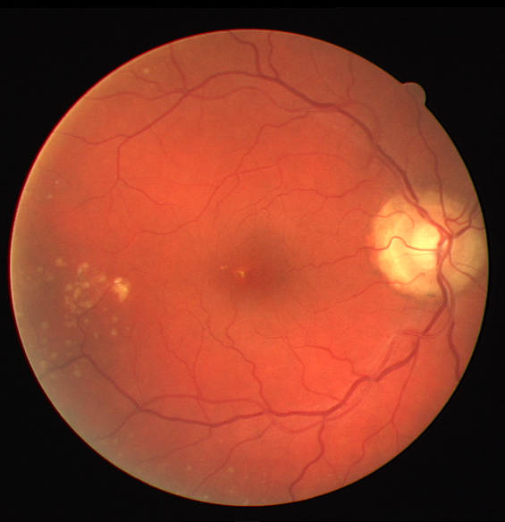



Why vessels, and why not deep learning
Diabetic retinopathy damages vessels first
Changes in vessel shape and spread (tortuosity, dropout, abnormal branching) appear before vision is lost.
Screening lacks experts and GPUs
Eye camps and primary health centres capture many fundus photos but rarely have an ophthalmologist or a GPU on site.
Existing tools stop short
Classical methods output only a binary mask; deep networks (U-Net) need labelled data and GPUs, and give no reason for their answer.
DRIVE image 08 — early DR with exudates
Notes:
Diabetic retinopathy is a leading cause of blindness in working-age adults. Damage shows up early in the vessel tree. In India most screening happens in camps with no specialist and no GPU, so we want something cheap, CPU-only and explainable.

Slide 3




Objective and contributions
Segment the retinal vessel tree with a training-free, multi-scale DIP pipeline, measure six structural and texture properties, and fuse them into one graded, explainable DR risk score validated on DRIVE.
End-to-end pipeline
Tuned multi-scale Frangi
Structure + texture fusion
Explainable by design
Raw fundus image → graded risk, every stage a standard DIP operation
σ = 1–3, β = 0.5, c = 15: thin and thick vessels, no optic-disc halo
3 skeleton features + 3 GLCM features measured in the same pass
Fixed weights on physically measurable quantities — nothing learned
Notes:
State the objective, then the four contributions. Emphasise the last one: every term of the score can be checked by hand.

Slide 4

Where existing approaches fall short
Approach | Examples | Needs labels | Needs GPU | Clinical score | Explainable
Matched filter / line detector | Chaudhuri 1989, Nguyen 2013 | No | No | No | Yes
Morphological / model-based | Zana & Klein 2001, Mendonça 2006 | No | No | No | Yes
Classical supervised | Staal 2004, Soares 2006, Marín 2011 | Yes | No | No | Partly
Deep learning | U-Net 2015, Liskowski 2016 | Yes | Yes | No | No
This work | Frangi + structure/texture fusion | No | No | Yes | Yes
Gaps we target: matched filters fire on the optic-disc rim and exudates; thin peripheral vessels are still the weakest result everywhere; structural and texture features are almost always studied separately; and no unsupervised pipeline produces a per-image risk value.
Notes:
Walk through the four families from the literature survey. The key gap: nothing unsupervised goes beyond the mask to a clinical output.

Slide 5
Seven-module pipeline in four stages
A
Clean & enhance
B
Extract the tree
C
Measure
D
Fuse & validate
M1 Green channel + FOV mask
M2 CLAHE (clip 3.0, 8×8)
M3 DFT high-emphasis
M4 Illumination division + median
M5 Multi-scale Hessian (Frangi)
Otsu threshold
Closing + area filter
Zhang–Suen thinning
M6 Vessel density
Tortuosity (arc/chord)
Branch points
GLCM contrast · homogeneity · energy
M7 Normalise to 0–1
Score = Σ wᵢ · fᵢ
Low / Medium / High
Se · Sp · Acc · Dice · Jaccard
Input: one colour fundus photograph. Output: vessel mask, skeleton, six features and a graded risk with per-feature contributions. Runtime: ≈0.5 s per image on a laptop CPU.
Notes:
This is the block diagram from Review I, implemented exactly as modules. Stage A cleans the image, B extracts and thins the tree, C measures it, D fuses and validates.

Slide 6
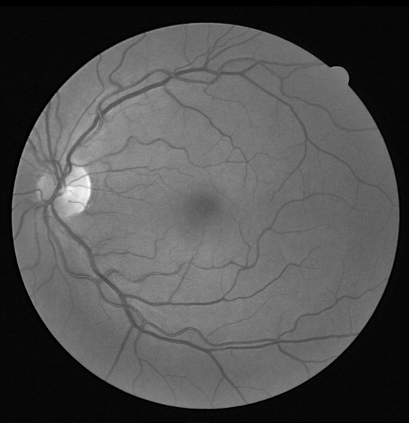
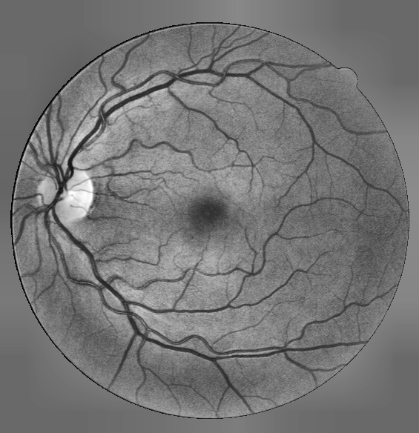
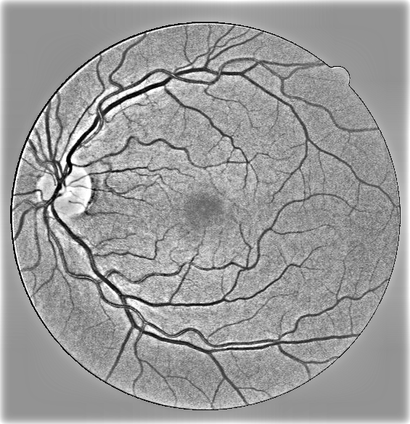
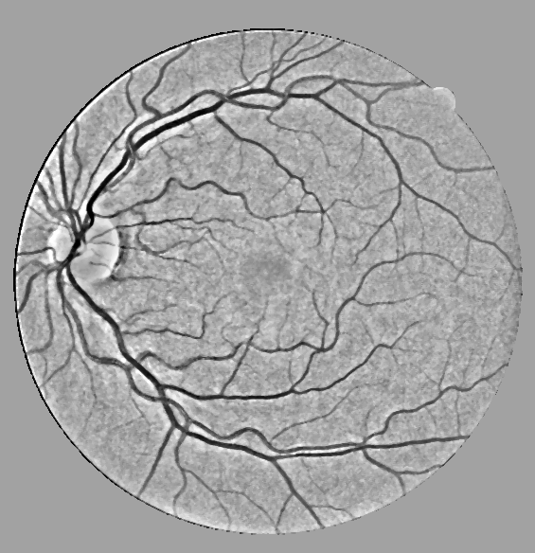
Stage A — preparing the image (Modules 1–4)
M1 Green channel
M2 CLAHE
M3 DFT filter
M4 Restoration
Haemoglobin absorbs green → best vessel contrast. FOV from Otsu on red (99.6% agreement with DRIVE masks).
8×8 tiles, clip 3.0. Local equalisation avoids blowing out the bright optic disc.
High-emphasis H(u,v) = a + b·H_HP, a = 0.5, b = 1.5, Gaussian D₀ = 15. Sharpens thin-vessel edges.
g = f·L + n: divide by a 51×51 median background, then 3×3 median for impulse noise.
Notes:
Show how each step changes the image. Green channel has the most contrast. CLAHE is local so the optic disc is not over-amplified. The frequency-domain high-emphasis filter keeps half the low frequencies and boosts the high ones. Restoration treats illumination as a multiplicative degradation and divides it out.

Slide 7
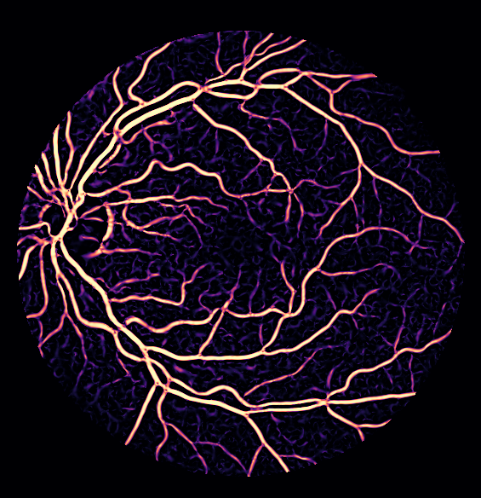
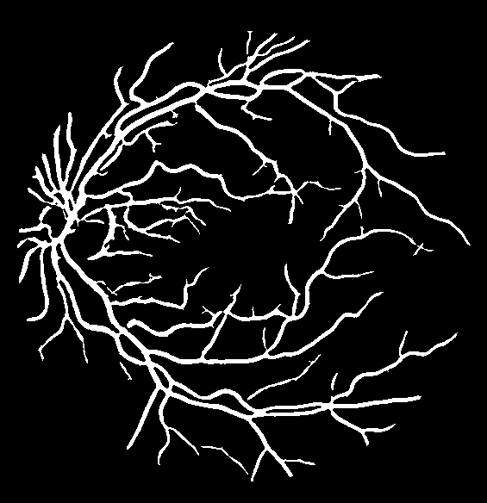
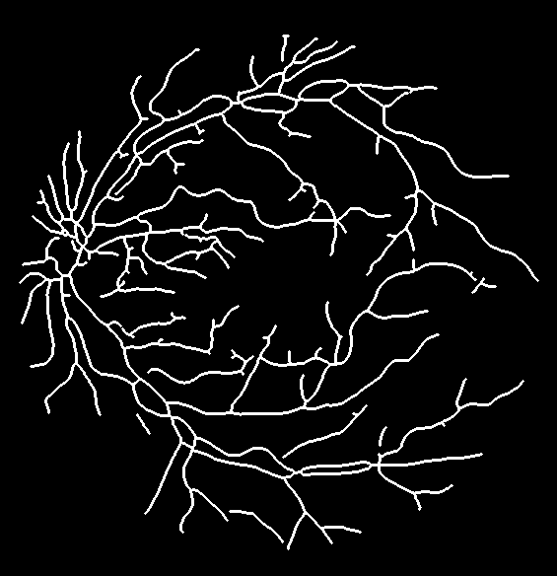
Stage B — multi-scale Frangi (Module 5)
Hessian per pixel, per scale σ
Eigenvalues |λ₁| ≤ |λ₂|, Rᵦ = λ₁/λ₂, S = √(λ₁² + λ₂²)
V(σ) = exp(−Rᵦ² / 2β²) · (1 − exp(−S² / 2c²))
σ = 1, 1.5, 2, 2.5, 3 → keep the max response
β = 0.5, c = 15 (best on training split)
λ₂ > 0 only: vessels are dark in green
Otsu on V^0.7, closing (disc 1), drop blobs < 60 px
Zhang–Suen thinning → 1-px centreline
Vesselness V
Binary mask
Skeleton
The Hessian responds to tube-shaped structures rather than to edges in general, so thin peripheral vessels survive thresholding. Using several scales captures both capillaries and the main arcades.
Notes:
Explain the eigenvalue intuition: along a vessel the curvature is small, across it is large, so λ1 small and λ2 large. Rb distinguishes lines from blobs, S suppresses flat background. The filter is hand-written in our code and cross-checked against scikit-image.

Slide 8





Stage C — six measurable features (Module 6)
Vessel density
Tortuosity
vessel px / FOV px
arc length / chord, length-weighted mean
Branch points
Contrast
skeleton px with ≥ 3 neighbours
Σ P(i,j)·(i − j)²
Homogeneity
Energy
Σ P(i,j) / (1 + (i − j)²)
√Σ P(i,j)²
Structural features come from the skeleton. Texture features (teal) come from the GLCM of non-vessel tissue on the restored image (32 levels, d = 1, 0°/45°/90°/135° averaged).
Cyan: skeleton · Yellow: branch points · Magenta: most tortuous segments
Notes:
Three structural features from the skeleton and three Haralick texture features from the tissue around the vessels. We mask the vessels out (plus a 2-pixel margin) so texture describes the retina, not the vessels.

Slide 9
Stage D — rule-based fusion (Module 7)
Risk = Σ wᵢ · fᵢ
fᵢ scaled to 0–1 against the DRIVE 5th–95th percentile range
Low
< 0.30
Medium
0.30 – 0.60
High
> 0.60
Why rule-based? Every weight is fixed in advance, and every input is a quantity a clinician can measure on the image. The score can be decomposed into six bars, so the system can always say why it gave a value.
(↓) lower value = higher risk, entered as 1 − f
Notes:
Tortuosity and GLCM contrast get the highest weights, following the clinical literature (Cheung et al. 2010). Homogeneity, energy and density enter inverted because lower values indicate disease. We use percentile instead of strict min-max scaling so one badly segmented outlier image doesn't compress everyone else.

Slide 10

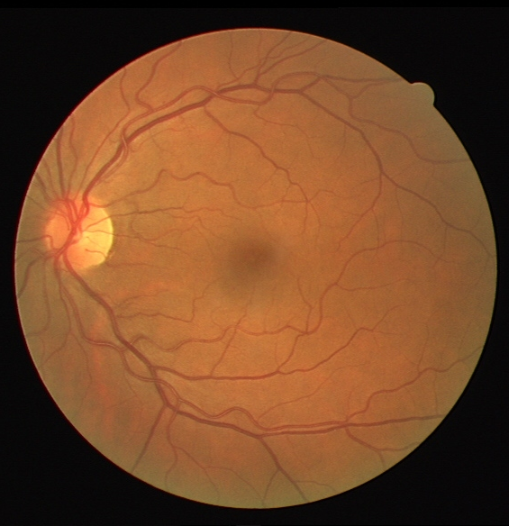
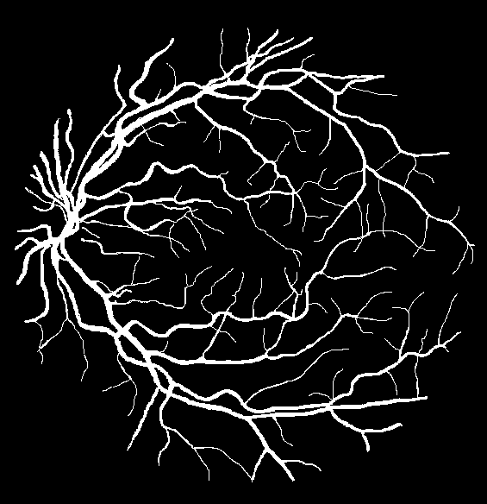

Experimental setup
DRIVE dataset
40 colour fundus images (565 × 584), 20 training + 20 test, each with an expert vessel mask and FOV mask. 7 images show signs of mild early DR.
Honest tuning
Filter constants chosen by grid search on the 20 training images only; all headline numbers reported on the untouched test split.
Metrics
Sensitivity, specificity, accuracy, Dice and Jaccard, computed inside the field of view against the 1st manual annotation.
Input
Expert mask
Baseline + checks
Python · NumPy · SciPy · OpenCV · scikit-image · Streamlit — CPU only
Plain Otsu on the green channel; ablation of every module; JPEG q = 70/80 robustness; ±20 % weight sensitivity.
Notes:
DRIVE is the standard benchmark. Even though the method has no learned weights, we still tuned the few filter constants on training images only, so the test numbers are a fair estimate.

Slide 11
Segmentation: 3.7× the baseline Dice
0.749
Dice
0.938
Accuracy
0.730
Sensitivity
0.969
Specificity
20 DRIVE test images, mean
Notes:
Plain Otsu on the green channel cannot separate vessels from the uneven background — it labels half the retina as vessel. Our pipeline reaches Dice 0.749 on the test split, with specificity close to 0.97.

Slide 12
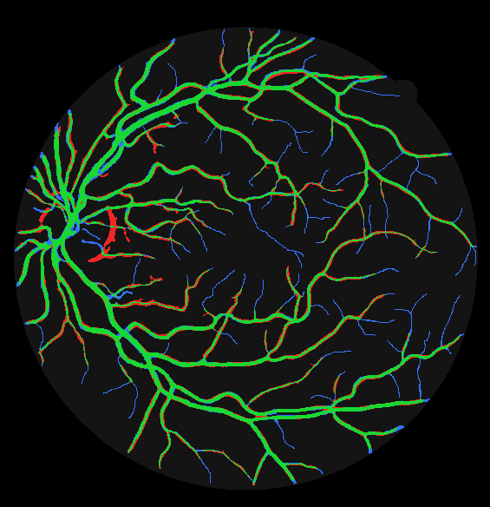
Comparable to published unsupervised methods
Method (DRIVE) | Se | Sp | Acc
Chaudhuri et al. 1989 — matched filter | – | – | 0.877
Zana & Klein 2001 — morphology | 0.697 | – | 0.938
Mendonça & Campilho 2006 | 0.734 | 0.976 | 0.945
Nguyen et al. 2013 — multi-scale line | – | – | 0.941
Azzopardi et al. 2015 — B-COSFIRE | 0.766 | 0.970 | 0.944
This work (test split) | 0.730 | 0.969 | 0.938
Published values as reported in the original papers / Fraz et al. 2012 survey.
Our pipeline sits in the same accuracy band as classical unsupervised methods, while adding something none of them produce: a per-image clinical risk value.
Green correct · Red false vessel · Blue missed (mostly capillaries)
Notes:
We are in the same band as the classical unsupervised methods. Deep networks reach about 0.82 Dice but need labelled data and a GPU — that is not what we compare against. The overlay shows most misses are the faintest capillaries.

Slide 13
Ablation: every module earns its place
−0.051
CLAHE: Largest single contribution — local contrast is what makes thin vessels visible.
−0.015
Multi-scale Frangi: One scale cannot fit both capillaries and main arcades.
−0.006 / −0.002
Restoration / DFT: Small but consistent gains on top of CLAHE.
Notes:
Removing CLAHE costs five Dice points. Multi-scale Frangi beats any single scale. Restoration and the frequency filter give smaller but consistent improvements — honest result, they are refinements on top of CLAHE.

Slide 14
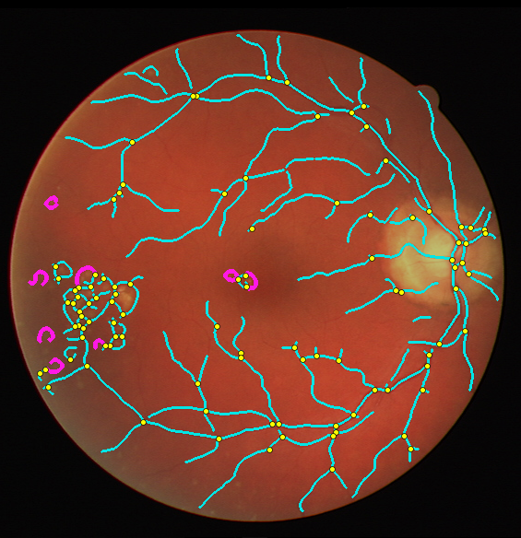
Explainability: why image 08 scores 0.498
Reading it: tortuosity is at its maximum because the most tortuous "segments" (magenta) are the rims of exudates. Lesions push the score up through a term a clinician can see and verify on the image.
Notes:
This is the explainability in action. The score is not a black box: it decomposes into six bars, and the overlay shows exactly which structures drove each bar. In this early-DR image the exudate rings register as very tortuous segments.

Slide 15
Risk stratification and robustness
< 0.01
Dice drop under JPEG compression at quality 70–80
0.05
mean risk-score shift under JPEG (was 0.21 before measuring texture on the restored image)
≤ 4 / 40
images change band when any single weight moves ±20 %
0.508 vs 0.415
mean score, 7 early-DR images vs the rest (p = 0.079)
0.5 s
per image on a laptop CPU, no GPU, no training data
Notes:
Bands spread across all three levels. DRIVE has no DR grades, only seven images flagged with mild early DR — those score higher on average; with only seven positives the difference is a trend (p = 0.079), not proof. The score is stable under JPEG compression and under weight perturbation.

Slide 16
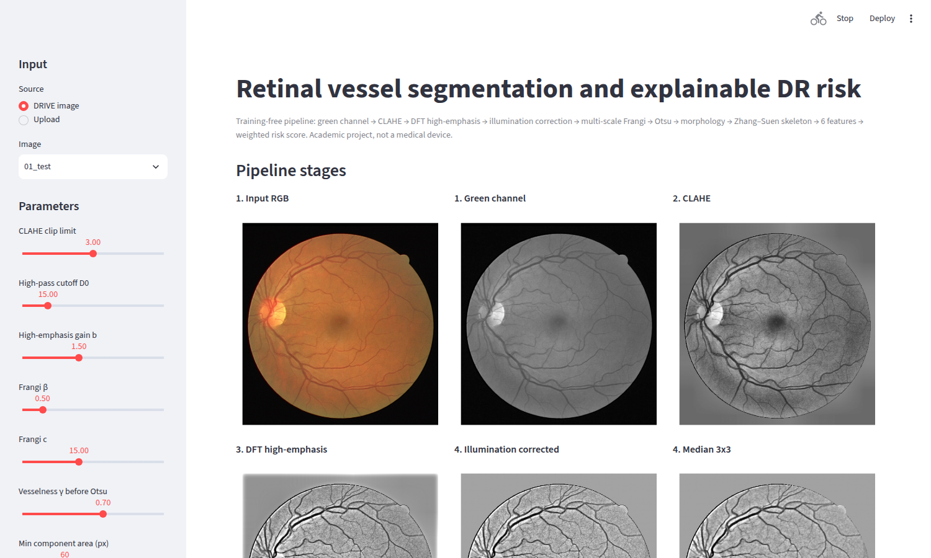
Interactive demo (Streamlit)
Pick a DRIVE image or upload any fundus photo
Every pipeline stage shown side by side
Sliders for CLAHE, D₀, β, c, γ, min area
Metrics against the expert mask
Risk score with per-feature contributions
streamlit run app/streamlit_app.py
Notes:
If time allows, switch to the live app here: show 01_test, then 08_test, and move the Frangi c slider to show its effect on the mask.

Slide 17

Limitations and future work
Limitations
Future work
No graded ground truth on DRIVE — the risk score is a sanity-checked screening aid, not a clinical validation
Faintest capillaries are still missed (sensitivity 0.73)
Bright lesion rims can be segmented as small vessel loops
GLCM features carry most of the remaining compression drift
Validate the score on graded datasets (IDRiD, Messidor)
Optic-disc detection and masking before Frangi
Separate exudate detection to stop lesions leaking into the vessel mask
Learn only the 6 fusion weights from graded data, keeping the score explainable
Notes:
Be upfront: DRIVE has no DR grades, so the score is checked, not clinically validated. The natural next step is a graded dataset.

Slide 18

Thank you
A training-free, CPU-only pipeline from fundus photograph to explainable DR risk — Dice 0.749 on DRIVE test images
Mrinali Bhardwaj
23BCE0910
S K Krithika
23BCE0908
Aviral Chaubey
23BCE0566
github.com/MrinaliBhardwaj/dip_project
Notes:
Summarise in one sentence and invite questions.

