Slide 1
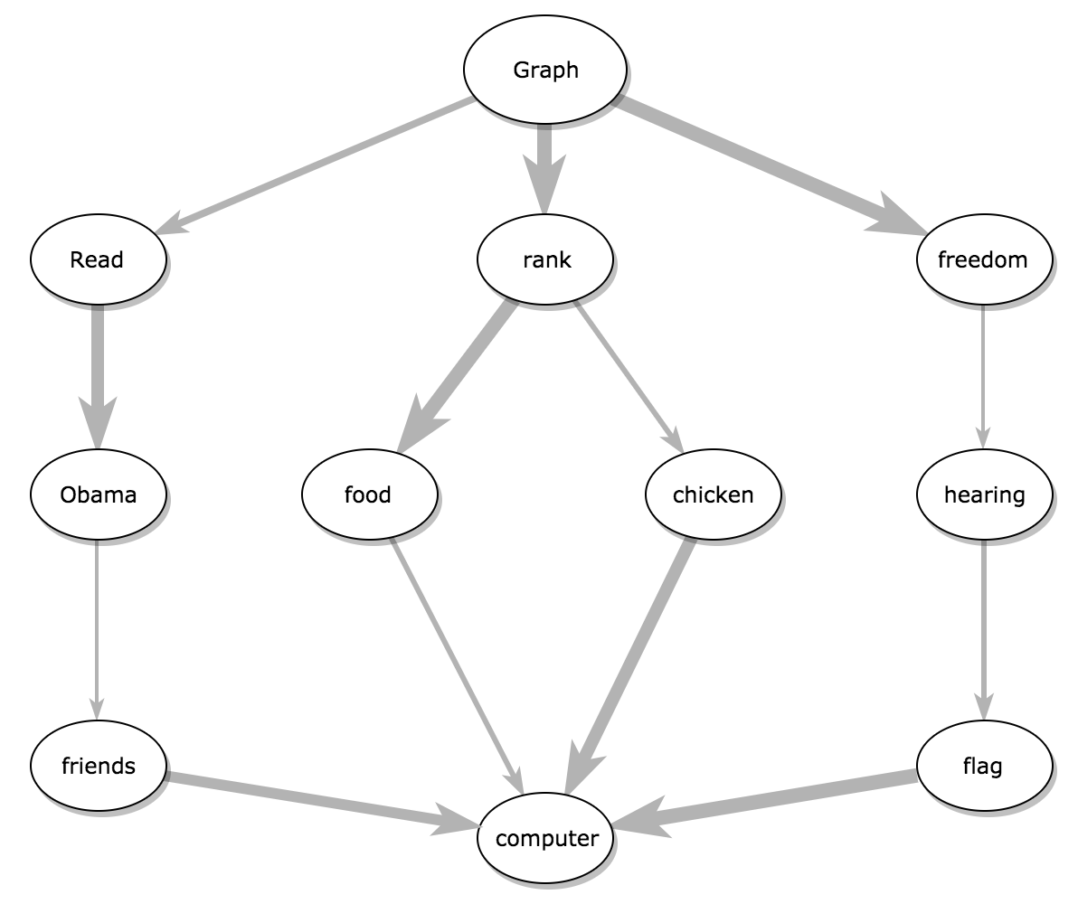
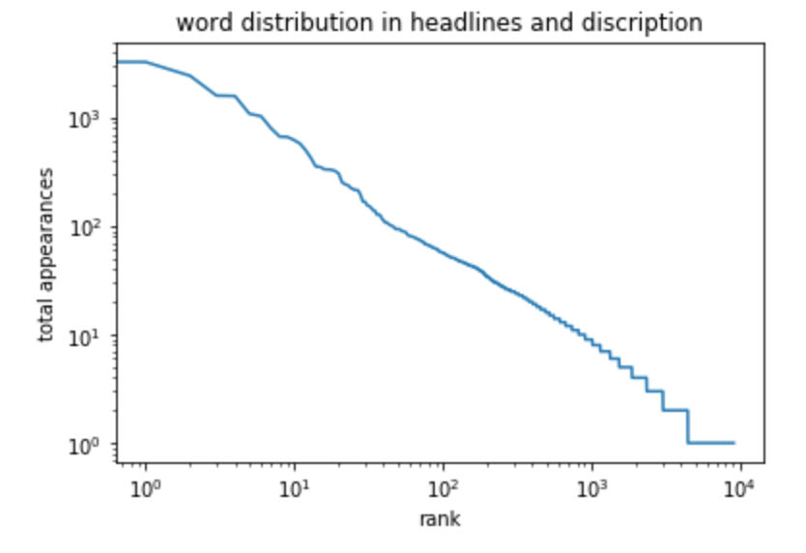
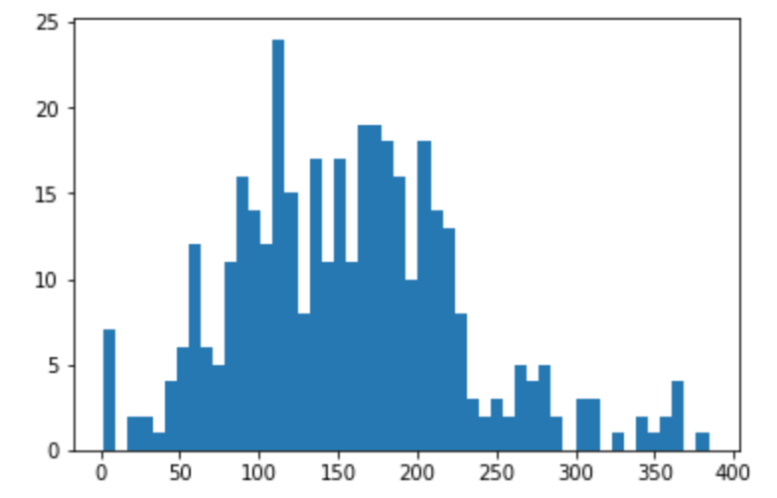
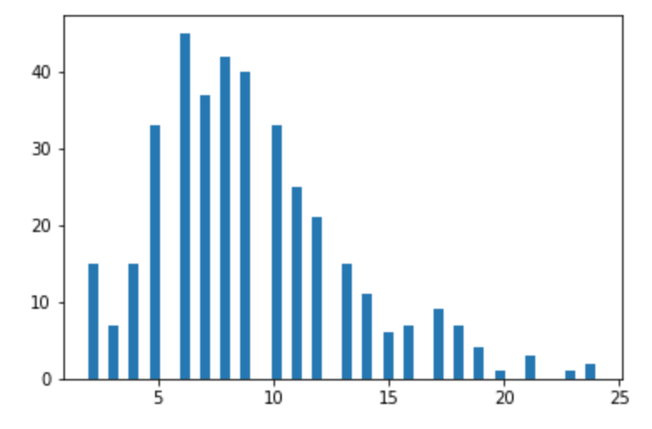
Extractive vs. Abstractive Text Summarization Methods
Michelle Zhao
California Institute of Technology
INTRODUCTION
Automatic text summarization is the process of shortening a text documentation using an information prioritization system. Technologies that generate summaries take into account variables including length, style, and syntax. Automatic summarization is based on the logical quantification of features of the text.
Encoder-Decoder Network Implementation
The encoder reads the entire input sequence and encodes it into an internal latent factor representation, often a fixed-length vector called the context vector.
The tokens of the input text are fed one-by-one into the encoder (a single-layer bidirectional LSTM), producing a sequence of encoder hidden states.
Decoder
Encoder
The decoder reads the encoded input sequence from the encoder and generates the output sequence.
Single-layer unidirectional LSTM
The decoder takes as input the hidden layers generated after feeding in the last word of the input text.
TextRank Algorithm Implementation
TextRank algorithm transforms the text into a graph. It regards words as vertices and relations between words as edges with different weight. When a vertex links to another (in phrases or sentences), it casts a vote of importance for that vertex. A vertex’s
importance also dictates how heavily weighted its
votes are. Words with more edges have a higher
weight, and will be ranked higher.
Algorithm
Preprocessing:
Text Embeddings
Word2Vec
Global-Vectors (GloVe)
LSTM Encoder
w
Output
Summary
Identify relations that connect such text units and use these relations to draw edges between vertices in the graph.
Identify filtered text units most representative of the text and add them as vertices to the graph.
Input
Text
LSTM Decoder
Extractive Summarization
Abstractive Summarization
Source Document
Embedding
LSTM
Summary
Iterate the graph-based ranking until convergence
Uses words already in the text.
Selects some combination of the existing words most relevant to the meaning of the source.
Ranking sentences and phrases in order of importance and selecting the most important components.
More robust.
Lack flexibility.
Cannot use new words or paraphrase.
Generating entirely new phrases and sentences to capture the meaning of the text.
More complex.
Read over the text and deem certain factors to be important.
Learn to construct some cohesive phrasing of the relevant concepts.
Similar to how humans summarize.
Able to paraphrase.
More susceptible to error.
LSTM
Output
Sort vertices based on their final score. Use the values attached to each vertex for ranking/selection decisions.
What is an LSTM recurrent neural network?
?
RNNs can use their internal state (memory) to process sequences of inputs. LSTMs are capable of learning long term dependencies by storing long-term states and inputs in gated cell memory.
TextRank Results
Encoder-Decoder Results
Text Input
Commercial exploitation over the past two hundred years drove the great Mysticete whales to near extinction. Variation in the sizes of populations prior to exploitation, minimal population size during exploitation and current population sizes permit analyses of the effects of differing levels of exploitation on species with different biogeographical distributions and life-history characteristics. Dr. Stephen Palumbi at the University of Hawaii will study the genetic population structure of three whale species in this context, the Humpback Whale, the Gray Whale and the Bowhead Whale. The effect of demographic history will be determined by comparing the genetic structure of the three species. Additional studies will be carried out on the Humpback Whale. The humpback has a world-wide distribution, but the Atlantic and Pacific populations of the northern hemisphere appear to be discrete populations, as is the population of the southern hemispheric oceans. Each of these oceanic populations may be further subdivided into smaller isolates, each with its own migratory pattern and somewhat distinct gene pool. This study will provide information on the level of genetic isolation among populations and the levels of gene flow and genealogical relationships among populations. This detailed genetic information will facilitate international policy decisions regarding the conservation and management of these magnificent mammals.
(Left.) Indexing words by frequency.
(Bottom.) The set/distribution of text input words is much larger/wider than that of words in the summaries.
Summary
The percentage of reduction can be specified.
The highest ranked, most important sentences are selected.
80% Reduction:
Stephen Palumbi at the University of Hawaii will study the genetic population structure of three whale species in this context, the Humpback Whale, the Gray Whale and the Bowhead Whale. This study will provide information on the level of genetic isolation among populations and the levels of gene flow and genealogical relationships among populations.
Text Input
Proposal seeks to demonstrate a technique for observing ocean currents by electric field measurements using a towed instrument of recent design measurements will be made in conjunction with a cruise across the in which several additional observational techniques will be employed several data types will be to improve the accuracy of the methods
Distribution of Text Input Words
Summary TRAIN #1
Drum frame multidisciplinary
Summary
TRAIN #2
Extension solver bearing.
Distribution of Summary Words
The summaries generated each instance were different, with training runtime ~15 minutes.
Conclusions
Next Steps
TextRank selected the two most significant sentences in the text. E-D generated two different three-word summaries, using words not present in the text, but the summaries generated were not representative of the text and did not make logical sense.
The extractive summarizer worked better than the abstractive text summarizer.
The encoder-decoder network didn’t have enough training.
TextRank ran much quicker than the encoder-decoder network.
Improve the encoder-decoder network
Train on a larger training set
Experiment with model hyper-parameters
Use beam search
Explore different preprocessing methods
References:
https://aclanthology.info/pdf/A/A00/A00-1043.pdf%20
http://citeseerx.ist.psu.edu/viewdoc/download;jsessionid=5DA2951FA8E7B1C6F3E9474EEC71AC03?doi=10.1.1.686.2167&rep=rep1&type=pdf%20
https://github.com/JRC1995/Abstractive-Summarization/

