Slide 1

PORTFOLIOS ADVISED TO THE CLIENT Stock Market and Portfolio Management
Created by Mrinmoy Thokdar, Varun Agarwal, Soubhik Das, Rajeev Dubey

Slide 2
OBJECTIVE
Being an associate at the investment firm, we have to provide consultation to Ms Alexandra Kolishnyick (Potential Client) on the investment management based on the clients requirements.
Understanding the investment requirement.
Recommending suitable securities for Ms Alexa to invest.

Slide 3
UNDERSTANDING CLIENT REQUIREMENTS
Stable and promising stocks.
Conservative approach to expect stable return with the investment.
The client fits into the Medium Term Investment Horizon (3-5yrs).
The matured amount from the investment to be used for the setting up of NGO, after Bachelors.

Slide 4
DATA BACKGROUND
Sectors of Stock available to us:
Aviation
Health Care
Finance
Technology
Each sector has 3 stocks each to profile them and select the best possible portfolio for the Client.
S&P500 data to compare the market standard.

Slide 5
Assumptions
The client falls under the Medium Term Investment Horizon.
The client wont be withdrawing the amount for at least 3-5 yrs.
The client doesn’t want to invest in high risk Stocks/Securities.

Slide 6
DATA PREPARATION
Historical stocks with opening/closing balance provided.
Stocks having the values on the same day are included.
The records beyond the range of the dates have also been excluded.

Slide 7
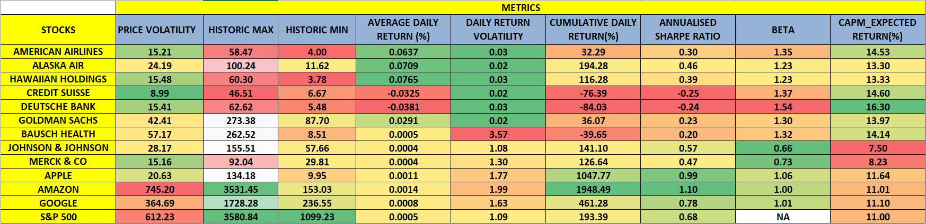
METRICS FOR THE STOCKS
We have calculated the following metrics for each stock and the market index
Color grades applied according to the following rules :
Less volatility - Green More volatility – Red
More Return - Green Less Return – Red
Higher Sharpe - Green Lesser Sharpe – Red
Lesser Beta - Green higher Beta – Red

Slide 8
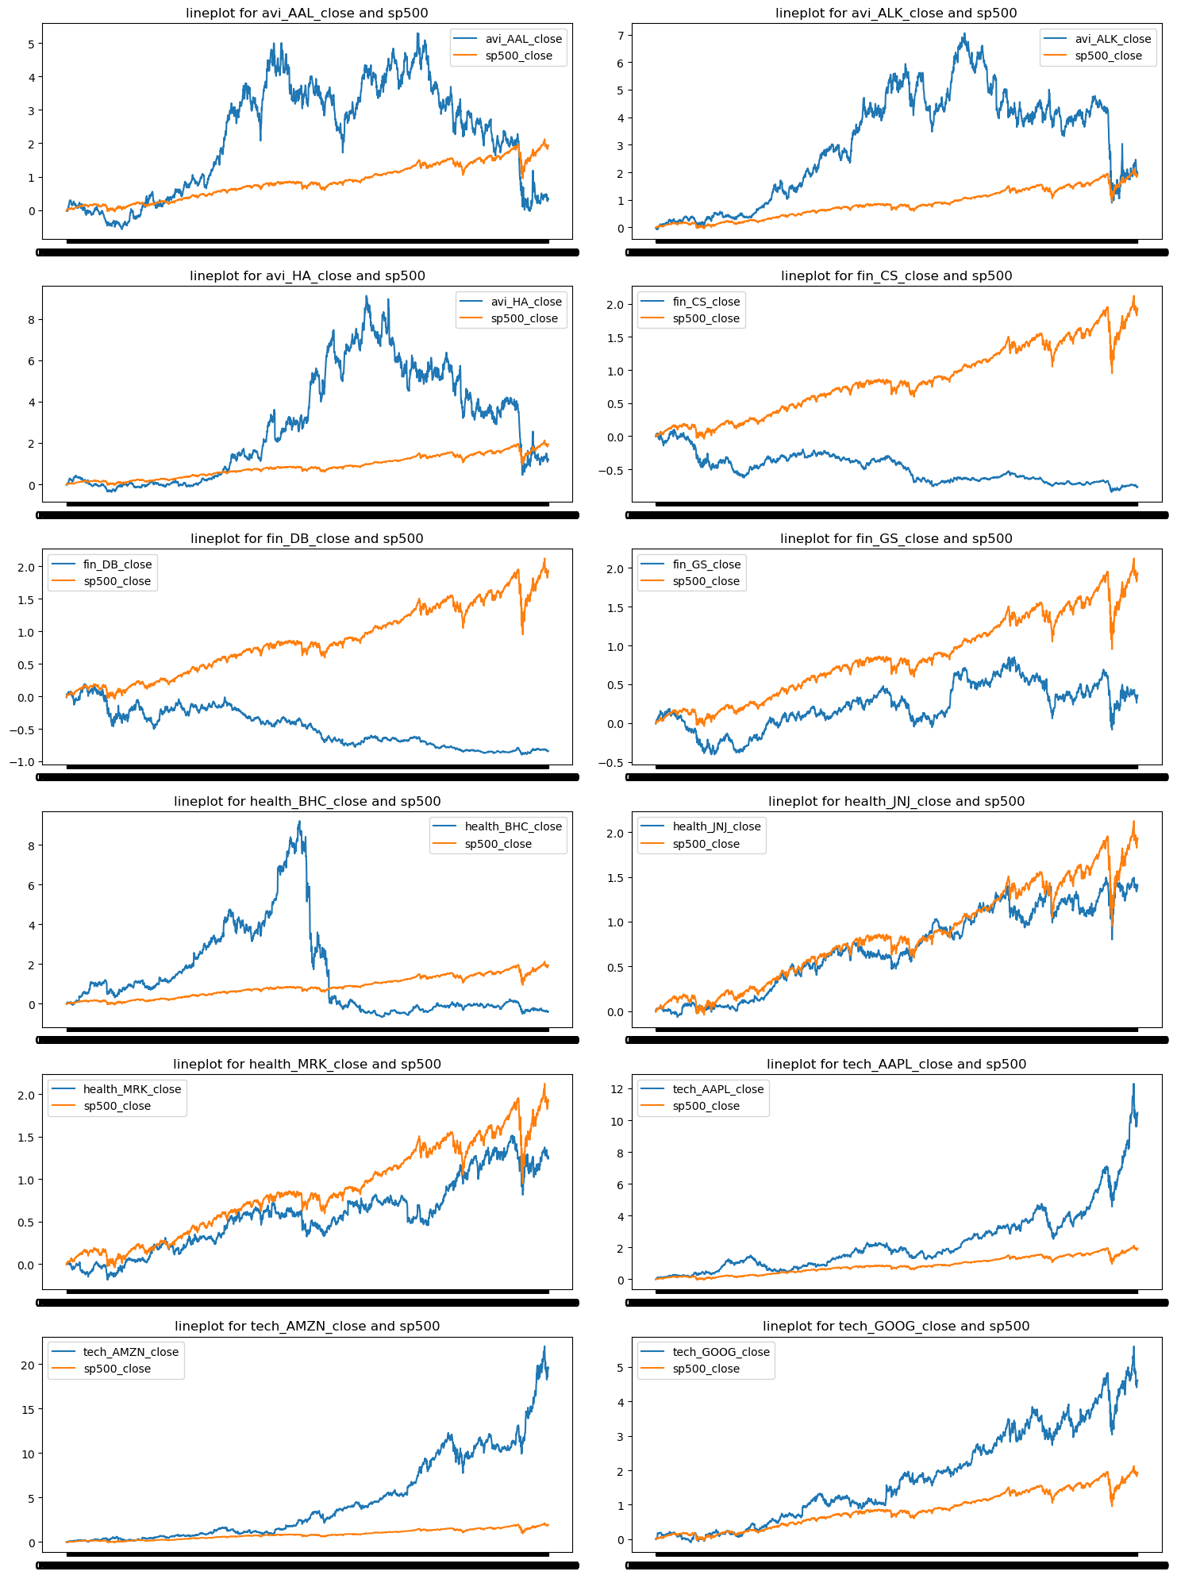
Observations
Seeing the stocks we understand that the closing of the tech based stocks of
Apple
Amazon
Google
Have yielded in higher closing in comparison with the S&P500.
Another stock that has shown positive response over the past is Johnson & Johnson.
The rest of the stocks have underperformed compared to the S&P500 index.

Slide 9
FURTHER UNDERSTANDING AND FINDINDINGS
Though Amazon, Apple and Google show higher returns compared to the S&P500 index but:
The belong to the same sector i.e Technology
Best portfolio we suggest is to have a diverse stocks from the sectors.
We want to include stock from health sector, which can resonate well with investor long term goals.
The other stocks are highly volatile and does not align with investing strategy.
Lets find of with the different combination of stocks, their SHARPE and RISK are

Slide 10
PORTFOLIO SUGGESTIONS
Portfolio of 3 stocks, 4 stocks and 5 stocks have been suggested.
A 3 stock portfolio comprises of Amazon, Apple, and J&J
Sharpe Ratio of 1.21
Risk of 0.199
Average Annual Return 26%
A 4 stock portfolio comprises of Amazon, Apple, Google and J&J
Sharpe Ratio of 1.16
Risk 0.198
Average Annual Return 24%
A 5 stock portfolio comprises of J&J, Apple, Amazon, Google and Merch & co.
Sharpe Ratio of 1.12
Risk 0.18
Average Annual Return 21%
We would like to suggest the 1st portfolio with 3 stocks which does not only provides better returns but also has good sharpe ratio with similar risk exposure.

Slide 11
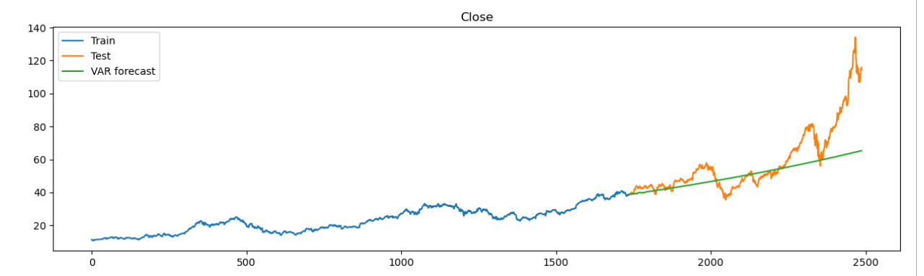
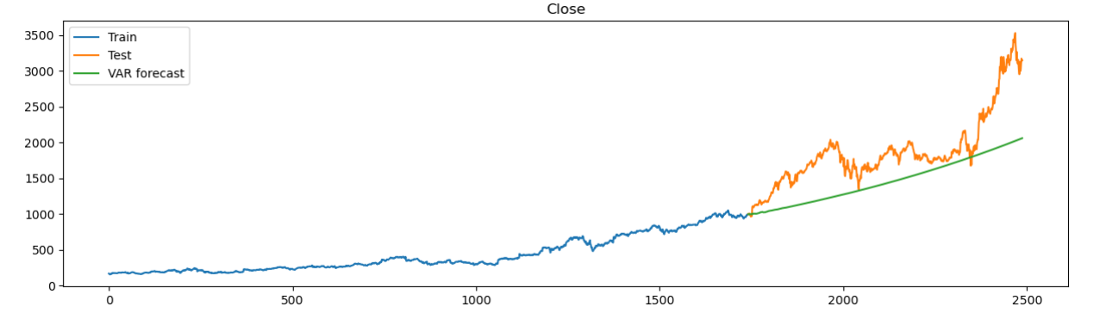
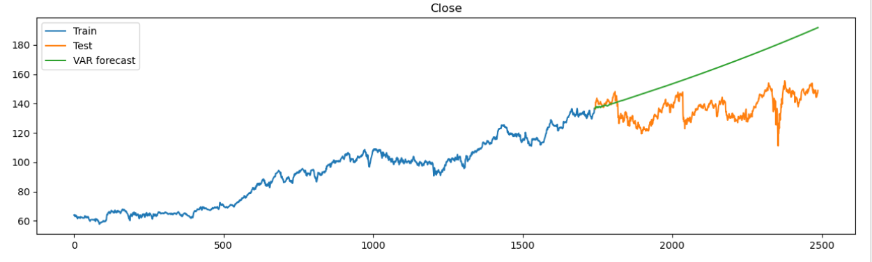
FORECASTING FOR FUTURE RETURNS FOR EACH SUGGESTED STOCKS
We have used Vector Autoregression Model (VAR) to understand the pattern in the data and predict stock prices in the next 5 years (As per client investing horizon)
APPLE (AAPL) :
AMAZON (AMZN) :
JOHNSON & JOHNSON (JNJ) :

Slide 12
FORECASTING FOR FUTURE RETURNS FOR EACH SUGGESTED STOCKS
As can be seen, our model is able to capture the trend in the data and same has been used to forecast future prices.
APPLE (AAPL) : For AAPL, we have found average annual return to be 27.67% over the
next 5 years.
AMAZON (AMZN) : For AMZN, we have found average annual return to be 49.46% over the
next 5 years.
JOHNSON & JOHNSON (JNJ) : For JNJ, we have found average annual return to be 15.67% over the next 5 years.
Now, combining the data , annual portfolio return can be estimated to be around 31%, which comfortably beats market average of 14%.
Also, all these companies are market leaders in their respective domains , have quality products and competitive advantage over peers , which emphasizes that the stocks will grow steadily and provide good returns.

Slide 13
THANK YOU

