Slide 1
DDS Analytics: An Exploration Into Attrition
By Mrinmoy Bhaumik

Slide 2

Objectives
To explore data and make observations and insights
Create a classifier model that can help predict employee attrition
Create a model that help predict employee salary

Slide 3
Exploratory Data Analysis
Total Number of Variables = 36
Total number of Observations = 870
Four of the variables were removed because they only consisted of one level

Slide 4
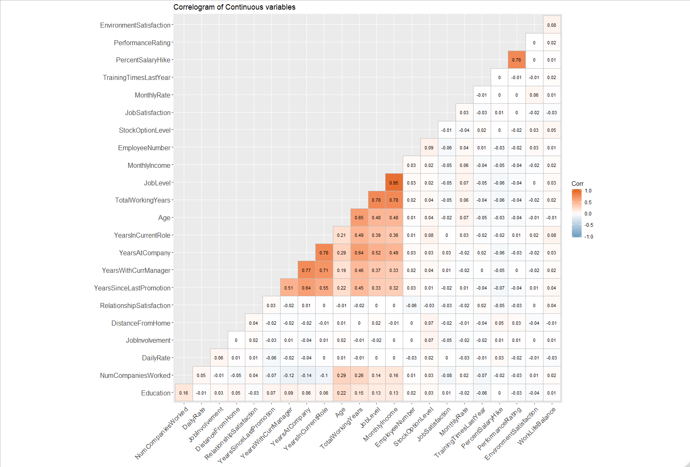
This is a correlogram of all the continuous variables in the data set
There are only a few highly correlated variable but most of them have very little correlation
A few these variables are actually highly correlated with Monthly Income

Slide 5
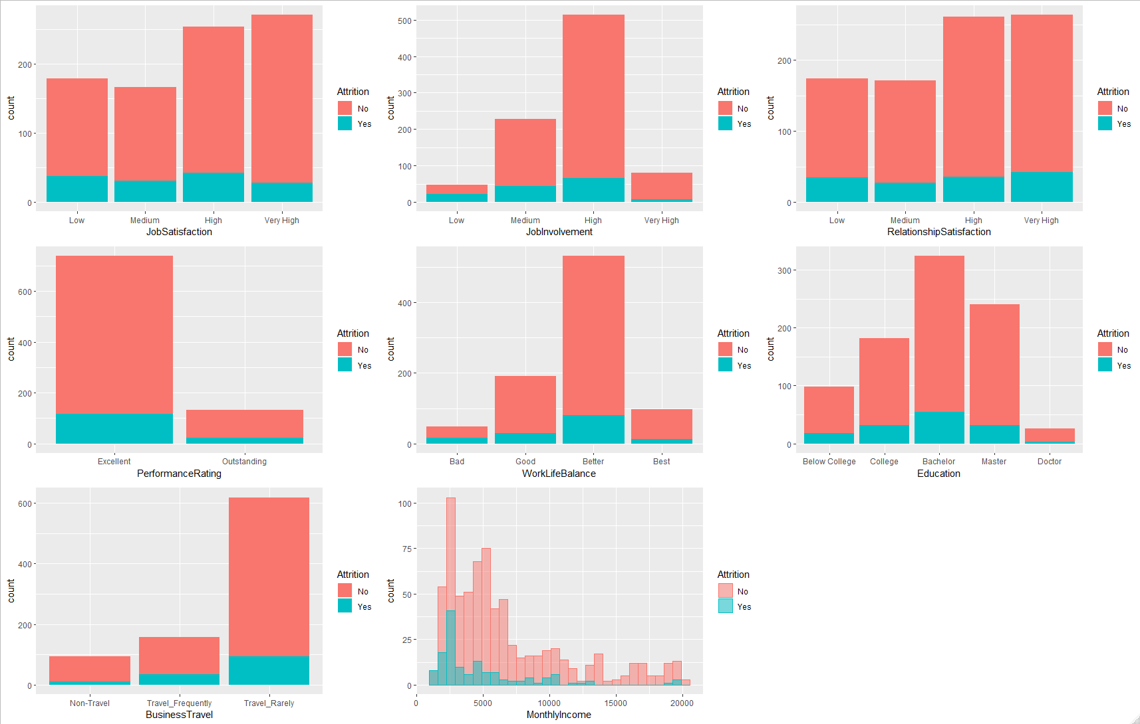
Next we look at the distributions of the categorical variables with respect to Attrition
Most seem to show signs of normality except for Business Travel and Monthly Income
From these graphs, we can determine that it is quite difficult to hold on to employees and there is a strong tendency for employees to leave the company

Slide 6
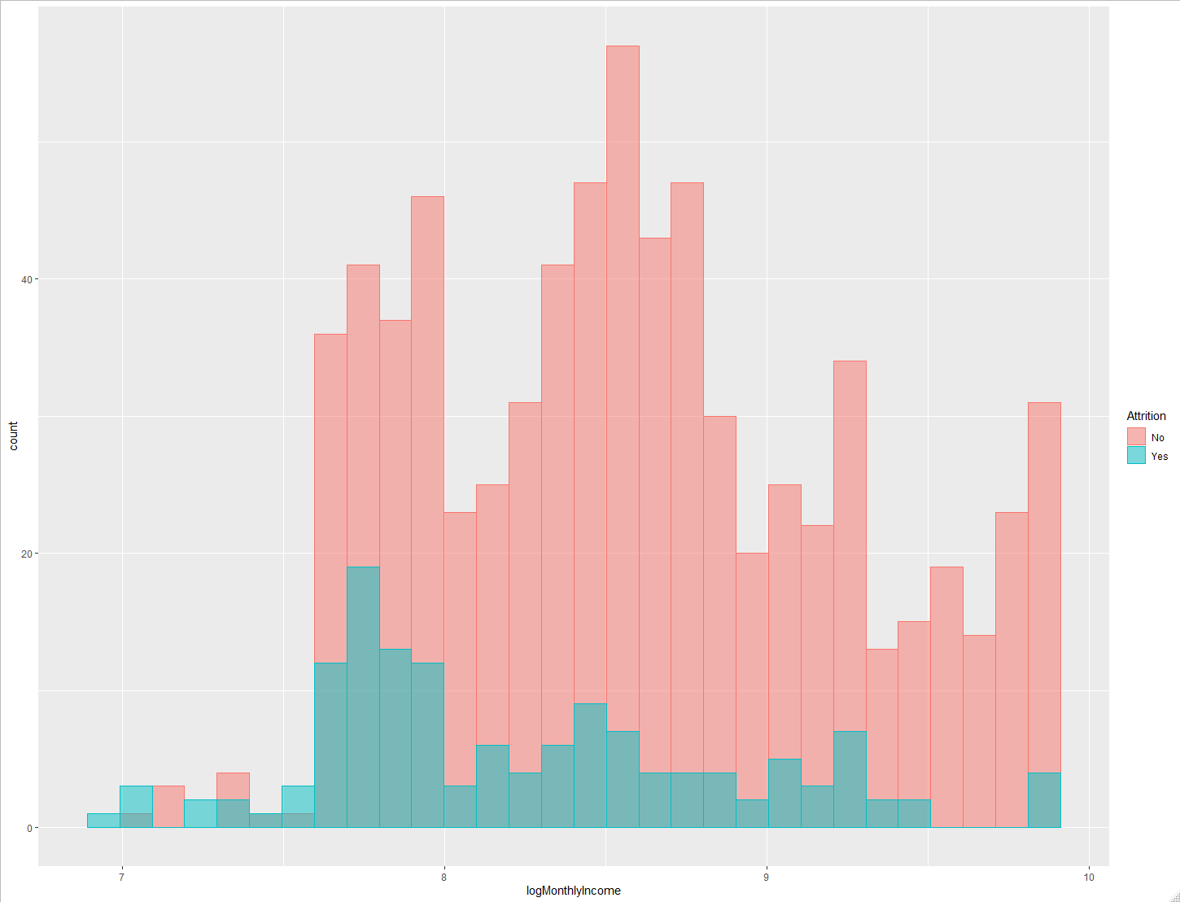
Since we are trying to predict Monthly Income and there is heavy skewness, it was a good idea to see the distribution after a log transformation
It looks like the distribution improved a great deal and is showing increased signs of normality

Slide 7
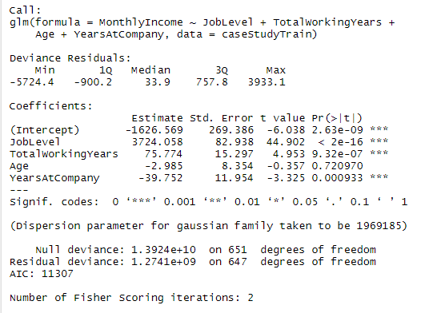
Salary Models
Three types of regression models were created
The first was a model that was created based on the correlation plots
The RMSE is 1387.26

Slide 8
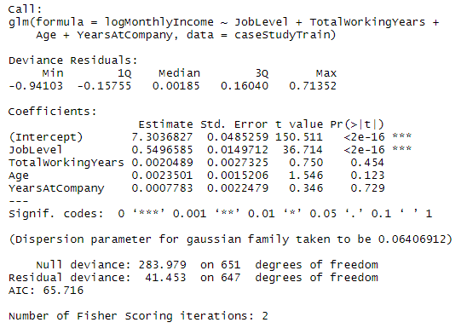
Salary model
The second model was the same as the first model but instead of using Monthly Income, we used the log transformation
The RMSE is 2088.641

Slide 9
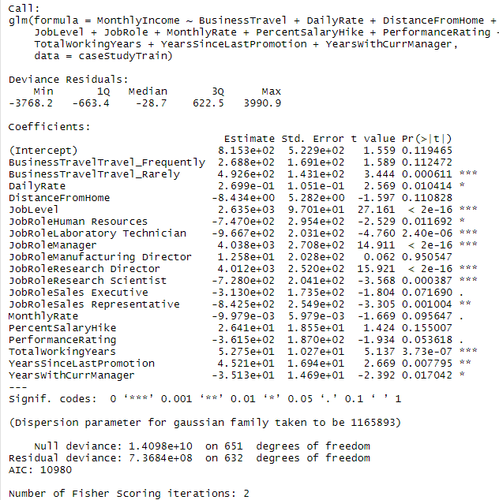
Salary Model
The last model was a pure stepwise linear regression model
The RMSE is 1065.832
Best model because it has the lowest RMSE

Slide 10
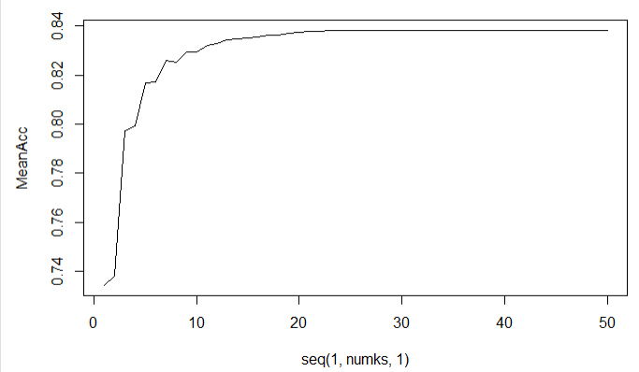
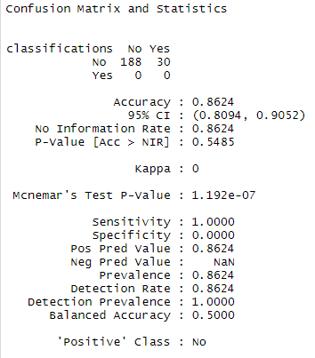
Knn Model (Attrition)
Out of the classifier models, this performed the worse
The Sensitive is 1 while the Specificity is 0
KNN had an over 80% accuracy when k was around 24 and over

Slide 11
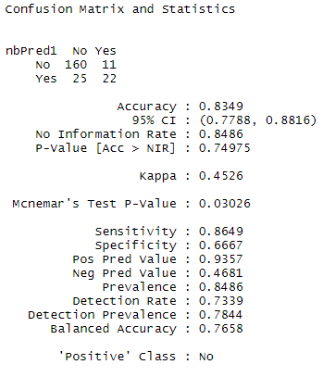
Naïve bayes (Attrition)
Naïve Bayes worked better than the KNN
Two models were created one with all the variables and one without the heavily correlated variables, the model with all the variables was more successful

Slide 12
Findings
Very little correlation between the different explanatory variables
Not much data on effective attrition
Even if we account for normalizing distributions within the variables it wont necessarily help with regression models
Lack of knowledge of independence might have played a factor
More successful to more variables than less variables with the data

