Slide 1
MRA Project ML 2
Mrinmoy Majumdar
PGP-DSBA-JUN21

Slide 2
Agenda [Table OF CONTENT]
Problem Statement
About Data
Exploratory Analysis
Use of Market Basket Analysis (Association Rules)
Associations Identified
Suggestion of Possible Combos with Lucrative Offers

Slide 3
PROBLEM STATEMENT
A Grocery Store shared the transactional data with you. Your job is to identify the most popular combos that can be suggested to the Grocery Store chain after a thorough analysis of the most commonly occurring sets of menu items in the customer orders. The Store doesn’t have any combo meals. Can you suggest the best combo meals?

Slide 4
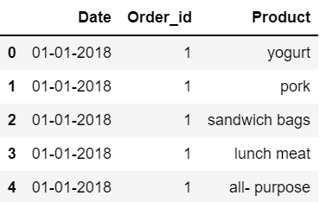
About data
The data consists of 3 columns with 2 variables of object type and 1 variable of integer type.
The data contains 20641 rows and 3 columns with no null values.
There are 4730 duplicated columns present in the dataset.
Multiple products are being sold to customers from the year 2018 to 2020.
Figure 1 : Head of Dataset

Slide 5
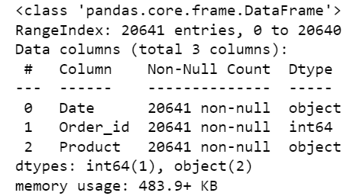
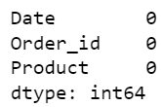
Figure 2: Information on dataset
Figure 3: Missing value check

Slide 6
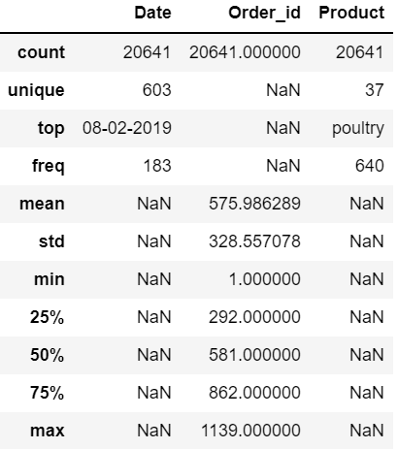
Figure 4: Summary of data

Slide 7
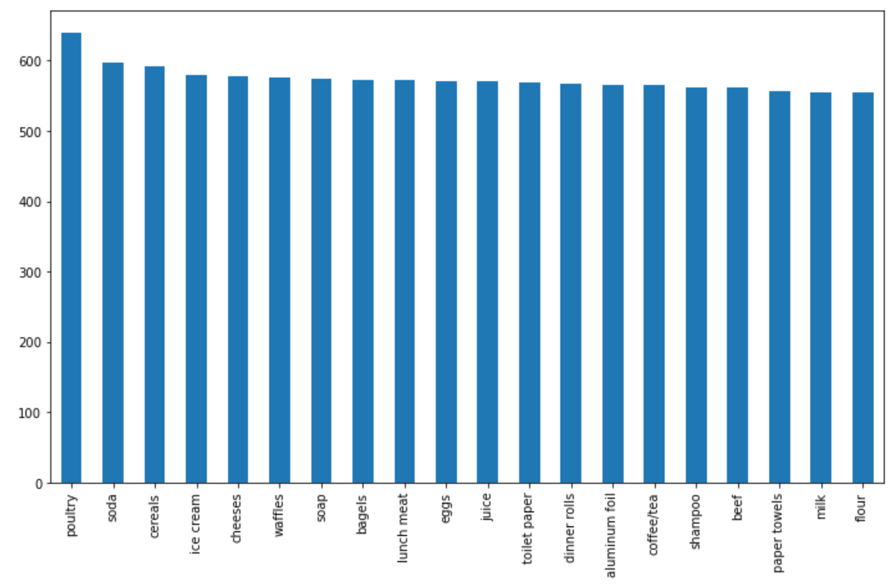
EDA (univariate , Bivariate and multivariate analysis)
Figure 5: Bar plot on different count of products

Slide 8
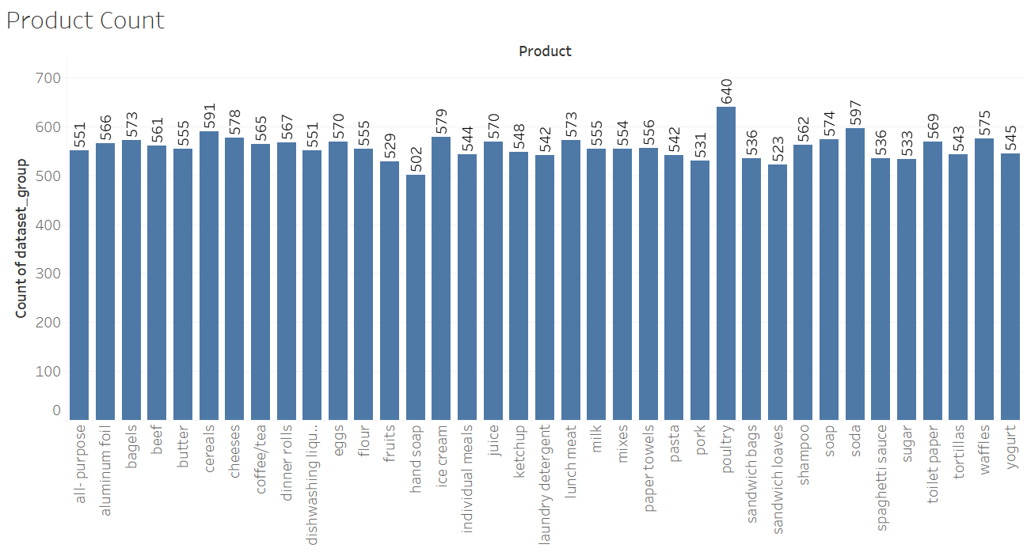
Figure 6: Univariate Analysis of Numerical Data

Slide 9
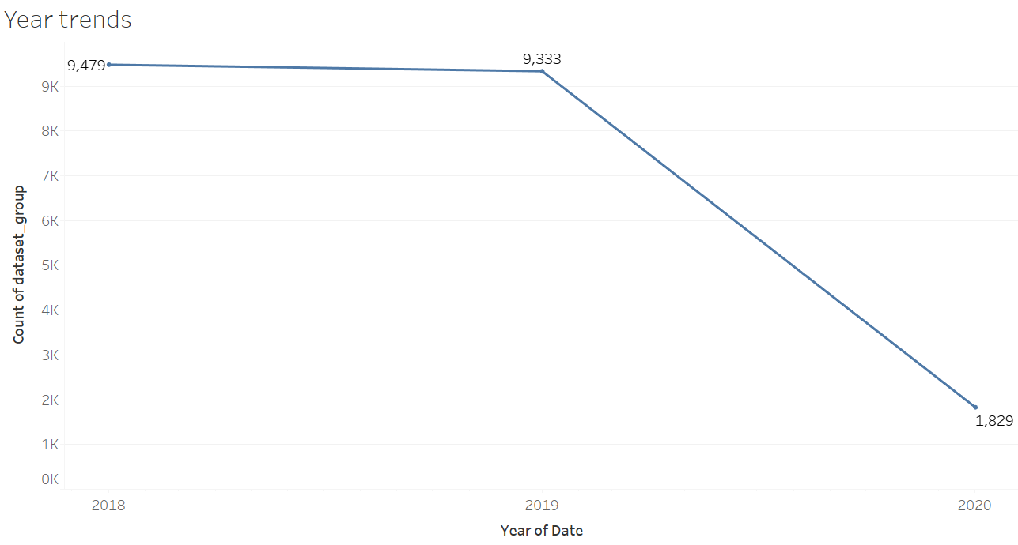

Slide 10
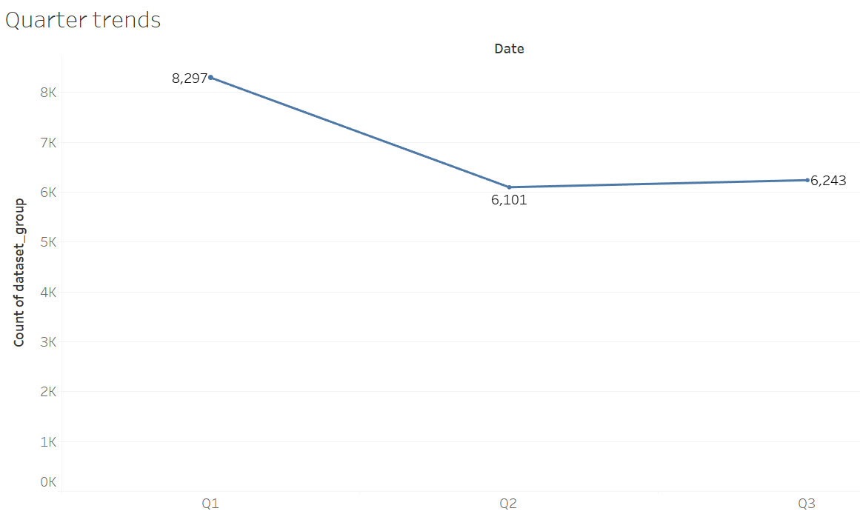

Slide 11
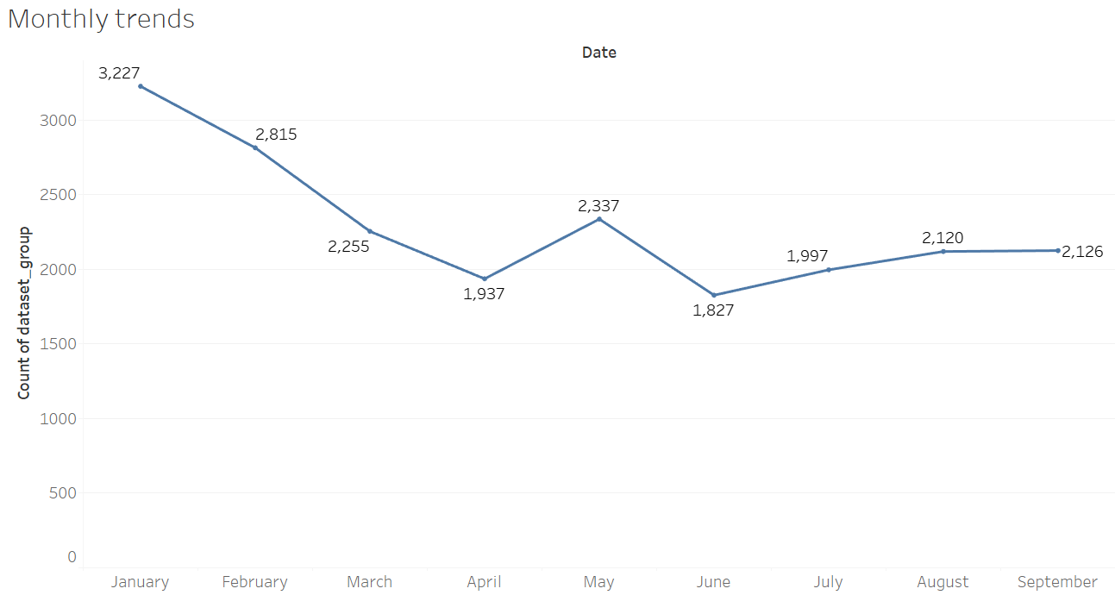

Slide 12
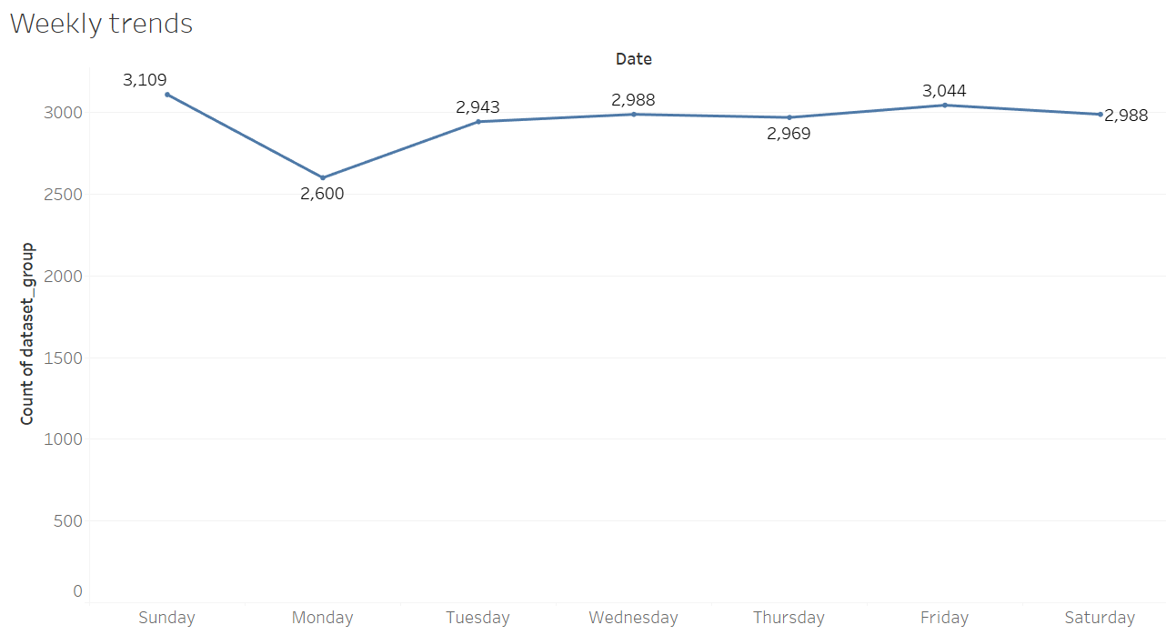

Slide 13
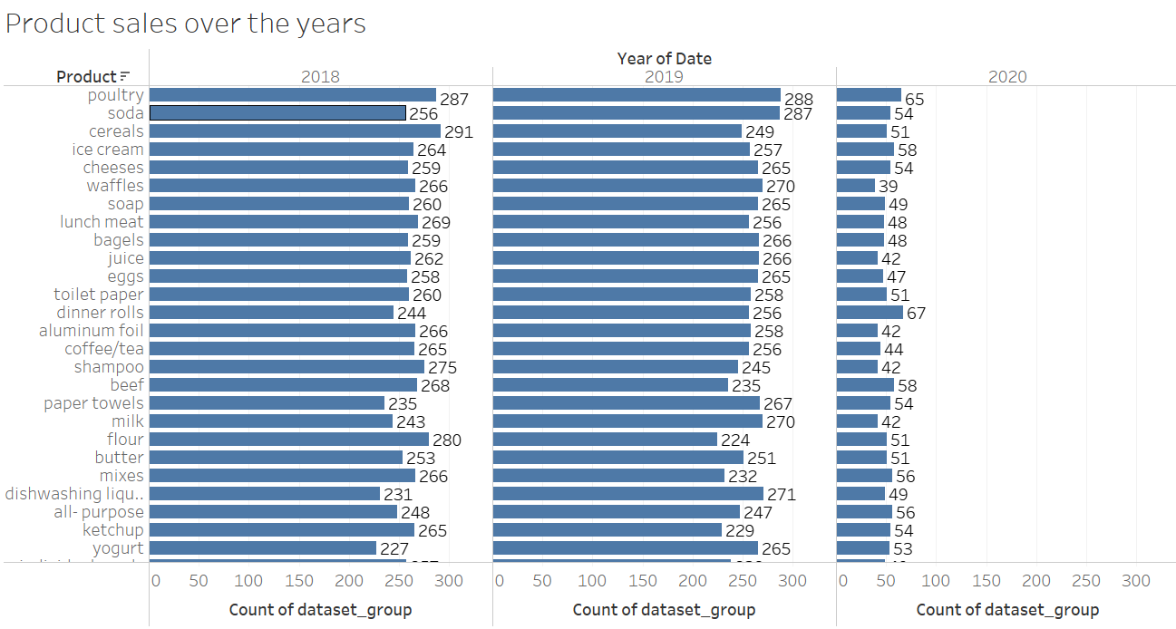

Slide 14
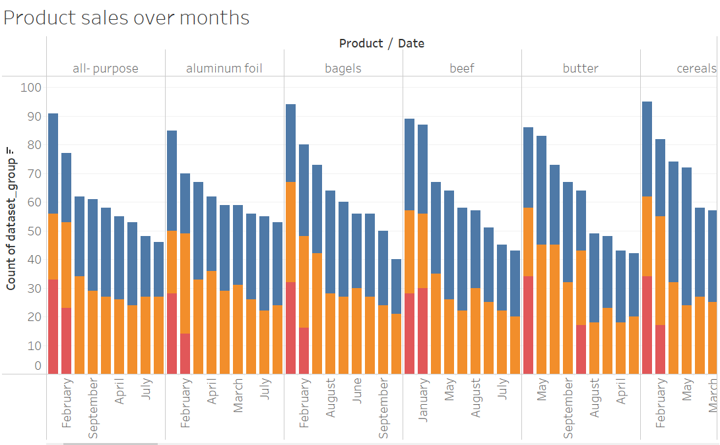

Slide 15
Eda SUMMARY [INFERENCES]
Poultry product count is the highest and hand soap has the lowest count.
2018 and 2019 product count was fairly consistent but registered a sharp fall in 2020.
Q1 record the highest count and then decrease in Q2 remaining constant in Q3.
Products are available in considerable amount in the month of January with fluctuating availability over the next months.
October, November and December numbers may have been missed.
Customers prefer Sunday to buy products which explains highest patterns in that week.
The stacked bar plot patterns of different products are identical.

Slide 16
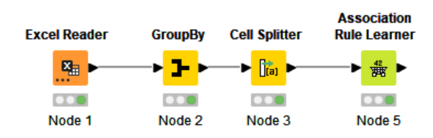
Use of market basket analysis
Tool used – KNIME
Market Basket Analysis is a technique to increase sales of a retailer by understanding customer purchasing patterns.
Market Basket Analysis helps to unravel association between products and identifies relationship between purchased products.
Association rules are of the form if X then Y. For example: 60% of those who buy comprehensive motor insurance also buy health insurance; 80% of those who buy books on-line also buy music on-line; 50% of those who have high blood pressure and are overweight have high cholesterol. These rules are actionable in that they can be used to target customers for marketing, or for product placing, or more generally to inform decision making.
Figure 7: Knime Workflow

Slide 17
Threshold Values
Support – Number of transactions containing all possible purchases per total number of transactions. In the given case study, support is assumed as 0.05.
Confidence – To consider a rule, we impose a minimum support indicating reasonable amount of data about the rule. The confidence measures how good a predictor of the rule is. Confidence is considered as 0.6 for the problem at hand.
Lift – Increase in sale of an associated product when the related product is sold off.

Slide 18
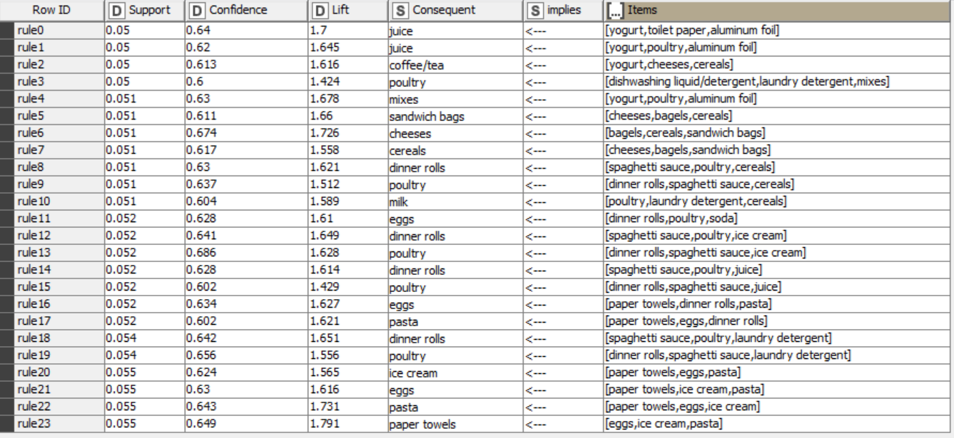
ASSOCIATIONS IDENTIFIED
Figure 8: Association table

Slide 19
Support, Confidence and Lift Calculations
We have here the three metrics that are Support, Confidence and Lift, we added a value to our Support which is between 0-1.We added value of 0.05 that is 5% sell of a product from overall transactions and we also selected the association rule for the minimum confidence as 0.6. So as you can see the values of confidence and support will help us to get threshold.

Slide 20
Suggestion of Possible Combos with Lucrative Offers
Recommendations
Since poultry and dinner rolls are the most sold items and dishwashing liquid and detergent are least sold items- a combo offer of these would eventually increase sale of dishwashing liquid and detergent as well.
We can offer special discount coupon on least sold products purchased, on the next shopping on all the product to increase the sale of least sold products and increase the frequency of customers.
Products with lower confidence and lift should either be completely removed or devise strategies to improve it’s performance at the stores.
Poor customer service or lack of offers could be the reason behind no sales in Q4 and decreasing orders over the years. The store should invest time and money to ensure customer satisfaction.

