Slide 1
MRA Project ML 1
Mrinmoy Majumdar
PGP-DSBA-JUN21

Slide 2
Agenda [Table OF CONTENT]
Problem Statement
About Data
EDA and Inferences
Customer Segmentation using RFM Analysis
Inferences from RFM Analysis and Identified Segments

Slide 3
PROBLEM STATEMENT
An automobile parts manufacturing company has collected data of transactions for 3 years. They do not have any in-house data science team, thus they have hired you as their consultant. Your job is to use your magical data science skills to provide them with suitable insights about their data and their customers.

Slide 4
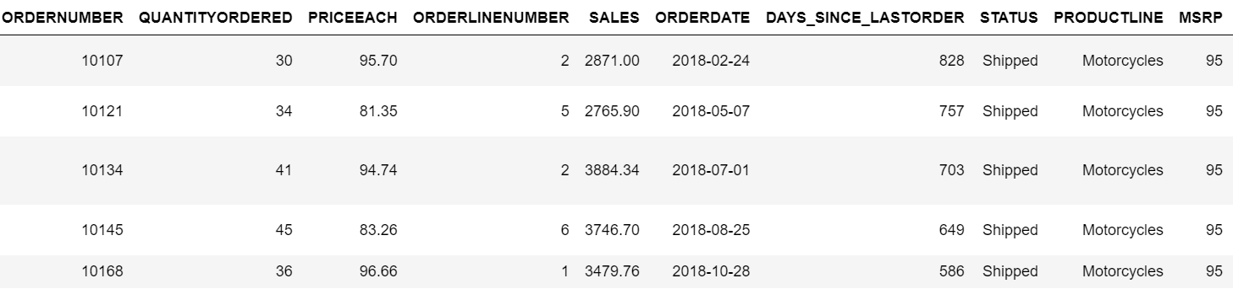
About data
The data consists of 20 columns with 5 variables of integer type,2 variables of float type,1 variable of datetime and rest of the variables of object type.
The data contains 2747 rows and 20 columns with no null and duplicate values.
The description of the data indicates normal distribution since mean and median values are almost same.
Figure 1 : Head of Dataset

Slide 5
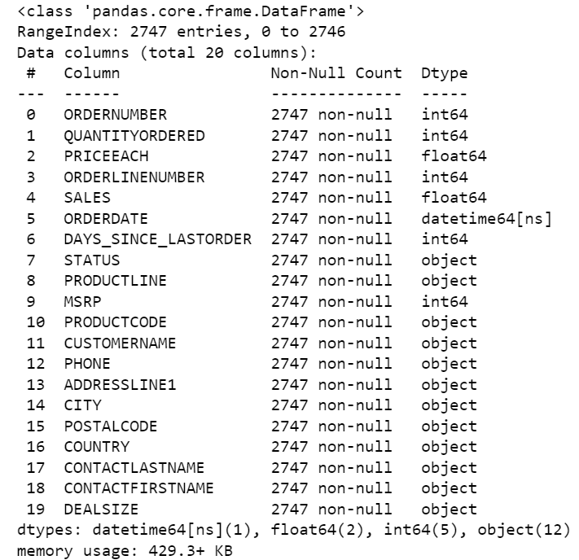
Figure 2: Information on dataset

Slide 6
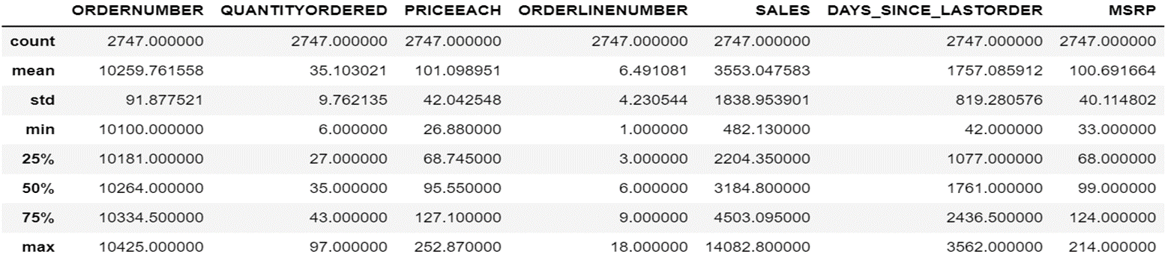
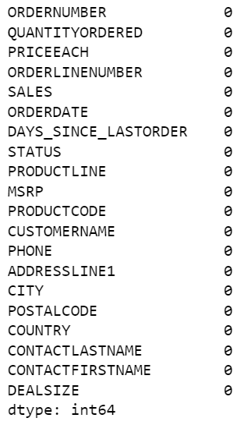
Figure 3: Summary of data
Figure 4: Missing value checks

Slide 7
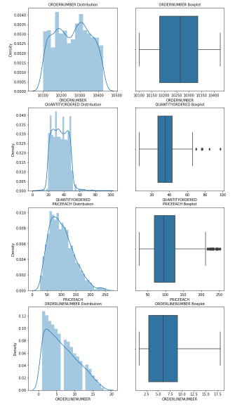
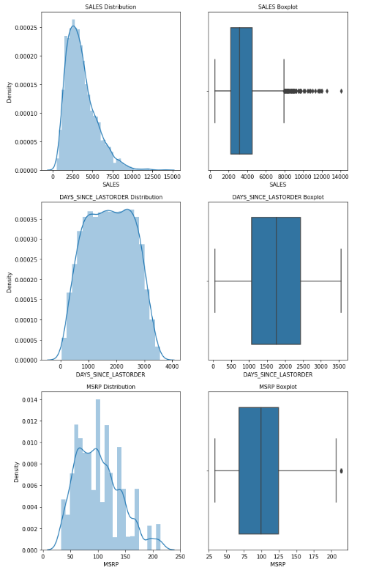
EDA (univariate , Bivariate and multivariate analysis)
Figure 5: Histogram and boxplot distribution of data

Slide 8
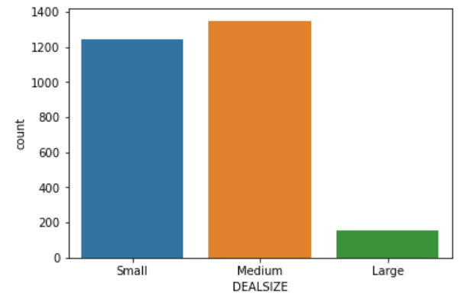
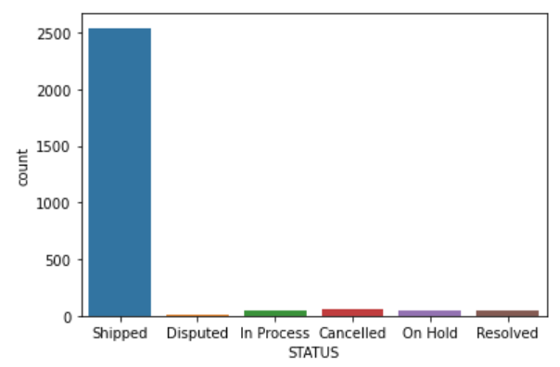
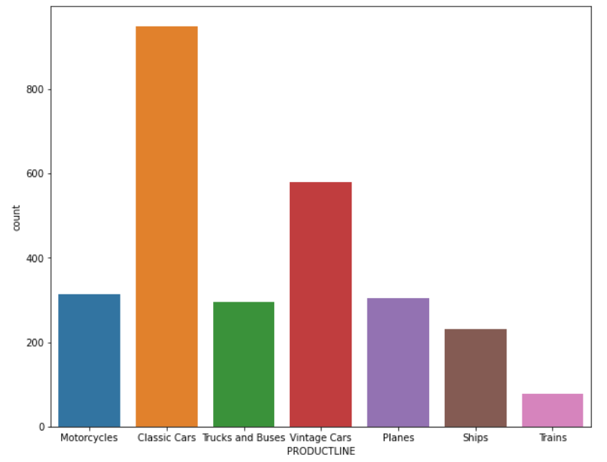
Figure 6: Univariate Analysis of Categorical Data

Slide 9
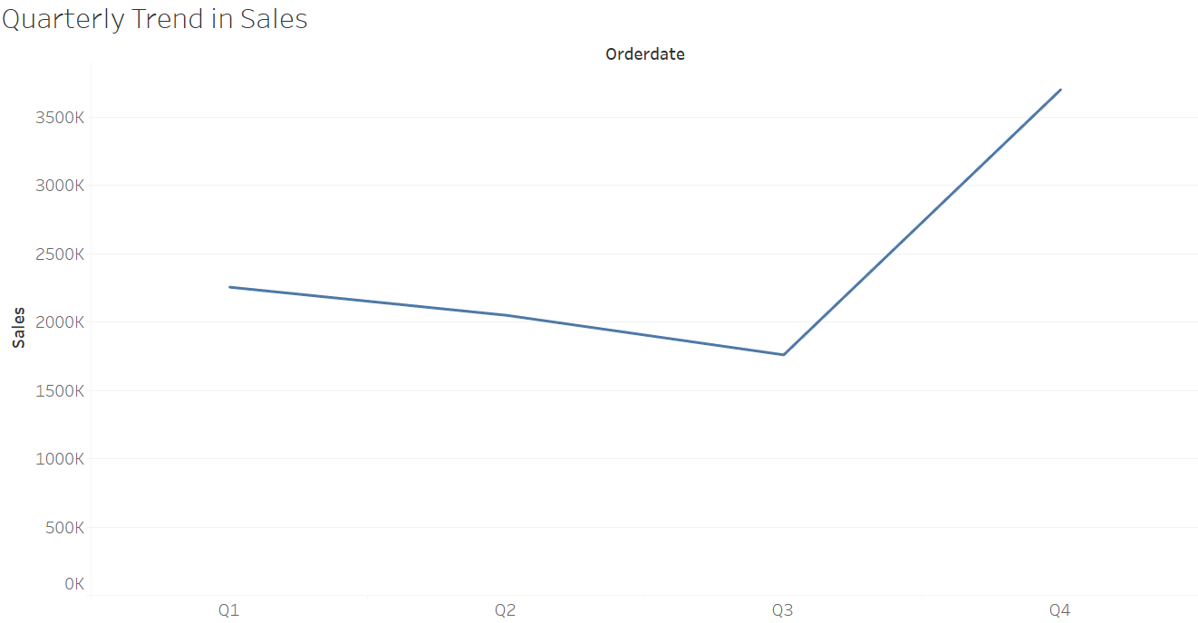
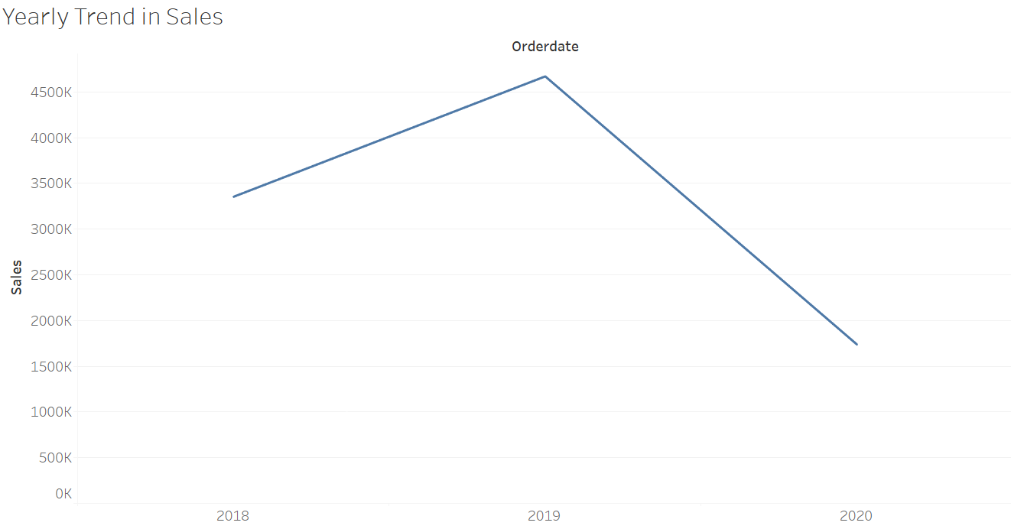

Slide 10
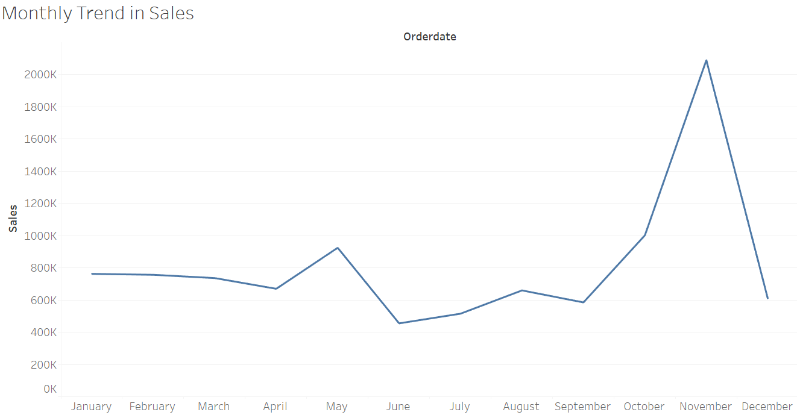
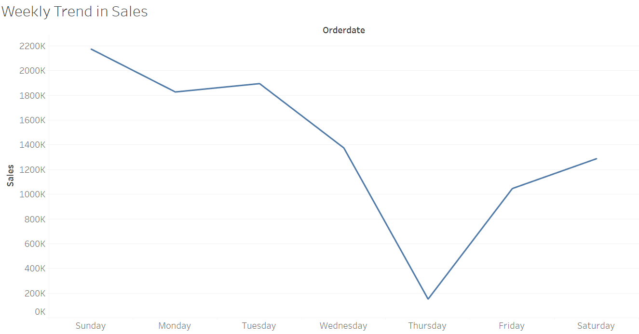

Slide 11
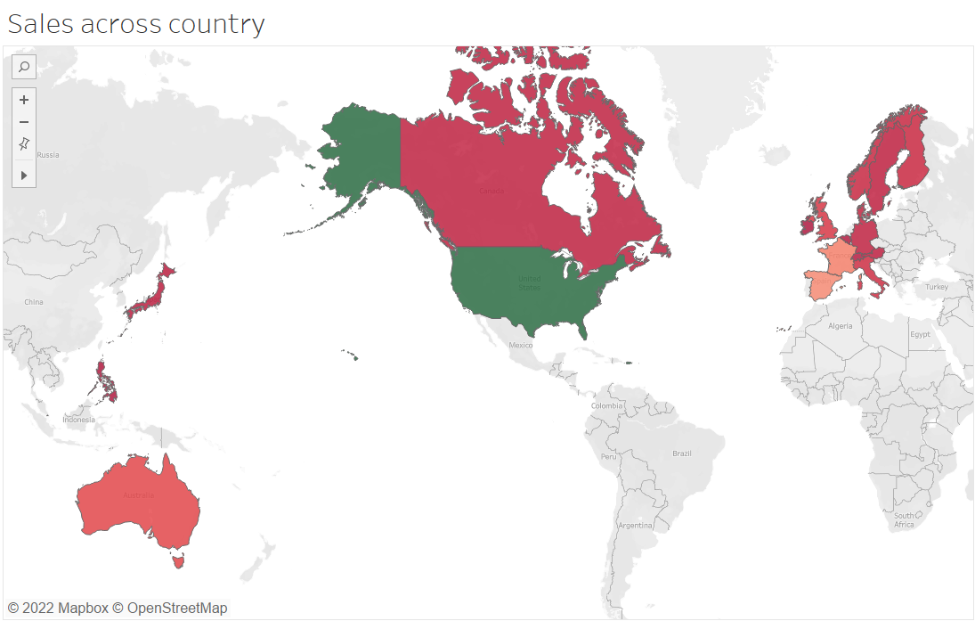
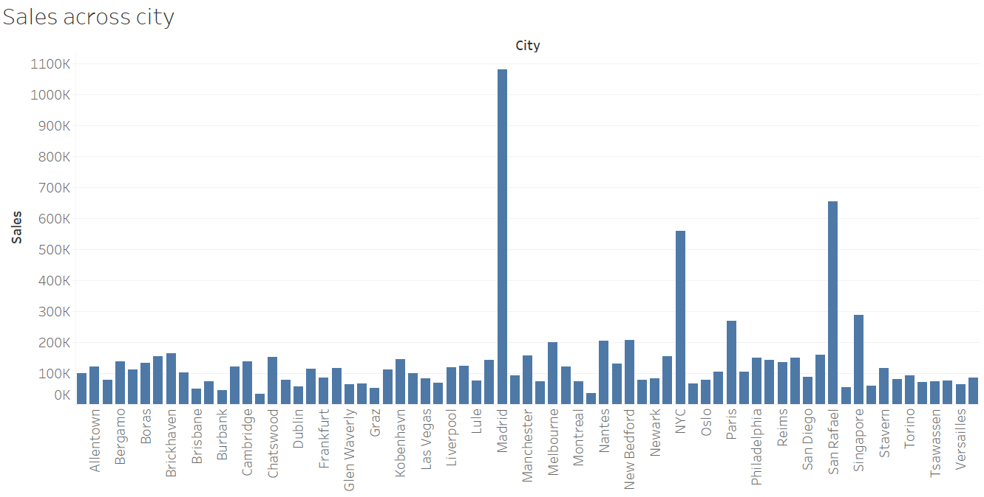

Slide 12
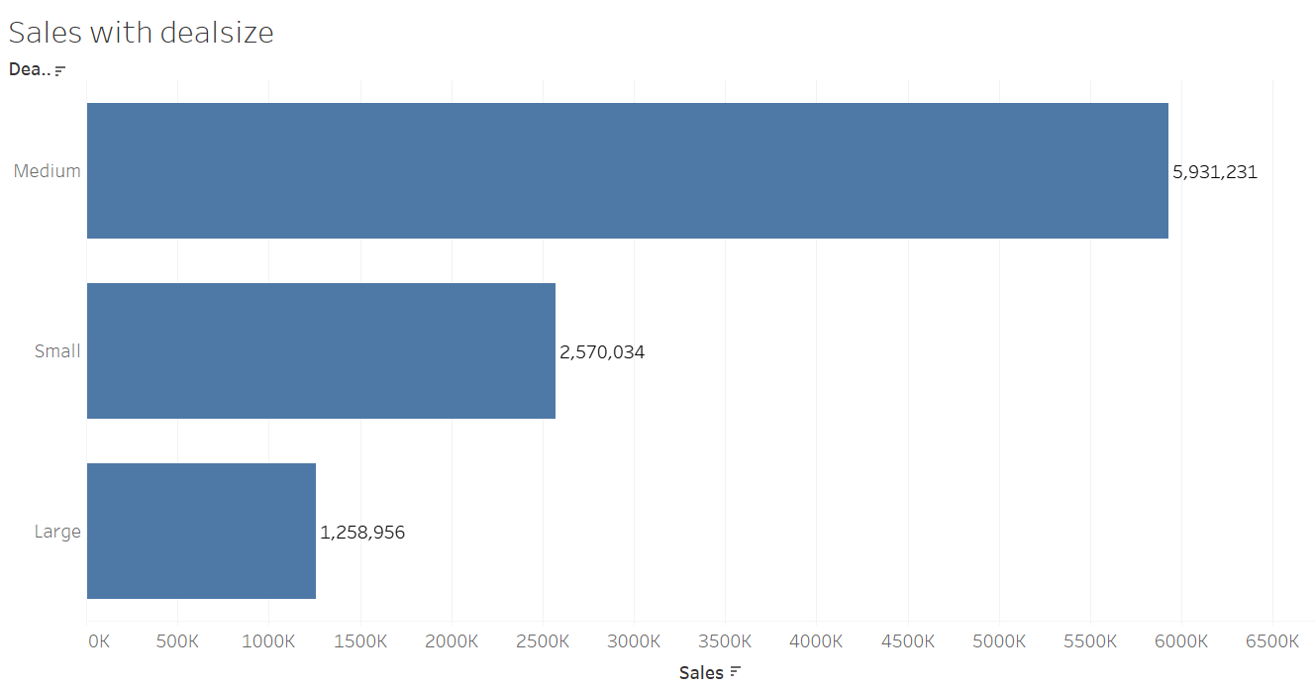
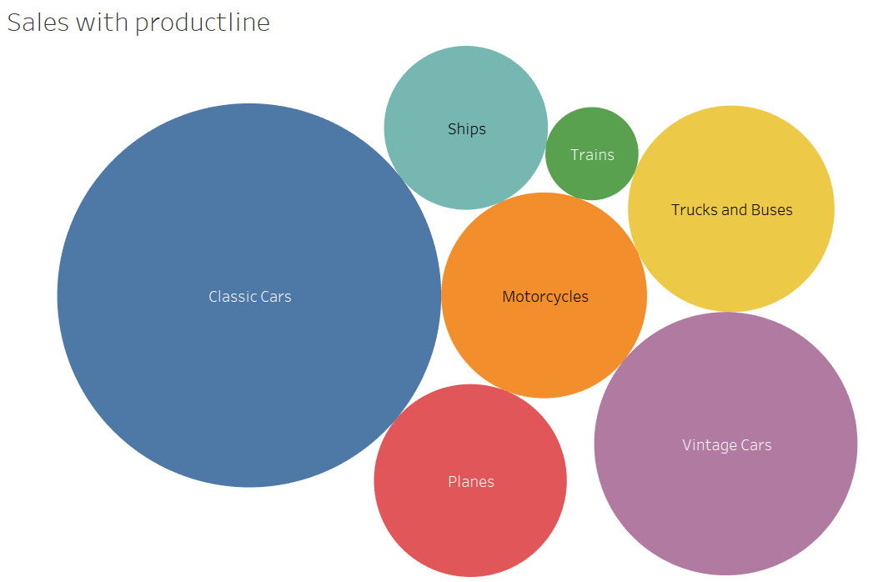

Slide 13
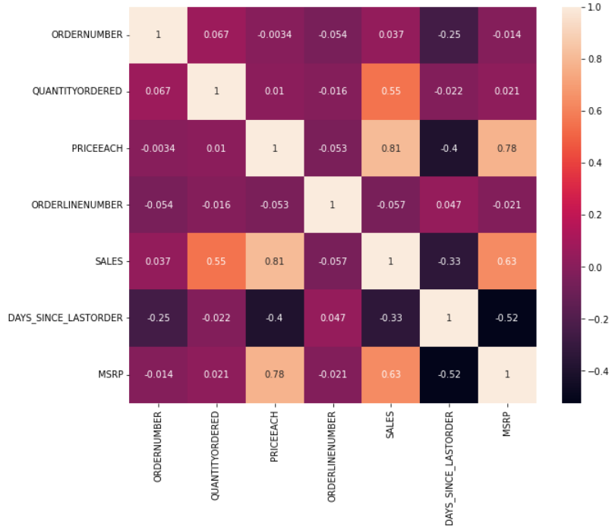
Figure 7: Correlation Plot

Slide 14
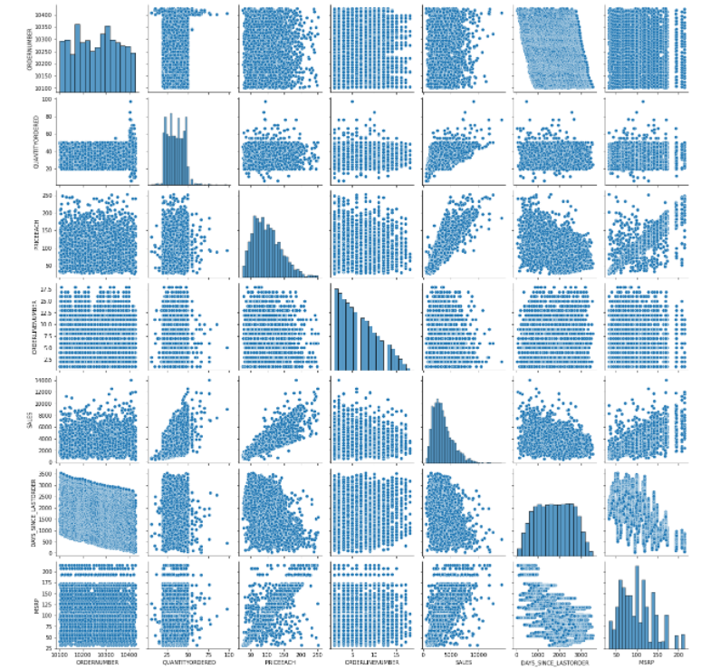
Figure 8: Pair Plot

Slide 15
Eda SUMMARY [INFERENCES]
There are outliers present in quantity ordered, price each, sales and MSRP as seen in boxplot.
Normal distribution is indicated by histogram plots.
Medium deal size cars were ordered the most by customers.
Customers preferred shipping mode to receive their purchased automobiles.
Classic cars are in high demand from customers.
Yearly trend suggests sales are highest in the year 2019.
Quarter 4 records maximum sales of automobiles.
Customers prefer to buy cars in the month of November and on weekends according to monthly and weekly patterns.
USA and Madrid are country and city respectively which generate considerably big sale numbers.
Sales, price each, quantity ordered and MSRP have high positive correlation with each other.
Sales seem to have linear relationship with price of each item while rest of the pair plots have cloud like distribution hence no relationship can be inferred for rest of the numerical features.

Slide 16
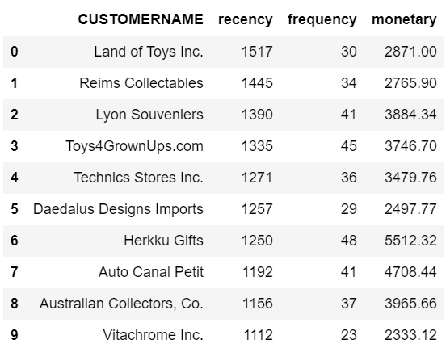
Customer segmentation using RFm
Tool used – Python using pandas , numpy and matplotlib packages.
RFM is Recency, Frequency and Monetary metric where recency is the freshness of customer activity, frequency is the number of transactions or visits by a customer and monetary is the intention of the customer to spend.
Parameters used – recency = current date – order date , frequency = quantity ordered and monetary = sales
Customers have been categorized into 4 segments – best, loyal, lost and churned.
Figure 9 : Output Table Head

Slide 17
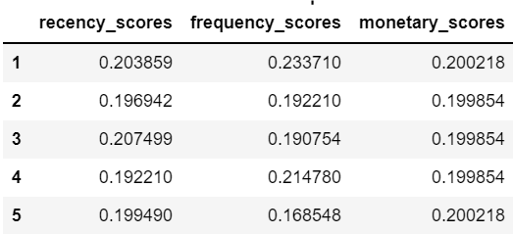
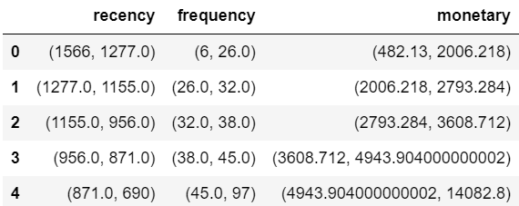
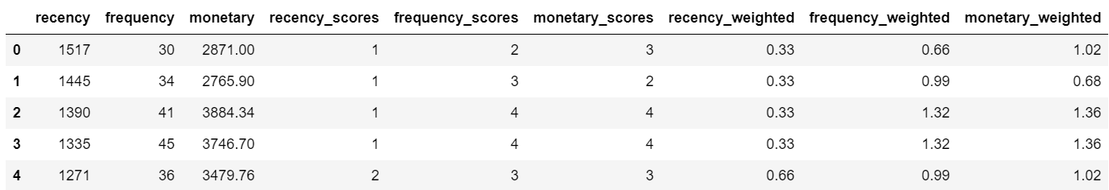
Figure 10: Percentage distribution of scores
Figure 11: RFM cut-off scores
Figure 12: RFM table post model fitting

Slide 18
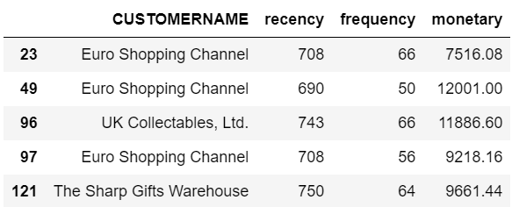
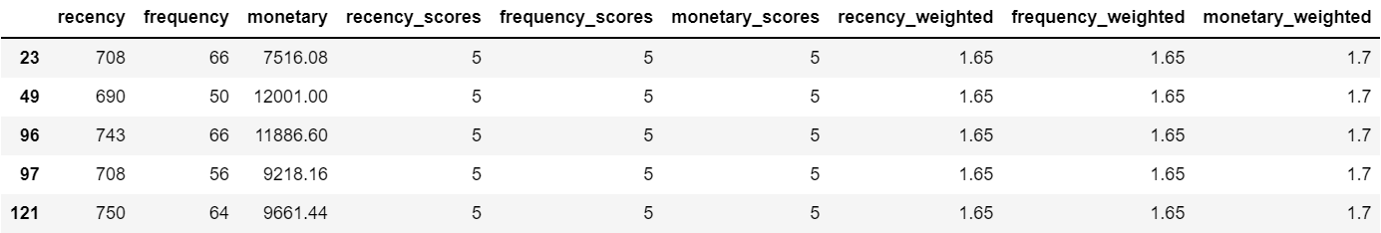
Inferences from RFM ANALYSIS AND IDENTIFIED SEGMENTS
Figure 13: Best customers with RFM scores

Slide 19
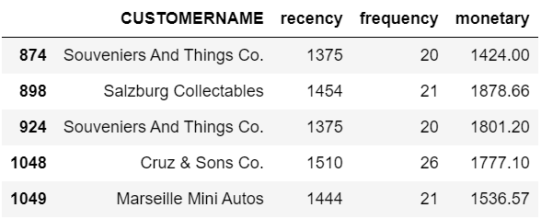
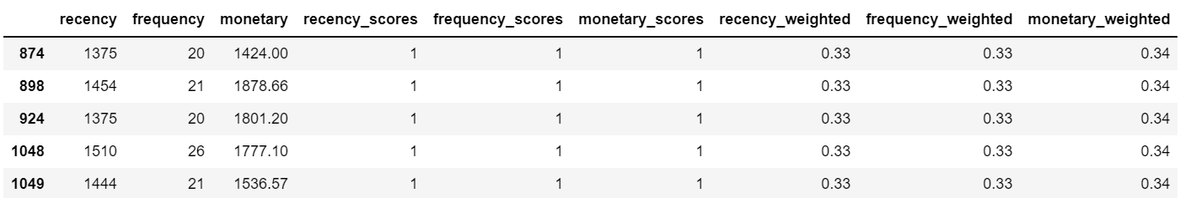
Figure 14: Customers on the verge of churning

Slide 20
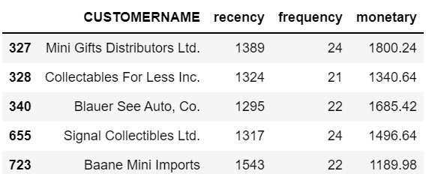
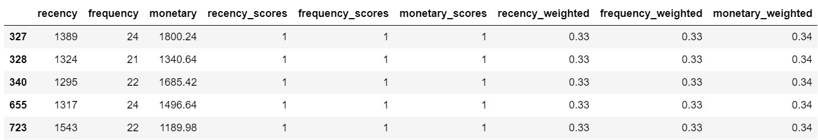
Figure 15: Lost Customers

Slide 21
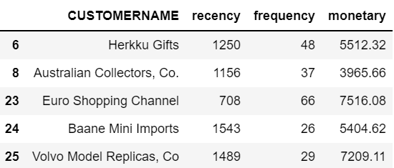
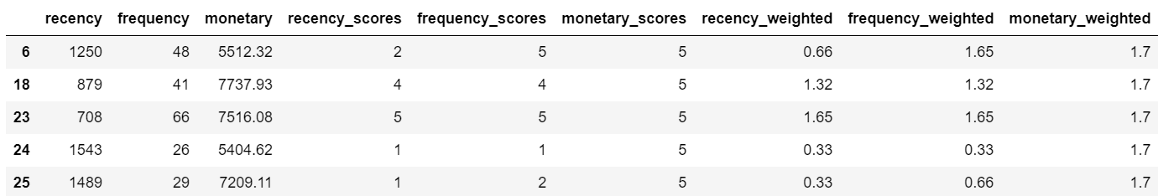
Figure 16: Loyal Customers

Slide 22
RECOMMENDATIONS
Best customers are those which have high recency, frequency and monetary values. Automobile company needs to satisfy these customer type at all costs by providing promotions and offers.
Customers on the verge of churning are looking for an alternative as they may be dissatisfied with the existing products. The organization needs to take feedback from them to improve their existing car range.
Lost customers are inactive and the company needs to get rid of these types as they lead to negligible sales.
Loyal customers will purchase cars from the company irrespective of competition. Free car service can be provided for such type of customers.

