Slide 1



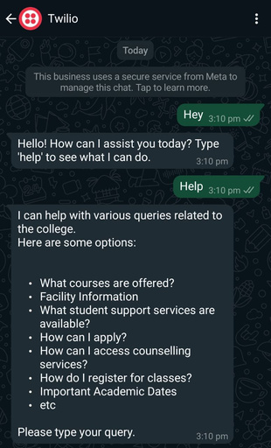
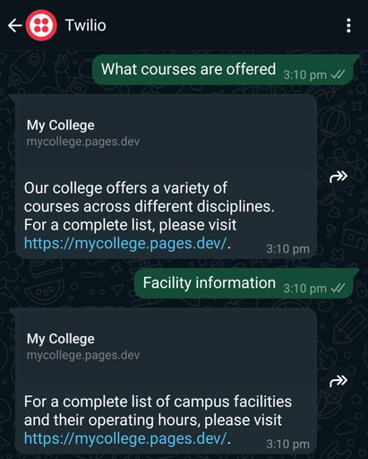
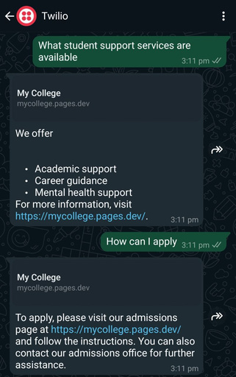
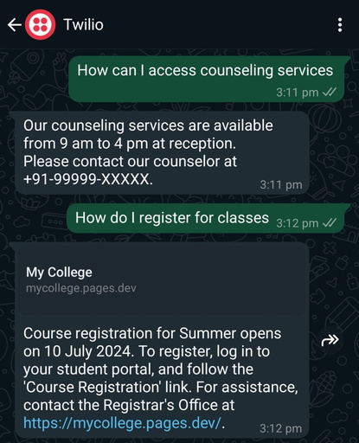
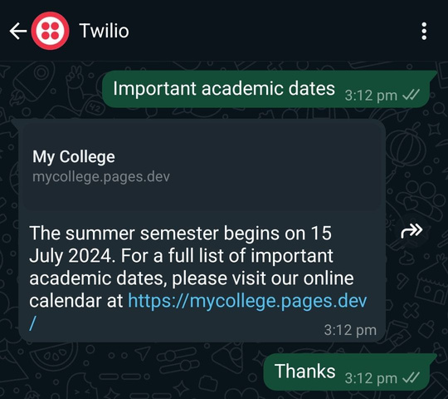
My College - ChatBot
Project Summary
Developed a WhatsApp chatbot named "My College - ChatBot" utilizing IBM Cloud and Twilio. This innovative solution facilitates seamless communication of essential information such as course details, academic calendars, and campus resources across our college community, enhancing accessibility and efficiency.
Program Feedback
The program provided an excellent introduction to IBM Cloud and related technologies. The theoretical knowledge and live sessions were commendable, offering valuable skills and practical insights. I would highly recommend this program to anyone looking to start with IBM Cloud.
Final Outcome Screenshot
Archit Jain
jain.archit03112004@gmail.com
SRM Institute of Science & Technology
Delhi/NCR Campus
#skillsbuild
Notes:
1

