Slide 1
MINOR PROJECT • REVIEW 2
AI-Based Intelligent Vehicle Monitoring and Traffic Violation Detection System
Team: Tech Titans
Members: Ankit Aadarsh (RA2411003012098)
Mrithika K (RA2411003011614)
Sahil Prajapati (RA2411003012283)
Mentors: Dr. B. Sowmiya
Dr. B. Ida seraphim
Date: 14 Aug 2026
Notes:
Keep the opening under 20 seconds.
State the project title, target user, and one-line purpose.
[Sources]
No external sources; instructional template content authored for this deck.

Slide 2
MINOR PROJECT • REVIEW 2
Project Overview (Problem Statement and Motivation)
AI-Based Intelligent Vehicle Monitoring & Traffic Violation Detection System helps traffic authorities improve traffic surveillance by using AI-powered vehicle detection, OCR-based license plate recognition, and speed estimation and generate email alerts.
DOMAIN: AI
Problem statement
Why it matters
Traffic authorities face challenges in manually monitoring traffic, identifying speeding vehicles, and recording vehicle registration numbers from surveillance footage. This manual process is time-consuming, prone to human error, and difficult to scale in high-traffic environments.
Our project addresses this challenge by developing an AI-based system that automatically detects vehicles, recognizes license plates, estimates vehicle speed, and identifies traffic violations from traffic videos and generate email alerts for authorities.
Impact: Reduces manual effort and improves the efficiency of traffic monitoring and violation detection
Frequency: Traffic monitoring is a continuous requirement on highways, urban roads, and major intersections.
Affected group: Traffic police, smart city authorities, highway operators, and road users.
03
Notes:
Every member should speak during the review.
Avoid vague labels such as 'coding' or 'documentation'; assign observable outputs.
[Sources]
No external sources; instructional template content authored for this deck.

Slide 3
MINOR PROJECT • REVIEW 2
Proposed Architecture and Methodology
INPUT
M1
DETECTION & TRACKING
M2
CV & ANALYSIS
M2
DECISION
M3
APPLICATION / OUTPUT
Traffic Video
Vehicle Detection (YOLO)
Plate Extraction & OpenCV Preprocessing
Speed Limit Comparison
Structured Violation Result as Email Alerts
Live / recorded CCTV feed captured frame-by-frame as pipeline input.
License Plate Detection
OCR & Plate Validation
Overspeed Detection
Backend / Database
Vehicle Tracking
Speed Estimation
Rule-Based Fine Calculation
Dashboard
Unique Track ID
METHODOLOGY
1
Capture
2
Detect & Track
3
Extract & Read
4
Estimate
5
Decide
6
Generate Result
Analyze traffic video frames.
ID vehicles, plates & Track IDs.
Crop plate, preprocess, OCR.
Compute speed from tracked motion.
Compare with limit; flag violation.
Calculate fine; send to app layer and generate email alerts.
03
Notes:
Every member should speak during the review.
Avoid vague labels such as 'coding' or 'documentation'; assign observable outputs.
[Sources]
No external sources; instructional template content authored for this deck.

Slide 4
MINOR PROJECT • REVIEW 2
Review 2 - Work Completed – SO FAR
A
Modules
B
Dataset Status
Vehicle Detection & Tracking module built and tested end-to-end
YOLOv8 + ByteTrack integrated; output format finalized and shared with team
UCSD/VISAL Traffic DB (254 clips) — primary baseline dataset
UA-DETRAC — ground-truth recall benchmarking
BMD-45 (Bengaluru, India) — used for fine-tuning
C
Model Build and Training status
D
Outcomes
Base model: YOLOv8s — benchmarked vs YOLOv11, v8 selected for higher recall
Tracking bug found and fixed in ByteTrack integration
Fine-tuned 5-class model (car/bike/bus/truck/rickshaw) on Indian traffic data — completed
Full detection + tracking pipeline operational end-to-end
Measured strong gains after fine-tuning on Indian traffic data
Two-wheeler recall: 42% → 88%; rickshaw detection: 0% → 91%
Car↔truck confusion reduced by 78% with fine-tuning
11
Notes:
Show one artefact live only if it opens reliably in under 20 seconds.
Screenshots are acceptable backup evidence for Review 1.
[Sources]
No external sources; instructional template content authored for this deck.

Slide 5
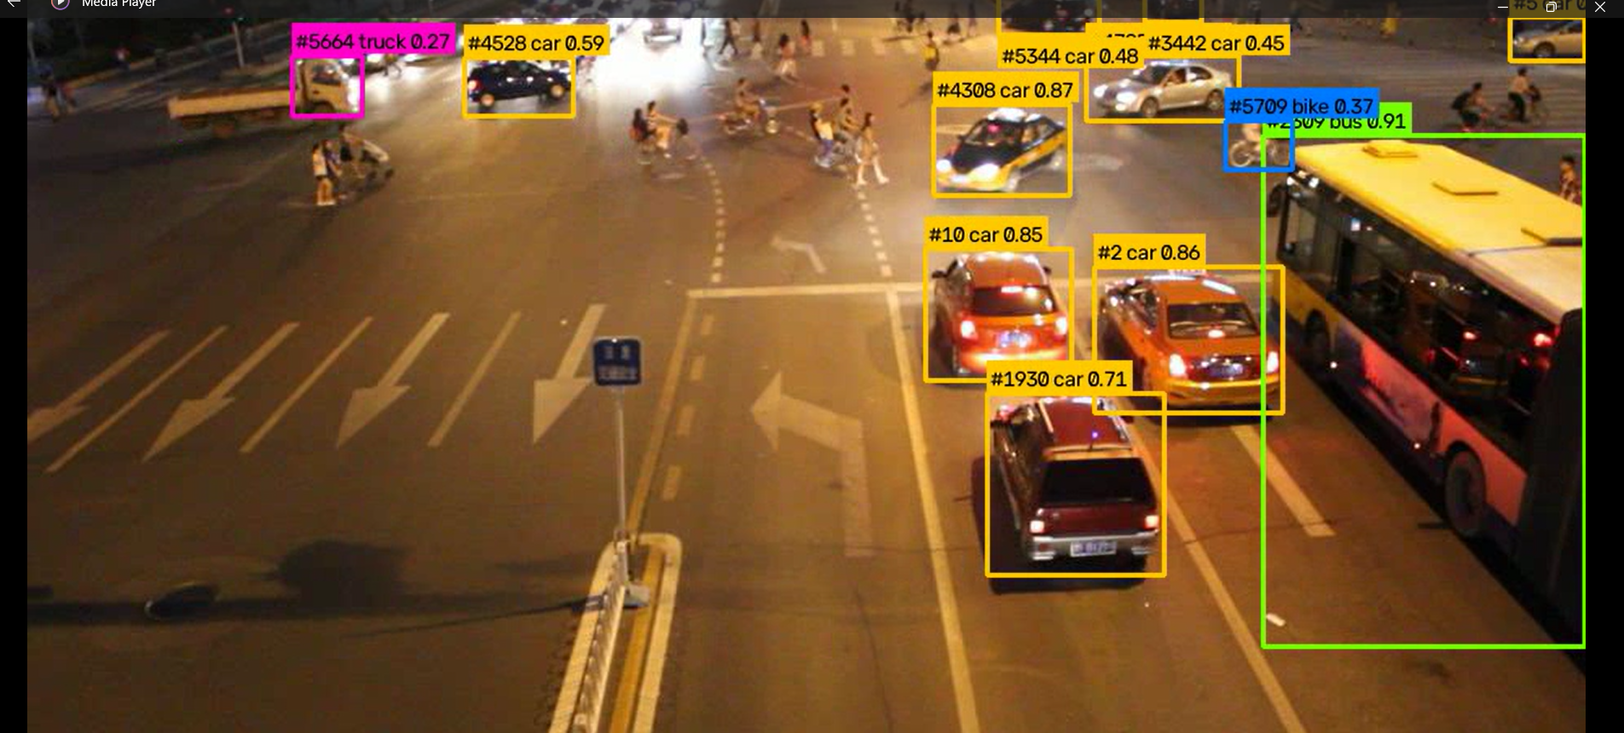
MINOR PROJECT • REVIEW 2
Sample Screenshots / Partial Results
YOLOv8 + ByteTrack output — multi-class detection with persistent vehicle IDs (car, bus, truck, bike) on live traffic footage
13
Notes:
Finish with specific commitments rather than a generic thank-you slide.
Invite the panel to approve the scope and point out the highest-risk assumption.
[Sources]
No external sources; instructional template content authored for this deck.

Slide 6
MINOR PROJECT • REVIEW 2
Way Forward Plan
During Review 3, we will deliver:
1. License Plate Recognition
Implement license plate extraction, OpenCV-based image preprocessing, OCR, and plate text validation.
2. Speed Estimation
Estimate vehicle speed using vehicle tracking information, position changes across consecutive frames, and time-based calculations.
3. Violation Detection & Fine Calculation
Implement configurable speed limits to identify overspeeding vehicles and generate rule-based fine details.
4. Integration with Vehicle Detection & Tracking Module
Integrate the OCR, speed estimation, and violation detection modules with Member 1's YOLO-based vehicle detection and tracking output for testing the combined computer vision pipeline.
13
Notes:
Finish with specific commitments rather than a generic thank-you slide.
Invite the panel to approve the scope and point out the highest-risk assumption.
[Sources]
No external sources; instructional template content authored for this deck.

