Slide 1
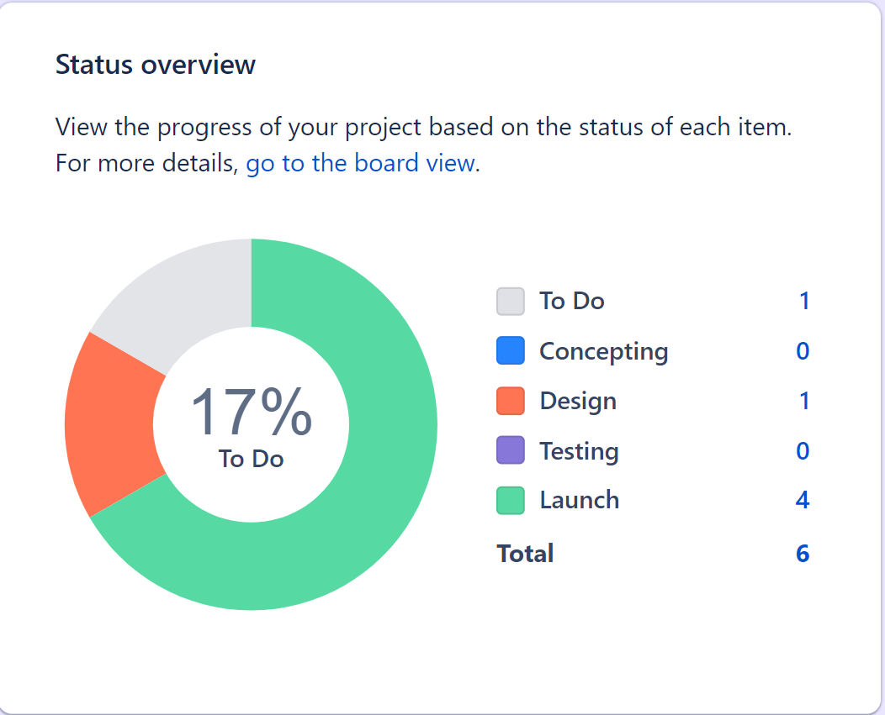
FOODIE EXPRESS
PIE CHART

Slide 2
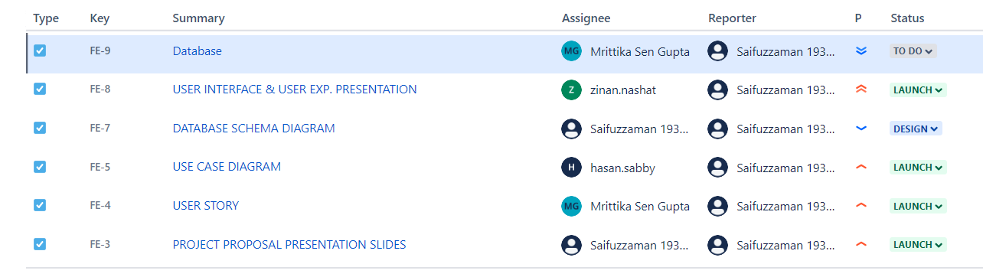
FOODIE EXPRESS
ISSUES

Slide 3
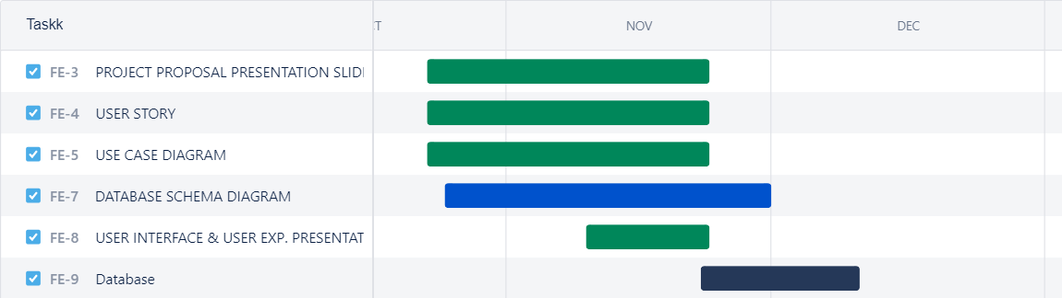
FOODIE EXPRESS
TIMELINE

