Slide 1

~ Numerical Differentiation and Integration ~
Numerical Differentiation
Chapter 23

Slide 2
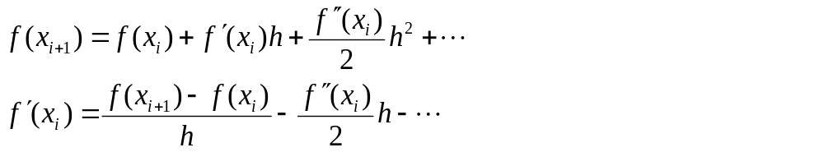
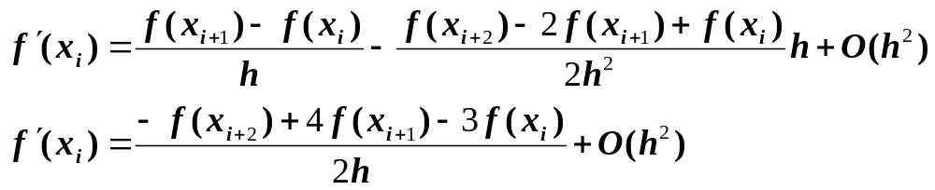
High Accuracy Differentiation Formulas
High-accuracy divided-difference formulas can be generated by including additional terms from the Taylor series expansion.
Inclusion of the 2nd derivative term has improved the accuracy to O(h²).
Similar improved versions can be developed for the backward and centered formulas

Slide 3
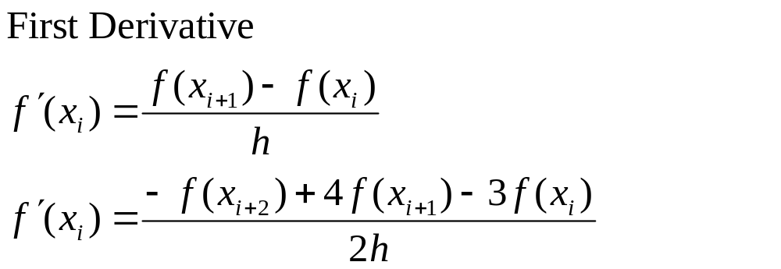
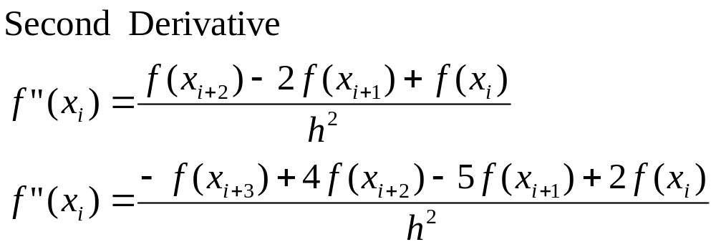
Forward finite-divided-difference formulas
Error
O(h)
O(h²)
Error
O(h)
O(h²)

Slide 4
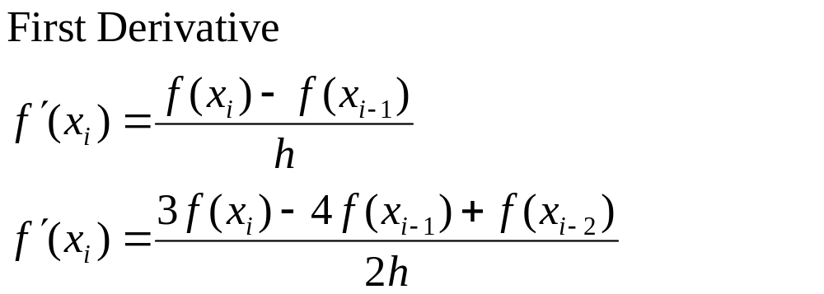
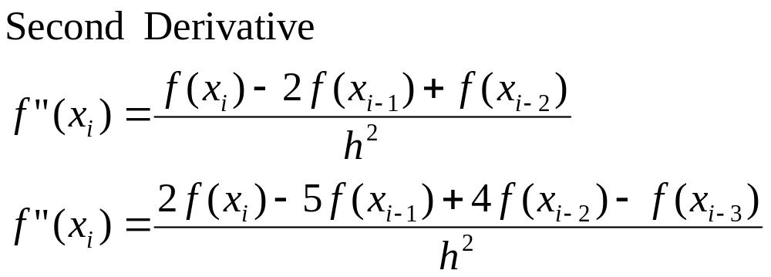
Backward finite-divided-difference formulas
Error
O(h)
O(h²)
Error
O(h)
O(h²)

Slide 5
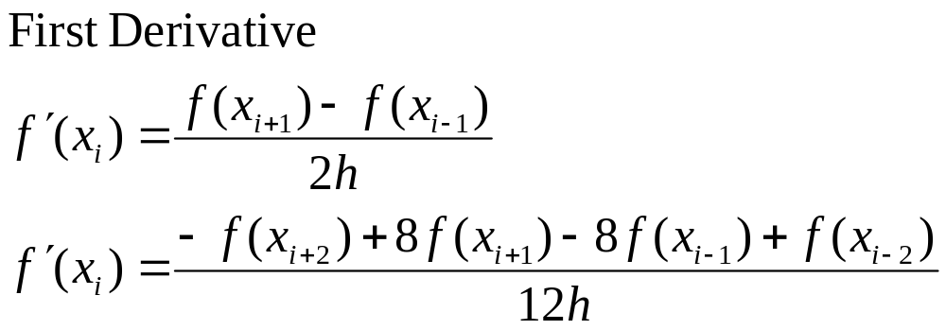
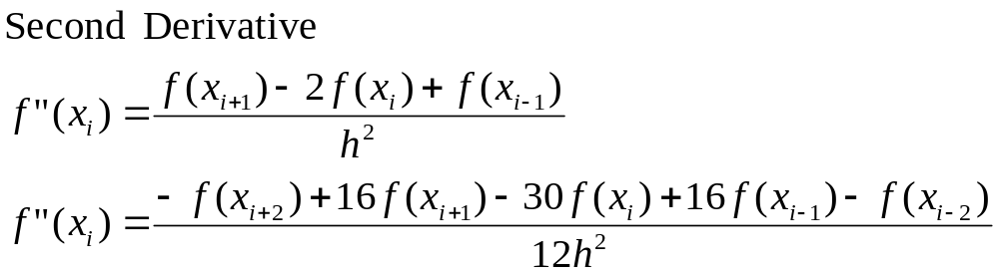
Centered finite-divided-difference formulas
Error
O(h²)
O(h⁴)
Error
O(h²)
O(h⁴)

Slide 6
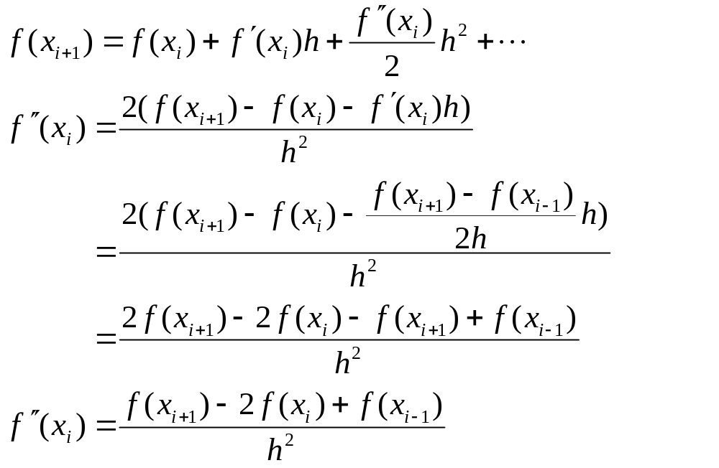
Derivation of the centered formula for f’’(x_{i})

Slide 7
Differentiation Using MATLAB
 | x | f(x)
i-2 | 0 | 1.2
i-1 | 0.25 | 1.1035
i | 0.50 | 0.925
i+1 | 0.75 | 0.6363
i+2 | 1 | 0.2
First, create a file called fx1.m which contains y=f(x):
function y = fx1(x)
y = 1.2 - .25*x - .5*x.^2 - .15*x.^3 -.1*x.^4 ;
Command window:
>> x=0:.25:1
0 0.25 0.5 0.75 1
>> y = fx1(x)
1.2 1.1035 0.925 0.6363 0.2
>> d = diff(y) ./ diff(x) % diff() takes differences between
% consecutive vector elements
d = -0.3859 -0.7141 -1.1547 -1.7453
Forward: x = 0 0.25 0.50 0.75 1
Backward: x = 0.25 0.50 0.75 1

Slide 8
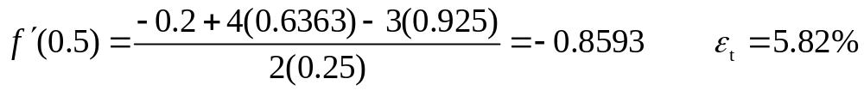
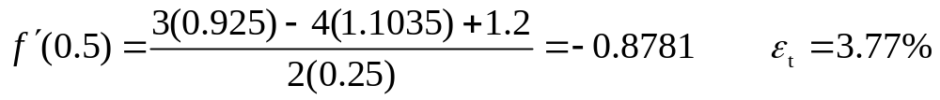
Example :
    f(x) = -0.1x⁴ – 0.15x³ – 0.5x² – 0.25x + 1.2
    f’(x) = -0.4x³ – 0.45x² – x – 0.25
At x = 0.5 True value for First Derivative = -0.9125
Using finite divided differences and a step size of h = 0.25 we obtain:
 | x | f(x)
i-2 | 0 | 1.2
i-1 | 0.25 | 1.1035
i | 0.50 | 0.925
i+1 | 0.75 | 0.6363
i+2 | 1 | 0.2
 | Forward O(h) | Backward O(h)
Estimate | -1.155 | -0.714
ε_{t} (%) | 26.5 | 21.7
Forward difference of accuracy O(h²) is computed as:
Backward difference of accuracy O(h²) is computed as:

Slide 9
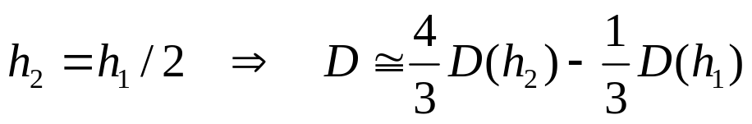
Richardson Extrapolation
There are two ways to improve derivative estimates when employing finite divided differences:
  Decrease the step size, or
  Use a higher-order formula that employs more points.
A third approach, based on Richardson extrapolation, uses two derivative estimates (with O(h²) error) to compute a third (with O(h⁴) error) , more accurate approximation. We can derive this formula following the same steps used in the case of the integrals:
Example: using the previous example and Richardson’s formula, estimate the first derivative at x=0.5 Using Centered Difference approx. (with error O(h²)) with h=0.5 and h=0.25 :
D_{h=0.5}(x=0.5) = (0.2-1.2)/1 = -1 [ ε_{t}=|(-.9125+1)/-.9125| = 9.6% ]
D_{h=0.25}(x=0.5) = (0.6363-1.103)/0.5=-0.9343 [ ε_{t}=|(-.9125+0.9343)/-.9125| = 2.4%]
The improved estimate is:
D = 4/3(-0.9343) – 1/3(-1) = -0.9125 [ ε_{t}=(-.9125+.9125)/-.9125 = 0% ➔ perfect!]

Slide 10
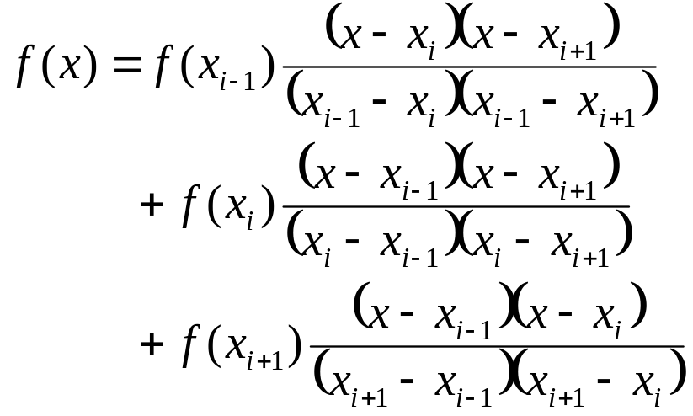
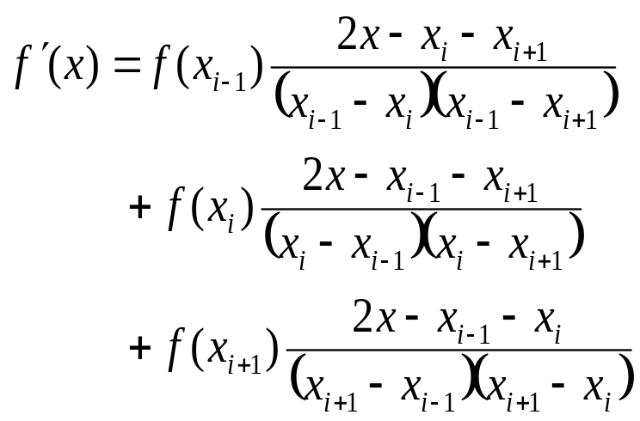
Derivatives of Unequally Spaced Data
Derivation formulas studied so far (especially the ones with O(h²) error) require multiple points to be spaced evenly.
Data from experiments or field studies are often collected at unequal intervals.
Fit a Lagrange interpolating polynomial, and then calculate the 1st derivative.
As an example, second order Lagrange interpolating polynomial is used below:
*Note that any three points, x_{i-1} x_{i} and x_{i+1} can be used to calculate the derivative. The points do not need to be spaced equally.

Slide 11
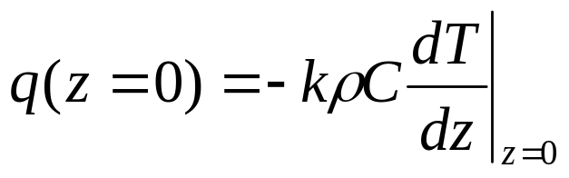
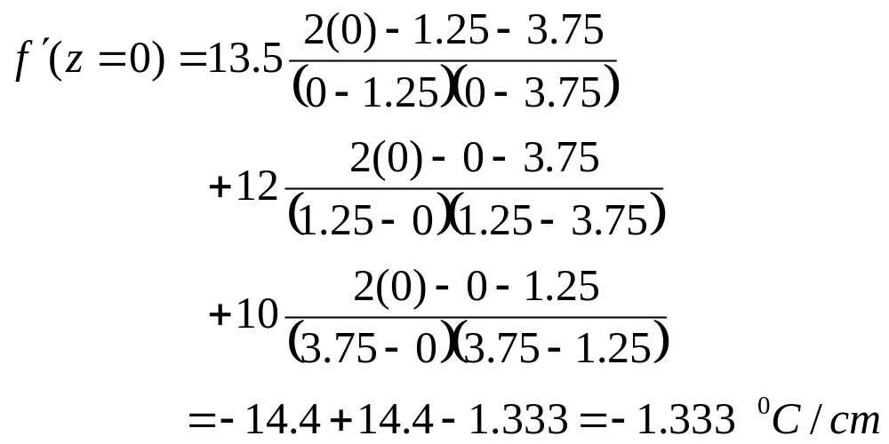
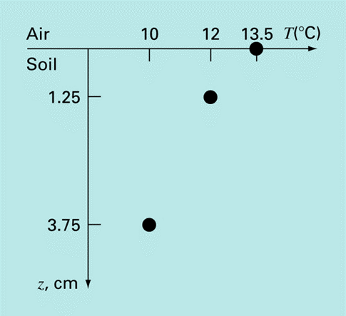
Example:
The heat flux at the soil-air interface can be computed with Fourier’s Law: q = heat flux k = coefficient of thermal diffusivity in soil (≈3.5x10⁻⁷ m²/s) ρ = soil density(≈ 1800 kg/m³) C = soil specific heat(≈ 840 J/kg . Cº)
*Positive flux value means heat is transferred from the air to the soil
Calculate dT/dz (z=0) first and then and determine the heat flux.
A temperature gradient can be measured down into the soil as shown below.
MEASUREMENTS
which can be used to compute the heat flux at z=0:
q(z=0) = -3.5x10⁻⁷(1800)(840)(-133.3 ⁰C/m)=70.56 W/m²

