Slide 1

~ Numerical Differentiation and Integration ~
Newton-Cotes Integration Formulas
Chapter 21

Slide 2
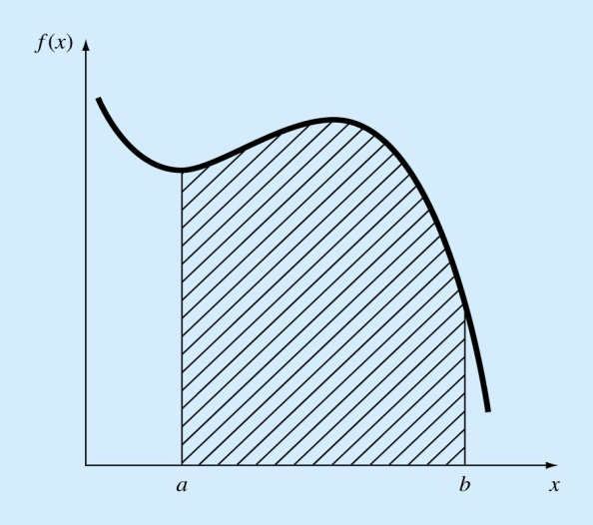
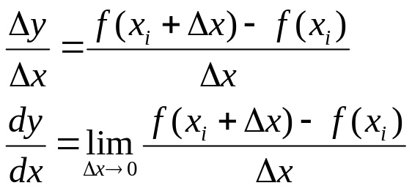
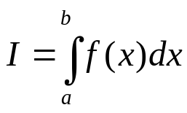
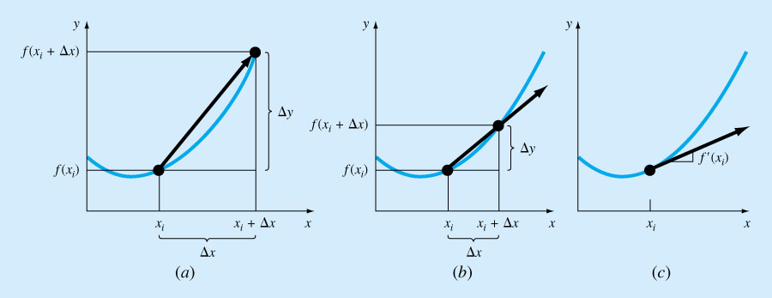
Calculus is the mathematics of change. Since engineers continuously deal with systems and processes that change, calculus is an essential tool of engineering.
Standing at the heart of calculus are the concepts of:
Differentiation
and Integration

Slide 3
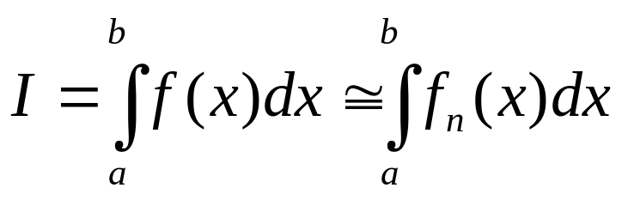
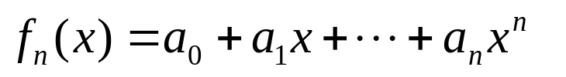
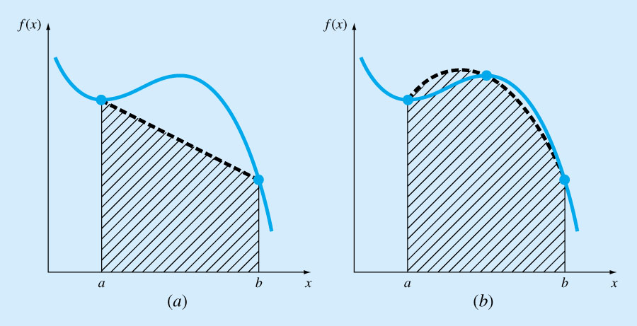

Newton-Cotes Integration Formulas
Based on the strategy of replacing a
complicated function or tabulated data
with an approximating function that is
easy to integrate:
Zero order approximation First-order Second-order

Slide 4
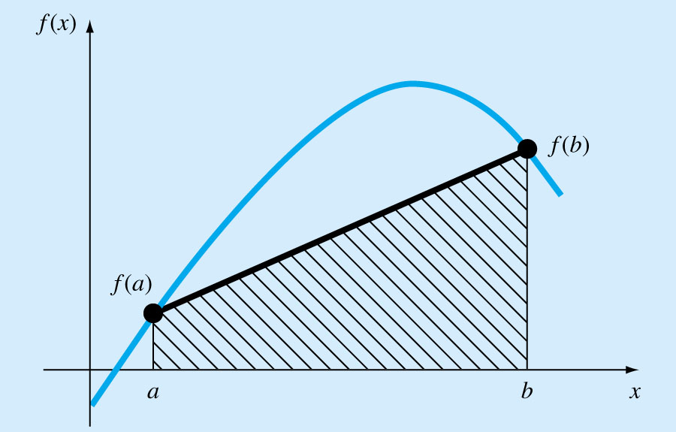
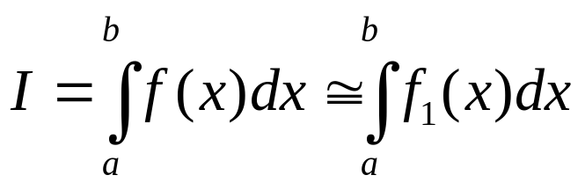
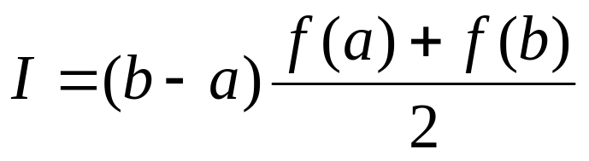
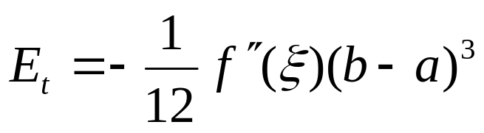
The Trapezoidal Rule
Use a first order polynomial in approximating the function f(x) :
The area under this first order polynomial is an estimate of the integral of f(x) between a and b:
Trapezoidal rule
Error:
where ξ lies somewhere in the interval from a to b

Slide 5
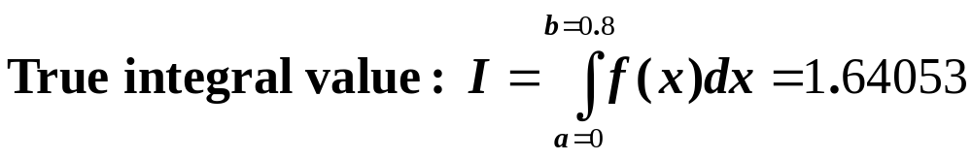
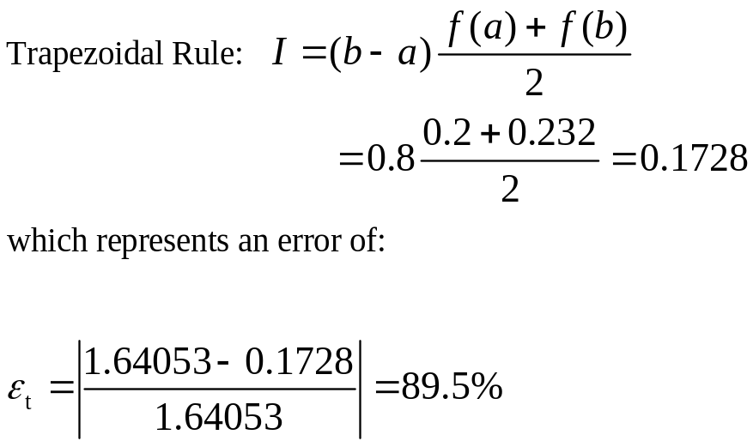
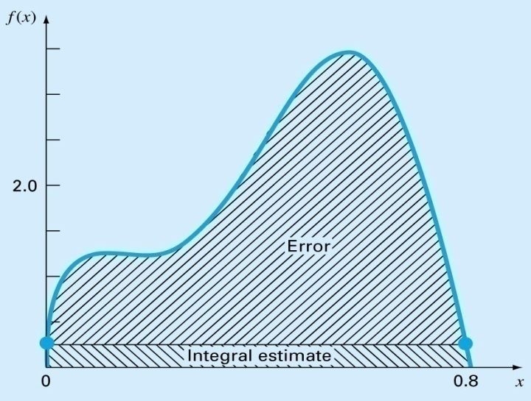
Example 21.1 Single Application of the Trapezoidal Rule f(x) = 0.2 +25x – 200x² + 675x³ – 900x⁴ + 400x⁵
Integrate f(x) from a=0 to b=0.8
Solution: f(a)=f(0) = 0.2 and f(b)=f(0.8) = 0.232

Slide 6
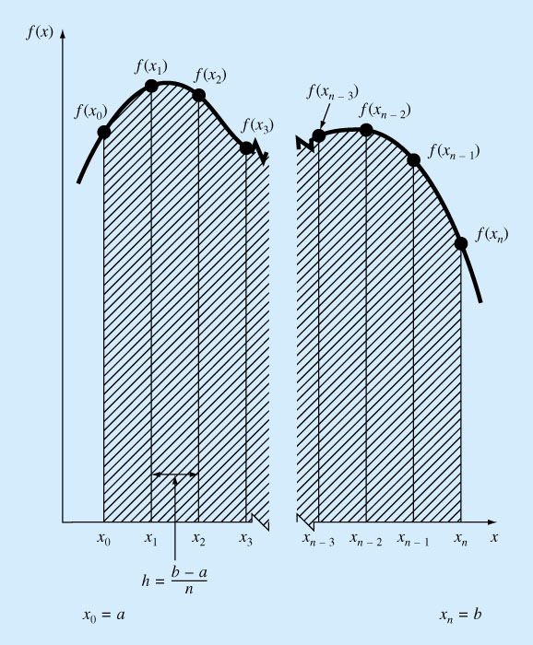
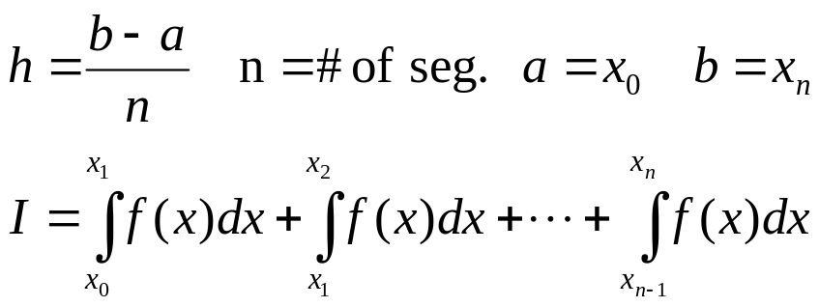
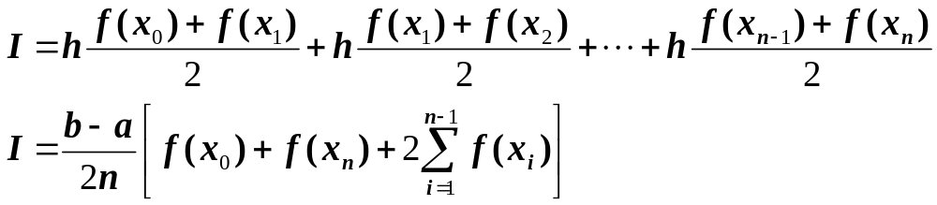
The Multiple-Application Trapezoidal Rule
The accuracy can be improved by dividing the interval from a to b into a number of segments and applying the method to each segment.
The areas of individual segments are added to yield the integral for the entire interval.
Using the trapezoidal rule, we get:

Slide 7
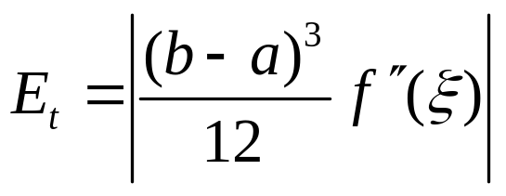
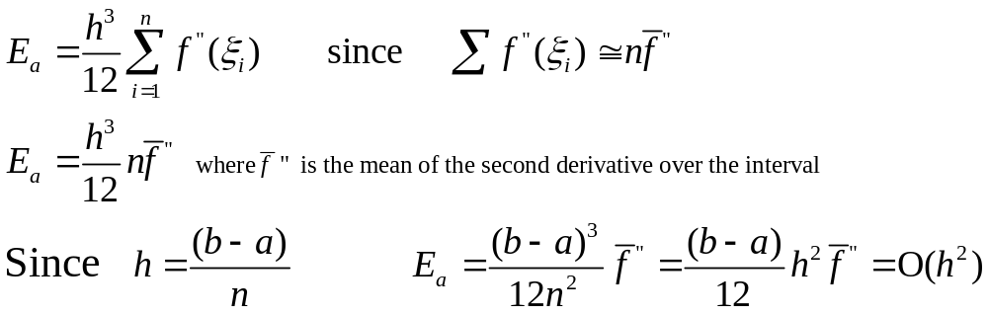
The Error Estimate for
The Multiple-Application Trapezoidal Rule
Error estimate for one segment is given as:
An error for multiple-application trapezoidal rule can be obtained by summing the individual errors for each segment:
Thus, if the number of segments is doubled,
the truncation error will be quartered.

Slide 8
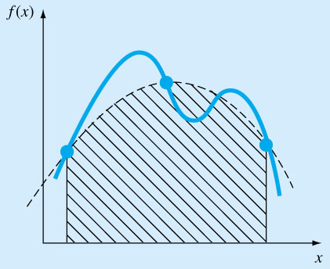
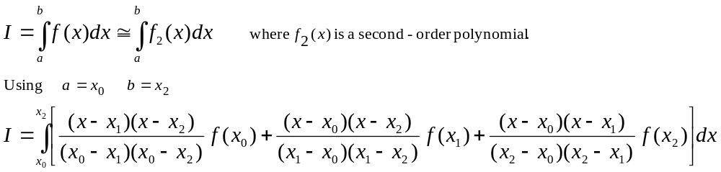
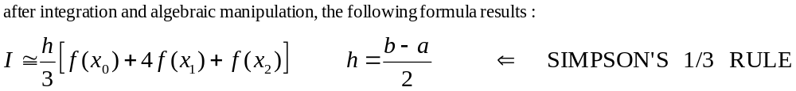
Simpson’s Rules
More accurate estimate of an integral is obtained if a high-order polynomial is used to connect the points. These formulas are called Simpson’s rules.
Simpson’s 1/3 Rule: results when a 2nd order Lagrange interpolating polynomial is used for f(x)
a=x₀ x₁ b=x₂

Slide 9
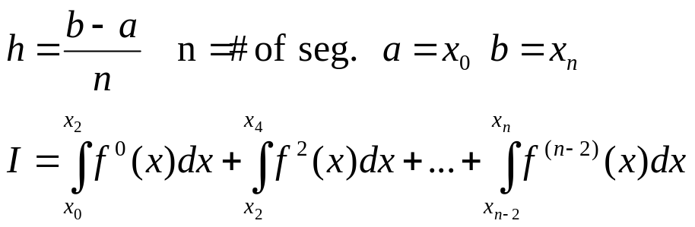
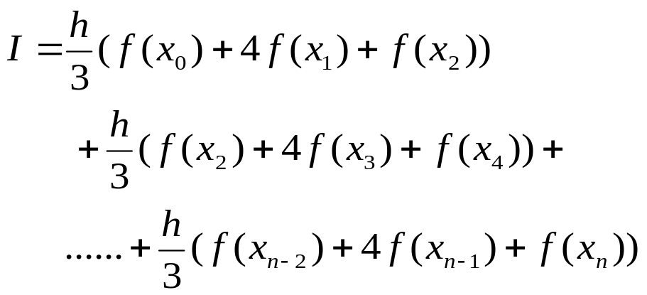
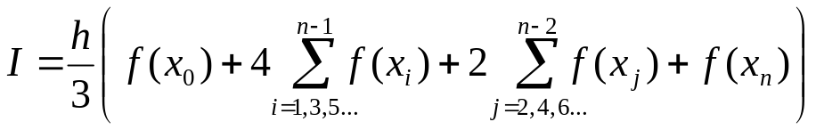
The Multiple-Application Simpson’s 1/3 Rule
Just as the trapezoidal rule, Simpson’s rule can be improved by dividing the integration interval into a number of segments of equal width.
However, it is limited to cases where values are equispaced, there are an even number of segments and odd number of points.

Slide 10
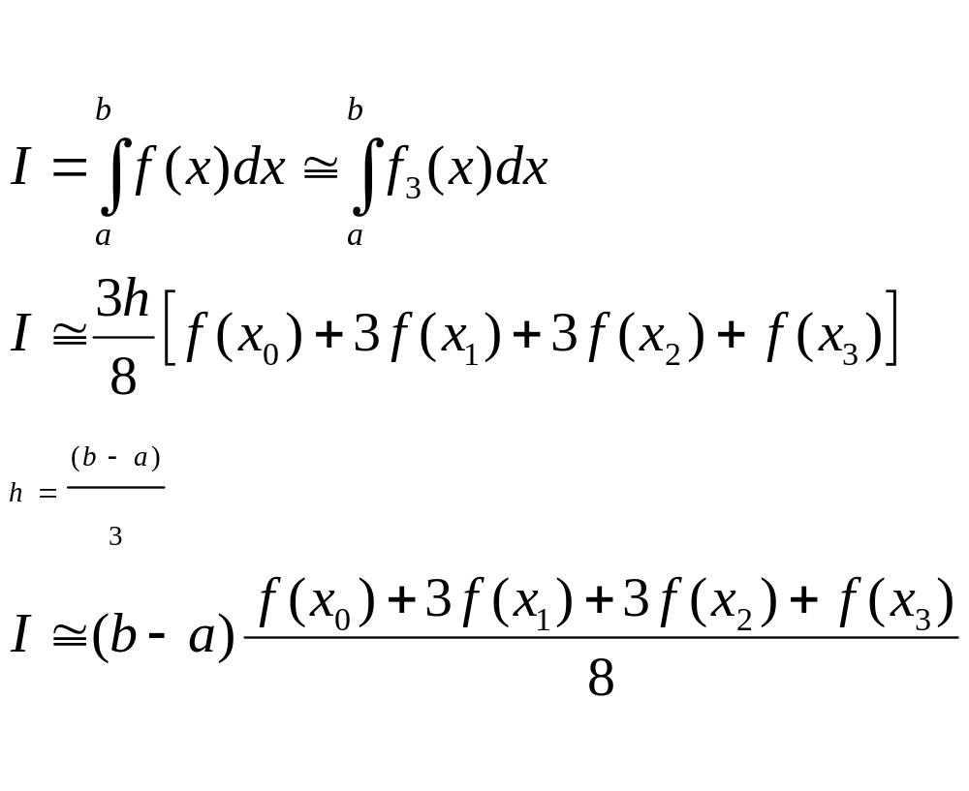
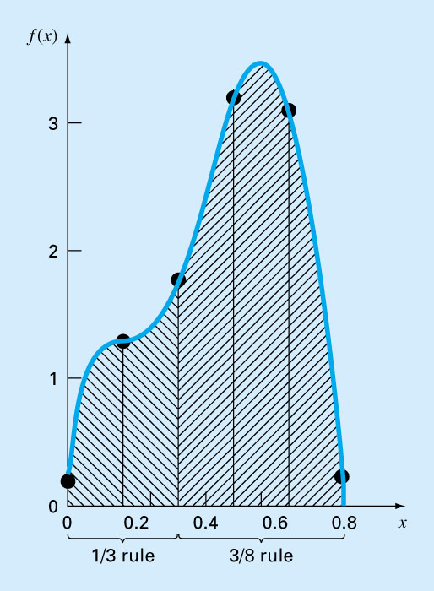
*here Simpson’s 3/8 Rule
Fit a 3rd order Lagrange interpolating polynomial to four points and integrate
Simpson’s 1/3 and 3/8 rules can be applied in tandem to handle multiple applications with odd number of intervals

Slide 11
Newton-Cotes Closed Integration Formulas
Points | Name | Formula | Truncation Error
2 | Trapezoidal | (b-a) * (f(x₀)+ f(x₁))/2 | (1/12)(b-a)³f”(ξ)
3 | Simpson’s 1/3 | (b-a) * (f(x₀)+ 4f(x₁)+f(x₂))/6 | (1/2880)(b-a)⁵f⁽⁴⁾(ξ)
4 | Simpson’s 3/8 | (b-a) * (f(x₀)+ 3f(x₁)+ 3f(x₂)+ f(x₃))/8 | (1/6480)(b-a)⁵f⁽⁴⁾(ξ)
5 | Boole’s | (b-a) * (7f(x₀) + 32f(x₁) + 12f(x₂) + 32f(x₃) + 7f(x₄))/90 | proportional with (b-a)⁷
Same order,
but Simpson’s 3/8 is more accurate
In engineering practice, higher order (greater than 4-point) formulas are rarely used

Slide 12
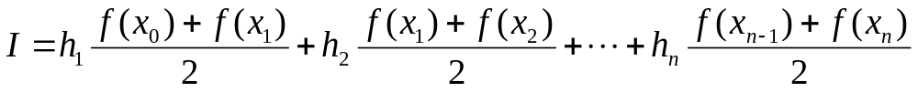
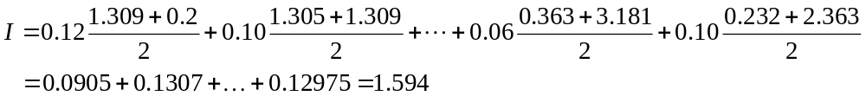
Integration with Unequal Segments
Using Trapezoidal Rule
Example 21.7
which represents a relative error of ε = 2.8%
x | f(x) | x | f(x)
0.0 | 0.2 | 0.44 | 2.842
0.12 | 1.309 | 0.54 | 3.507
0.22 | 1.305 | 0.64 | 3.181
0.32 | 1.743 | 0.70 | 2.363
0.36 | 2.074 | 0.80 | 0.232
0.40 | 2.456
Data for
f(x)= 0.2+25x-200x²+675x³-900x⁴+400x⁵

Slide 13
Compute Integrals Using MATLAB
x | f(x) | x | f(x)
0.0 | 0.2 | 0.44 | 2.842
0.12 | 1.309 | 0.54 | 3.507
0.22 | 1.305 | 0.64 | 3.181
0.32 | 1.743 | 0.70 | 2.363
0.36 | 2.074 | 0.80 | 0.232
0.40 | 2.456
First, create a file called fx.m which contains f(x):
function y = fx(x)
y = 0.2+25*x-200*x.^2+675*x.^3-900*x.^4+400*x.^5 ;
Then, execute in the command window:
>> Q=integral('fx', 0, 0.8) % true integral
Or
>> Q=quad('fx', 0, 0.8) % true integral
Q =1.6405 ⬅ true value
>> x=[0 .12 .22 .32 .36 .4 .44 .54 .64 .7 .8]
>> y = fx(x)
y = 0.200 1.309 1.305 1.743 2.074 2.456
2.843 3.507 3.181 2.363 0.232
>> I = trapz(x,y) % or trapz(x, fx(x))
Integral =1.5948
Demo: (how I changes wrt n) + (0th order approx. With large n).

