Slide 1

~ Numerical Differentiation and Integration ~
Integration of Equations
Chapter 22
Credit: Prof. Lale Yurttas, Chemical Eng., Texas A&M University

Slide 2
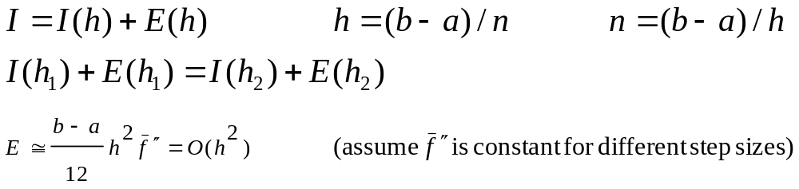
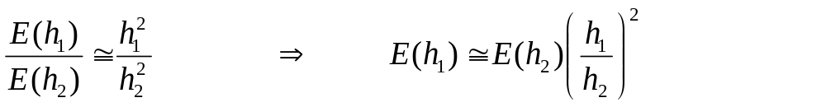
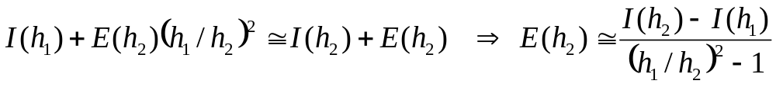
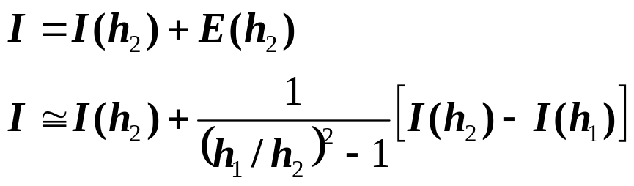
Romberg Integration
Successive application of the trapezoidal rule to attain efficient numerical integrals of functions.
Richardson’s Extrapolation: In numerical analysis, Richardson extrapolation is a
sequence acceleration method, used to improve the rate of convergence of a sequence.
Here we use two estimates of an integral to compute a third and more accurate approximation.
I = exact value of integral E(h) = the truncation error
I(h): trapezoidal rule (n segments, step size h)
Improved estimate of the integral. It is shown that the error of this estimate is O(h⁴). Trapezoidal rule had an error estimate of O(h²).

Slide 3

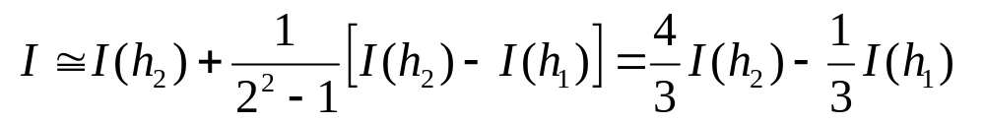

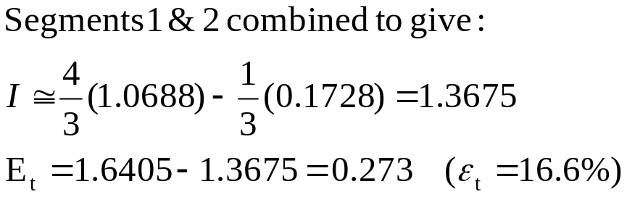
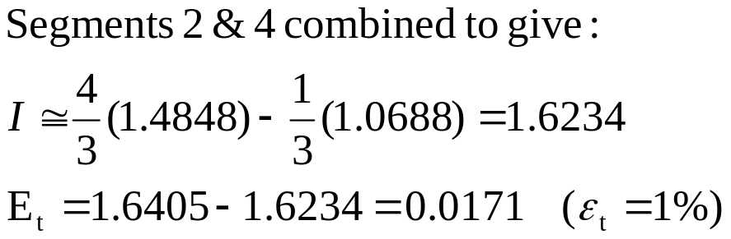
Example
Evaluate the integral of f(x) = 0.2 +25x – 200x² + 675x³ – 900x⁴ + 400x⁵
from a=0 to b=0.8. I (True Integral value) = 1.6405
Segments | h | Integral | ε_{tr}%
1 | 0.8 | 0.1728 | 89.5
2 | 0.4 | 1.0688 | 34.9
4 | 0.2 | 1.4848 | 9.5
In each case, two estimates with error O(h²) are combined to give a third estimate with error O(h⁴)

Slide 4
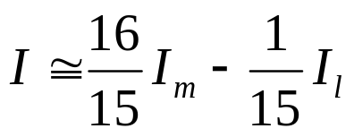
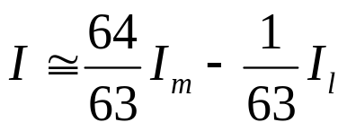
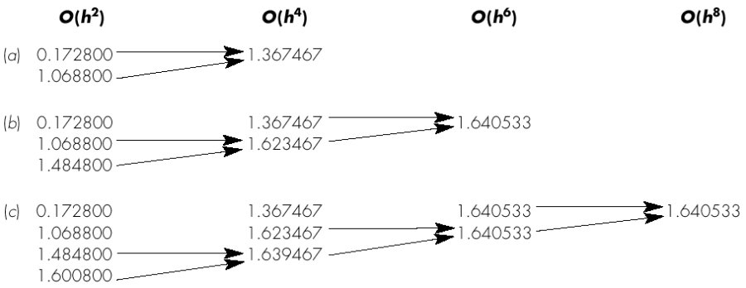
In Example 22.1, we computed two improved estimates of O(h⁴). These two estimates can, in turn, be combined to yield an even better value with error O(h⁶).
For the special case where the original trapezoidal estimates are based on successive halving of the step size, the equation used for O(h⁶) accuracy is:
where I_{m} and I_{l} are more and less accurate estimates
Similarly, two O(h⁶) estimates can be combined to compute an I that is O(h⁸).

Slide 5
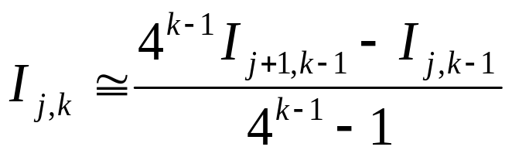
The Romberg Integration Algorithm
k=1 refers to trapezoidal rule, hence O(h²) accuracy.
k=2 refers to O(h⁴) and k=3 ➔ O(h⁶)
Index j is used to distinguish between the more (j+1) and the less (j) accurate estimates.

