Slide 1
Airline Management System:
Class Diagram & ERD
1505066
1505071
1505077

Slide 2
Our Subsystems
We have total 5 subsystems
User Registration and Login System
Flight Booking System
Crew Management System
Flight Schedule System
Human Resources

Slide 3
Today
We will demonstrate 3 subsystems

Slide 4
Flight Booking System

Slide 5
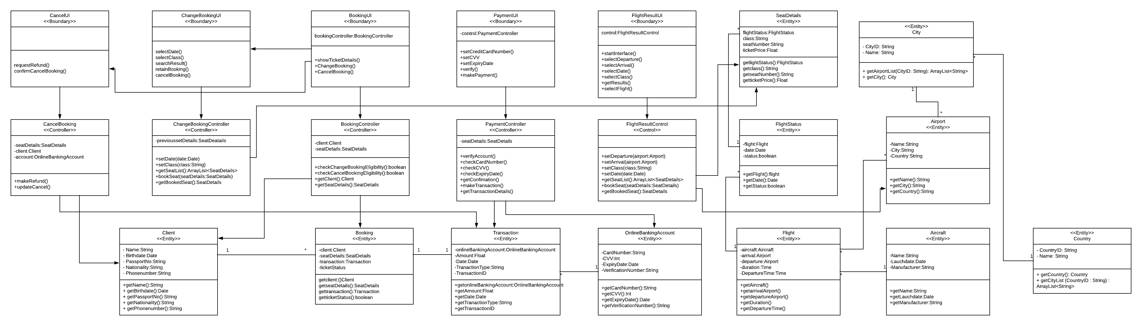
Complete Class Diagram

Slide 6
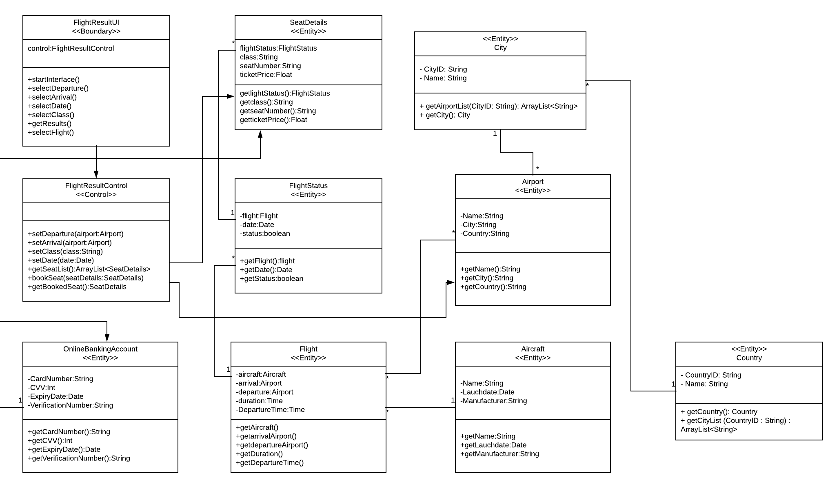
Check Booking

Slide 7
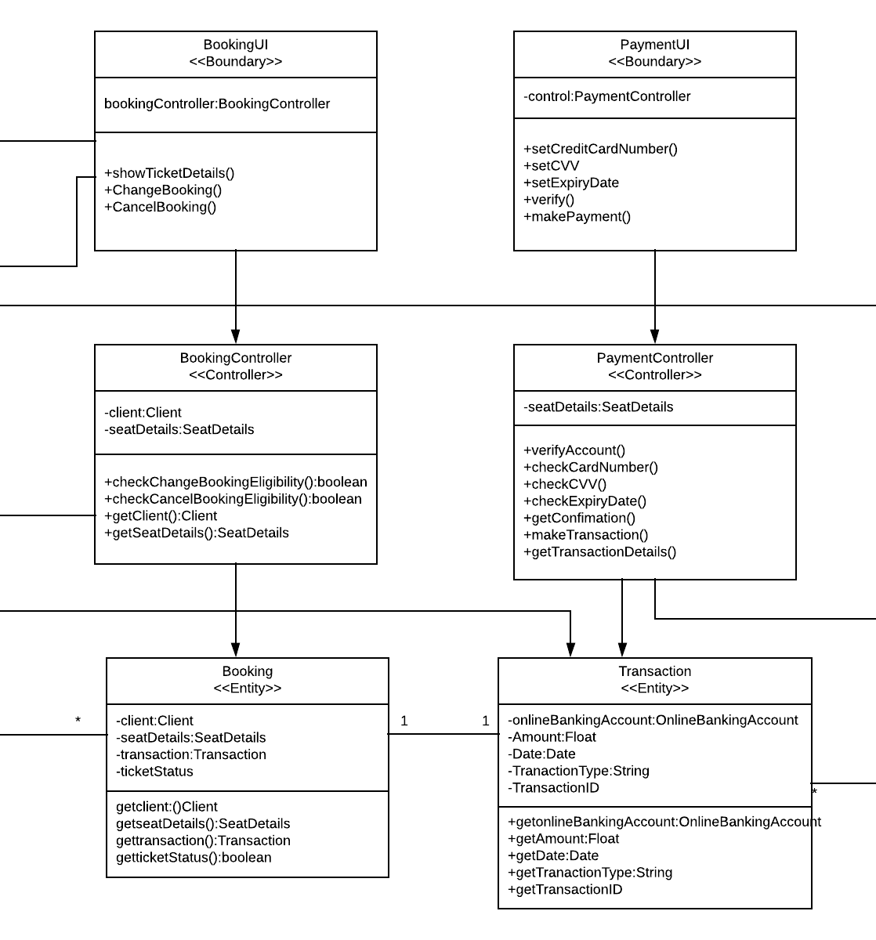
Payment

Slide 8
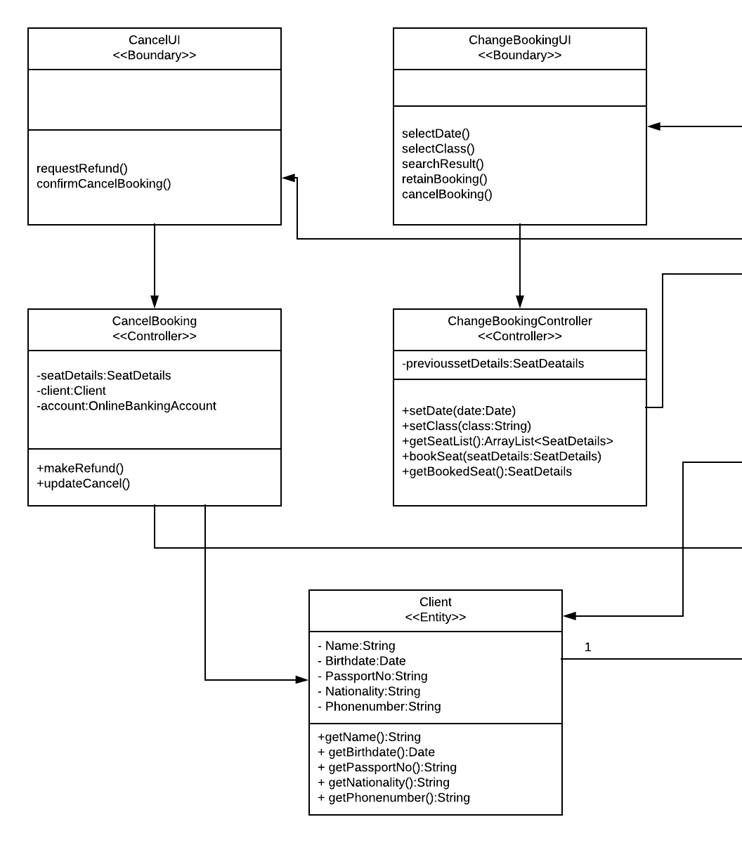
Change and Cancel after Booking

Slide 9
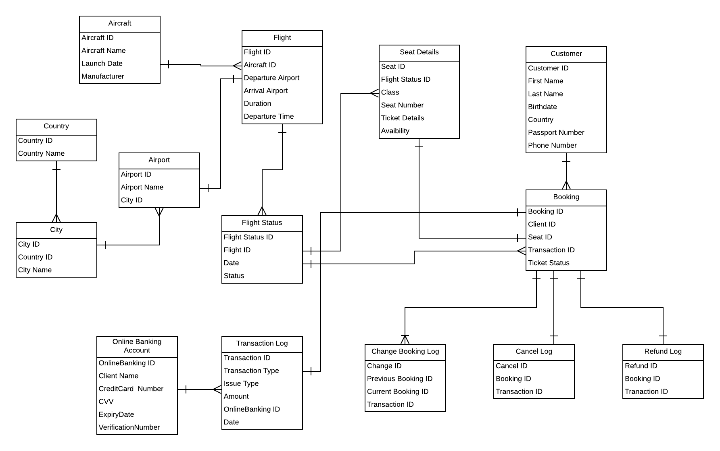
ERD of Flight Booking System

Slide 10
Crew Management

Slide 11
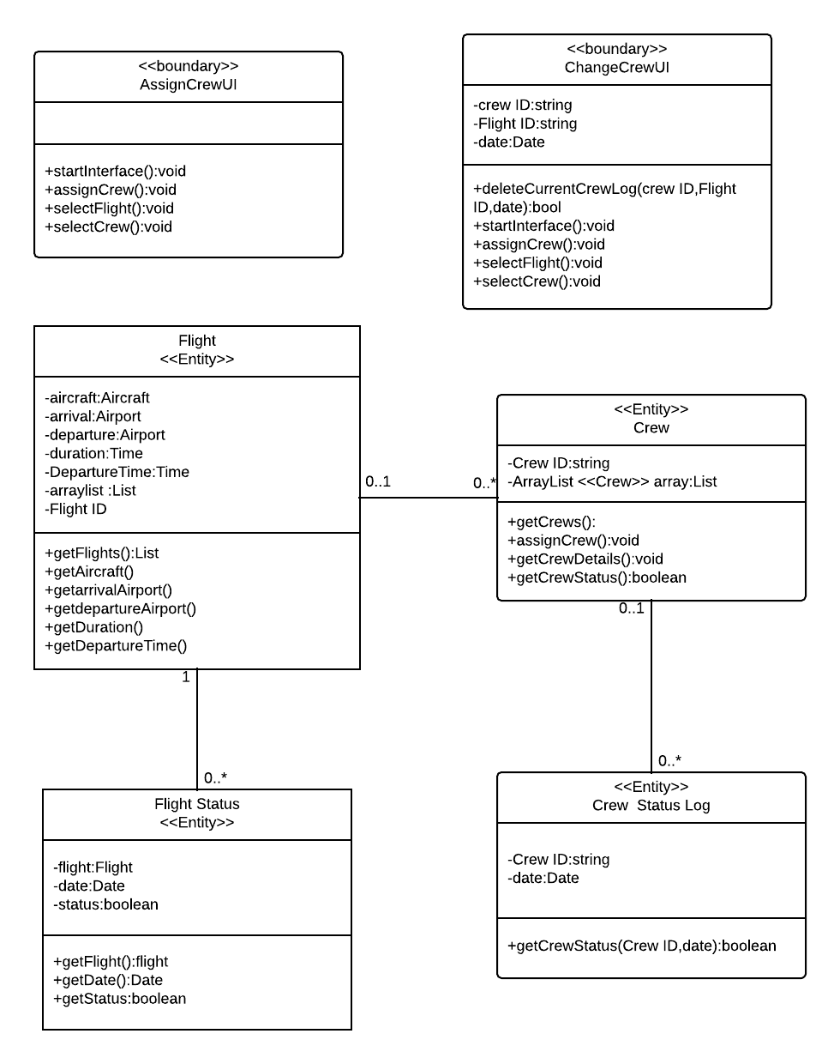
Class Diagram

Slide 12
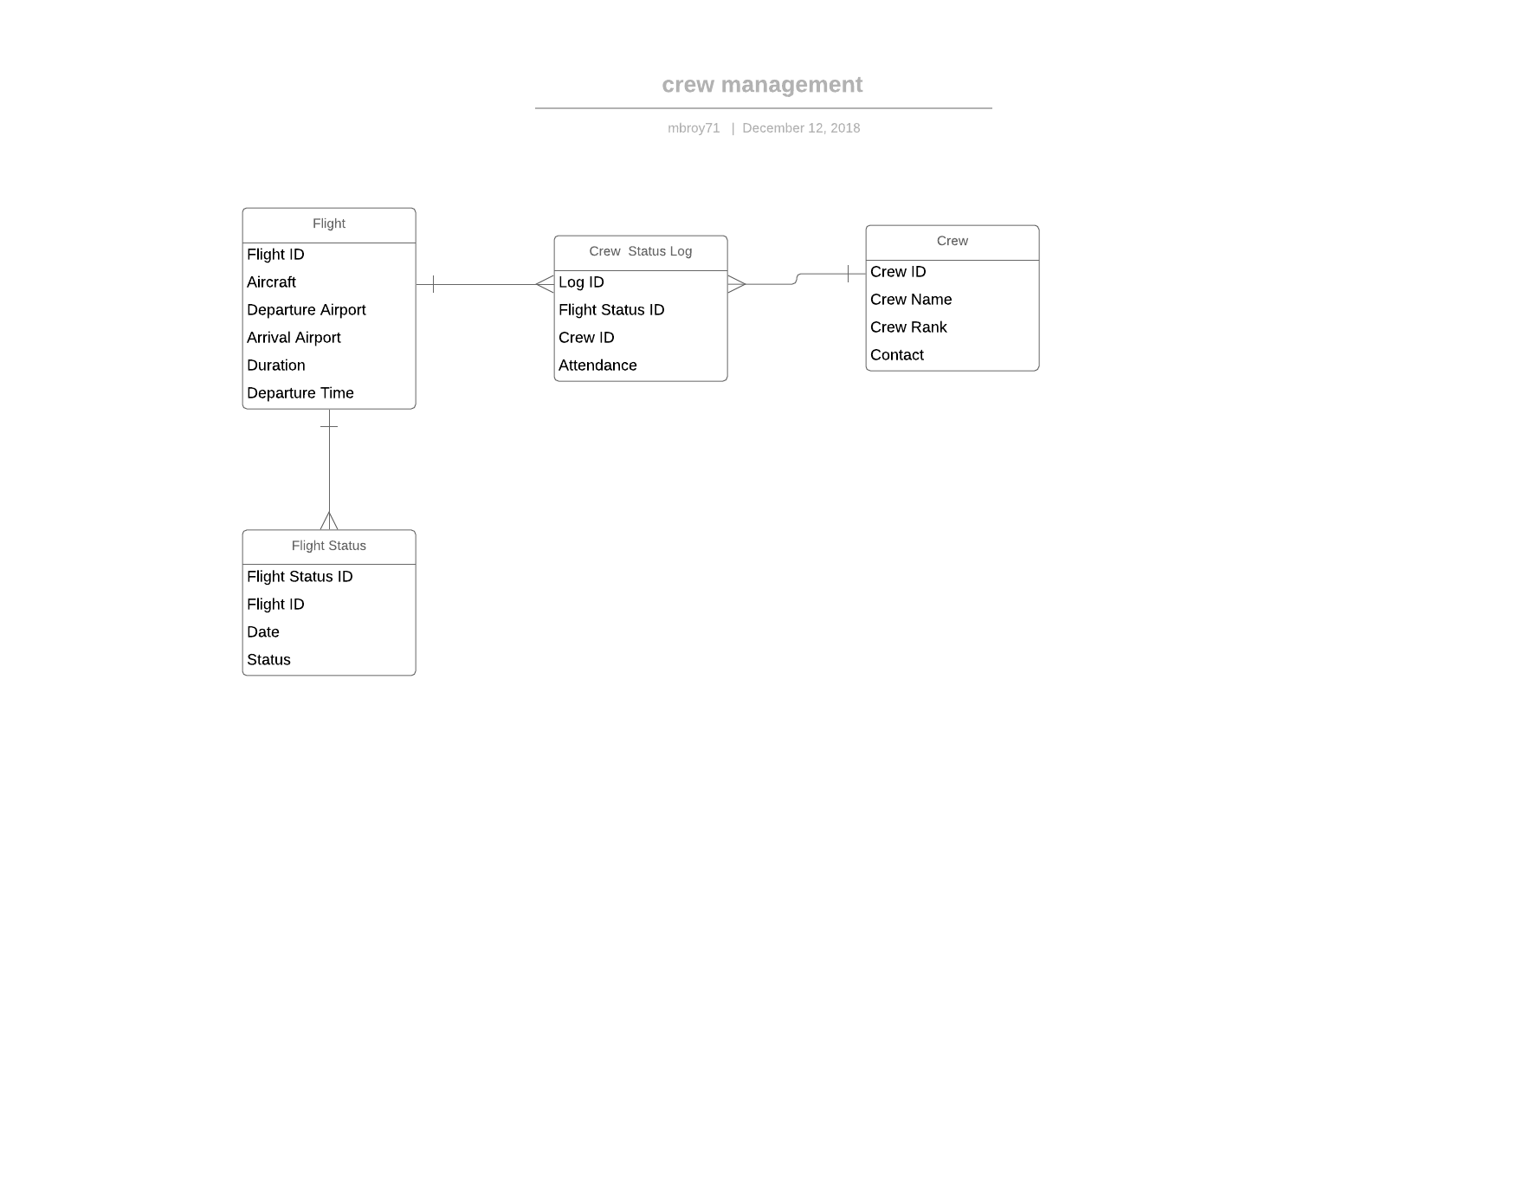
ERD

Slide 13
Flight Schedule System

Slide 14
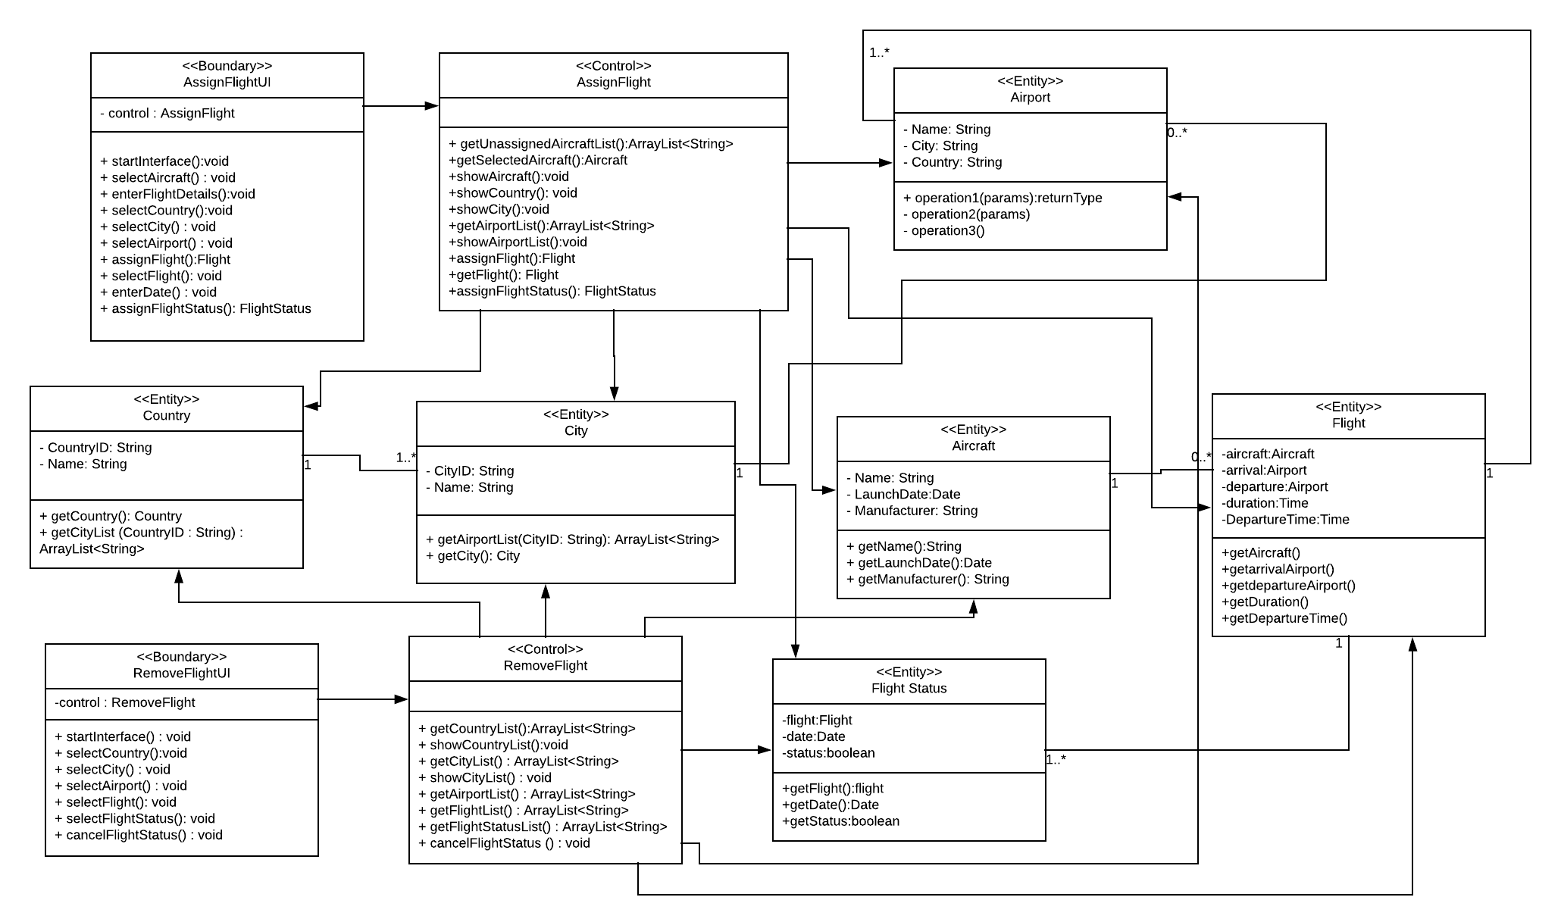

Slide 15
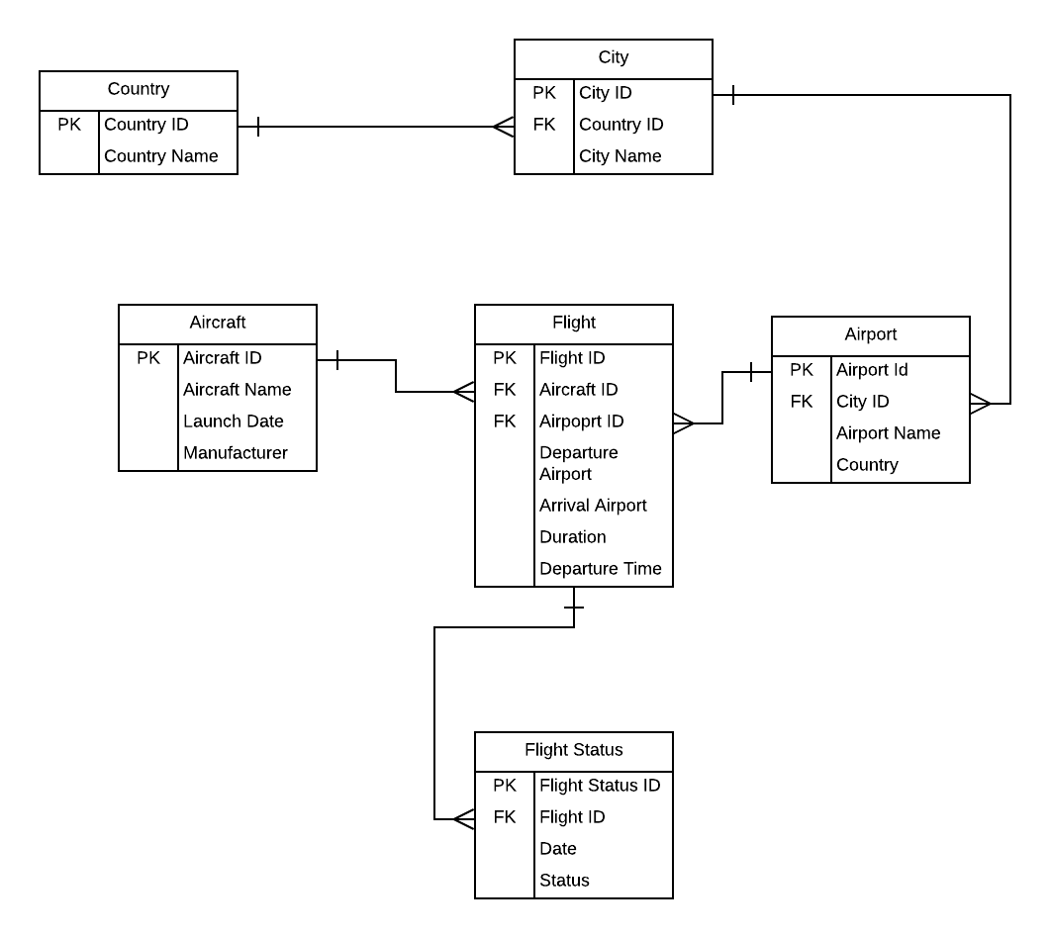

Slide 16
Any Questions?

