Slide 1
Cuckoo search algorithm

Slide 2


Cuckoo search algorithm
A method of global optimization based on the behavior of cuckoos was proposed by Yang & Deb (2009).
The original “cuckoo search (CS) algorithm” is based on the idea of the following :-
How cuckoos lay their eggs in the host nests.
How, if not detected and destroyed, the eggs are hatched to chicks by the hosts.
How a search algorithm based on such a scheme can be used to find the global optimum of a function.

Slide 3
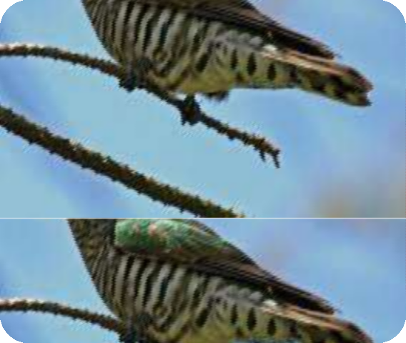

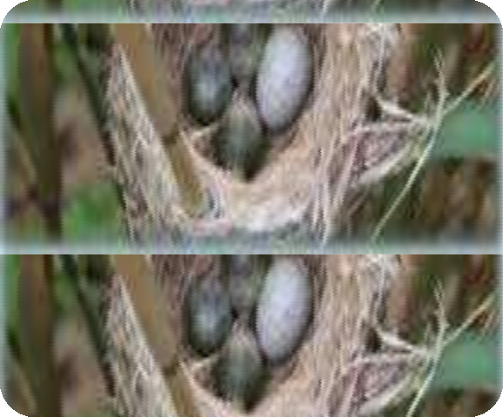

Behavior of Cuckoo breeding
The CS was inspired by the obligate brood parasitism of some cuckoo species by laying their eggs in the nests of host birds.
Some cuckoos have evolved in such a way that female parasitic cuckoos can imitate the colors and patterns of the eggs of a few chosen host species.
This reduces the probability of the eggs being abandoned and, therefore, increases their reproductivity .

Slide 4
If host birds discover the eggs are not their own, they will either throw them away or simply abandon their nests and build new ones.
Parasitic cuckoos often choose a nest where the host bird just laid its own eggs.
In general, the cuckoo eggs hatch slightly earlier than their host eggs.

Slide 5
Once the first cuckoo chick is hatched, his first instinct action is to evict the host eggs by blindly propelling the eggs out of the nest.
This action results in increasing the cuckoo chick’s share of food provided by its host bird .
Moreover, studies show that a cuckoo chick can imitate the call of host chicks to gain access to more feeding opportunity.

Slide 6
Characteristics of Cuckoo search
Each egg in a nest represents a solution, and a cuckoo egg represents a new solution.
The aim is to employ the new and potentially better solutions (cuckoos) to replace not-so-good solutions in the nests.
In the simplest form, each nest has one egg.
The algorithm can be extended to more complicated cases in which each nest has multiple eggs representing a set of solutions

Slide 7
The CS is based on three idealized rules:
Each cuckoo lays one egg at a time, and dumps it in a randomly chosen nest
The best nests with high quality of eggs (solutions) will carry over to the next generations
The number of available host nests is fixed, and a host can discover an alien egg with probability p ϵ [0,1] .
In this case, the host bird can either throw the egg away or abandon the nest to build a completely new nest in a new location.

Slide 8
Lѐvy Flights
In nature, animals search for food in a random or quasi-random manner.
Generally, the foraging path of an animal is effectively a random walk because the next move is based on both the current location/state and the transition probability to the next location.
The chosen direction implicitly depends on a probability, which can be modeled mathematically.

Slide 9
A Lévy flight is a random walk in which the step-lengths are distributed according to a heavy-tailed probability distribution.
After a large number of steps, the distance from the origin of the random walk tends to a stable distribution.

Slide 10
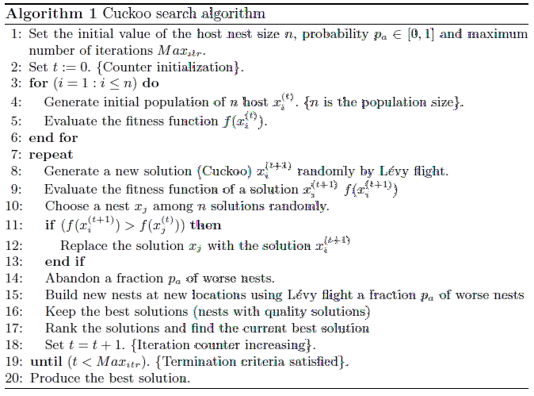
Cuckoo search Algorithm

Slide 11
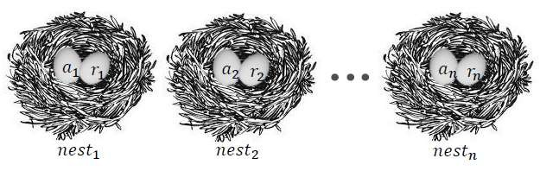
The following steps describe the main concepts of Cuckoo search algorithm
Step1. Generate initial population of n host nests.
(𝑎𝑖,𝑟𝑖) : a candidate for optimal parameters

Slide 12
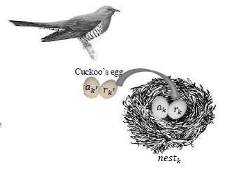
Step2. Lay the egg (𝑎𝑘′,𝑏𝑘′) in the k nest.
K nest is randomly selected.
Cuckoo’s egg is very similar to host egg. Where
𝑎𝑘′=𝑎𝑘+𝑅𝑎𝑛𝑑𝑜𝑚𝑤𝑎𝑙𝑘(Lѐvy flight)𝑎𝑘
𝑟𝑘′=𝑟𝑘+𝑅𝑎𝑛𝑑𝑜𝑚𝑤𝑎𝑙𝑘(Lѐvy flight)𝑟𝑘

Slide 13
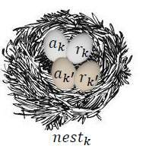
Step3. Compare the fitness of cuckoo’s egg with the fitness of the host egg.
Root Mean Square Error (RMSE)

Slide 14

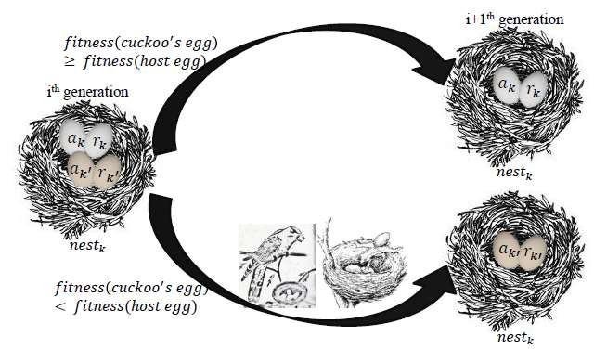
Step4. If the fitness of cuckoo’s egg is better than host egg, replace the egg in nest k by cuckoo’s egg.

Slide 15
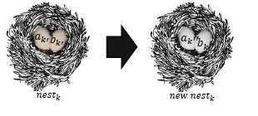
Step5. If host bird notice it, the nest is abandoned and new one is built. (p <0.25) (to avoid local optimization)
Iterate steps 2 to 5 until termination criterion satisfied

Slide 16
Application of the CS Algorithm
Engineering optimization problems
NP hard combinatorial optimization problems
Data fusion in wireless sensor networks
Nanoelectronic technology based operation-amplifier
(OP-AMP)
Train neural network
Manufacturing scheduling
Nurse scheduling problem

