Slide 1
Genetic Algorithms
Notes:
‹#›

Slide 2
What is GA
A genetic algorithm (or GA) is a search technique used in computing to find true or approximate solutions to optimization and search problems.
Genetic algorithms are categorized as global search heuristics.
Genetic algorithms are a particular class of evolutionary algorithms that use techniques inspired by evolutionary biology such as inheritance (acquired characteristics), mutation (alteration or change), selection (choosing), and crossover (also called recombination).
Notes:
‹#›

Slide 3
What is GA
Genetic algorithms are implemented as a computer simulation in which a population of abstract representations (called chromosomes or the genotype or the genome) of candidate solutions (called individuals, creatures, or phenotypes) to an optimization problem evolves toward better solutions.
Traditionally, solutions are represented in binary as strings of 0s and 1s, but other encodings are also possible.
Notes:
‹#›

Slide 4
What is GA
The evolution usually starts from a population of randomly generated individuals and happens in generations.
In each generation, the fitness of every individual in the population is evaluated, multiple individuals are selected from the current population (based on their fitness), and modified (recombined and possibly mutated) to form a new population.
Notes:
‹#›

Slide 5
What is GA
The new population is then used in the next iteration of the algorithm.
Commonly, the algorithm terminates when either a maximum number of generations has been produced, or a satisfactory fitness level has been reached for the population.
If the algorithm has terminated due to a maximum number of generations, a satisfactory solution may or may not have been reached.
Notes:
‹#›

Slide 6
Key terms
Individual - Any possible solution
Population - Group of all individuals
Search Space - All possible solutions to the problem
Chromosome - Blueprint for an individual
Gene – Part of a chromosome for an individual
Notes:
‹#›

Slide 7
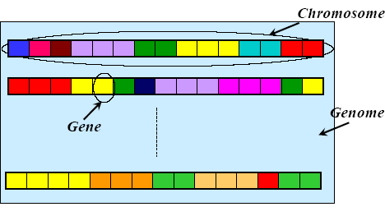
Chromosome, Genes and Genomes
Notes:
‹#›

Slide 8
Representation
Chromosomes could be:
Bit strings (0101 ... 1100)
Real numbers (43.2 -33.1 ... 0.0 89.2)
Permutations of element (E11 E3 E7 ... E1 E15)
Lists of rules (R1 R2 R3 ... R22 R23)
Program elements (genetic programming)
... any data structure ...
Notes:
‹#›

Slide 9
GA Requirements
A typical genetic algorithm requires two things to be defined:
a genetic representation of the solution domain, and
a fitness function to evaluate the solution domain.
A standard representation of the solution is as an array of bits. Arrays of other types and structures can be used in essentially the same way.
The main property that makes these genetic representations convenient is that their parts are easily aligned due to their fixed size, that facilitates simple crossover operation.
Variable length representations may also be used, but crossover implementation is more complex in this case.
Tree-like representations are explored in Genetic programming.
Notes:
‹#›

Slide 10
GA Requirements
The fitness function is defined over the genetic representation and measures the quality of the represented solution.
The fitness function is always problem dependent.
For instance, in the knapsack problem we want to maximize the total value of objects that we can put in a knapsack of some fixed capacity.
A representation of a solution might be an array of bits, where each bit represents a different object, and the value of the bit (0 or 1) represents whether or not the object is in the knapsack.
Notes:
‹#›

Slide 11
GA Requirements
Not every such representation is valid, as the size of objects may exceed the capacity of the knapsack.
The fitness of the solution is the sum of values of all objects in the knapsack if the representation is valid, or 0 otherwise. In some problems, it is hard or even impossible to define the fitness expression; in these cases, interactive genetic algorithms are used.

Slide 12
GA Example
0/1 Knapsack Problem
Maximum weight: 25 Maximize Profit
A: 5 (Profit:100), B: 10 (Profit:150), C:15 (Profit: 200)
Possible Solutions: Population
Chromosome Weight Profit
A: 100 5 100
AB: 110 15 250
AC: 101 20 300
BC: 011 25 350
ABC: 111 30 450

Slide 13
Basics of GA
The most common type of genetic algorithm works like this:
a population is created with a group of individuals created randomly.
The individuals in the population are then evaluated.
The evaluation function is provided by the programmer and gives the individuals a score based on how well they perform at the given task.
Two individuals are then selected based on their fitness, the higher the fitness, the higher the chance of being selected.
These individuals then "reproduce" to create one or more offspring, after which the offspring are mutated randomly.
This continues until a suitable solution has been found or a certain number of generations have passed, depending on the needs of the programmer.
Notes:
‹#›

Slide 14
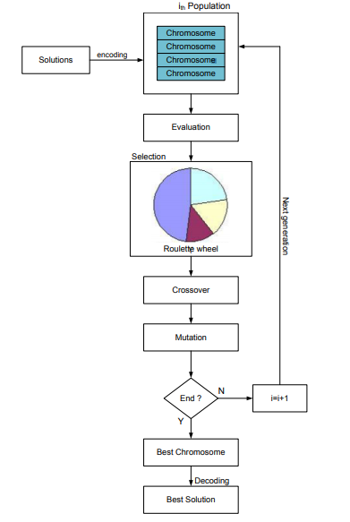
Flow Chart

Slide 15
Genetic Algorithms Process
Step 1. Determine the number of chromosomes, generation, and mutation rate and crossover rate value
Step 2. Generate chromosome number of the population, and the initialization value of the genes chromosome with a random value
Step 3. Process steps 4-7 until the number of generations is met
Step 4. Evaluation of fitness value of chromosomes by calculating objective function
Step 5. Chromosomes selection
Step 6. Crossover
Step 7. Mutation
Step 8. Solution (Best Chromosomes)

Slide 16
General Algorithm for GA
Initialization
Initially many individual solutions are randomly generated to form an initial population. The population size depends on the nature of the problem, but typically contains several hundreds or thousands of possible solutions.
Traditionally, the population is generated randomly, covering the entire range of possible solutions (the search space).
Occasionally, the solutions may be "seeded" in areas where optimal solutions are likely to be found.
Notes:
‹#›

Slide 17
General Algorithm for GA
Selection
During each successive generation, a proportion of the existing population is selected to breed a new generation.
Individual solutions are selected through a fitness-based process, where fitter solutions (as measured by a fitness function) are typically more likely to be selected.
Certain selection methods rate the fitness of each solution and preferentially select the best solutions. Other methods rate only a random sample of the population, as this process may be very time-consuming.
Most functions are stochastic and designed so that a small proportion of less fit solutions are selected. This helps keep the diversity of the population large, preventing premature convergence on poor solutions. Popular and well-studied selection methods include roulette wheel selection and tournament selection.
Notes:
‹#›

Slide 18
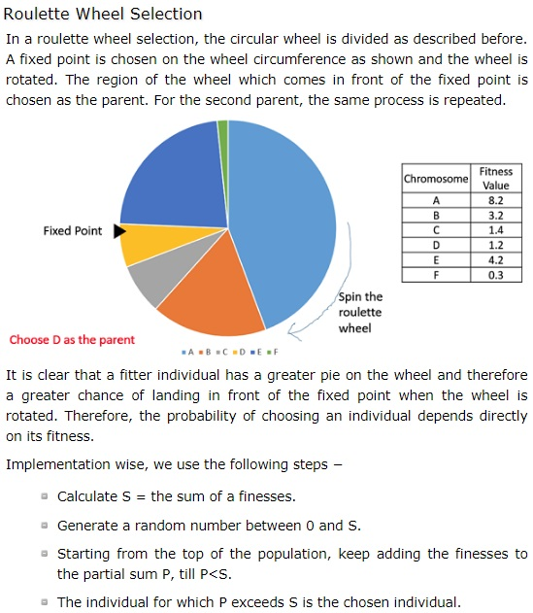
Selection in GA

Slide 19
General Algorithm for GA
In roulette wheel selection, individuals are given a probability of being selected that is directly proportionate to their fitness.
Two individuals are then chosen randomly based on these probabilities and produce offspring.
Notes:
‹#›

Slide 20
Roulette wheel selection
The basic part of the selection process is to stochastically select from one generation to create the basis of the next generation. The requirement is that the fittest individuals have a greater chance of survival than weaker ones. This replicates nature in that fitter individuals will tend to have a better probability of survival and will go forward to form the mating pool for the next generation. Weaker individuals are not without a chance. In nature such individuals may have genetic coding that may prove useful to future generations.

Slide 21
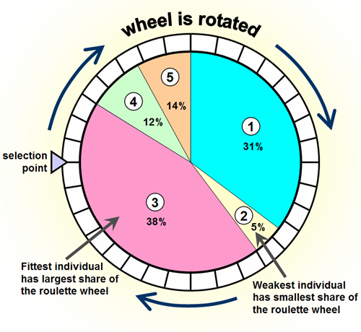

Slide 22
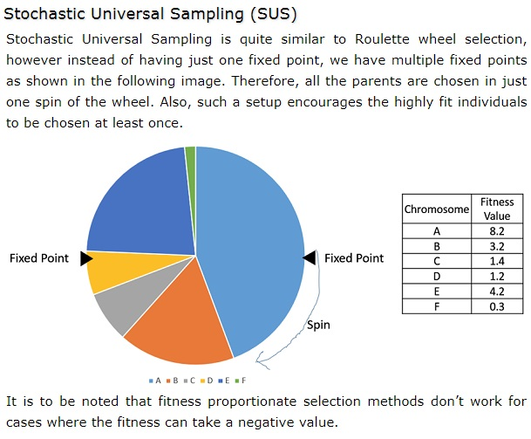

Slide 23
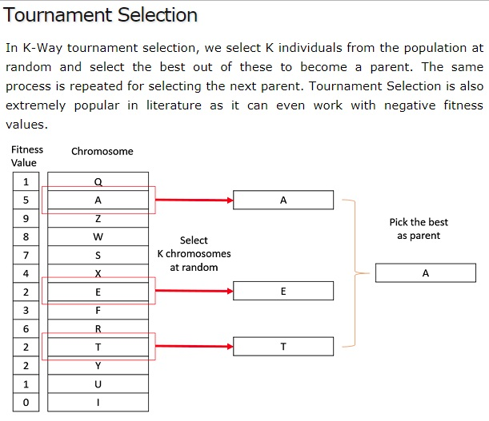

Slide 24
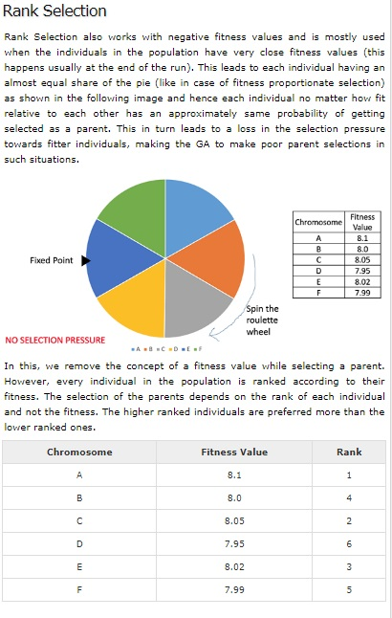

Slide 25
General Algorithm for GA
Reproduction
The next step is to generate a second generation population of solutions from those selected through genetic operators:
crossover (also called recombination), and/or mutation.
For each new solution to be produced, a pair of "parent" solutions is selected for breeding from the pool selected previously.
By producing a "child" solution using the above methods of crossover and mutation, a new solution is created which typically shares many of the characteristics of its "parents". New parents are selected for each child, and the process continues until a new population of solutions of appropriate size is generated.
Notes:
‹#›

Slide 26
General Algorithm for GA
These processes ultimately result in the next generation population of chromosomes that is different from the initial generation.
Generally the average fitness will have increased by this procedure for the population, since only the best organisms from the first generation are selected for breeding, along with a small proportion of less fit solutions, for reasons already mentioned above.
Notes:
‹#›

Slide 27
Crossover
The most common type is single point crossover. In single point crossover, you choose a locus at which you swap the remaining alleles from on parent to the other. This is complex and is best understood visually.
As you can see, the children take one section of the chromosome from each parent.
The point at which the chromosome is broken depends on the randomly selected crossover point.
This particular method is called single point crossover because only one crossover point exists. Sometimes only child 1 or child 2 is created, but oftentimes both offspring are created and put into the new population.
Crossover does not always occur, however. Sometimes, based on a set probability, no crossover occurs and the parents are copied directly to the new population. The probability of crossover occurring is usually 60% to 70%.
Notes:
‹#›

Slide 28
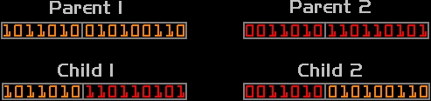
Crossover
Notes:
‹#›

Slide 29
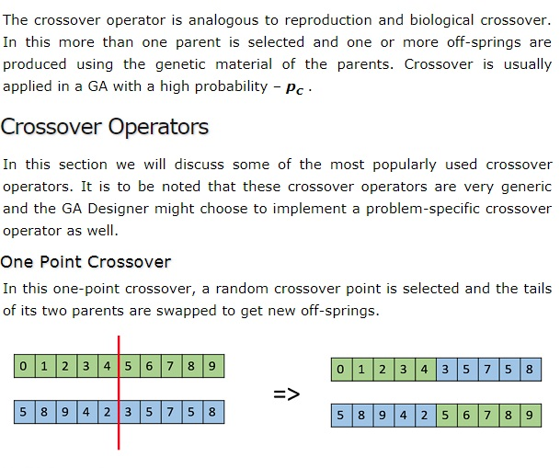
Crossover (Recombination)

Slide 30
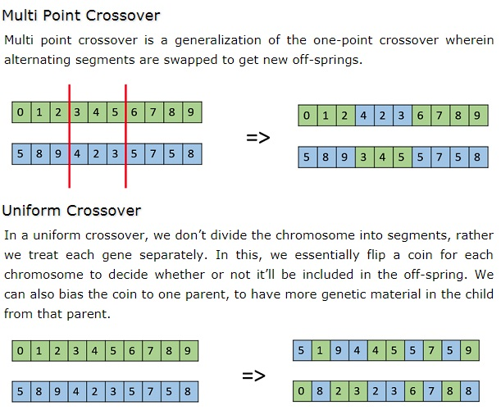

Slide 31
Mutation
After selection and crossover, you now have a new population full of individuals.
Some are directly copied, and others are produced by crossover.
In order to ensure that the individuals are not all exactly the same, you allow for a small chance of mutation.
Mutation is fairly simple. You just change the selected alleles based on what you feel is necessary and move on. Mutation is, however, vital to ensuring genetic diversity within the population.
Notes:
‹#›

Slide 32

Mutation
Notes:
‹#›

Slide 33
Mutation
Bit Flip Mutation
In this bit flip mutation, we select one or more random bits and flip them. This is used for binary encoded GAs.
Swap Mutation
In swap mutation, we select two positions on the chromosome at random, and interchange the values. This is common in permutation based encodings.

Slide 34
General Algorithm for GA
Termination
This generational process is repeated until a termination condition has been reached.
Common terminating conditions are:
A solution is found that satisfies minimum criteria
Fixed number of generations reached
Allocated budget (computation time/money) reached
The highest ranking solution's fitness is reaching or has reached a plateau such that successive iterations no longer produce better results
Manual inspection
Any Combinations of the above
Notes:
‹#›

Slide 35
GA Pseudo-code
Choose initial population
Evaluate the fitness of each individual in the population
Repeat
Select best-ranking individuals to reproduce
Breed new generation through crossover and mutation (genetic operations) and give birth to offspring
Evaluate the individual fitnesses of the offspring
Replace worst ranked part of population with offspring
Until <terminating condition>
Notes:
‹#›

