Slide 1
Firefly algorithm (History and main idea)
Firefly Algorithm (FA) was first developed by Xin-She Yang in late 2007, which was based on the flashing patterns and behavior of fireflies
Firefly algorithm is a metaheuristic population based method.

Slide 2
Behavior of fireflies
The sky filled with the light of fireflies is a marvelous sight in the summer in the moderately temperature regions.
There are near to two thousand firefly species, and most of them produce short and rhythmic flashes.
The pattern observed for these flashes is unique for most of the times for a specific species.
Females of a species respond to individual pattern of the male of the same species.

Slide 3
Characteristics of firefly algorithm
Fireflies are unisex so that one firefly will be attracted to other fireflies regardless of their sex.
The attractiveness is proportional to the brightness, and they both decrease as their distance increases.
For any two flashing fireflies, the less brighter one will move towards the brighter one.
If there is no brighter one than a particular
firefly, it will move randomly.
The brightness of a firefly is determined by the landscape of the objective function.

Slide 4
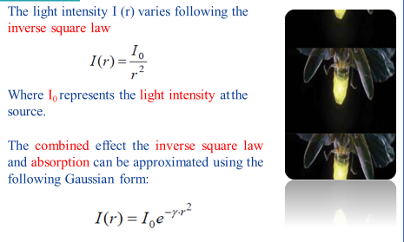
The basic steps of the firefly Algorithm

Slide 5
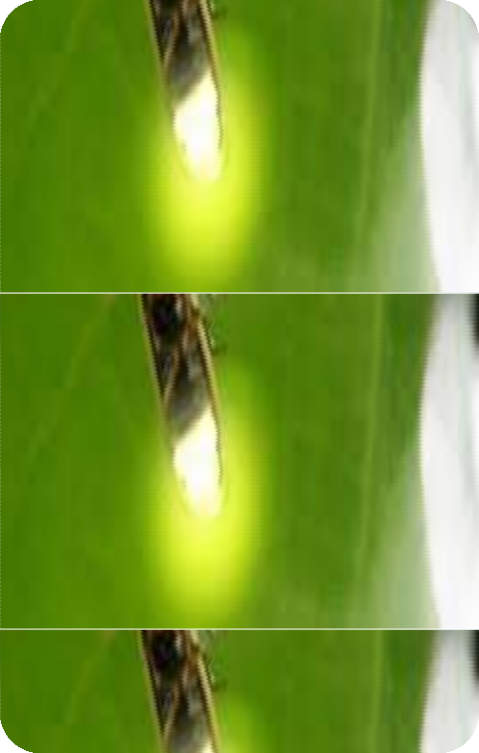


The basic steps of the firefly Algorithm
Company
LOGO
(attractiveness )
As a firefly’s attractiveness is proportional to the light intensity seen by adjacent fireflies, the attractiveness function of the firefly is established by:
Where β₀ is the firefly attractiveness value at r = 0 and γ is the media light absorption coefficient.

Slide 6
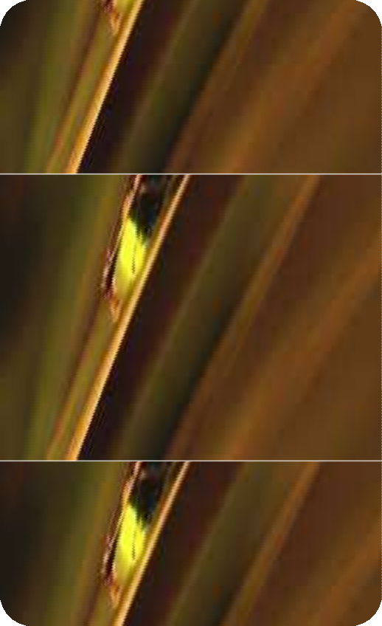
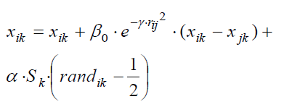

The basic steps of the firefly Algorithm
Company
LOGO
(movement )
Fireflies movement is based on the principles of attractiveness: when firefly j is more attractive than firefly i the movement is determined by the following equation:
where k =1,2,...,D (D is dimension of problem), α and S_{k} are the scaling parameters and rand_{ik} rand is random number between 0 and 1.

Slide 7
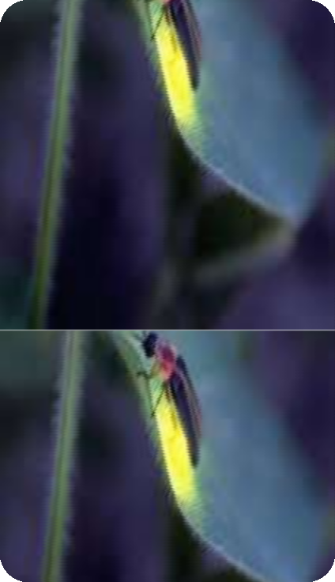
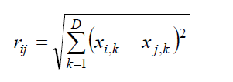

The basic steps of the firefly Algorithm (distance)
Company
LOGO
Distance r_{ij} between fireflies i and j is obtained by Cartesian distance form by:

Slide 8
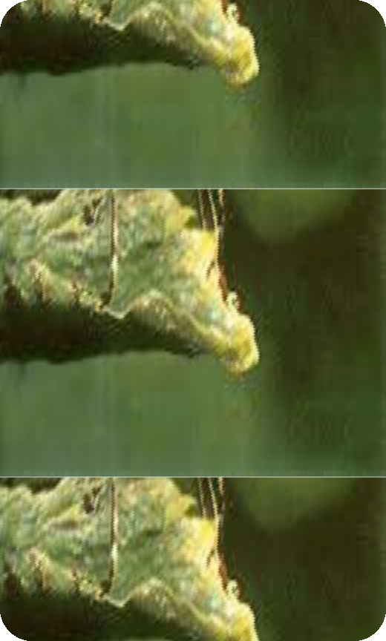

The basic steps of the firefly Algorithm (special case )
Company
LOGO
If β₀ = 0, it becomes a simple random walk.
On the other hand, if γ = 0, it reduces to a
variant of particle swarm optimization

Slide 9
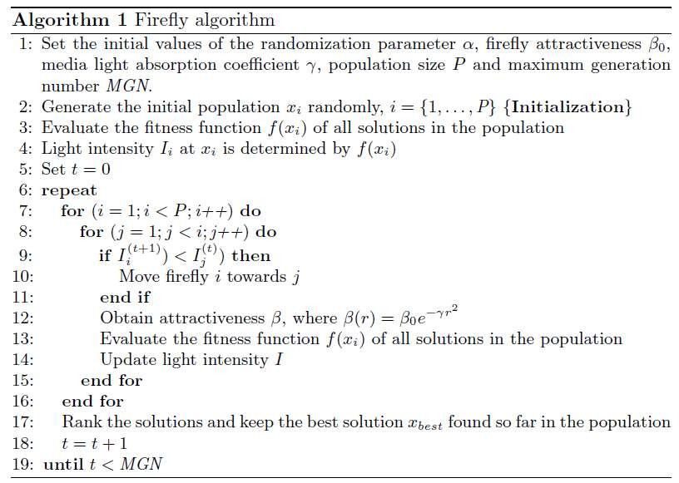
The basic steps of the firefly Algorithm
(algorithm)
Company
LOGO

Slide 10
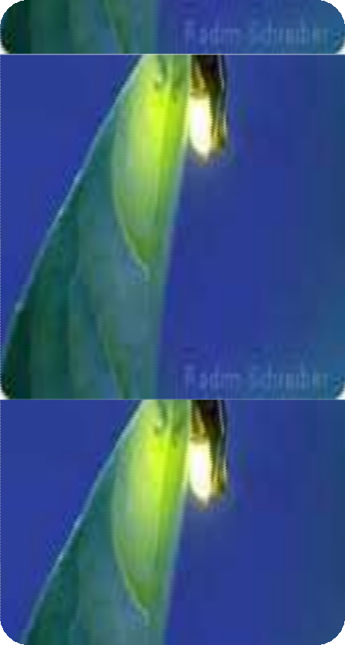

Application of the firefly Algorithm
Company
LOGO
Digital Image Compression Processing
Feature selection and fault detection
Antenna Design
Structural Design
Scheduling
Semantic Web Composition
Chemical Phase equilibrium
Clustering
Dynamic Problems
Rigid Image Registration Problems
and Image

