Slide 1
Team Induction
Mercury Life Saver
When you are on road, your loved ones are waiting for you at home

Slide 2
Problem Statement
1. Lack of Instant Medical Relief in case of catastrophic and real time Emergency state.
Sudden cardiac death is the largest cause of natural death in the United States, causing about 325,000 adult deaths in the United States each year
More than 1.25 million people die each year as a result of lack of Medical relief during road traffic crashes.
2. No real time Instant Insurance & Monetary service to save the life of victim
Nearly 27% of the total deaths in India happen with no medical attention at the time of death due to sufficient monetary funds.
3. Lack of Real Time collaborative communication between multiple service provider and stack holders in case of emergency.
4. No Instant data Analysis , Fraud Detection and Payments
Fraud steals $80 billion a year across all lines of insurance in UK and Europe.
5. Absence of recorded Multimedia data, Sensor data and contextual data for future investigation of medical and financial decisions.
6. Scarcity of social, psychological and motivational human nature to help the victim.
7. Absence of efficient real time Medical and Insurance services in legitimate prices.
Notes:
Open API access to the Mercury platform to provide the emergency services.

Slide 3
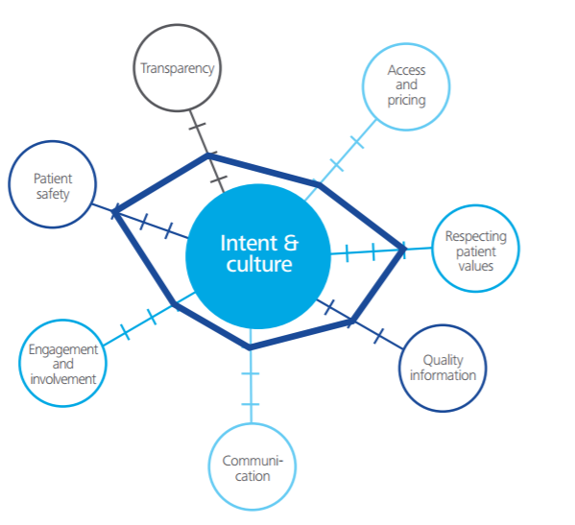
Our Solution and Unique Value Proposition

Slide 4
Our Solution and Unique Value Proposition
An Intelligent cognitive Emergency platform as a service leveraging IoT, Communication as a service and block chain for Instant relief in Minimal cost.
Application uses multiple sensor data as an input for local data analysis to identify emergency conditions proactively and send non persistent data to the Mercury Platform (Which is compliant with upcoming GDPR standards.)
Geospatial search and Consumer real time communication services notify to the govt. emergency service providers (ambulance, police, loved ones) and first responders to connect with hospital Dispatchers, Insurance Attendants, victim and other stack holders.
The archived multimedia session recording will be processed by Mercury Cognitive Analysis Node for Multimedia Content Analytics , Semantic Analytics, and Financial Decisions to minimize relief time and cost.
Blockchain cryptocurrency payments will benefit all emergency stack providers, helper and Victim by cutting down the financial transaction rate and time.
Insta rewards, social media leads and interlinking will improve the helping nature of human’s psychologically to build a better, safe planet.

Slide 5






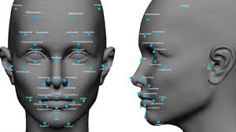







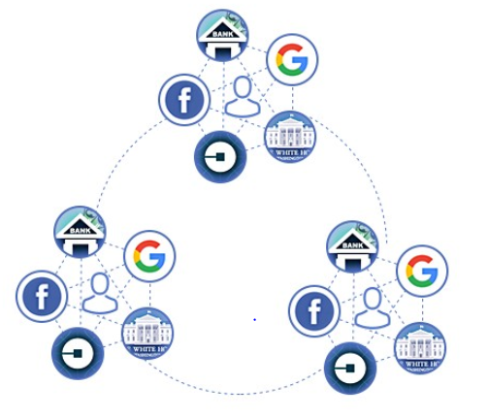
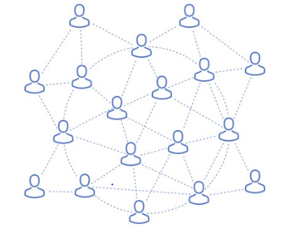


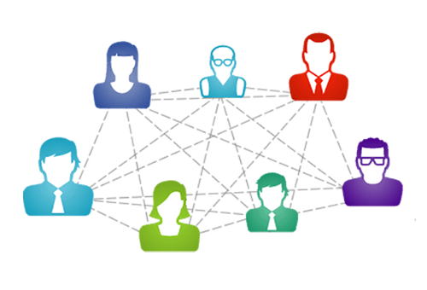


Emergency/Government Service Stack
Automatic Call Distribution
Cognitive Analytics Microservices
Insurance
Media Recorder
Media Server
Service Controller
Near Field
Notifications
Hospital
SMS Notification
Geospatial
Local Data Analysis
Car Manufacturer
Intelligent Mercury Platform
Service Providers Stack
Sensor Aggregator and Router
First Responders
Authentication and Data Exchange
User Level Data Analysis
Third Party Insurance Data Analysis and Verification Miners
Catastrophic Conditions & Events

Slide 6
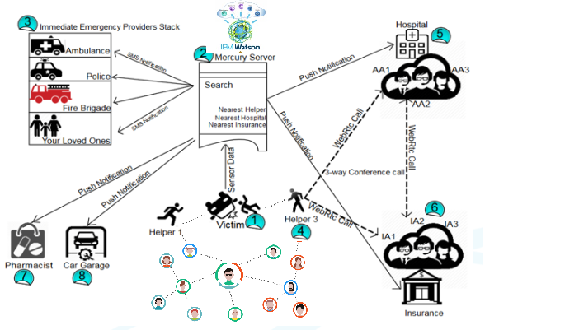
Use case demo

Slide 7
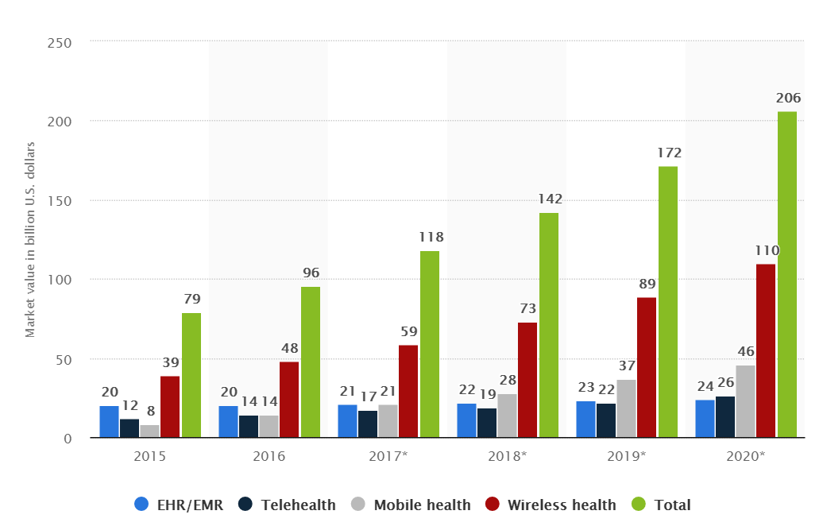
Our Paying Customer
As per Deliotte markets research report - 2018, the mobile health market is expected to reach 28 billon U.S. dollars worldwide. The digital health market is expected to reach 206 billion U.S. dollars by 2020, driven particularly by the mobile and wireless health market. The market in the Asia-Pacific region is expected to be a key region in the future.
Medical and Pharma Industries
Vehicle manufacturers
Insurance Providers
End users
Government Agencies
Media and Advertising
Oil and transportation Industry
Education and Training
IT organizations

Slide 8
References
https://my.clevelandclinic.org/health/diseases/17522-sudden-cardiac-death-sudden-cardiac-arrest
https://www.webmd.com/heart-disease/guide/sudden-cardiac-death#1
http://www.insurancefraud.org/statistics.htm
http://www.who.int/mediacentre/factsheets/fs358/en/
https://www.statista.com/statistics/387867/value-of-worldwide-digital-health-market-forecast-by-segment/
https://en.unesco.org/themes/education-health-and-well-being

Slide 9


