Slide 1
Team Induction
Mercury Life Saver
When you are on road, your loved ones are waiting for you at home …

Slide 2

Slow Response time
Inefficiency in decision making
High cost to save life.
Notes:
No Real Time Emergency Relief in Catastrophic Conditions.
Scarcity of social, psychological and motivational human nature to help the victim.
No Instant data Analysis , Fraud Detection and Payments.
Absence of efficient real time Medical and Insurance services in legitimate prices and limited economic resources

Slide 3

Proactive real time communication
Process relevant contextual information for efficient decision making
Multimedia content analysis for informed decision making

Slide 4

By Providing an Intelligent cognitive Emergency platform leveraging IoT, Communication as a service and blockchain to save human life in real time and least cost.

Slide 5


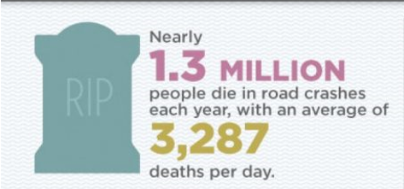




Catastrophic Conditions
Car Crash Emergency
Bike Crash Emergency
Cardiac Arrest Emergency
House Fire Emergency

Slide 6
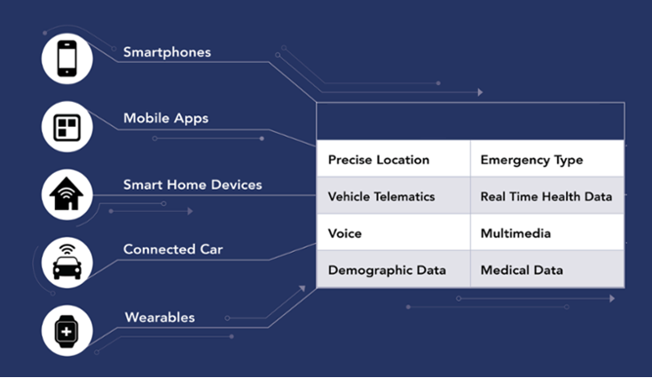
One thing in Common
Use Sensors and Generates Data

Slide 7
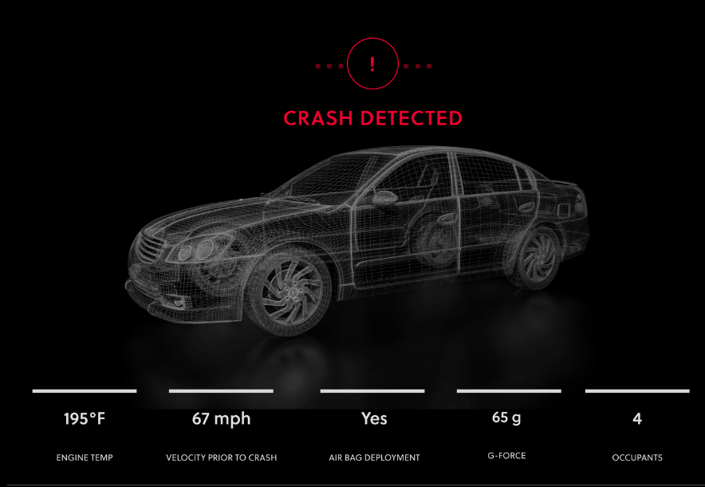
Use Case : Car Crash

Slide 8



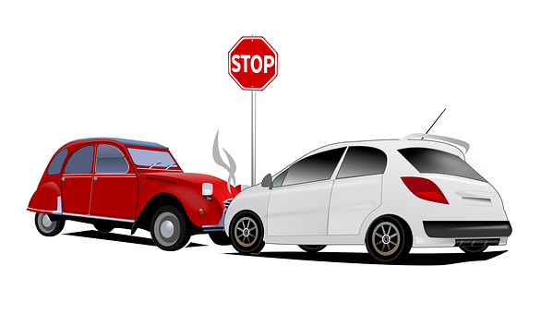





Use Case : Contd..
EMERGENCY SOS!!
Please reach at Brussels Expo
Alfons Gossetlaan 11, 1702 Groot-Bijgaarden,
Lat : 50.8714833
Long : 4.2798169
Click link to help: xxxxxxx
User Level Data Analysis
Send Notifications and Alerts To Specific Emergency Responders
First Responders
Notifications, Alerts and transient data will pass from our Intelligent IoE platform with GDPR Compliance.
Drones
Emergency Responders Stack

Slide 9


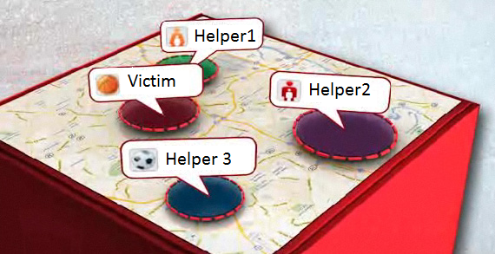
1st Responders has less knowledge what to do in these situation ??
Automatic Call Distribution
Hospital
Helper2 accepted help the Victim and a Real time Multimedia session will be created between Helper2, Hospital and Insurance.
Insurance
Service Providers Stack

Slide 10





Business Model and Unique Value Proposition
Service Providers Stack
Hospital
Hospital
Insurance
Insurance
Recorded Multimedia Data Pushed to Analytics Microservices
Police Stations
Cognitive Analytics Microservices
Government
Car Manufacturers
Dispatcher Panel
Education & Training
Pharmaceuticals
Analysis Performed on Analytics Platforms
Oil & Gas
Sensor Data Analysis
Predictive Analysis
Semantic Analysis
Financial Analysis
Multimedia content Analysis
Video Content
Driving Behavior Analysis
Many More …..
Advertising
Many more …..
Blockchain cryptocurrency payments

Slide 11
Business Model and Unique Value Proposition
Insurance Companies
- Fraud steals $80 billion a year across all lines of insurance in UK and Europe.
- Spend atleast 10 Man Days to analyze and make report for 1 case.
- Using real time multimedia analysis we are appx cutting down 80-90% of time and money invested today in analyzing Insurance case.
Government can use for Infrastructural decisions, Road Safety Observation and decisions, Health related surveys and decisions, Driving Licensing decisions, Education & Trainings
Police can use transparent real time analysis content to generate police reports automatically, Education & trainings.
Medical History and relief reports
On-Demand car and automobile manufacturing decisions
Scientific research
Financial decisions
On-demand pharmaceuticals decisions.

Slide 12

Improving the helping nature of humans
Providing Insta rewards, Coupons to helpers.
Transparent data (Recorded Multimedia Data) will be provided to all entities so there will be no hassle for people to help the Victim.
Social media leads and interlinking will improve the helping nature of humans psychologically to build a better, safe planet.

Slide 13
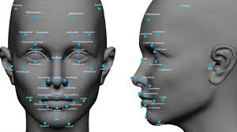






Emergency Responder Stack
Service Providers Stack
Automatic Call Distribution
Cognitive Analytics Microservices
Media Recorder
Media Server
Service Controller
Notifications/Alerts
Near Field
Notifications
Hospital
Geospatial
Local Data Analysis
Insurance
Intelligent Mercury Platform
Police Stations
Sensor Aggregator and Router
Government
First Responders
Authentication and Data Exchange
Car Manufacturers
User Level Data Analysis
Education & Training
Pharmaceuticals
Oil & Gas
Drones
Catastrophic Conditions & Events

Slide 14
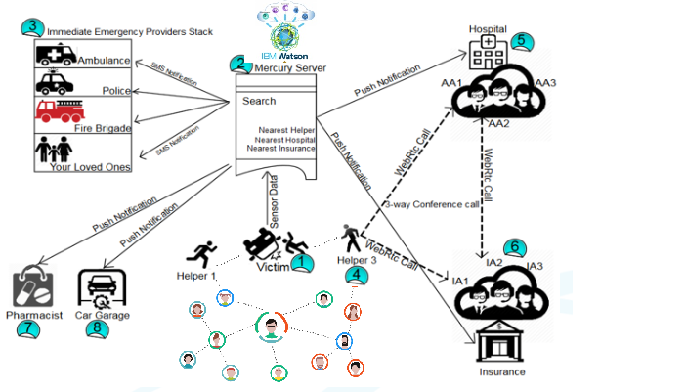
Use case demo

Slide 15
References
https://my.clevelandclinic.org/health/diseases/17522-sudden-cardiac-death-sudden-cardiac-arrest
https://www.webmd.com/heart-disease/guide/sudden-cardiac-death#1
http://www.insurancefraud.org/statistics.htm
http://www.who.int/mediacentre/factsheets/fs358/en/
https://www.statista.com/statistics/387867/value-of-worldwide-digital-health-market-forecast-by-segment/
https://en.unesco.org/themes/education-health-and-well-being
https://www.garymartinhays.com/atlanta-car-accident-lawyer-infographic/

Slide 16



