Slide 1
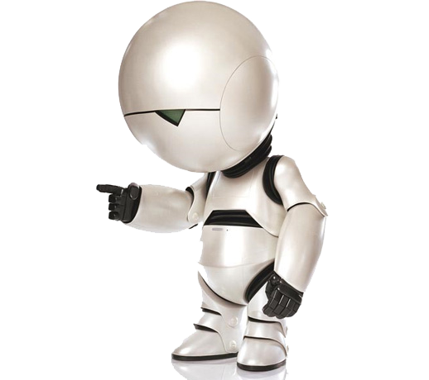
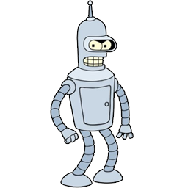
TELE ROBO MIMICRY
Greek for “remote” or “distant”
Relating to robotics
The act of imitating closely
Matthew
Johnson
Eric
Badger

Slide 2
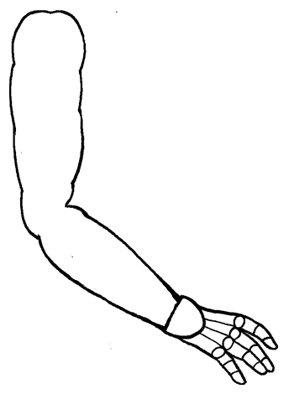
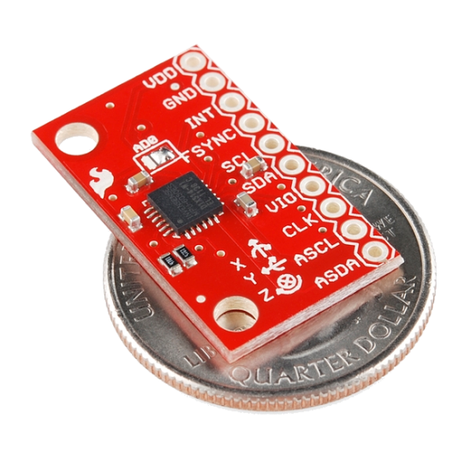
Accelerometer/Gyroscope
MPU-6050

Slide 3
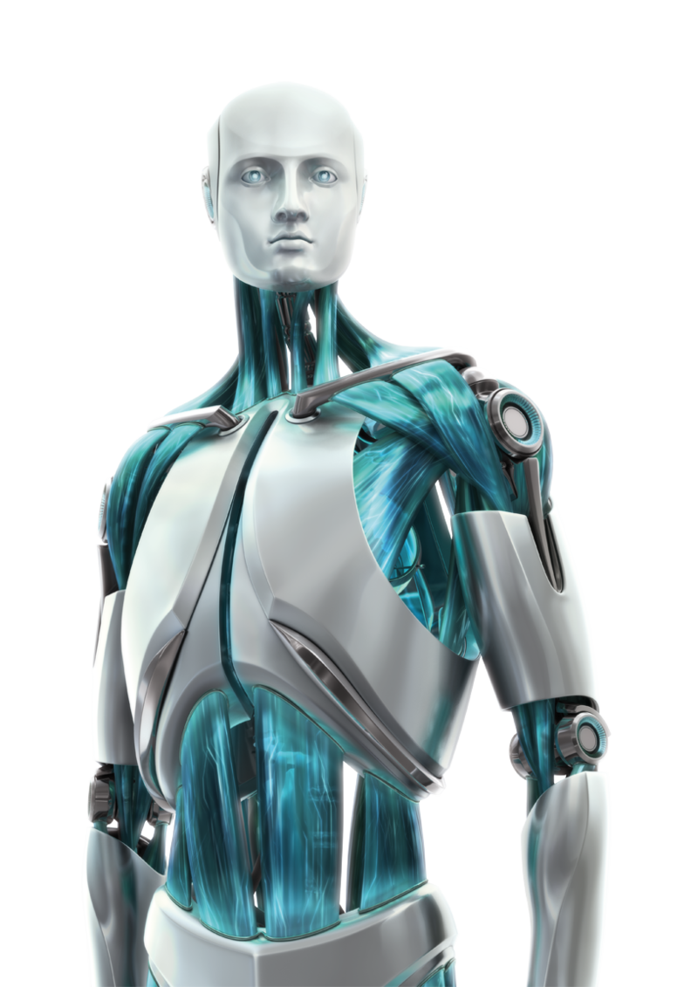

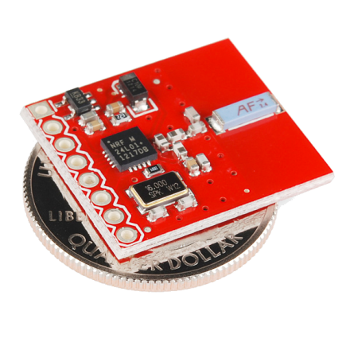
Transmitter/Receiver
nRF24L01+

Slide 4
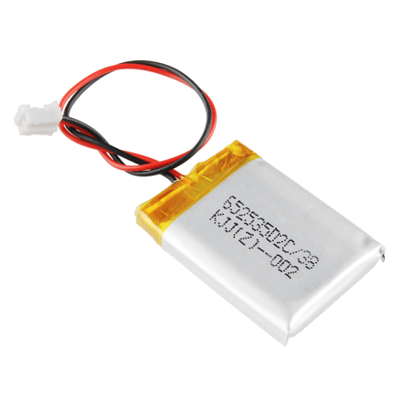
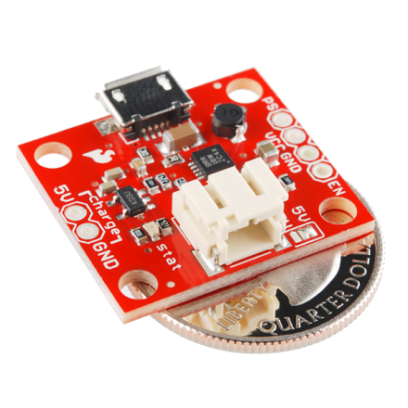
Power
PowerCell
LiPo Charger
Boost Converter
1000mAh
Lithium Polymer Battery

Slide 5
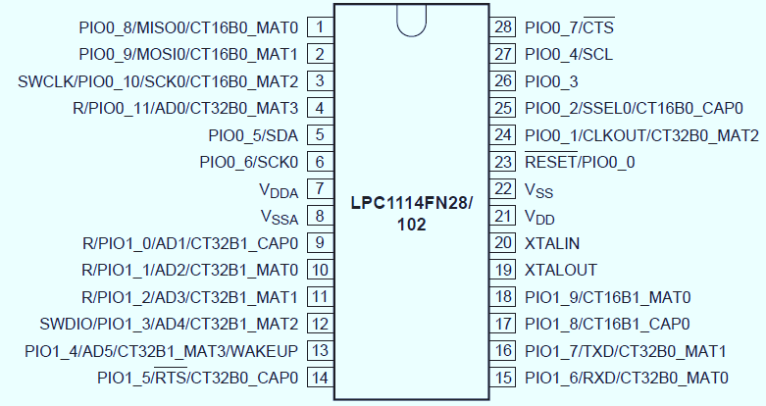
Microcontroller
50MHz
ARM Cortex M0
UART
I2C
SPI
Timers
GPIO
Low Power
< $2.50

Slide 6
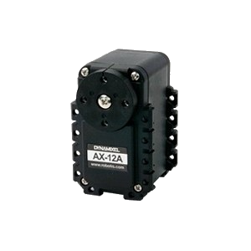
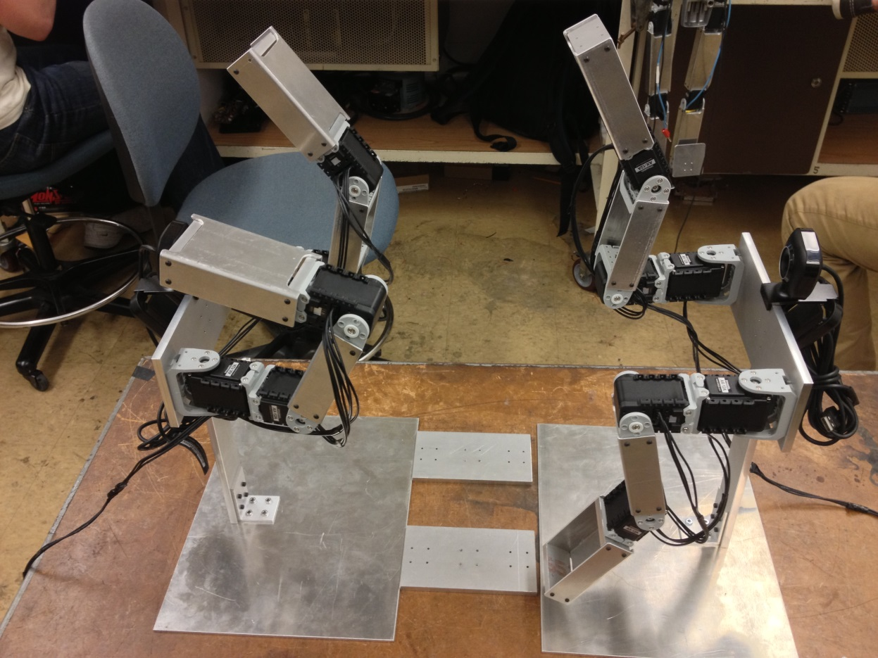
Robot Arms
AX-12 Servos
Serial Interface
1MHz
Half-Duplex
Operates @ 12 V
15.3 kg-cm of Torque
Overheat Protection

Slide 7
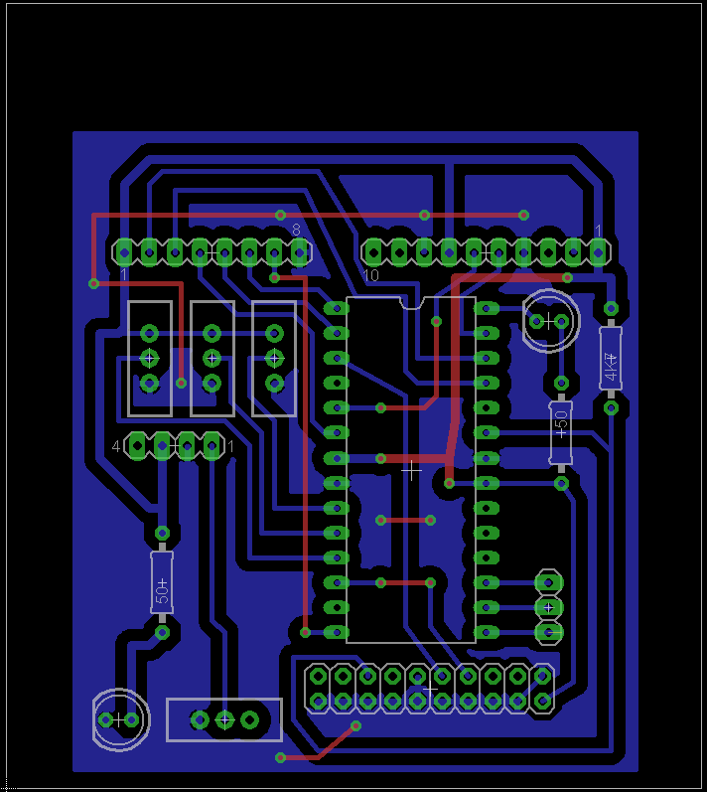
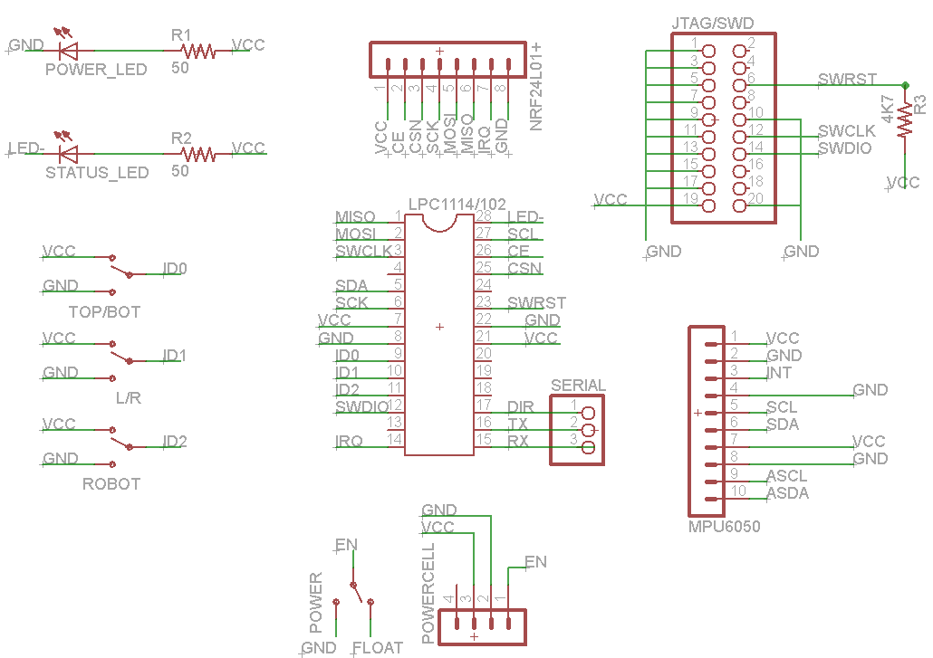
Printed Circuit Board (PCB)

Slide 8
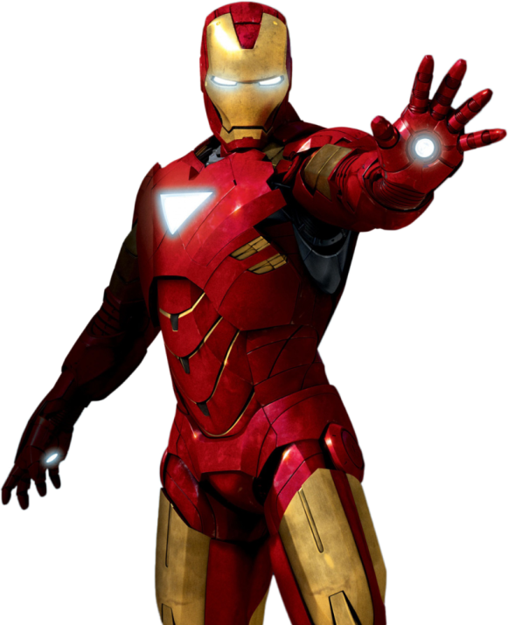
Potential Uses
Remote-Controlled Humanoid Drones/Droids
Robotically Assisted Surgery
High-Tech Prostheses
Telepresence Systems
Motion Capture for Movie/Game Production
Computer/Game Console Input Device
Hazardous Environment Search/Rescue
Space Exploration
IRON MAN!

Slide 9
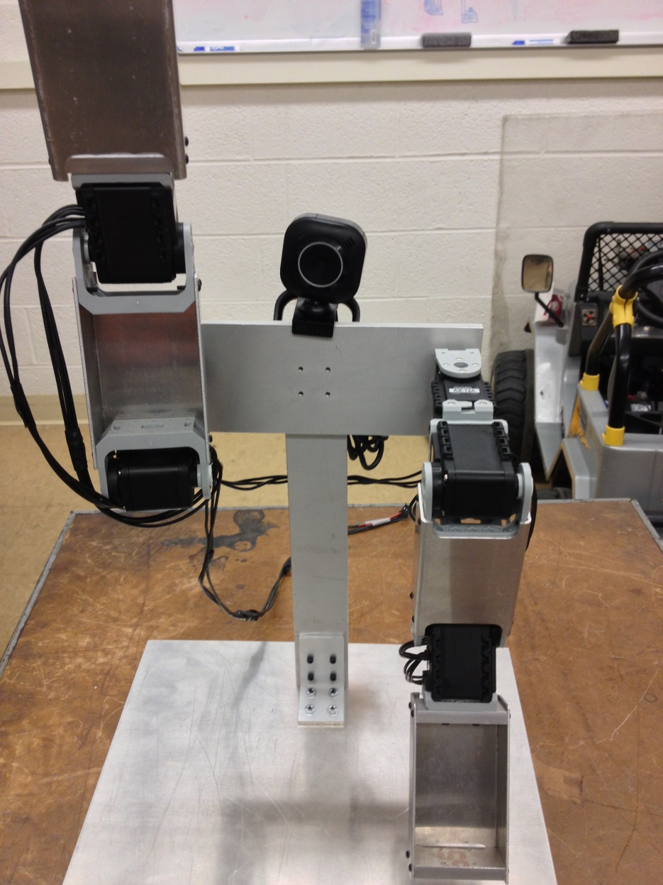
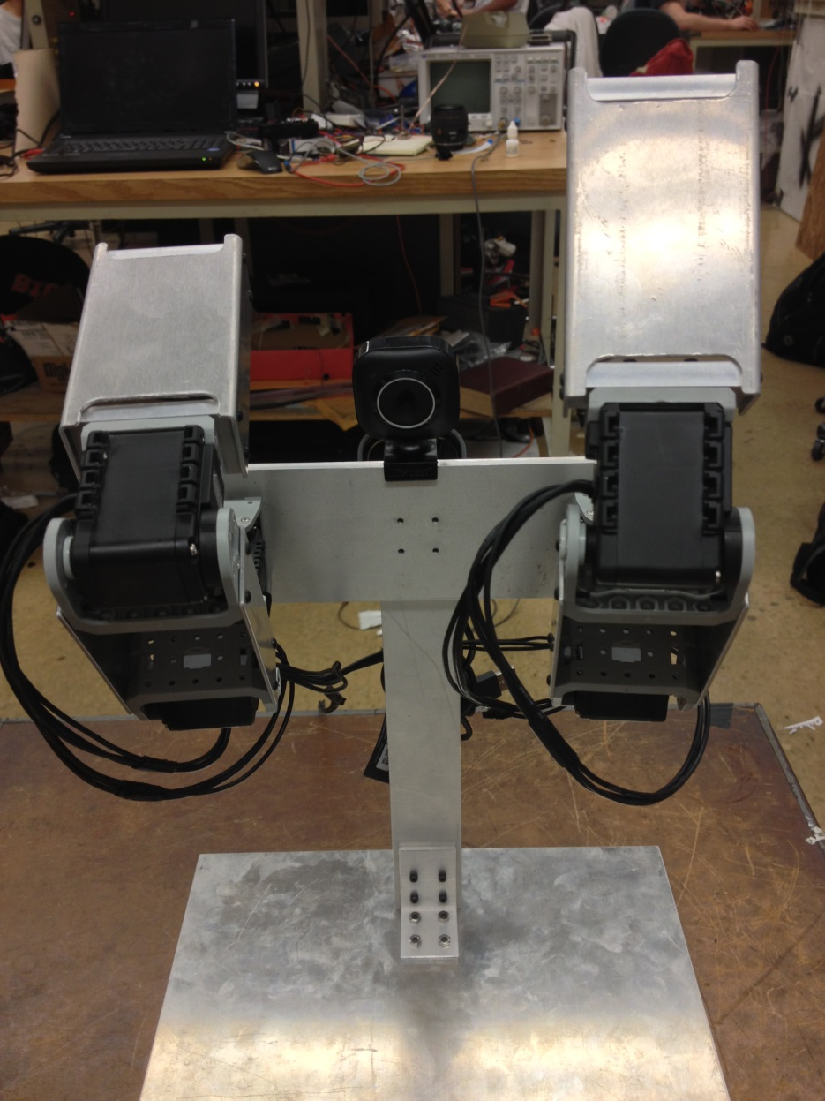
TELE ROBO MIMICRY

