Slide 1
ArcGIS API for JavaScript
ArcGIS API for JavaScript

Slide 2
ArcGIS JavaScript API介绍
使用ArcGIS API for JavaScript 可以做什么？
快速创建交互式地图应用
调用ArcGIS Sever 的GP服务，提供专业的分析结果

Slide 3
为什么选择JavaScript
•所有主流浏览器都支持 •世界上使用最广泛的一种WEB开发脚本语言 纯粹的客户端语言(运行在客户端的浏览器内）
•完全免费的Web开发脚本语言 轻量级的Web开发脚本语言(无需安装任何插件）
•有各种成熟的框架（Dojo、JQuery、Ext、Prototype) •支持多种开发方式 •非常成熟、稳定

Slide 4
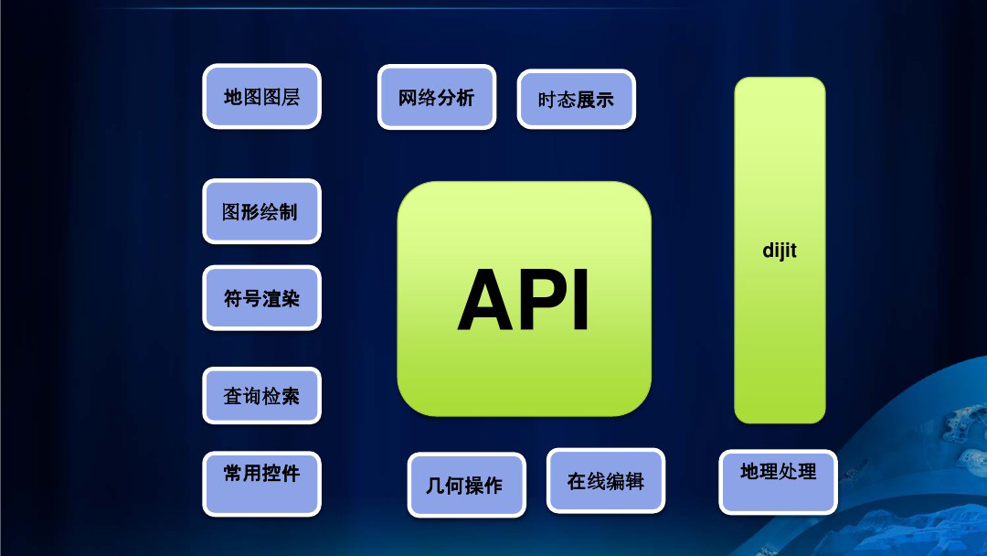

Slide 5
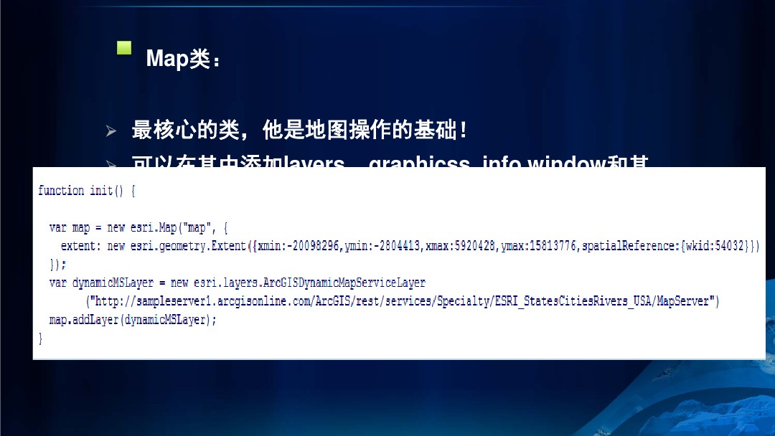

Slide 6
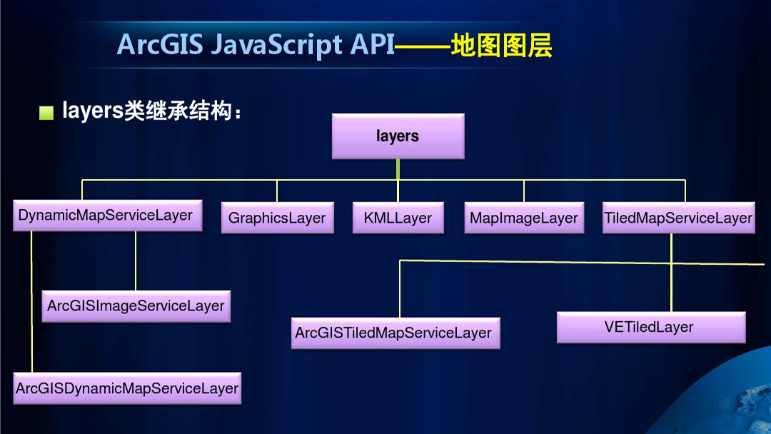

Slide 7
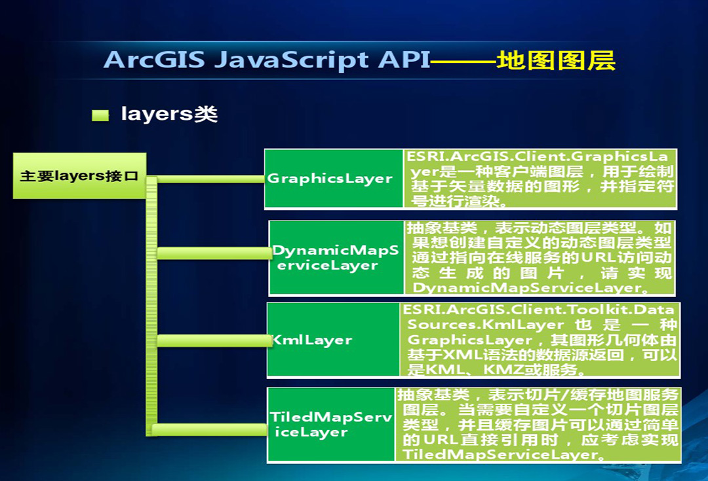

Slide 8
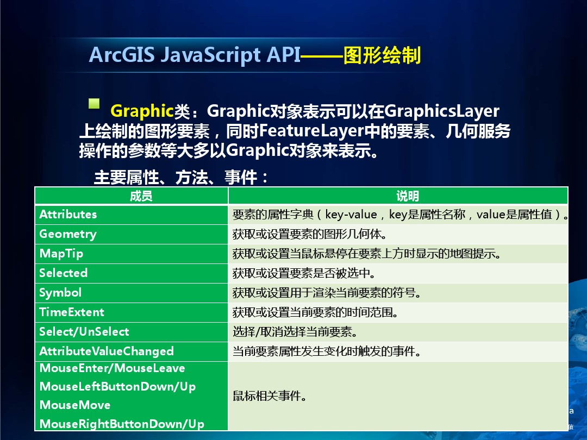

Slide 9
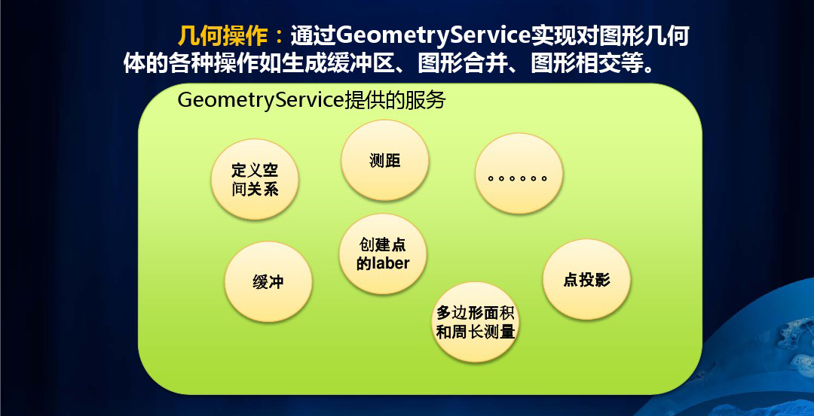

Slide 10
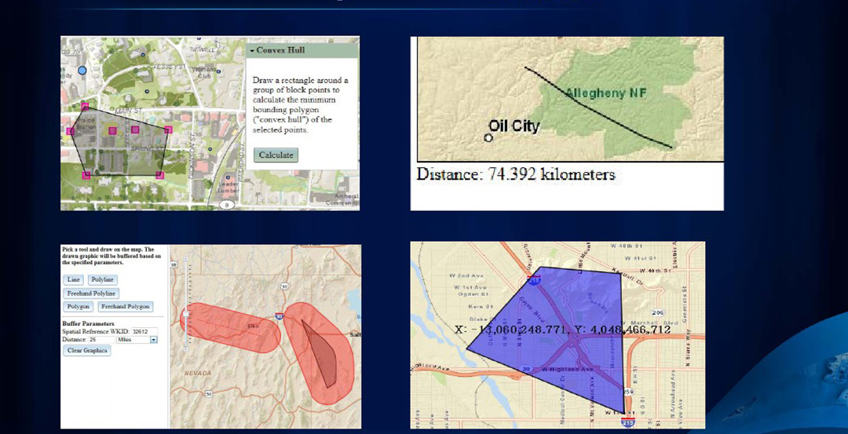

Slide 11




如何离线部署
1. 官网下载api和sdk 需要自己注册用户 2. 解压，放到项目中 3. 修改两个文件 arcgis_js_api\library\3.22\3.22\init.js 和 arcgis_js_api\library\3.22\3.22\dojo\dojo.js 找到 [HOSTNAME_AND_PATH_TO_JSAPI]，替换为本地路径，例："主机:端口\arcgis_js_api\library\3.22\3.22\"

Slide 12


require（[reference package...],function(Class declaration){code...}）方法中的引用部分的顺序，必须与function中的类声明的顺序 必须一致，否则找不到对应的类对象，不会报错，但程序无效。
require(["esri/Map",
"esri/views/SceneView",
"esri/Basemap",
"esri/Ground",
"esri/layers/WebTileLayer",
"esri/layers/ElevationLayer",
"esri/layers/FeatureLayer",
"dojo/domReady!"],
function (Map, SceneView,
Basemap, Ground, WebTileLayer, ElevationLayer,FeatureLayer)
{}

Slide 13

代码实例
<link rel="stylesheet" type="text/css" href="http://主机:端口/arcG322/js/arcgis_js_api/library/3.22/3.22/esri/css/esri.css" /> <script src="http://主机:端口/arcG322/js/arcgis_js_api/library/3.22/3.22/init.js"></script> <script> var map; require(["esri/map", "dojo/domReady!"], function(Map) { map = new Map("map", { basemap: "streets", center: [-122.45, 37.75], // longitude, latitude zoom: 13 }); }); </script> </head> <body> <div id="map"></div> </body> </html>

Slide 14
如何实现画线 等功能
导入包
require([
"esri/Map",
"esri/views/MapView",
"esri/views/2d/draw/Draw",
"esri/Graphic",
"esri/geometry/Polyline",
"esri/geometry/Polygon",
"esri/geometry/Point",
"esri/geometry/Circle",
"esri/geometry/geometryEngine",
"dojo/domReady!"
]

Slide 15

创建二维视图
//二维视图
var view = new MapView({
map: map,
container: "viewDiv"
});
view.ui.add("line-button", "top-left"); //添加绘制线按钮，自定义UI
view.ui.add("area-button", "top-left"); //添加绘制面按钮，自定义UI
view.ui.add("point-button", "top-left"); //添加绘制面按钮，自定义UI
view.ui.add("circle-button", "top-left"); //添加绘制面按钮，自定义UI
view.ui.add("rectangle-button", "top-left"); //添加绘制面按钮，自定义UI
view.ui.remove("attribution"); //移除底部ESRI logo

Slide 16
view.when(function() {
var draw = new Draw({
view: view
});
//绑定线按钮绘制事件
var drawLineButton = document.getElementById("line-button");
drawLineButton.onclick = function() {
view.graphics.removeAll(); //清楚之前的绘制
enableCreateLine(draw, view);
};
//绑定面按钮绘制事件
var drawAreaButton = document.getElementById("area-button");
drawAreaButton.onclick = function() {
view.graphics.removeAll(); //清楚之前的绘制
enableCreateArea(draw, view);
};
//绑定面按钮绘制事件
var drawPointButton = document.getElementById("point-button");
drawPointButton.onclick = function() {
enableCreatePoint(draw, view);
};
下页还有。。。。

Slide 17
//绑定面按钮绘制事件
var drawCircleButton = document.getElementById("circle-button");
drawCircleButton.onclick = function() {
enableCreateCircle(draw, view);
};
//绑定面按钮绘制事件
var drawRectangleButton = document.getElementById("rectangle-button");
drawRectangleButton.onclick = function() {
enableCreateRectangle(draw, view);
};
});

Slide 18
开始画线

Slide 19
//开始监听画线
function enableCreateLine(draw, view) {
var action = draw.create("polyline", {
mode: "click"
});
// 获取焦点
view.focus();
// 顶点添加事件
action.on("vertex-add", createPolyline);
//顶点移除事件
action.on("vertex-remove", createPolyline);
// 鼠标移动事件
action.on("cursor-update", createPolyline);
// 绘制完成事件
action.on("draw-complete", createPolyline);
}

Slide 20
//根据点坐标生成新的线
function createPolyline(event) {
//获取所有顶点
var vertices = event.vertices;
//清除之前绘制
view.graphics.removeAll();
var line = new Polyline({
paths: vertices,
spatialReference: view.spatialReference
});
// 生成绘制的图形
var graphic = new Graphic({
geometry: line,
symbol: {
type: "simple-line", // autocasts as new SimpleFillSymbol
color: [4, 90, 141],
width: 4,
cap: "round",
join: "round"
}
});
// 将绘制的图形添加到view
view.graphics.add(graphic);
if (event.type == "draw-complete") {
createBuffer(line);
}
}

Slide 21
开始画面

Slide 22
//开始监听画面
function enableCreateArea(draw, view) {
var action = draw.create("polygon", {
mode: "click" //点击方式加点
});
// 获取焦点
view.focus();
// 顶点添加事件
action.on("vertex-add", createPolygon);
//顶点移除事件
action.on("vertex-remove", createPolygon);
// 鼠标移动事件
action.on("cursor-update", createPolygon);
// 绘制完成事件
action.on("draw-complete", createPolygon);
}

Slide 23
//根据点坐标生成新的线
function createPolygon(event) {
//获取所有顶点
var vertices = event.vertices;
//清除之前绘制
view.graphics.removeAll();
var polygon = new Polygon({
hasZ: false,
hasM: false,
rings: [vertices],
spatialReference: view.spatialReference
});
// 生成绘制的图形
var graphic = new Graphic({
geometry: polygon,
symbol: {
type: "simple-fill", // autocasts as new SimpleFillSymbol()
color: [51, 51, 204, 0.9],
style: "solid",
outline: { // autocasts as new SimpleLineSymbol()
color: "white",
width: 1
}
}
});
// 将绘制的图形添加到view
view.graphics.add(graphic);
if (event.type == "draw-complete") {
createBuffer(polygon);
}
}

Slide 24
开始画点

Slide 25
//开始监听画点
function enableCreatePoint(draw, view) {
var action = draw.create("point", {
mode: "click" //点击方式加点
});
// 获取焦点
view.focus();
// 顶点添加事件
action.on("vertex-add", createPoint);
//顶点移除事件
action.on("vertex-remove", createPoint);
// 绘制完成事件
action.on("draw-complete", createPoint);
}

Slide 26
//根据点坐标生成新的点
function createPoint(event) {
//获取所有顶点
var coordinates = event.coordinates;
var point = new Point({
hasZ: false,
hasM: false,
x: coordinates[0],
y: coordinates[1],
spatialReference: view.spatialReference
});
//生成绘制的图形
var graphic = new Graphic({
geometry: point,
symbol: {
type: "simple-marker", // autocasts as new SimpleMarkerSymbol()
style: "square",
color: "blue",
size: "8px", // pixels
outline: { // autocasts as new SimpleLineSymbol()
color: [255, 255, 0],
width: 3 // points
}
}
});
// 将绘制的图形添加到view
view.graphics.add(graphic);
if (event.type == "draw-complete") {
createBuffer(point);
}
}

Slide 27
完整代码演示
仅供参考 点我

Slide 28
谢谢观看

