Slide 1

CHEF INFRA · ENGINEERING GUIDE
Creating Chef Policyfiles for a New Server Class
Define the class. Lock its dependencies. Promote the same revision.

Slide 2
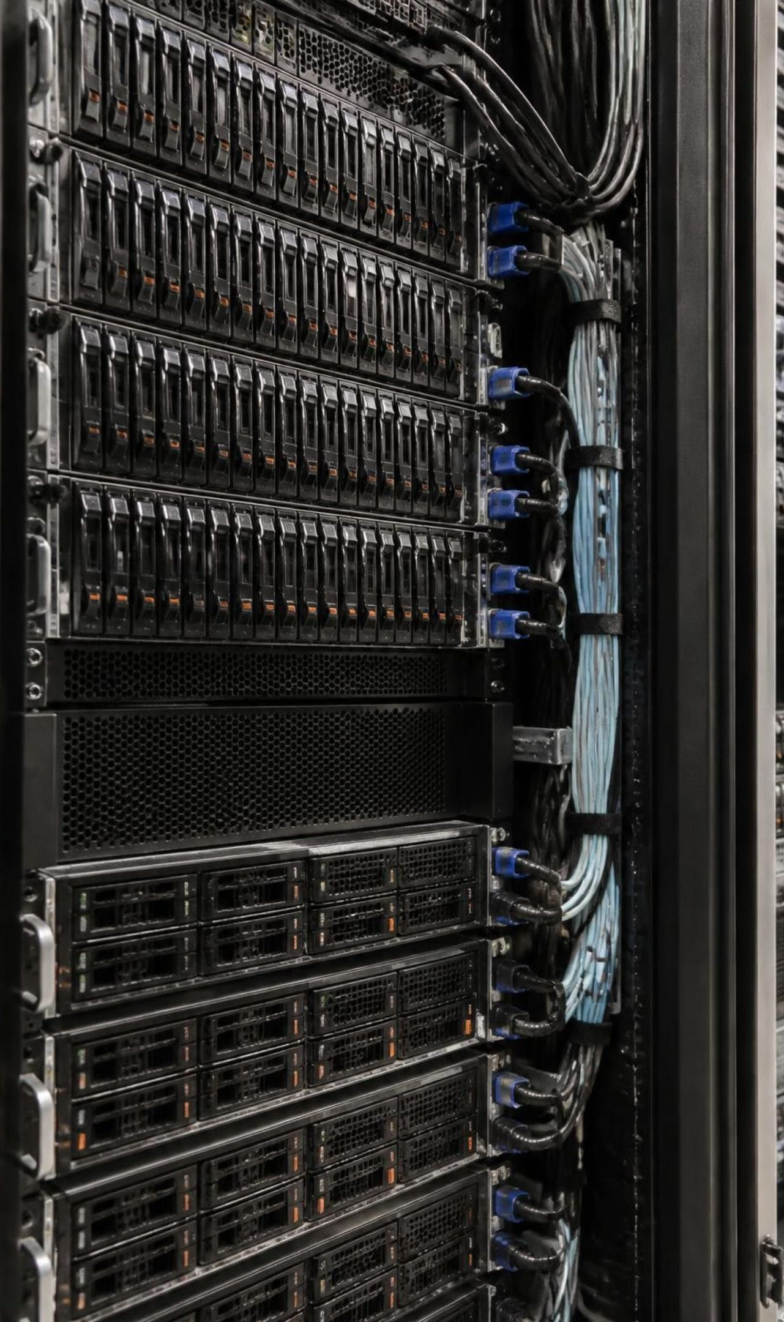
THE REASON TO CHANGE
Why enterprises move from roles to policyfiles
Mutable configuration
Locked policy
Roles group recipes; environments scope configuration. Both are mutable, so a shared change can reach every consuming node at once.
A Policyfile pins cookbooks and versions per server class: the same code in test and production, with controlled rollouts.

Slide 3
THE OPERATING MODEL
A policyfile is one artifact per server class
A server class is a group of nodes with the same configuration purpose.
01
02
03
Declare
Lock
Converge
Policyfile.rb describes the run list, cookbook sources and attributes.
Policyfile.lock.json freezes exact cookbook versions, identifiers and checksums.
Nodes apply the locked policy, not whichever cookbook happens to be newest.
Treat the declaration and its lock file as one version-controlled release unit.

Slide 4
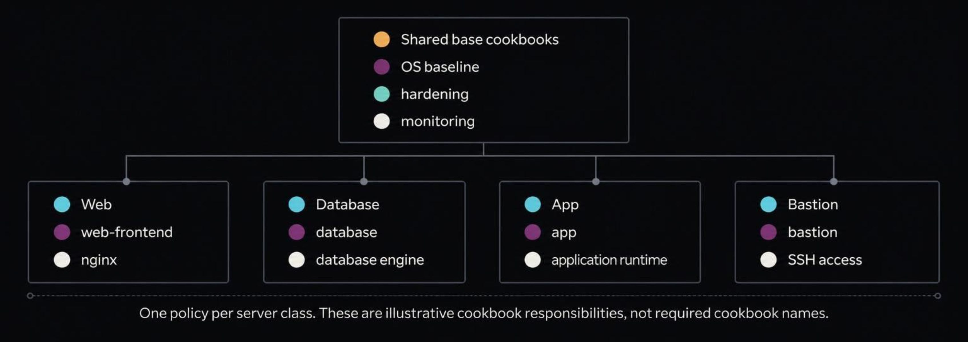
DESIGN BEFORE CODE
Start by defining your server classes
Choose one policy name per class, such as web-frontend. Separate shared configuration from class-specific behavior.
Reuse cookbooks across policies; keep each class independently releasable.

Slide 5
DECLARATION REFERENCE
What goes inside Policyfile.rb
Field | What it controls
name | The policy name nodes will request.
default_source | Where cookbooks are fetched: Supermarket or an internal source.
run_list | The ordered recipes Chef Infra Client executes.
cookbook | Version constraints, a local path or a Git source.
Optional declarations | Class-wide attributes and named run lists for special runs.

Slide 6
AUTHOR · STEP 1
Step 1: Generate the skeleton
chef generate policyfile web-frontend
Start with the generated defaults, then make the policy specific to this class.
Keep one policy directory per server class in version control.
Use Policyfile.rb as the standard declaration filename.
Set its policy name to web-frontend.
The generator may name the file web-frontend.rb. Rename it to Policyfile.rb for the commands that follow.

Slide 7
AUTHOR · STEP 2
Step 2: Declare cookbook sources
name 'web-frontend'
default_source :chef_server, 'https://chef.example.com/organizations/acme'
cookbook 'nginx', '~> 12.0'
cookbook 'company_base', path: '../../cookbooks/company_base'
Point default_source at your approved internal source.
Use constraints to define acceptable versions; the lock selects exact ones.
Use path: for in-house cookbooks under development.
Illustrative source and cookbook names. Replace them with your enterprise's approved endpoints and dependencies.

Slide 8
AUTHOR · STEP 3
Step 3: Set the run list and attributes
run_list 'company_base::default', 'nginx::default',
'web_app::default'
default['web_app']['listen_port'] = 8080
named_run_list :maintenance, 'web_app::maintenance'
Order recipes from base hardening to the application.
Set class-wide defaults with default['key'] attributes.
Use a named run list for an explicit special case, such as maintenance.
Example recipes must exist in the cookbooks resolved by your policy.

Slide 9
RESOLVE · STEP 4
Step 4: Compile and lock with chef install
01
02
03
Policyfile.rb
Dependency solver
Policyfile.lock.json
Desired recipes, sources and constraints.
chef install resolves a compatible cookbook set.
Exact cookbook content and a policy revision.
chef install Policyfile.rb
Commit the lock file with the declaration. Use chef update only when you intentionally want to refresh dependencies.

Slide 10
VALIDATE · STEP 5
Step 5: Test before anything is shared
kitchen test
Test Kitchen creates disposable test instances and verifies convergence. Configure its Chef provisioner to use your Policyfile.
Resolve locally
Verify behavior
Review the diff
Fail fast on missing cookbooks and incompatible constraints.
Exercise the locked policy on the target operating system.
Check cookbook versions, sources and lock changes in code review.

Slide 11
PUBLISH · STEP 6
Step 6: Push the policy to a policy group
chef push dev Policyfile.lock.json
Upload the locked policy and its cookbooks to Chef Infra Server.
A policy group is a deployment stage, such as dev, staging or production.
The group associates a policy name with a particular revision.
Run the command from the policy directory using configured server credentials.
Pushing publishes a revision. Nodes consume it on their next successful Chef Infra Client run.

Slide 12
PROMOTE WITHOUT REBUILDING
Policy groups are your promotion pipeline
Push the same lock file to each stage. Its revision ID stays identical.
dev
staging
production
Validate the candidate
Verify integration
Release approved code
Same locked revision
Same locked revision
Same locked revision
chef push staging Policyfile.lock.json
chef push production Policyfile.lock.json
During promotion, different groups can reference different revisions of the same policy.

Slide 13
ENROLL · STEP 7
Step 7: Bring nodes onto the policy
New servers
Existing servers
Bootstrap with the policy name and policy group.
Set policy_name and policy_group in client.rb through a controlled migration.
Validate one node before expanding the migration.
knife bootstrap HOST \
--policy-name web-frontend \
--policy-group dev
At each chef-client run, the node fetches the locked policy assigned to that name and group.

Slide 14
NODE CONFIGURATION
The client settings that matter
# client.rb
use_policyfile true
policy_name 'web-frontend'
policy_group 'dev'
Setting | Meaning
use_policyfile | Explicitly enables Policyfile mode where required by your client version.
policy_name | The server class this node implements.
policy_group | The deployment stage this node belongs to.
Bake these into your provisioning template so new servers join automatically.
Notes:
Check the supported settings for your deployed Chef Infra Client version. Modern clients can infer Policyfile mode from the policy settings; older deployments may require use_policyfile explicitly.

Slide 15
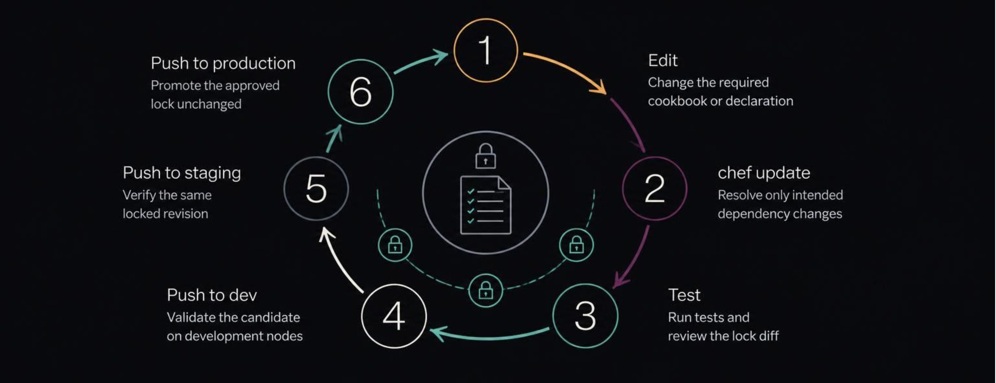
CONTROLLED CHANGE
Rolling out a change safely
Change only the cookbooks that need it. Review the lock diff, then promote group by group.

Slide 16

TEAM WORKFLOW
Enterprise practices that scale
Separate ownership
Automate checks
One directory per policy; shared base cookbooks in their own repositories.
CI runs chef install and tests on every pull request.
Protect production
Control supply
Restrict who can push to production policy groups.
Use an internal cookbook source for supply-chain control.

Slide 17
AVOID PREVENTABLE FAILURES
Common pitfalls
The lock file never gets committed
An update replaces an install
Commit declaration and lock together so reviewers and CI see the same release.
chef install reuses the lock. chef update intentionally refreshes dependencies.
Roles and policies get mixed
The requested name does not match
Do not combine role-driven configuration and Policyfiles on the same node. Migrate deliberately.
Match the policy's name to the node's policy_name, and verify its group.

Slide 18

FIRST IMPLEMENTATION
Your checklist for the first new server class
01
Name the class and list its cookbooks
02
Generate and edit Policyfile.rb
03
Run chef install and test
04
Push to dev, then promote
05
Bootstrap one node as a pilot

