Slide 1

Mastering Chef Automate
Visibility, Compliance, and Automation at Scale — a comprehensive guide from foundational concepts to advanced enterprise usage.

Slide 2
Agenda: What We'll Cover Today
From foundational concepts to advanced mastery — here's your roadmap for this session.
01
02
Platform Foundations
Basic Use Cases
What Chef Automate is, its core components, and how it unifies infrastructure observability.
Node management, patch automation, compliance scanning, visibility, and RBAC.
03
04
Graphs & Visualization
Best Practices & Advanced Usage
Dashboards, trend lines, event feeds, and filtering across your fleet.
Tagging strategies, CI/CD pipelines, multi-cloud, SIEM integrations, and custom compliance profiles.

Slide 3
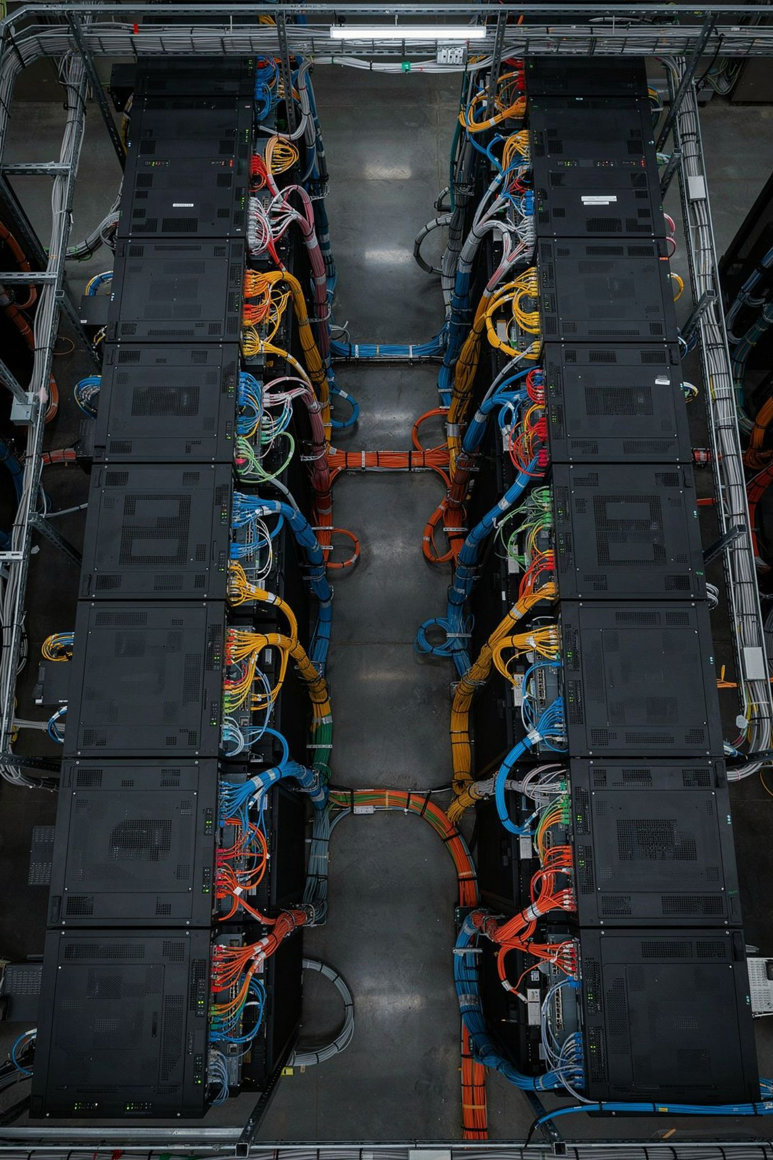
What Is Chef Automate?
Chef Automate is a unified infrastructure observability and compliance platform built on top of the Chef ecosystem. It provides a single pane of glass for monitoring node health, enforcing policy, auditing compliance, and delivering applications — across any cloud, on-premise, or hybrid environment.

Slide 4
The Core Components
Chef Automate brings together four tightly integrated pillars that collectively power enterprise-grade infrastructure automation.
Chef Automate
Infra Server
The central UI and API layer — dashboards, event feed, notifications, and RBAC.
Manages cookbooks, roles, environments, and node run lists at scale.
Compliance
Applications
InSpec-powered scanning engine for auditing nodes against security benchmarks and custom profiles.
Habitat-based application delivery with real-time service health monitoring.

Slide 5

BASIC USE CASE
Centralizing Node Management
Chef Automate aggregates node data from across your entire infrastructure — on-prem, cloud, and hybrid — into a single unified view. You can search, filter, and inspect every managed node by status, platform, environment, or cookbook, eliminating the need to SSH into individual machines to assess fleet health.

Slide 6
BASIC USE CASE
Patch Management & Configuration Drift Detection
Automated Patching
Drift Detection
Define cookbook policies that enforce desired OS and package versions. Chef client runs continuously reconcile each node back to its declared state — ensuring patches are applied consistently and reliably across your fleet without manual intervention.
When a node deviates from its policy — a manual change, a rogue update, or a failed run — Chef Automate flags it immediately. Drift reports surface exactly which resources changed, so engineers can act before small deviations become major incidents.

Slide 7
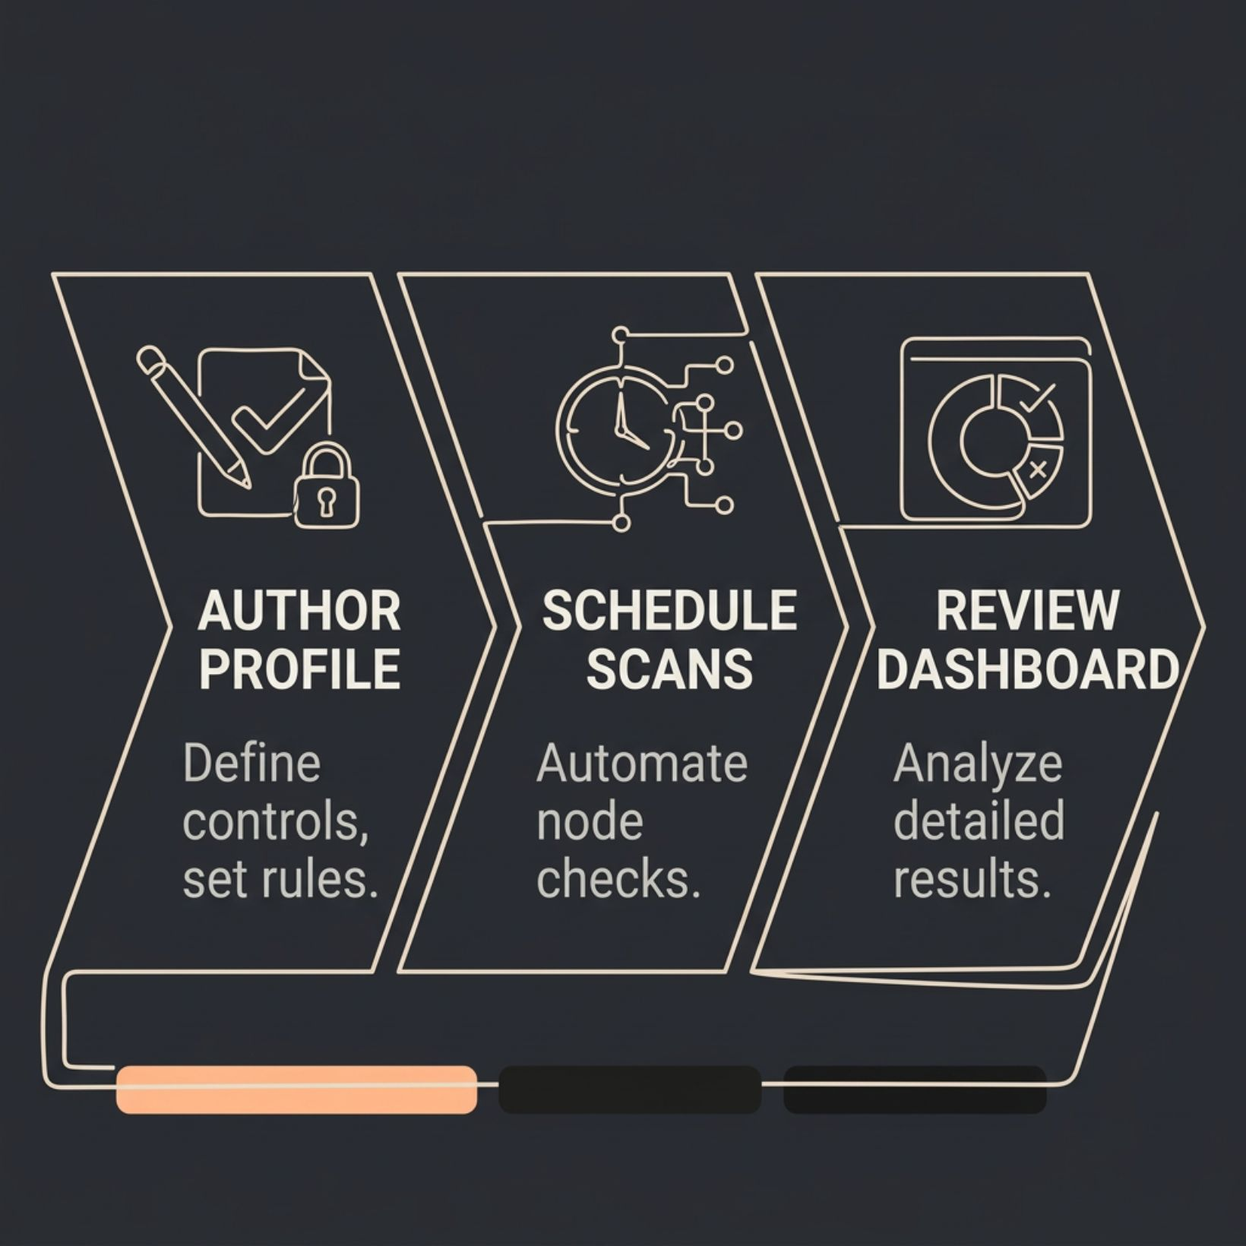
BASIC USE CASE
Running Compliance Scans with InSpec
InSpec profiles let you encode security and regulatory requirements as executable code. Chef Automate runs these profiles across your nodes on a schedule and surfaces pass/fail results per control, per node, and per profile — mapped to frameworks like CIS Benchmarks, DISA STIGs, PCI-DSS, and HIPAA.
Built-in profiles for major compliance frameworks
Custom profiles for internal security policies
Waiver management for accepted risks

Slide 8

BASIC USE CASE
Real-Time Visibility Into Cookbook Run Status
Every Chef client run — successful or failed — is reported back to Chef Automate in real time. The Infrastructure dashboard shows run history, failure counts, resource changes, and error messages, giving ops teams immediate insight into what ran, what changed, and what broke.

Slide 9
BASIC USE CASE
Role-Based Access Control
Chef Automate's RBAC system ensures the right people have access to the right data — and nothing more.
Teams & Users
Projects & Policies
Custom Roles
Map local users or LDAP/SAML identities to Automate teams. Assign roles at the project or resource level.
Segment nodes, compliance results, and event data by project — isolating visibility across business units or environments.
Define fine-grained permissions using Chef Automate's IAM v2 — controlling who can view, update, or delete specific resources.

Slide 10

Graphs & Visualization in Chef Automate
Chef Automate transforms raw infrastructure telemetry into actionable visual intelligence. Its built-in dashboards give engineers, security teams, and leadership a shared view of node health, compliance posture, and configuration change events — all without writing a single query.

Slide 11
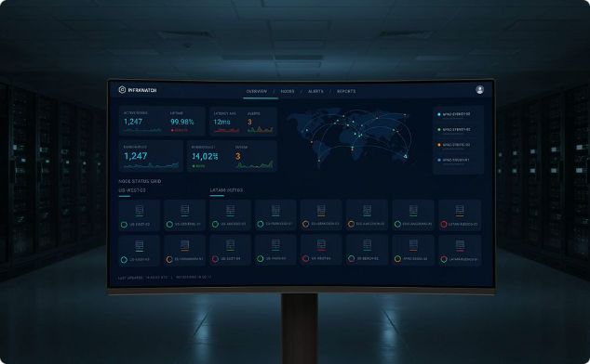
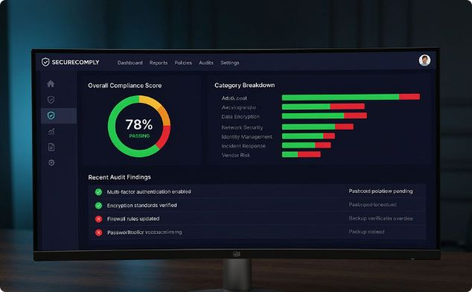
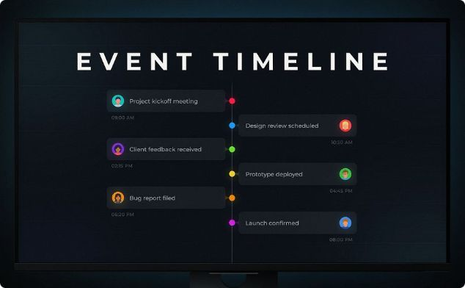
The Three Core Dashboards
Infrastructure Dashboard
Compliance Dashboard
Event Feed
Displays node run status, failure rates, cookbook versions, and resource changes across your entire fleet in real time.
Visualizes InSpec scan results by profile, control, node, and environment — with trend lines showing compliance posture over time.
A chronological stream of every change event — cookbook updates, policy changes, node check-ins — for traceability and auditing.

Slide 12
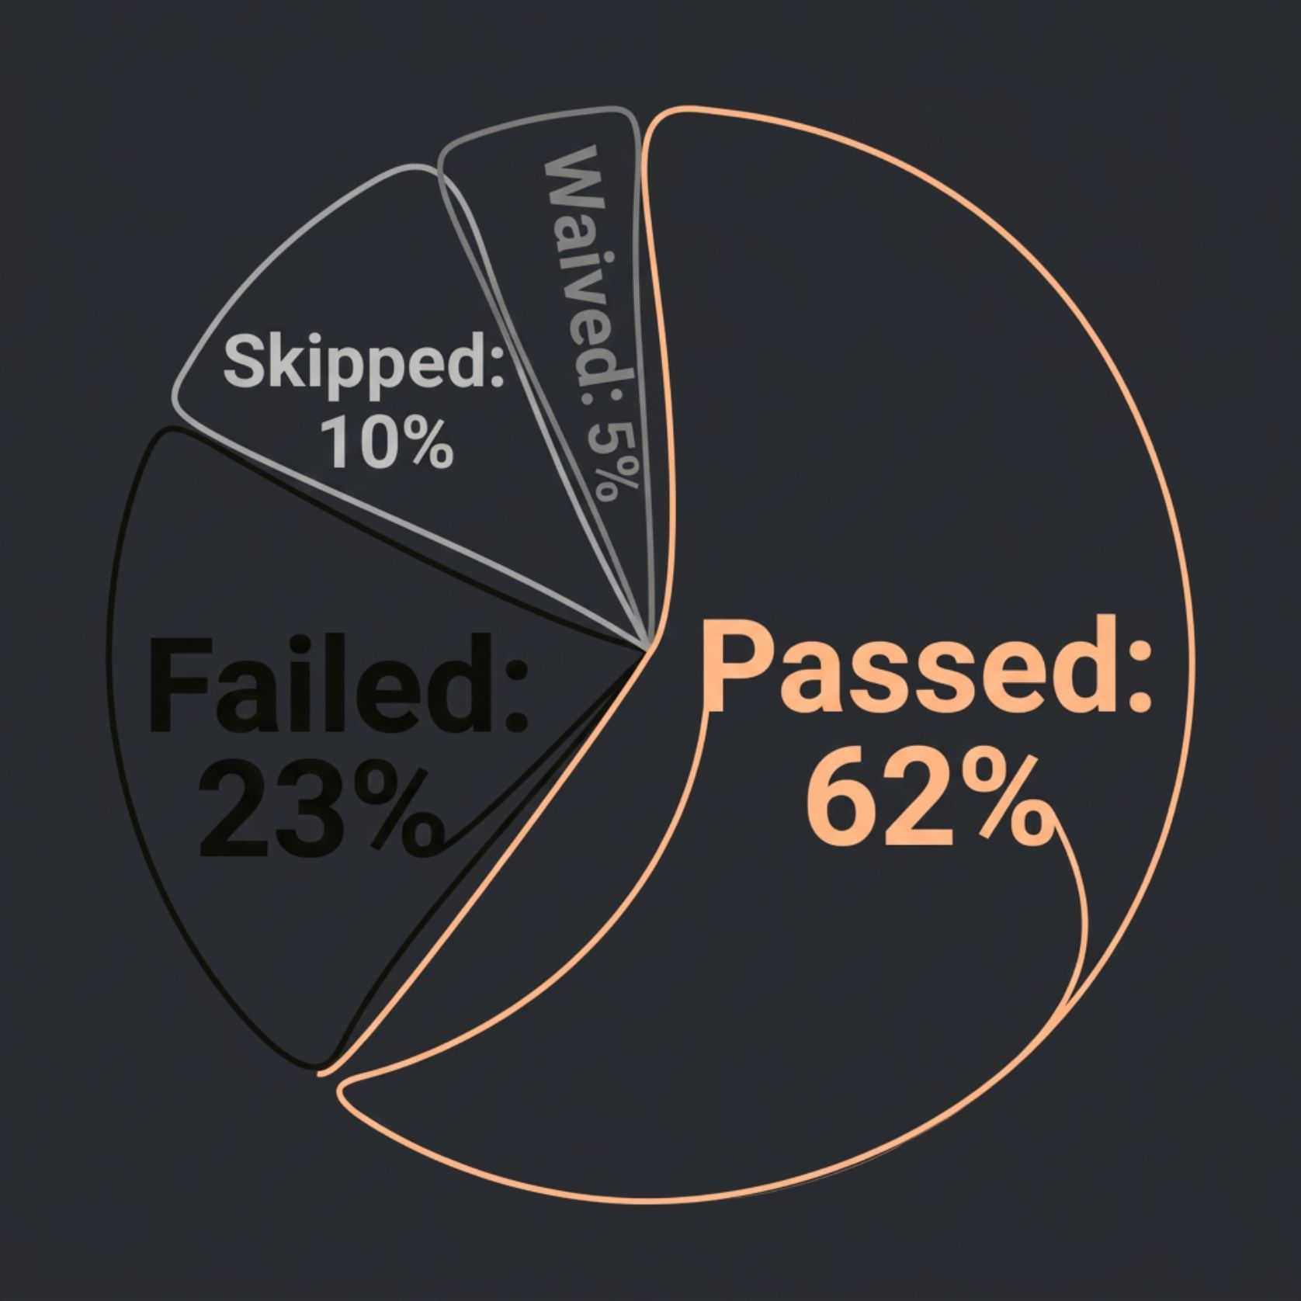
VISUALIZATION
Visualizing Compliance Posture
The Compliance dashboard renders trend lines that track your fleet's pass/fail ratio over time. Use these charts to:
Identify regression after infrastructure changes
Measure remediation effectiveness over sprints
Demonstrate audit-readiness to stakeholders
Pinpoint which controls or profiles are chronic failures

Slide 13

VISUALIZATION
Node Lifecycle Graph: Detecting Anomalies
The Node Lifecycle graph plots each node's check-in history over a configurable time window, making it easy to spot patterns that signal problems.
Missing
Active
Unreachable
Removed
Nodes that transition from Active to Missing without a decommission event often indicate a silent failure — a key signal that's easy to miss without timeline visualization.

Slide 14
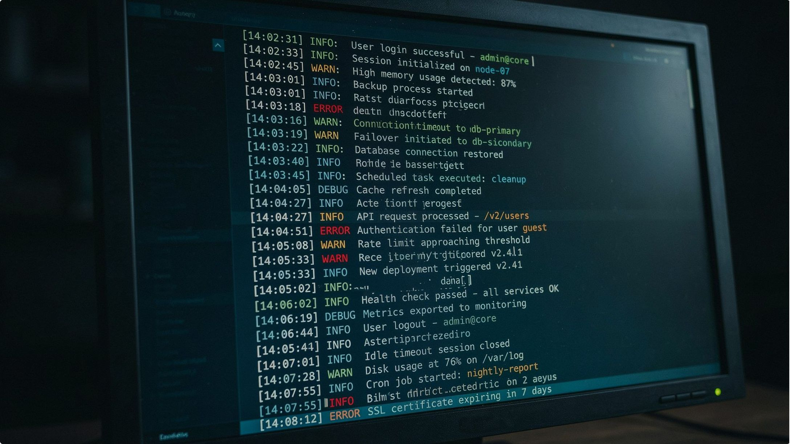
VISUALIZATION
Event Feed Visualization
The Event Feed is your chronological audit trail for every change across your fleet. It captures cookbook uploads, policy applications, node check-ins, and compliance scan completions — all timestamped and searchable.
Use it to correlate incidents with configuration changes: if a service degraded at 3pm, the event feed shows exactly what changed at 2:55pm.

Slide 15
VISUALIZATION
Filtering & Segmenting Views
Powerful filtering lets you slice your infrastructure data to surface exactly what matters to your team right now.
Tags
Environments
Filter nodes by custom metadata tags — team, cost center, application, or criticality tier.
Isolate views to dev, staging, or production — compare compliance posture across environments side by side.
Platforms
Policies
Segment by OS — Ubuntu, RHEL, Windows — to target platform-specific patching or compliance profiles.
View nodes grouped by applied policy file or cookbook, instantly showing which policy versions are live.

Slide 16

VISUALIZATION
Integrating With Splunk, Elastic & Grafana
Chef Automate's Data Feed feature streams compliance and node run telemetry to external platforms — enabling custom dashboards, long-term retention, and cross-tool correlation in your existing observability stack.
Splunk
Elastic Stack
Grafana
Forward compliance and run data as JSON events for SIEM alerting and executive reporting.
Index node telemetry in Elasticsearch and build Kibana visualizations for ops teams.
Connect via the Data Feed API to render time-series compliance and run metrics alongside application performance data.

Slide 17
BEST PRACTICE
Tagging Nodes Consistently
Meaningful tags are the foundation of filtered, actionable reports. Without a consistent tagging taxonomy, dashboards become noise. Establish a company-wide tagging standard before onboarding nodes at scale.
Why It Matters
Consistent tags unlock segmented compliance reports, targeted remediation, and meaningful trend analysis — turning raw data into decision-ready intelligence for every team in your organization.
Use environment tags: env:prod, env:staging
Use team tags: team:platform, team:security
Use criticality tags: tier:1, tier:2
Enforce tags via cookbook attributes or Policyfiles

Slide 18

BEST PRACTICE
Scheduling Scans & Automating Remediation
Run InSpec
Schedule Scans
Detect & Alert
Auto‑Remediate
Automate the full loop — from scan to fix — to reduce mean time to remediation (MTTR) and eliminate manual toil in your compliance workflow.

Slide 19

BEST PRACTICE
Setting Up Failure Notifications
Chef Automate supports webhook-based notifications that fire when a Chef client run fails or a compliance scan crosses a threshold. Integrate with Slack, PagerDuty, or any HTTP endpoint to ensure the right team is alerted the moment something goes wrong — not during the next morning's standup.
Configure per-project or global notification rules
Filter alerts by severity, profile, or environment

Slide 20
BEST PRACTICE
Version-Controlling Policies & Using Habitat
Policyfiles in Source Control
Habitat for Application Delivery
Promotion Pipelines
Use Chef Automate's visibility layer to gate cookbook promotions — only advancing to production when compliance and run success rates meet defined thresholds.
Store all Policyfiles and cookbook versions in Git. Treat infrastructure policy as code — with pull requests, code review, and a full audit trail of every change to your fleet's desired state.
Package applications with Habitat to decouple app delivery from OS configuration. Automate surfaces Habitat service health alongside infrastructure data, giving you a unified operational view.

Slide 21

ADVANCED USAGE
Custom Compliance Profiles & Waiver Management
Beyond built-in benchmarks, teams can author custom InSpec profiles tailored to internal security policies, application-specific controls, or proprietary infrastructure configurations. Waiver management allows formally documenting accepted risks — with expiry dates and justifications — so exceptions are tracked and auditable rather than silently ignored.

Slide 22
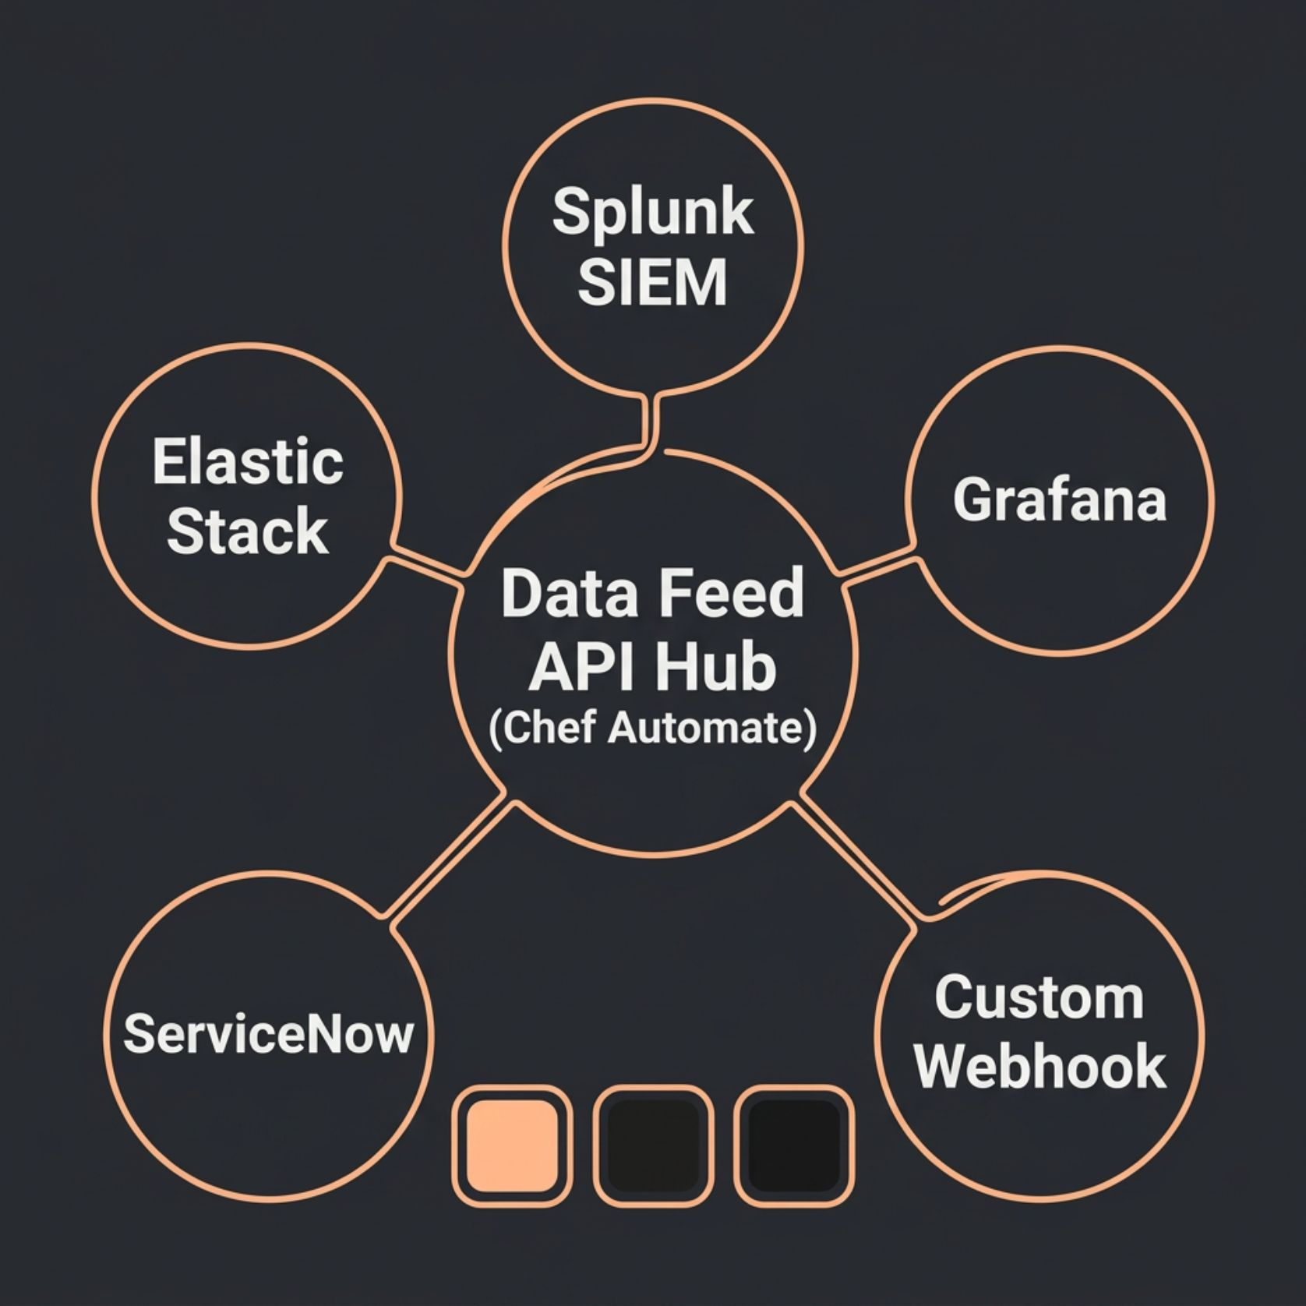
ADVANCED USAGE
Data Feeds API: Exporting to External SIEM Tools
The Data Feeds API enables continuous streaming of Chef Automate telemetry to any external system. Configure multiple destinations simultaneously — each receiving a normalized JSON payload of compliance results and node run data.
Supports custom HTTP endpoints with auth headers
Configurable push intervals (as low as 4 hours)
Payload includes full control-level detail
Ideal for long-term retention beyond Automate's default window

Slide 23

ADVANCED USAGE
Chef Automate in Multi-Cloud & Hybrid Environments
Chef Automate is cloud-agnostic by design. A single Automate instance can aggregate telemetry from nodes running on AWS, Azure, GCP, and on-premise data centers simultaneously — providing a unified compliance and operational view regardless of where your workloads live. Use cloud-specific InSpec resources to audit cloud configuration directly alongside OS-level controls.

Slide 24

ADVANCED USAGE
Automating End-to-End CI/CD Pipelines
Commit & Build
Automate Approval
Staging Gate
Chef Automate acts as the visibility and gating layer in your pipeline — blocking promotions when compliance scores or run success rates fall below acceptable thresholds, ensuring only validated, compliant code reaches production.

Slide 25


Key Takeaways & Next Steps
1
Start with Visibility
Onboard nodes, establish consistent tagging, and get your Infrastructure and Compliance dashboards operational first.
2
Enforce Compliance as Code
Adopt InSpec profiles early. Version-control them alongside your cookbooks and schedule automated scans from day one.
3
Integrate & Scale
Connect Automate to your SIEM, alerting, and CI/CD tools to build a fully automated, self-healing infrastructure pipeline.
Start small, instrument everything, and let Chef Automate's visibility layer guide your path to full automation maturity.

