Slide 1
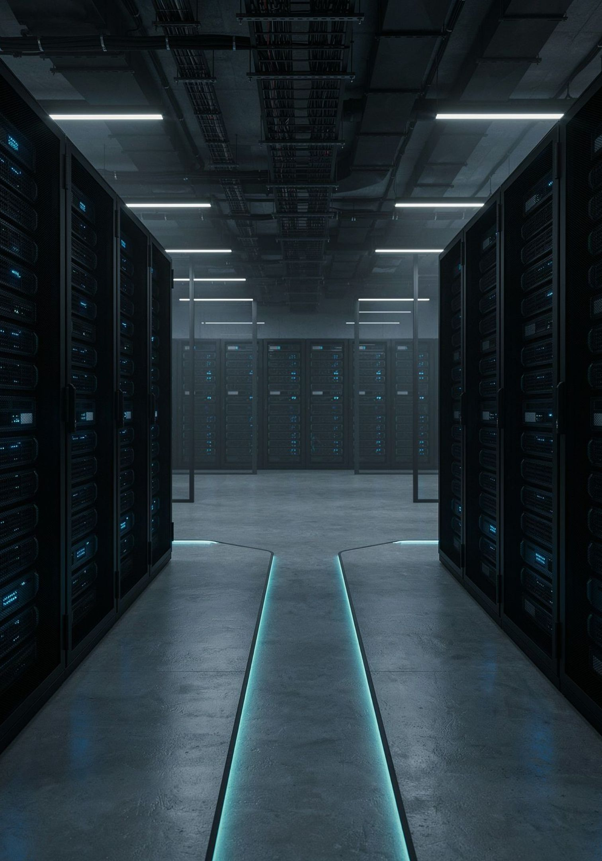
Tenable vs. Qualys: What You Need to Know
A practical guide to understanding both platforms — and why Qualys is the stronger choice for modern enterprise vulnerability management.

Slide 2
Agenda: What We'll Cover Today
01
02
03
The Landscape
Tenable Deep Dive
Qualys Deep Dive
Why vulnerability management tools are mission-critical
Capabilities, use cases, and where it falls short
Architecture, products, and key differentiators
04
05
Head-to-Head Comparison
Qualys in Practice
Feature-by-feature breakdown and why Qualys wins
Onboarding, dashboards, integrations, and best practices

Slide 3
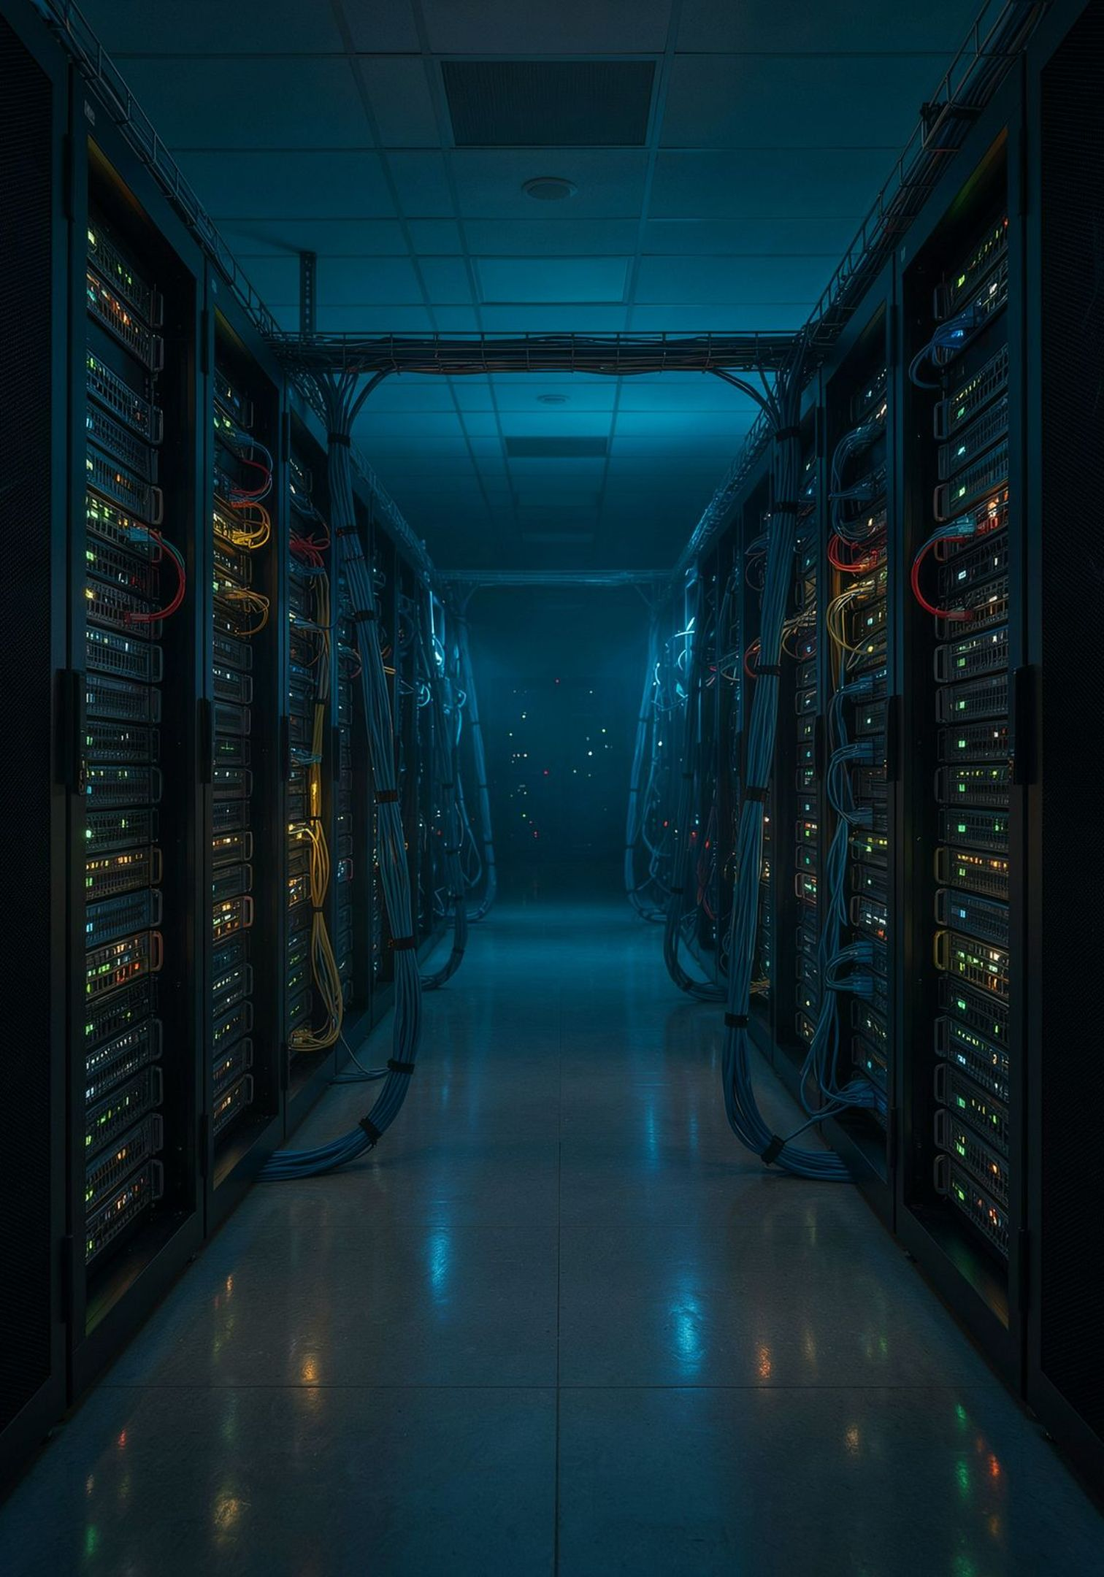
The Vulnerability Management Landscape
Every unpatched vulnerability is an open door. In today's threat environment, organizations face thousands of exposures across endpoints, cloud workloads, containers, and OT systems — often without realizing it.
🔍 Find
Continuously discover assets and scan for known vulnerabilities
⚖️ Prioritize
Risk-score findings so teams focus on what matters most
🛠️ Remediate
Drive fixes through ticketing, automation, and reporting
📋 Comply
Demonstrate posture to auditors and regulators continuously

Slide 4
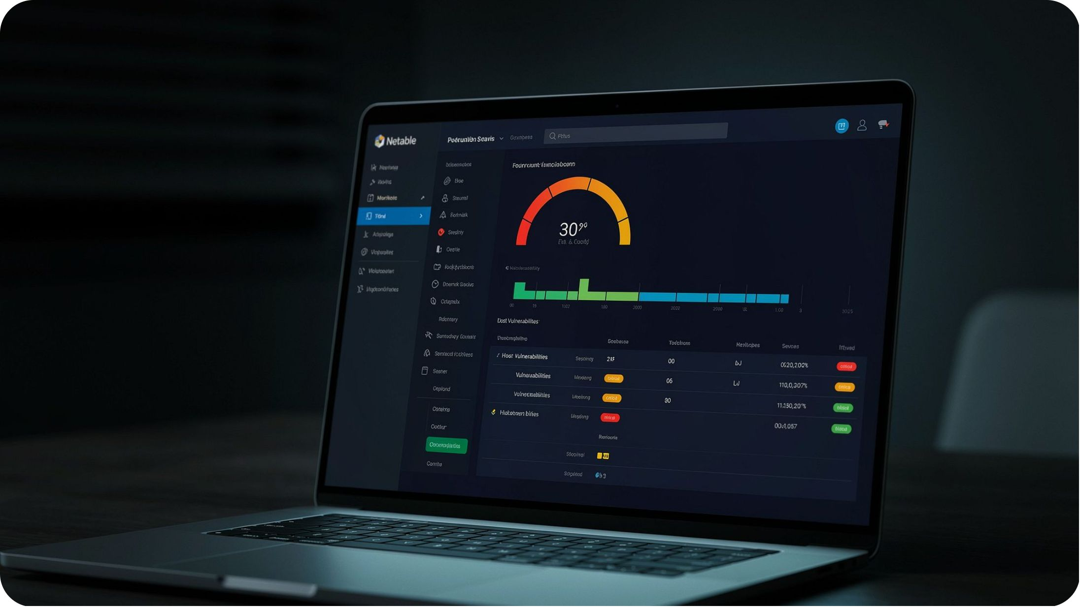
TENABLE
Introducing Tenable
Founded in 2002, Tenable pioneered vulnerability scanning with the Nessus scanner — still one of the most widely deployed tools in the world.
Tenable.io: Cloud-based VM platform
Tenable.sc: On-premises enterprise option
Nessus Pro: Standalone scanner for smaller teams
OT Security: Operational technology coverage
Tenable One: Exposure management platform

Slide 5
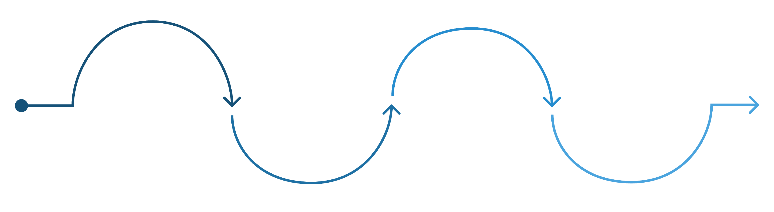
How Tenable Works
Authenticate
Report Findings
Deploy Scanner
Provide credentials for credentialed scans
Run Plugins
Send vulnerability results to console
Execute Nessus checks across assets
Install agent or scanner on targets
Tenable uses Nessus plugins (100,000+) to detect vulnerabilities. Scanning can be agent-based, agentless (credentialed/uncredentialed), or passive — covering cloud, on-prem, and mobile assets.

Slide 6

Tenable in Practice
Scheduled Network Scanning
Weekly or monthly credentialed scans across subnets, ideal for mid-market environments with stable infrastructure.
Compliance Auditing
Using built-in audit files to check CIS benchmarks, DISA STIGs, and PCI-DSS configurations.
Developer/DevOps Scanning
Container image scanning and CI/CD pipeline integration via Tenable.io for shift-left security.

Slide 7

TENABLE LIMITATIONS
Where Tenable Falls Short
Siloed Products
Tenable.io and Tenable.sc are separate platforms requiring separate licensing, data, and workflows — creating operational gaps at scale.
Scanner-Centric Architecture
Heavy reliance on scan scheduling means visibility gaps between scan windows. Near-real-time coverage requires significant agent rollout.
Remediation Workflow Gaps
Tenable surfaces findings but offers limited native remediation orchestration. Teams must rely on external ticketing tools.

Slide 8
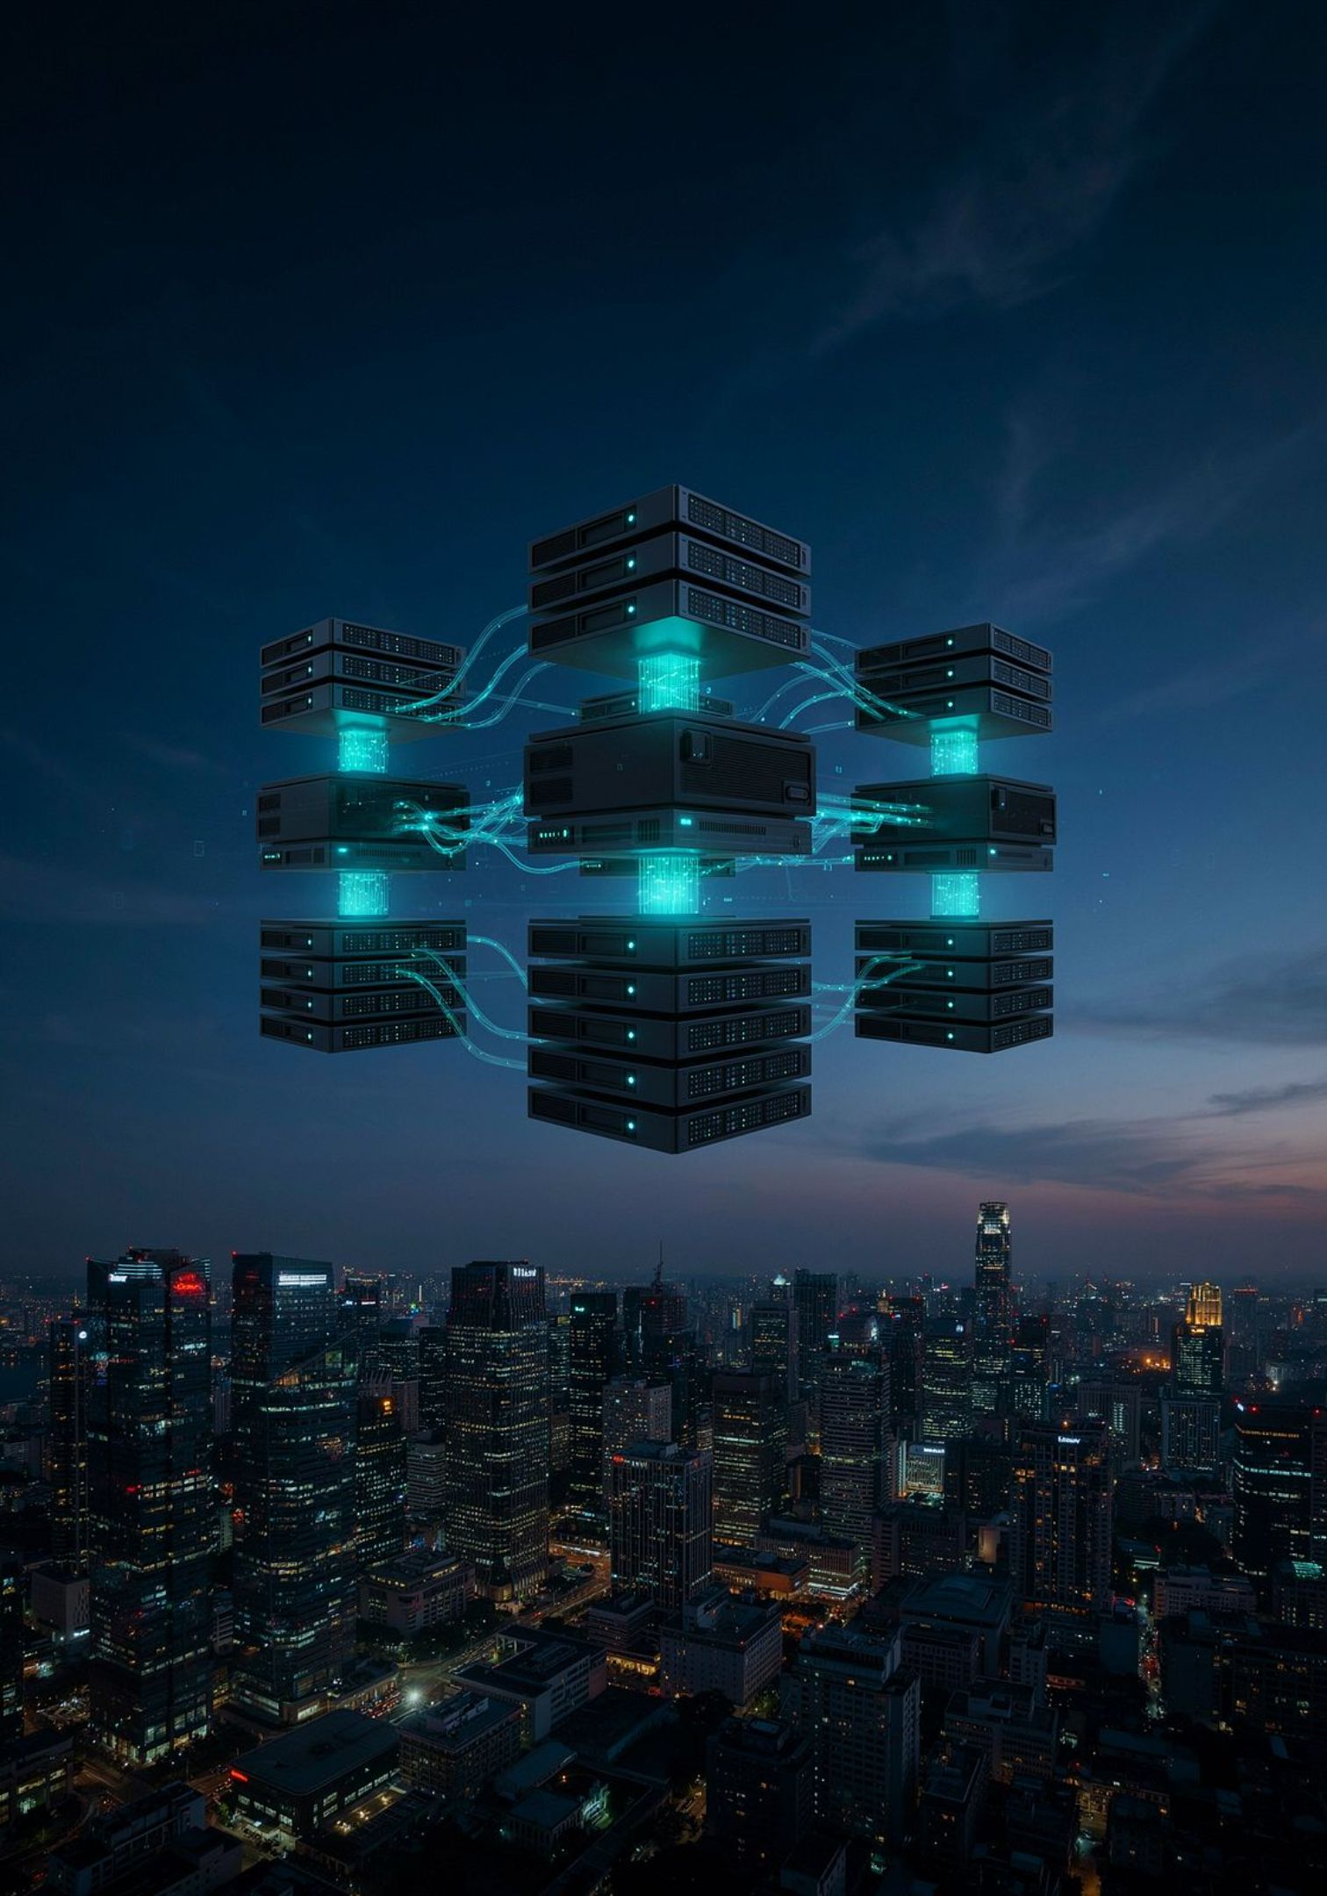
QUALYS
Introducing Qualys
Founded in 1999, Qualys pioneered cloud-native security long before it was the norm. Its single-platform architecture powers a full suite of security and compliance apps — no hardware required.
VMDR
Vulnerability Management, Detection & Response
CSAM
Cyber Security Asset Management
Policy Compliance
CIS, DISA, PCI, HIPAA benchmarks
TruRisk
AI-driven risk scoring and prioritization

Slide 9
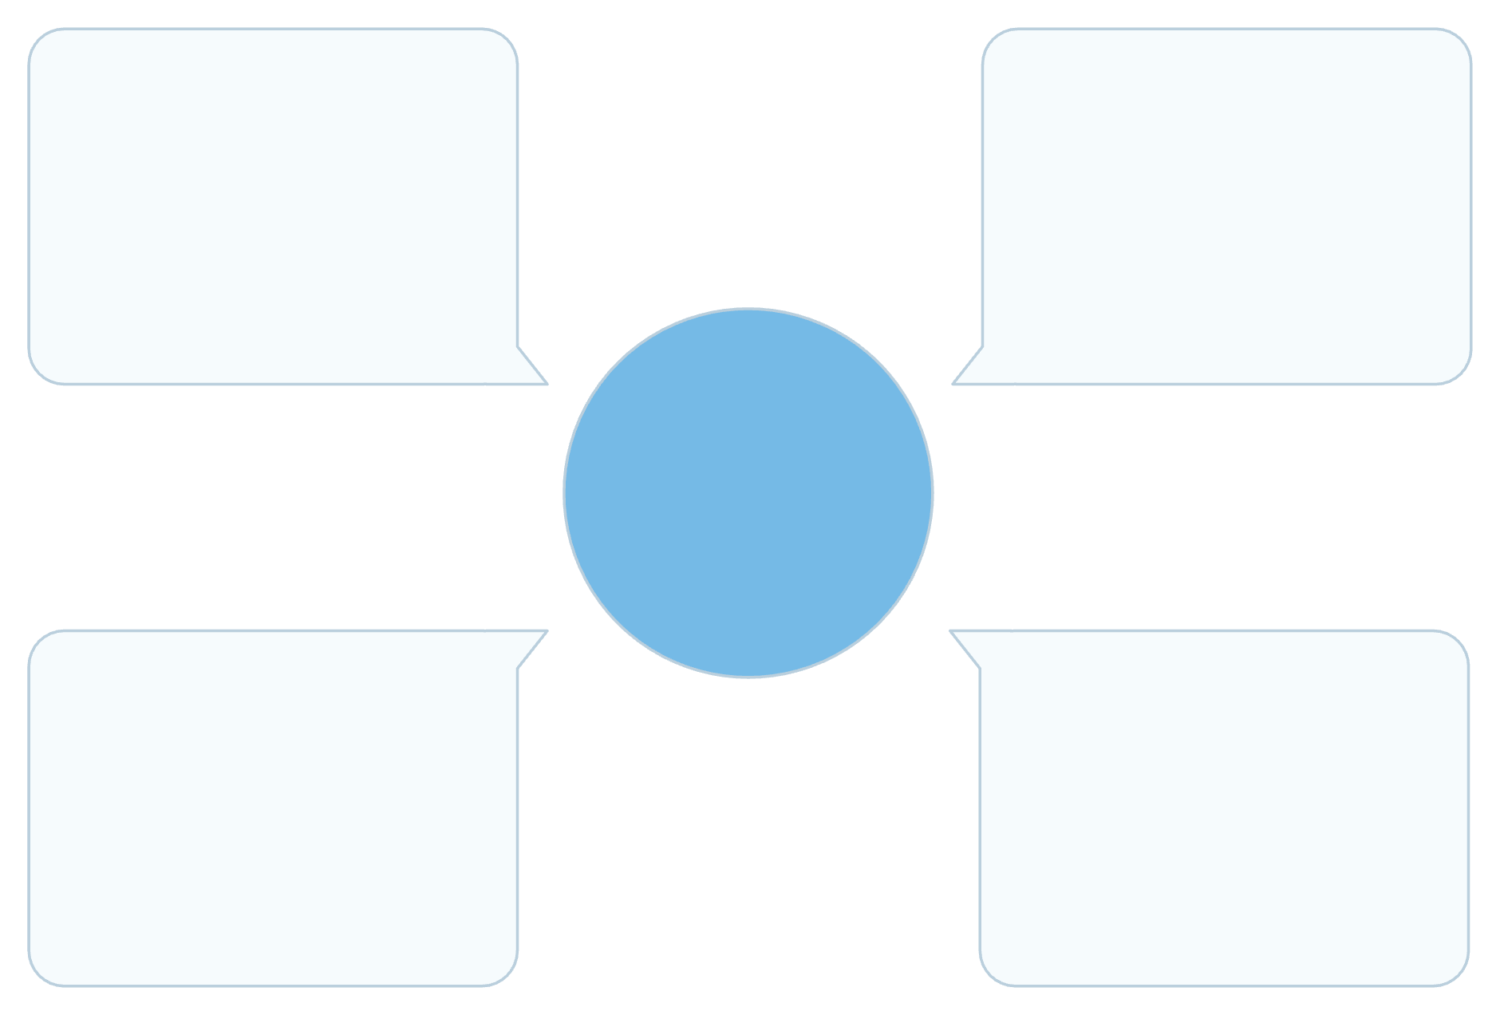

How Qualys Works
One Platform, Three Collection Methods
Qualys Cloud Platform
Qualys Cloud Agent
Qualys ingests data from lightweight agents (2–5 MB, no reboot), virtual scanner appliances, and cloud API connectors — all feeding a single cloud backend. Data is normalized, deduplicated, and scored automatically.
Unified analysis and reporting
Continuous endpoint telemetry
One Platform, Three Methods
API Connectors
Virtual Scanner Appliance
Agents provide continuous visibility between scan windows — a key advantage over traditional scanners.
Cloud asset ingestion
Network-based scanning

Slide 10
Qualys vs. Tenable: Head-to-Head
Feature | Tenable | Qualys
Architecture | Multiple products (io, sc, Nessus) | Single unified cloud platform
Agent Footprint | Moderate; can impact performance | Lightweight (~2–5 MB), low CPU impact
Risk Scoring | VPR (Vulnerability Priority Rating) | TruRisk — broader context, AI-driven
Compliance | Audit files via Nessus plugins | Native Policy Compliance app, built-in
Remediation | External tools required | Native Patch Management included
Cloud Coverage | Connectors available, less native | Deep native AWS, Azure, GCP integration

Slide 11
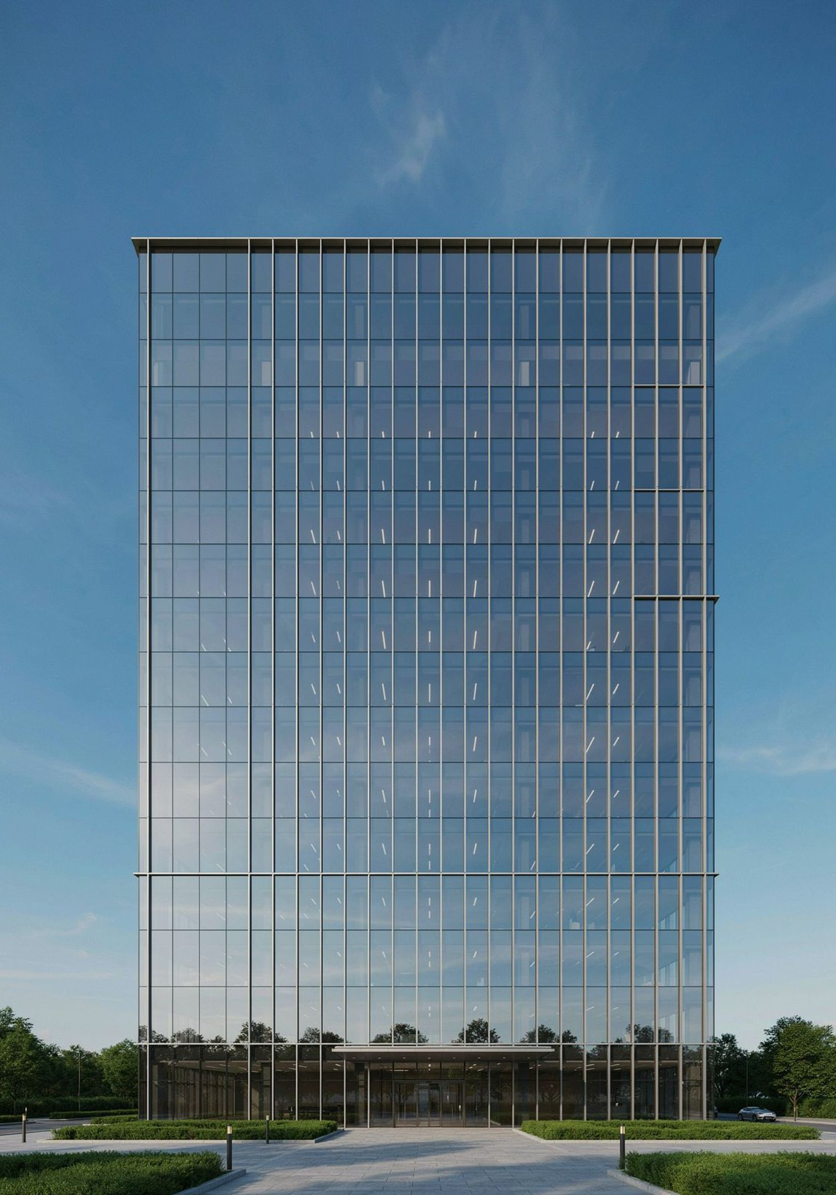
Why Qualys Wins
Enterprise Scalability
Higher Accuracy
Qualys handles millions of assets across hybrid environments from a single pane of glass — no data silos.
Continuous agent data reduces false positives and catches vulnerabilities between scan windows.
Unified Visibility
One platform covers VM, compliance, patching, and asset management — eliminating tool sprawl.

Slide 12

CSAM
Qualys Asset Management
You can't secure what you don't know you have. Qualys Cyber Security Asset Management (CSAM) builds a continuously updated inventory of every asset — on-prem, cloud, remote, and unmanaged.
Auto-discovery via agents, scanners, and cloud APIs
Asset tagging by business unit, criticality, or location
End-of-life software and hardware detection
Integration with CMDB tools like ServiceNow

Slide 13
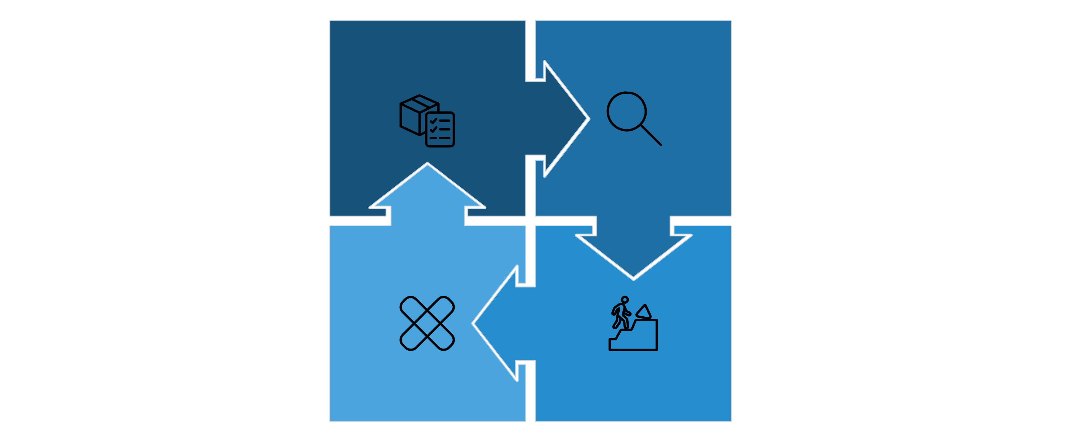
VMDR
Qualys VMDR: One Platform, Full Lifecycle
Discover
Assess
Remediate
Prioritize
VMDR consolidates four historically separate tools into one. Teams move from finding vulnerabilities to patching them without leaving the platform — dramatically reducing mean time to remediate (MTTR).

Slide 14

Qualys Policy Compliance
Automate configuration audits against industry benchmarks — continuously, not just at audit time.
1
2
Select a Framework
Run Continuous Checks
CIS Benchmarks, DISA STIGs, PCI-DSS, HIPAA, NIST, and more — 500+ built-in policies
Agents evaluate configurations in real time, not just during scheduled scans
3
Remediate & Report
Generate audit-ready evidence reports automatically; assign fixes via ServiceNow or Jira

Slide 15
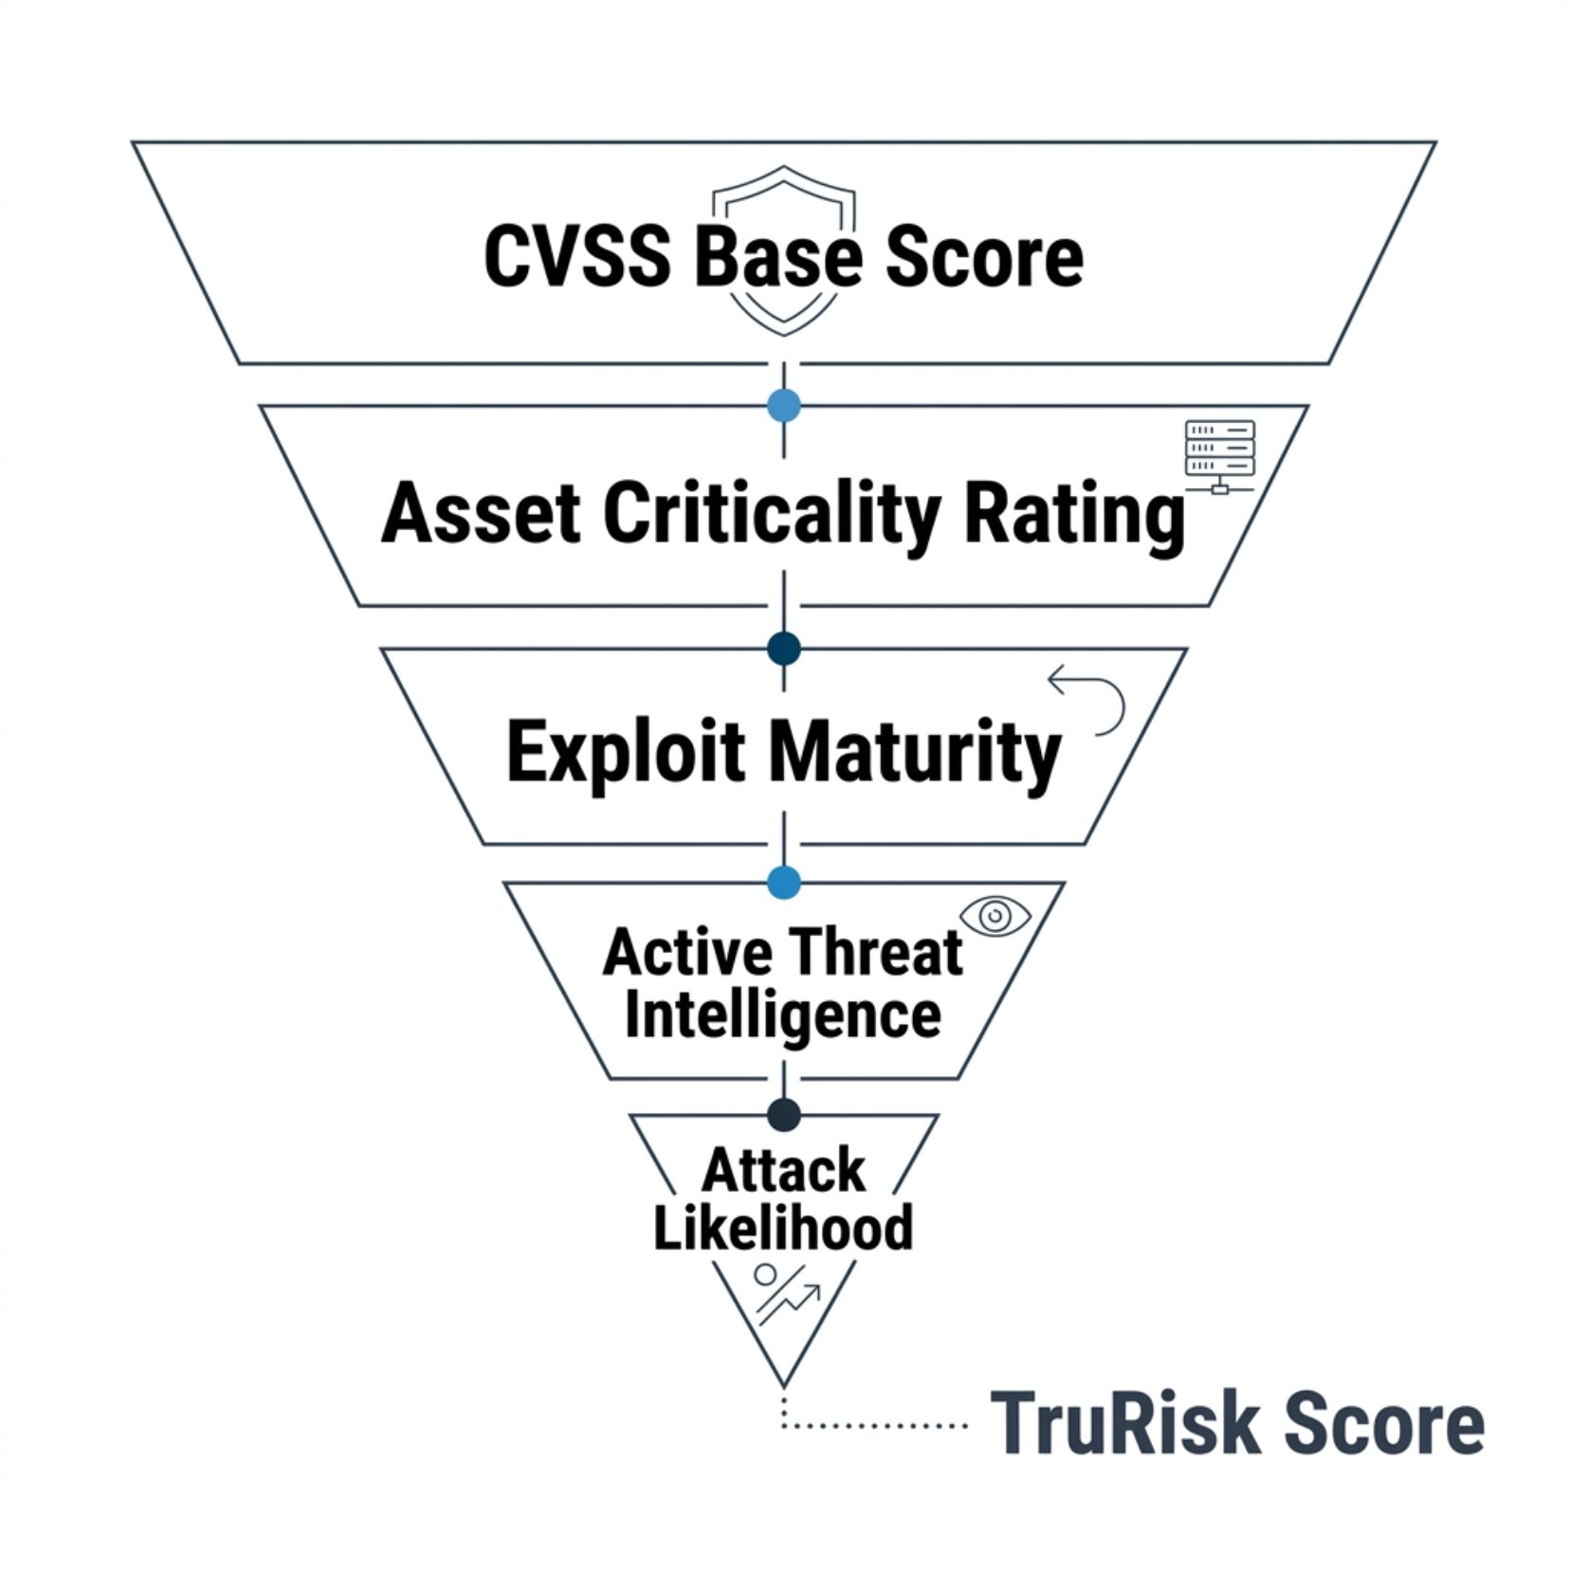

TRURISK
Qualys TruRisk
Not all vulnerabilities are equal. TruRisk goes beyond CVSS scores by combining asset criticality, real-world threat intelligence, exploit availability, and active attack likelihood into a single actionable risk score.
Asset Criticality Rating (ACR): Weight findings by business impact
Threat Intelligence Feeds: CISA KEV, exploit DB, dark web signals
Risk Aggregation: Roll up scores at host, group, or org level
TruRisk helps security teams reduce remediation backlog by focusing on the ~5% of vulnerabilities that pose real risk.

Slide 16




Getting Started with Qualys
Provision Subscription
Deploy Agents
Activate modules in the Qualys Cloud Platform portal; assign user roles and business units
Push the 2–5 MB Cloud Agent via GPO, SCCM, Ansible, or Jamf — no reboot required
Deploy Scanners
Run First Scan
Install virtual scanner appliances for network segments where agents aren't feasible
Launch an authenticated scan or rely on agent data — findings appear in minutes

Slide 17
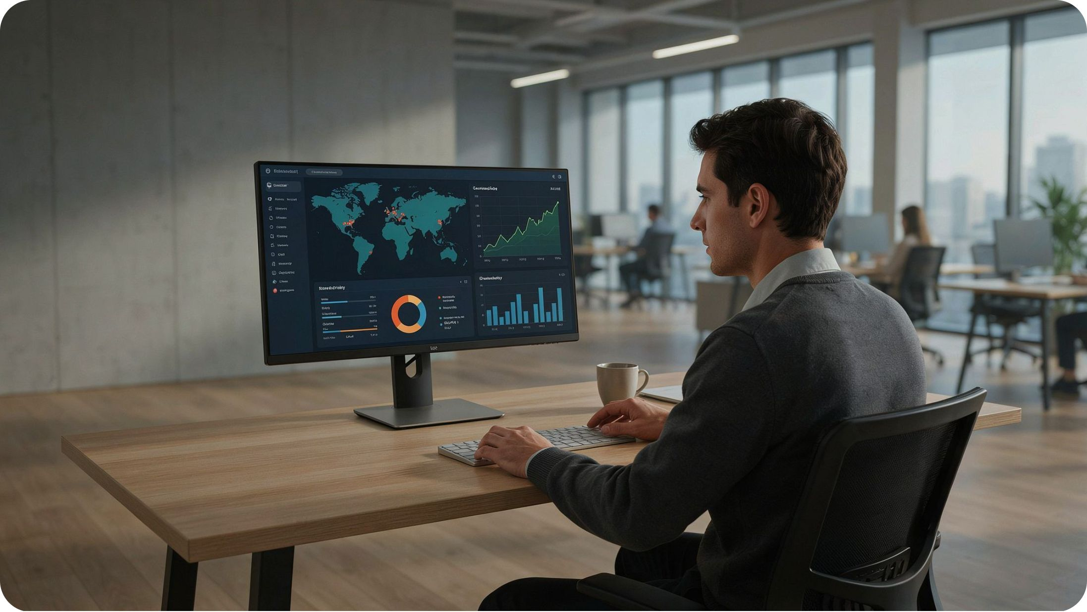
REPORTING
Dashboards & Reports
Qualys transforms raw vulnerability data into clear, role-appropriate insights — from executive summaries to technical remediation tickets.
Executive Dashboard: TruRisk trend, SLA compliance, top risks
Technical Reports: Host-level findings, CVE details, fix guidance
Compliance Reports: Pass/fail per control, audit evidence export
Custom Widgets: Drag-and-drop QQL-powered dashboards
Use Qualys Query Language (QQL) to filter and slice data across any dimension — asset tag, OS, severity, or business unit.

Slide 18

Integrating Qualys With Your Stack
SIEM Integration
ITSM / Ticketing
DevSecOps / CI-CD
Stream findings to Splunk, Microsoft Sentinel, or IBM QRadar via syslog, API, or native connectors for correlated threat detection.
Auto-create and assign remediation tickets in ServiceNow, Jira, or Remedy with full vulnerability context and SLA tracking.
Embed Qualys container scanning and IaC checks into Jenkins, GitLab, or GitHub Actions pipelines to catch issues before deployment.

Slide 19



Common Qualys Mistakes to Avoid
❌ Skipping Asset Tagging
Without tags, reports are ungrouped noise. Tag by environment, owner, and criticality from day one — it powers every downstream workflow.
❌ Ignoring ACR Tuning
Default Asset Criticality Ratings may not reflect your business. Tune ACR for crown-jewel systems to ensure TruRisk scores are meaningful.
❌ Scanner-Only Deployment
Relying solely on scanners creates blind spots. Always complement with agents for laptops, remote workers, and ephemeral cloud instances.
❌ No SLA Policy Defined
Without remediation SLAs tied to severity, dashboards are decorative. Define fix timelines (e.g., Critical = 7 days) and enforce them via reporting.

Slide 20
Key Takeaways & Next Steps
What You Learned
Your Next Steps
Tenable is mature but siloed — multiple products, limited native remediation
Qualys is cloud-native, unified, and purpose-built for enterprise scale
TruRisk and VMDR together close the loop from discovery to patch
Proper tagging, ACR tuning, and agent coverage are foundational
Request a Qualys trial or POC for your environment
Inventory existing tools and identify gaps Qualys can fill
Define asset tagging taxonomy before agent rollout
Set remediation SLAs aligned to your risk policy
Connect Qualys to ServiceNow or Jira for ticketing
Schedule a TruRisk review with your security leadership
The best vulnerability management program is one that runs continuously, not just at audit time. Qualys makes that possible at scale.

