Slide 1
Blood Database
Project-I Final Presentation

Slide 2
Team Members
Maheshwor Acharya (19070110)
Dipak Sharma (19070105)
Atrip Angthupo (19070096)
Ashish B.K (19070095)
Abhishek Bhatta (19070089)
Supervisor
Muhammad Humayo

Slide 3
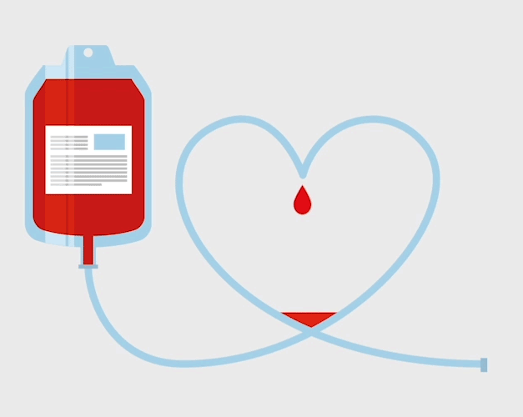
Contents
Objective
Motivation
Technologies Used
Implementation
Final Result
Live Demo
Q&A

Slide 4
Objective
A medium of communication between Blood receiver and potential Donors .
To save lives at emergencies.
Save time to search availability of person with required blood and easy contact.
Post a Blood Request.

Slide 5
Motivation
We initiated this project not just for credit point but to learn/practice about practical applications of Programming and work on real world project.
The main motivation is to contribute to our community at some situations like today (pandemic).

Slide 6
Technologies Used
Python as backend programming language.
Flask ,a mini web-framework
MySQL Database
HTML , CSS and Javascript (frontend)
Github for code sharing

Slide 7
Implementation

Slide 8
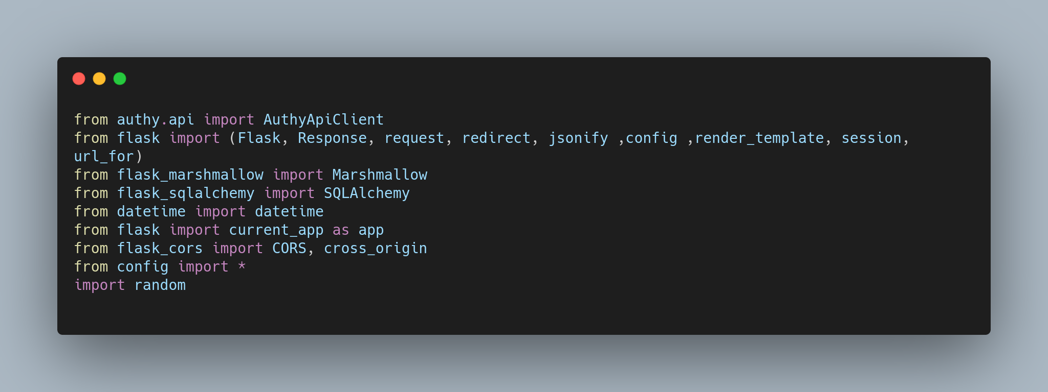
Modules used in backend

Slide 9
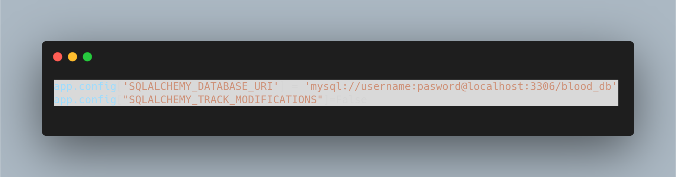
Database Configuration

Slide 10
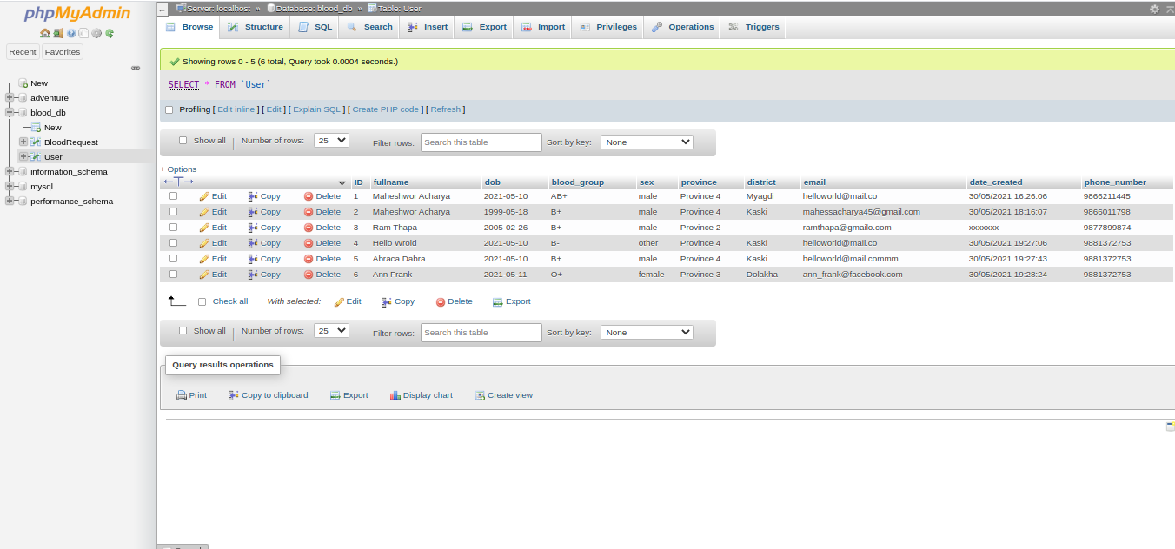
Database

Slide 11
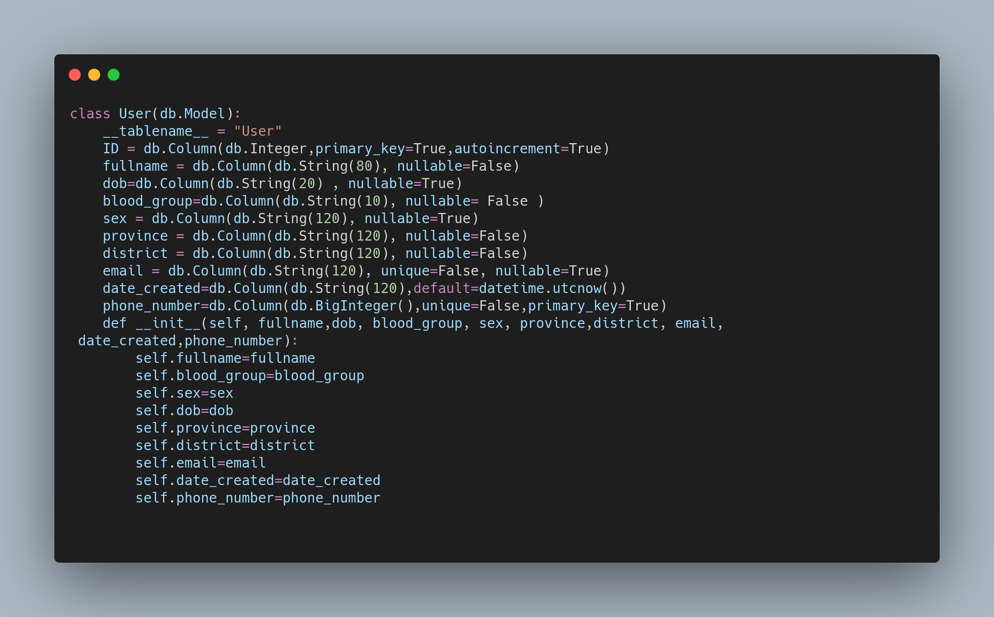
Database table in the form of Class

Slide 12
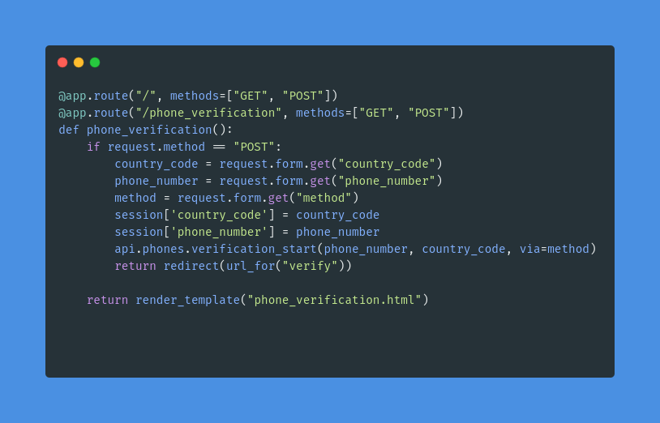
Routes
Phone Verification

Slide 13
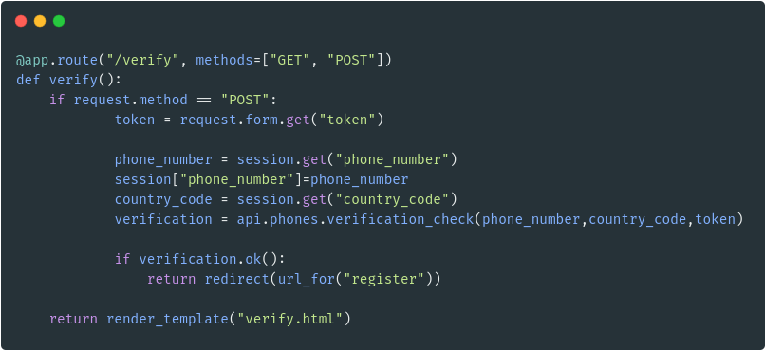
/verify
Twilio - A third party API for phone verification.

Slide 14
Front- End overview
Verify yourself with Phone Number and Registering yourself.
Searching Blood
Post Blood Request

Slide 15
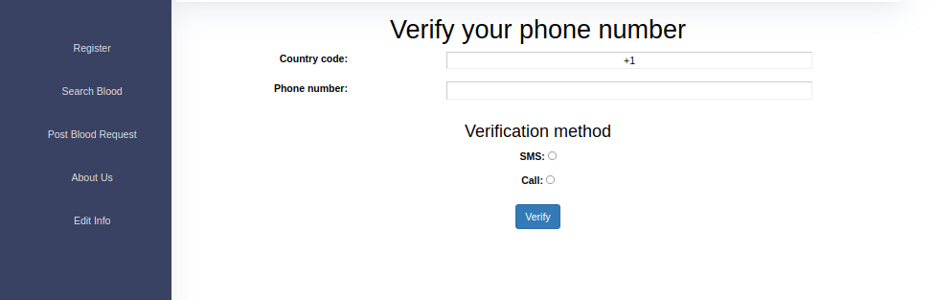

Slide 16
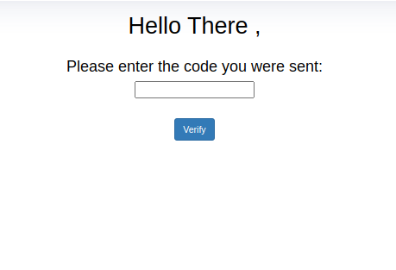
Verification...

Slide 17
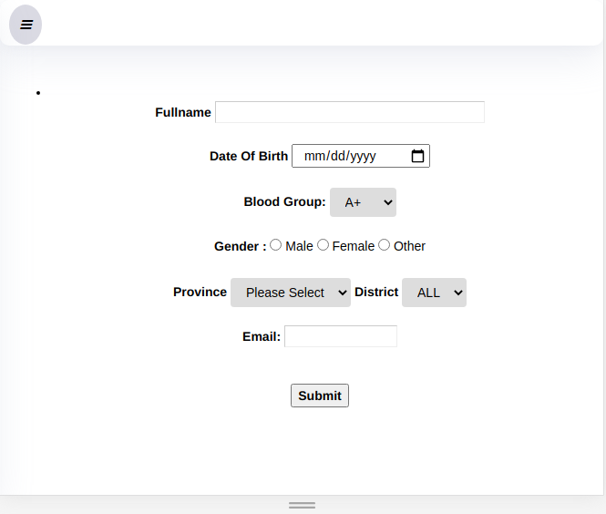
Register page

Slide 18
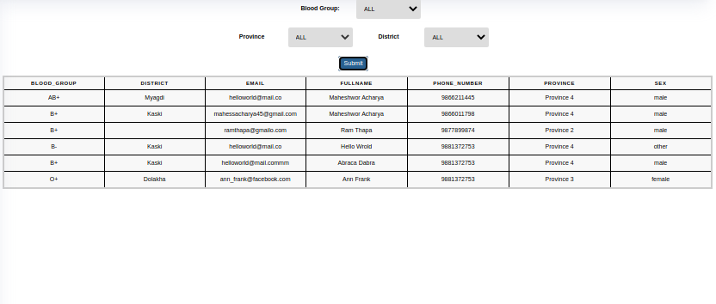
Searching Blood

Slide 19
Live Demo

Slide 20
Any Queries?
Prepared By:
Maheshwor Acharya

