Slide 1
Fundamentals and Benefits of CI/CD to Achieve, Build, and Deploy Automation for Cloud-Based Software Products
By Osanebi Peter

Slide 2
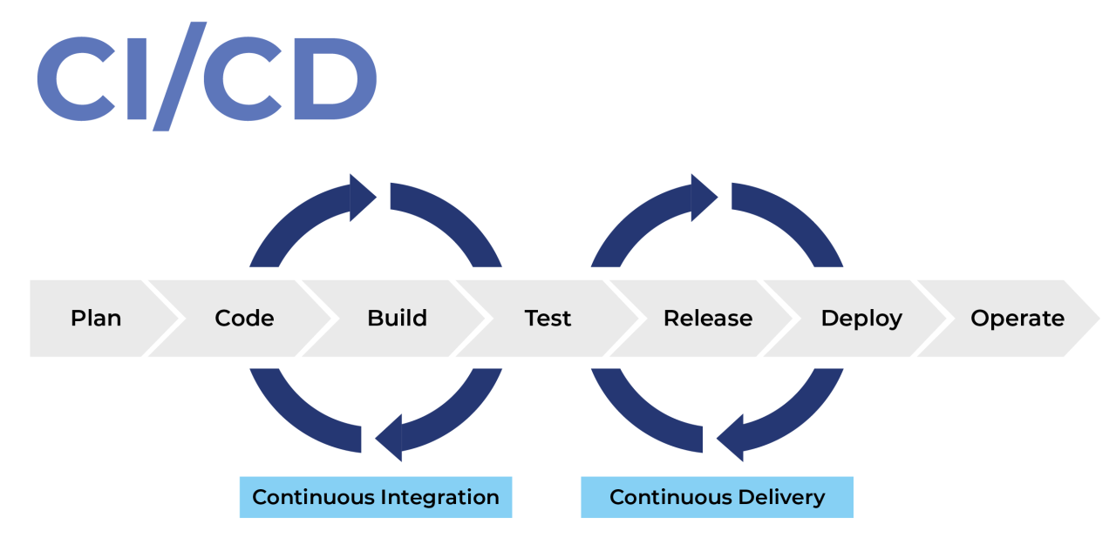
WHY CI/CD?
CI/CD allows organizations to ship software quickly and efficiently. CI/CD facilitates an effective process for getting products to market faster than ever before, continuously delivering code into production, and ensuring an ongoing flow of new features and bug fixes via the most efficient delivery method

Slide 3
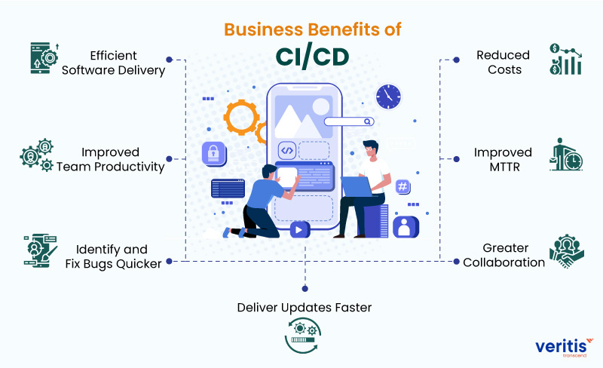
BENEFITS OF CI/CD TO THE BUSINESS

Slide 4
BENEFITS CONT…
1) Efficient Software Delivery
With continuous delivery, your team can automatically build, test, and prepare code changes for release to production, enabling a more efficient and rapid software delivery.
2) Improved Team Productivity
CI/CD practices improve your team’s productivity by freeing developers from manual tasks, reducing the number of errors and bugs deployed to customers.
3) Identify and Fix Bugs Quicker
With CI/CD, your team can perform more frequent and comprehensive testing and quickly identify and address bugs earlier. Continuous delivery enables you efficiently perform additional types of code tests. The discipline of ‘more tests more frequently’ enables teams to deliver quality code with a high assurance of stability and security.

Slide 5
BENEFITS CONT…
4) Deliver Updates Faster
Continuous delivery enables faster and frequent delivery of updates to customers. When implemented properly, continuous delivery will help you always have a deployment-ready build artefact that has passed through a standardized test process.
5) Greater Collaboration
CI/CD promotes closer team communication by enabling development, operational, management, and QA teams to collaborate on technologies, practices, and priorities.
6) Improved MTTR
Smaller code changes and quick fault isolation enabled by CI/CD practices reduce the Mean Time To Resolution (MTTR). CI/CD plays a vital role in keeping failures to a bare minimum and quickly recovering from any failures that do happen.
7) Reduced Costs
Automation in the CI/CD pipeline minimizes the number of errors that can occur in the many repetitive steps of CI and CD. It also frees up developers’ time that could be spent on product development as there won’t be many code changes to fix since the errors are identified quickly.
Moreover, increasing code quality with CI/CD also increases your ROI.

