Slide 1

Electronic Payment Systems
20-763
Lecture 7:
Credit Card Protocols

Slide 2
Outline
Credit card participants (7)
Secure Sockets Layer (SSL)
  security with public keys
Secure Electronic Transactions (SET)
  authentication with certificates
3-D Secure
  authentication without certificates
Fraud
Online card reading
Notes:
52

Slide 3


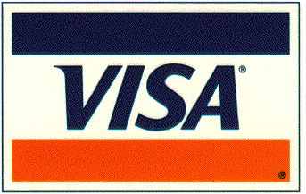





Participants
Processor
Processor
Card
Association
Merchant
Issuing Bank
Issues card
Extends credit
Assumes risk of card
Cardholder reporting
Consumer
Merchant Bank (Acquirer)
Sets up merchant
Extends credit
Assumes risk of merchant
Funds merchant
ELECTRONIC PAYMENT SYSTEMS 20-763 SPRING 2004 COPYRIGHT © 2004 MICHAEL I. SHAMOS

Slide 4
Credit Cards on the Internet
Problem: communicate credit card and purchasing data securely to gain consumer trust
  Authentication of buyer and merchant
  Confidential transmissions
Systems vary by
  type of public-key encryption
  type of symmetric encryption
  message digest algorithm
  number of parties having private keys
  number of parties having certificates
Notes:
52

Slide 5
Credit Card Protocols
SSL 1 or 2 parties have private keys
TLS (Transport Layer Security)
  IETF version of SSL
i KP (IBM) i parties have private keys
SEPP (Secure Encryption Payment Protocol)
  MasterCard, IBM, Netscape based on 3KP
STT (Secure Transaction Technology)
  VISA, Microsoft
SET (Secure Electronic Transactions)
  MasterCard, VISA all parties have certificates
3-D Secure real-time authentication
VERY IMPORTANT.
USAGE INCREASING
OBSOLETE
VERY SLOW
ACCEPTANCE; DEAD
RAPID
EXPANSION
Notes:
52

Slide 6


SSL (Secure Sockets Layer) Concept
PURPOSE: ALLOW A USER WITHOUT A CERTIFICATE TO SEND
SECRET INFORMATION (A CREDIT CARD NUMBER) EFFICIENTLY
Merchant
Non-Internet (telephone) line
Credit Card
Acquirer
Secure
“tunnel”
through the
Internet
Consumer must trust merchant with card
Similar to ordinary phone order
High transaction costs
Acquirer
notifies
Issuer
Internet
Credit Card
Issuer
Consumer
Issuer bills Consumer
SOURCE: MARVIN SIRBU

Slide 7

SSL Overview
Client has no certificate
Merchant has a certificate, therefore public and private keys
Merchant sends its certificate; client now has merchant’s public key
Client can send encrypted data to merchant
Merchant can’t send encrypted data to client
BRILLIANT IDEA: client creates a symmetric key, sends it to merchant
Now both can communicate secretly and fast
MERCHANT
SERVER
CLIENT
SOURCE: CARL SMIGIELSKI

Slide 8
SSL (Secure Sockets Layer)
NOT a payment protocol -- can be used for any secure communications, like credit card numbers
SSL is a secure data exchange protocol providing
  Privacy between two Internet applications
  Authentication of server
  Authentication of user optional (not authenticated)
Uses enveloping: public-key encryption used to exchange symmetric keys
SSL Handshake Protocol
  Negotiates symmetric encryption protocol
SSL Record Protocol
  Packs/unpacks records, performs encryption/decryption
Notes:
52

Slide 9
SSL Handshake
MERCHANT
SERVER
CLIENT
Client and Server Hello
Client now has server’s public key
Certificate
Merchant’s digital certificate
Contains server’s public key
Generate
pre-master secret
Client Key Exchange
Decrypt
pre-master secret
Pre-master secret encrypted
with server’s public key
Derive session key from
pre-master secret
ChangeCipherSpec
Derive session key from
pre-master secret
Finished
SOURCE: CARL SMIGIELSKI

Slide 10
Cipher Suite
For public-key, symmetric encryption and certificate verification we need
  public-key algorithm
  symmetric encryption algorithm
  message digest (hash) algorithm
This collection is called a cipher suite
SSL supports many different suites
Client and server must decide on which one to use
The client offers a choice; the server picks one
Notes:
52

Slide 11
Cipher Suites
INITIAL (NULL) CIPHER SUITE
SSL_NULL_WITH_NULL_NULL = { 0, 0 }
SSL_RSA_WITH_NULL_MD5 = { 0, 1 }
SSL_RSA_WITH_NULL_SHA = { 0, 2 }
SSL_RSA_EXPORT_WITH_RC4_40_MD5 = { 0, 3 }
SSL_RSA_WITH_RC4_128_MD5 = { 0, 4 }
SSL_RSA_WITH_RC4_128_SHA = { 0, 5 }
SSL_RSA_EXPORT_WITH_RC2_CBC_40_MD5 = { 0, 6 }
SSL_RSA_WITH_IDEA_CBC_SHA = { 0, 7 }
SSL_RSA_EXPORT_WITH_DES40_CBC_SHA = { 0, 8 }
SSL_RSA_WITH_DES_CBC_SHA = { 0, 9 }
SSL_RSA_WITH_3DES_EDE_CBC_SHA = { 0, 10 }
PUBLIC-KEY
ALGORITHM
SYMMETRIC
ALGORITHM
HASH
ALGORITHM
CIPHER SUITE CODES USED
IN SSL MESSAGES
Notes:
52

Slide 12
Secure Sockets Layer (SSL)
Layered on top of TCP/IP but below the application layer. (Requires reliable transport to operate.)
SSL is increasing in importance for Internet security
Invented by Phil Karlton (CMU Ph.D.) and others at Netscape
View protocol (63 pages)
Notes:
52

Slide 13
SSL Encryption
Premaster secret
  Created by client; used to “seed” calculation of encryption parameters
  Very simple: 2 bytes of SSL version + 46 random bytes
  Sent encrypted to server using server’s public key
Master secret
  Generated by both parties from premaster secret and random values generated by both client and server
Key material
  Generated from the master secret and shared random values
Encryption keys
  Extracted from the key material
Notes:
52

Slide 14
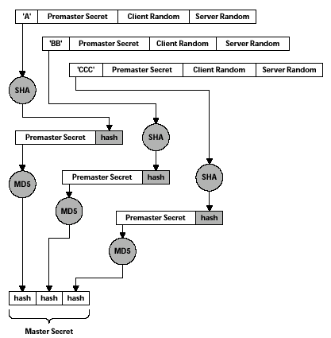
Forming the Master Secret
SERVER’S PUBLIC KEY
IS SENT BY SERVER IN
ServerKeyExchange
CLIENT GENERATES THE
PREMASTER SECRET
ENCRYPTS WITH PUBLIC
KEY OF SERVER
CLIENT SENDS PREMASTER
SECRET IN ClientKeyExchange
SENT BY SERVER
IN ServerHello
SENT BY CLIENT
IN ClientHello
MASTER SECRET IS 3 MD5
HASHES CONCATENATED
TOGETHER = 384 BITS
SOURCE: THOMAS, SSL AND TLS ESSENTIALS
Notes:
52

Slide 15
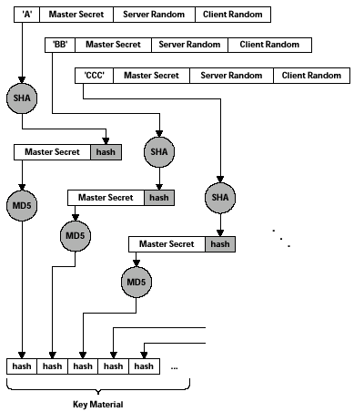
Forming the Key Material
JUST LIKE FORMING
THE MASTER SECRET
EXCEPT THE MASTER
SECRET IS USED HERE
INSTEAD OF THE
PREMASTER SECRET
. . .
SOURCE: THOMAS, SSL AND TLS ESSENTIALS
Notes:
52

Slide 16
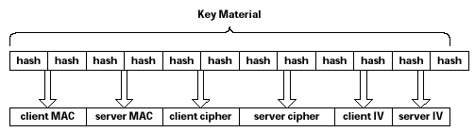
Obtaining Keys from the Key Material
SECRET VALUES
INCLUDED IN MESSAGE
AUTHENTICATION CODES
SYMMETRIC KEYS
INITIALIZATION VECTORS
FOR DES CBC ENCRYPTION
SOURCE: THOMAS, SSL AND TLS ESSENTIALS
Notes:
52

Slide 17
TLS (Transport Layer Security)
SSL is so important it was adopted by the Internet Engineering Task Force (IETF)
TLS Protocol 1.0 (RFC 2246)
TLS is very similar to SSL but they do not interoperate
Browsers understand both SSL and TLS
Goals
  Separate record and handshaking protocols
  Extensibility (add new cipher suites easily)
  Efficiency (minimize network activity)
Notes:
52

Slide 18
Secure Electronic Transactions (SET)
Merchant doesn’t see card #
Uses Internet to reach acquirer
High transaction cost
Secure
“tunnel”
through the
Internet
Internet
Credit Card
Acquirer
Credit Card
Issuer
Consumer
Issuer bills Consumer
SOURCE: MARVIN SIRBU, CMU

Slide 19
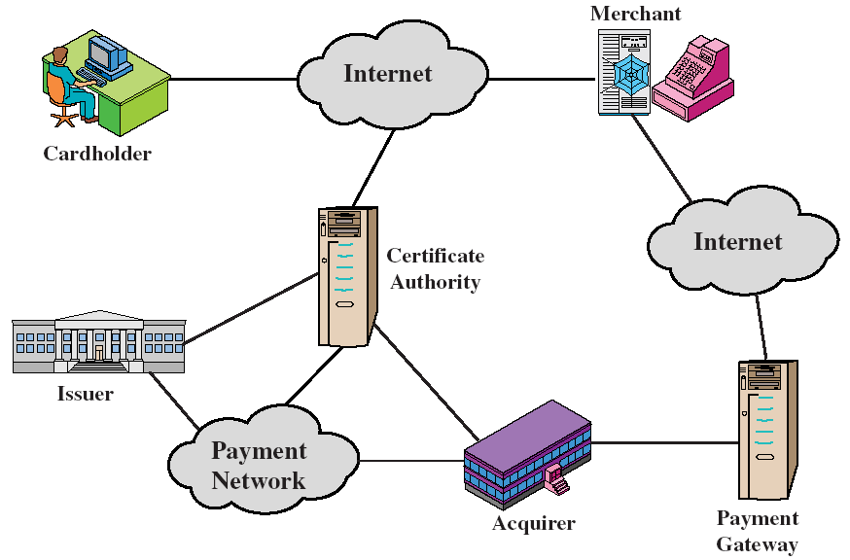
Parties in SET
SOURCE: WILLIAM STALLINGS
Notes:
52

Slide 20





SET Flow
cardholder
merchant
order info + payment instruction
MERCHANT
CERT
ack + services
Internet
payment info,
authorization
request
authorization
response +
capture token
capture
request
+ token
capture
response
CARD-
HOLDER
CERT
AT PURCHASE
AT END OF DAY
authorization processing
payment
gateway
GATEWAY
CERT
capture processing
payment network
money transfer
issuer
(cardholder’s bank)
acquirer
(merchant’s bank)

Slide 21

SET Message Flow
Financial Network
Non-SET
Non-SET
Card Issuer
Payment
Gateway
5. Auth. Request
6. Auth. Response
9. Payment Capture
Request
10. Payment Capture
Response
SET
1. Init Request
7. Inquiry Request
Card
Holder
3. Purchase Request
Merchant
2. Init Response
8. Inquiry Response
4. Purchase Response
SET
SOURCE: HUTTER/STEPHAN

Slide 22
Dual Signature
Links two messages intended for different recipients
data1
SENDER’S
PRIVATE KEY
hash
hash
sign
data2
DUAL
SIGNATURE
hash
RECIPIENT 1
RECEIVES:
RECIPIENT 2
RECEIVES:
data1
data2
HASH OF
DATA 2
HASH OF
DATA 1
DUAL
SIGNATURE

Slide 23




Using the Dual Signature
PI
Hash
Bank
PIMD
⎮⎮
Hash
POMD
En-
crypt
Dual Sig.
OIMD
Customer’s
public key
Customer’s
private key
OI
Hash
Merchant
SOURCE: RICHARD STANLEY

Slide 24
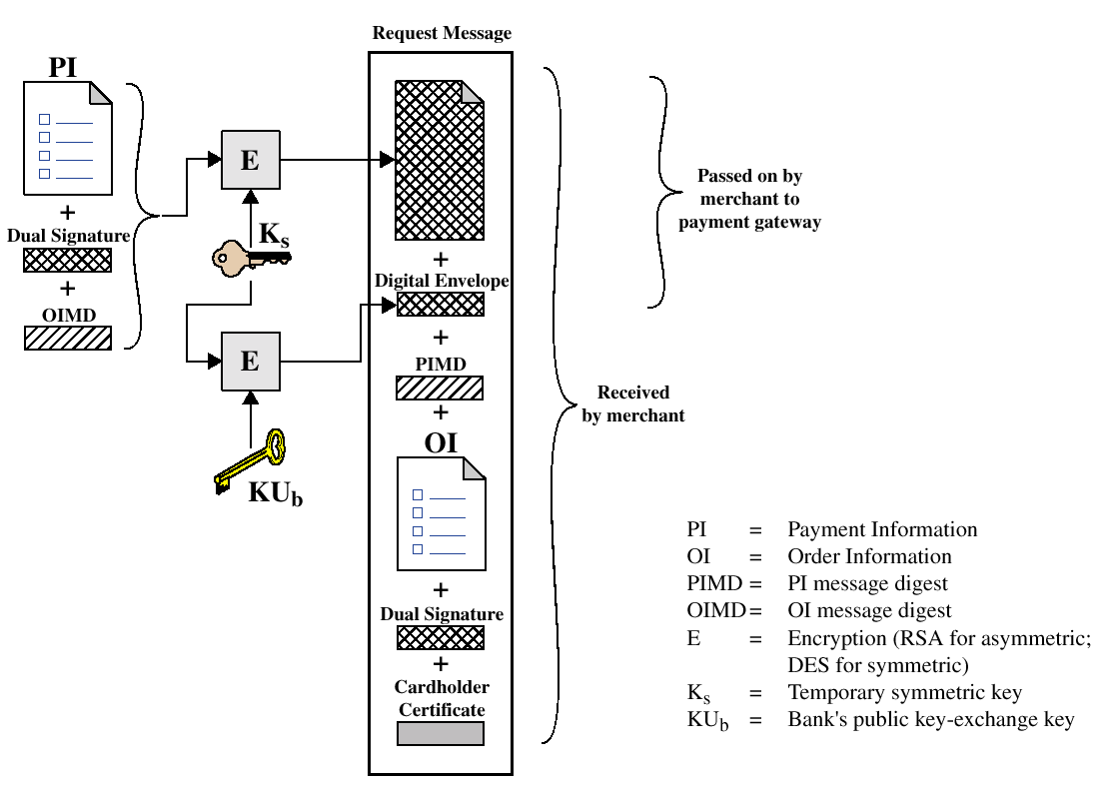
Cardholder Purchase Request
SOURCE: HENRIC JOHNSON

Slide 25
SET Objectives
Confidentiality of payment and order information
  Encryption
Integrity of all data (digital signatures)
Authentication of cardholder & account (certificates)
Authentication of merchant (certificates)
No reliance on secure transport protocols (TCP/IP)
Interoperability between SET software and network
  Standardized message formats
SET is a payment protocol
  Messages relate to various steps in a credit card transaction
Notes:
52

Slide 26
SET Security
Digital envelopes, nonces
Two public-private key pairs for each party
  One for digital signatures; one for key exchange messages
160-bit message digests
Statistically globally unique IDs (XIDs)
Certificates (5 kinds)
  Cardholder, Merchant, Acquirer, Issuer, Payment Gateway
Hardware cryptographic modules (for high security)
Idempotency (message can be received many times but is only processed once) f (f (x)) = f (x)
Complex protocol. Over 600 pages of detail
Dual signatures
Notes:
52

Slide 27
SET Process Steps (Simplified)
1. Merchant sends invoice and unique transaction ID (XID)
2. Merchant sends merchant certificate and bank certificate (encrypted
with CA’s private key)
3. Customer decrypts certificates, obtains public keys
4. Customer generates order information (OI) and payment info (PI)
encrypted with different session keys and dual-signed
5. Merchant sends payment request to bank encrypted with bank-
merchant session key, PI, digest of OI and merchant’s certificate
6. Bank verifies that the XID matches the one in the PI
7. Bank sends authorization request to issuing bank via card network
8. Bank sends approval to merchant
9. Merchant sends acknowledgement to customer
Notes:
52

Slide 28
SET Overhead
Simple purchase transaction:
Four messages between merchant and customer
Two messages between merchant and payment gateway
6 digital signatures
9 RSA encryption/decryption cycles
4 DES encryption/decryption cycles
4 certificate verifications
Scaling:
Multiple servers need copies of all certificates
Compaq sells SET software equipped for 5,000,000 certificates
NO ONE USES SET. WHY?
Visa used to list all SET-enabled merchants on its website. No more.
Notes:
52

Slide 29
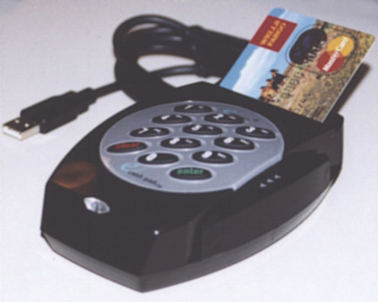
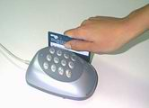
eCashPad
Convert a “Card Not Present” transaction into
“Card Present”
Installed in guest rooms at Arizona Holiday Inn

Slide 30
3-D Secure
Idea: authenticate user without a certificate
Requires the user to answer a challenge in real-time
Challenge comes from the issuing bank, not the merchant
Issuing bank confirms user identity to merchant
Notes:
52

Slide 31
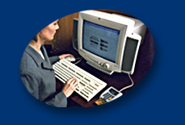




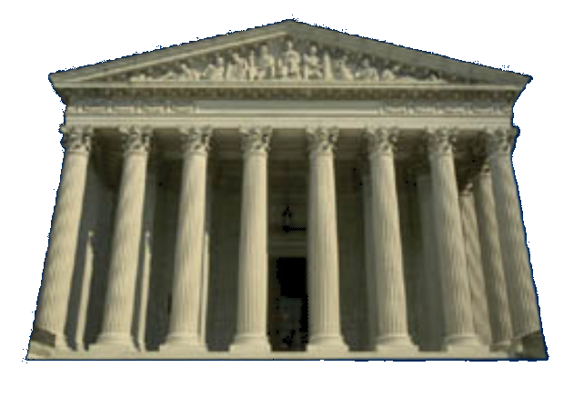

3-D (3-Domain) Model
Internet
Merchant
Cardholder
Wallet Server
eMerchant Server
Issuer
Acquirer
Payment Association
Issuer Domain
Interoperability Domain
Acquirer Domain
SOURCE: MASTERCARD

Slide 32
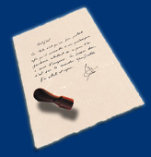
3-D Secure Process Flow
1. Card and order data
SSL
Merchant
Cardholder
2. Determine
issuer
SSL
MPI
Merchant Plug-In
3. Check user
participation
Global
Directory
5. Verify user
participation
SSL
Issuer
4. Verify user
participation
Payment Gateway
ACS
Access Control Server
Acquirer
SOURCE: MASTERCARD

Slide 33
3-D Secure Process Flow
10. Payer Authentication Response
Merchant
SSL
Cardholder
7. Payer Authentication Request
9.Payer Authentication Response
MPI
8. Cardholder Authentication
11. Normal Transaction
Global
Directory
Issuer
Payment Gateway
12. Normal Authorization Process
ACS
Acquirer
SOURCE: MASTERCARD

Slide 34
3-D Secure (1)
1. Customer enters details at merchant site
Customer
Active Merchant
3-D Secure
Merchant Plug-in
Merchant
Acquirer Plug-in
2. Merchant Plug-in checks card issuer participation with VISA directory
3. VISA directory checks card participation with issuer
Visa
Directory
3-D Secure
Access Control Server
Visanet
Payment
Gateway
Issuer
Acquirer
SOURCE: KMIS

Slide 35
3-D Secure (2)
6. Merchant Plug-in redirects customer’s browser to issuer’s Access Control Server with transaction details
Customer
Active Merchant
3-D Secure
Merchant Plug-in
Merchant
Acquirer Plug-in
5. Location of issuer’s Access Control Server sent to Merchant Plug-in
4. Issuer confirms card participation
Visa
Directory
3-D Secure
Access Control Server
Visanet
Payment
Gateway
Issuer
Acquirer
SOURCE: KMIS

Slide 36
3-D Secure (3)
Customer
Active Merchant
3-D Secure
Merchant Plug-in
Merchant
Acquirer Plug-in
7. Issuer’s Access Control Server requests username and password from customer
8. Customer presents password into issuer system
Visa
Directory
9. Issuer’s Access Control Server validates password, signs response and redirects customer to Merchant Plug-in
3-D Secure
Access Control Server
Visanet
Payment
Gateway
Issuer
Acquirer
SOURCE: KMIS

Slide 37
3-D Secure (4)
14. Merchant confirms transaction and issues receipt to customer
Active Merchant
3-D Secure
Merchant Plug-in
Merchant
Customer
Acquirer Plug-in
13. Acquirer sends transaction response back to merchant
10. Merchant submits normal transaction to acquirer
Visa
Directory
11. Acquirer sends authorization requests to issuer via Visanet
3-D Secure
Access Control Server
Visanet
Payment
Gateway
Issuer
12. Issuer sends authorization response to acquire via Visanet
Acquirer

Slide 38
Major Ideas
Credit cards are used because of convenience
But the processing cost is high
SSL, TLS are secure message protocols, not payment protocols
SSL requires the vendor to have a certificate
SSL is secure against breaking of any one form of encryption
SET is a payment protocol
SET requires all parties to have certificates
SET uses dual signatures
3-D Secure provides authentication without certificates
Notes:
52

Slide 39
Q
A
&

Slide 40
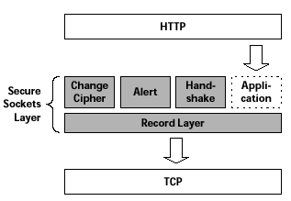
SSL (Secure Sockets Layer)
INITIALIZES SECURE
COMMUNICATION
ERROR HANDLING
HANDLES COMMUNICATION
WITH THE APPLICATION
Protocols
INITIALIZES COMMUNCATION
BETWEEN CLIENT & SERVER
HANDLES DATA
COMPRESSION
Notes:
52

Slide 41
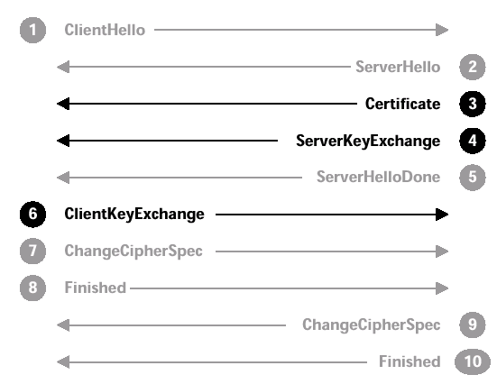
SSL Handshake Messages
CLIENT SIDE
SERVER SIDE
OFFER CIPHER SUITE
MENU TO SERVER
SELECT A CIPHER SUITE
SEND CERTIFICATE AND
CHAIN TO CA ROOT
SEND PUBLIC KEY TO
ENCRYPT SYMM KEY
SEND ENCRYPTED
SYMMETRIC KEY
SERVER NEGOTIATION
FINISHED
ACTIVATE
ENCRYPTION
CLIENT PORTION
DONE
( SERVER CHECKS OPTIONS )
ACTIVATESERVER
ENCRYPTION
( CLIENT CHECKS OPTIONS )
SERVER PORTION
DONE
NOW THE PARTIES CAN USE SYMMETRIC ENCRYPTION
SOURCE: THOMAS, SSL AND TLS ESSENTIALS
Notes:
52

Slide 42
High Risk Merchants
ELECTRONIC PAYMENT SYSTEMS 20-763 SPRING 2004 COPYRIGHT © 2004 MICHAEL I. SHAMOS

Slide 43
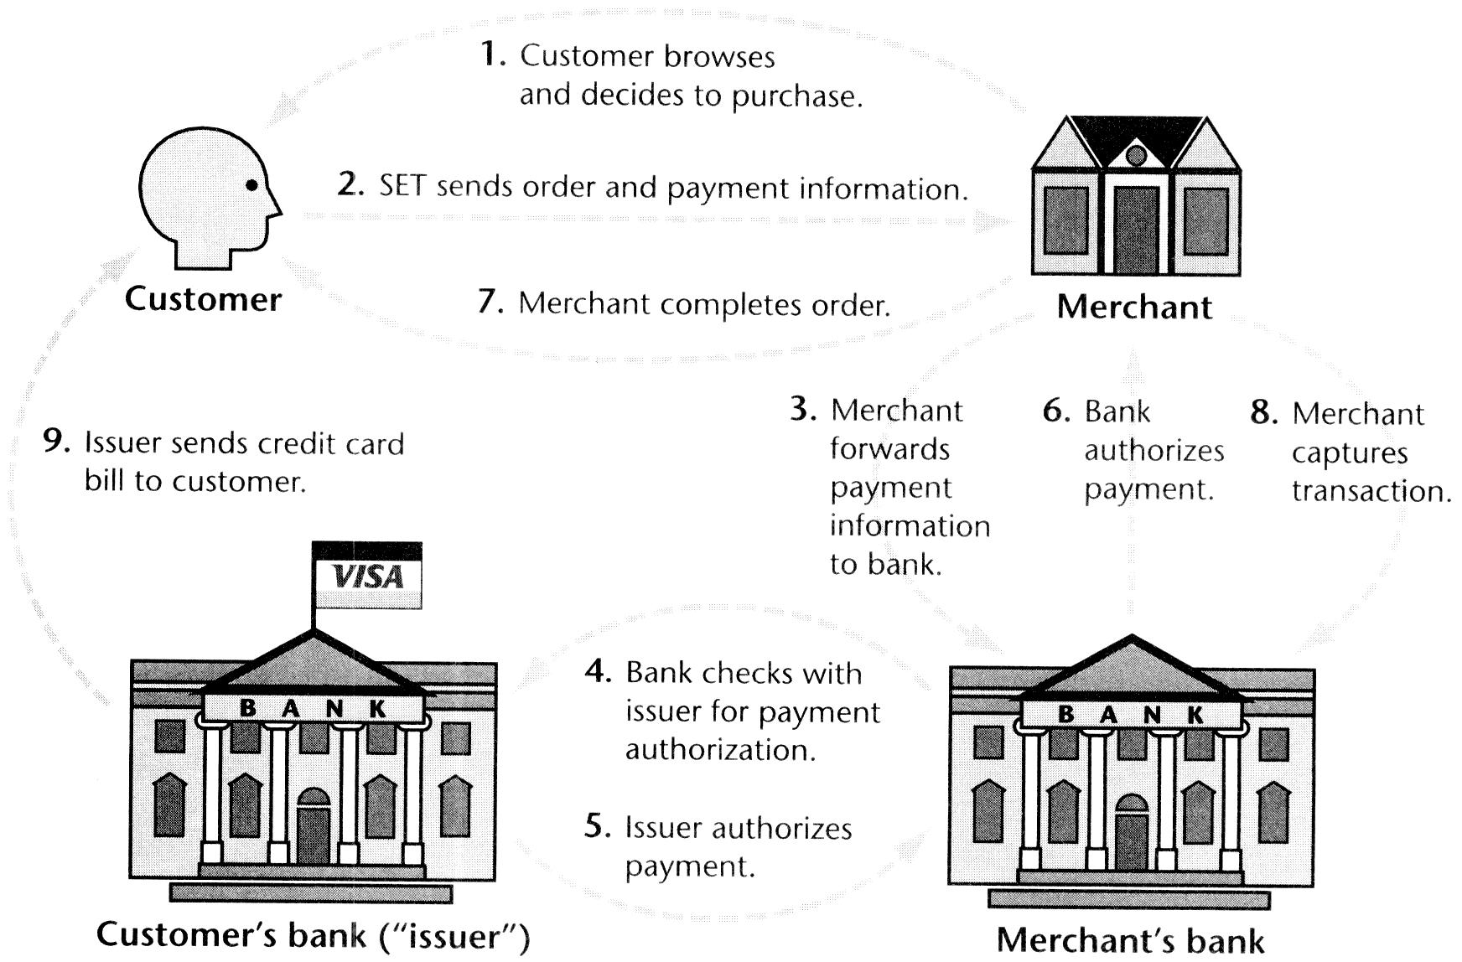
Secure Electronic Transactions (SET)

Slide 44
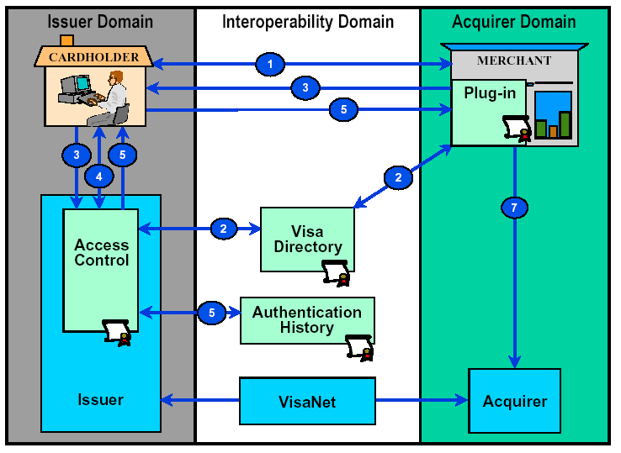
3-D Secure
SOURCE: VISA
Notes:
52

Slide 45


3-D Secure Transaction Flow
Cardholder visits merchant site and selects “Buy”
2
Merchant Plug-in queries Directory for account participation
1
Cardholder
MERCHANT
Merchant
Plug-in
Directory
Directory response indicates CH is/not enrolled
5
3
Issuer
Access
Control
Server
4
Merchant verifies the signature and sends an Authorization Request with selected authentication data (ECI and CAVV) to the Acquirer
Issuer prompts for password (and chip card insertion), validates password (and cryptogram), calculates CAVV, digitally
signs response to Merchant, sends copy to Authentication History Server
Authentication
History
Server
ISSUER
Visa
Net
Acquirer
Payment
Processor
8
Issuer verifies CAVV (or interrogates VisaNet codes), authorizes the transaction, sends response to the Acquirer
7
6
Acquirer formats message with ECI
and CAVV
VisaNet verifies CAVV, forwards to Issuer

Slide 46
SPA (1)
3. SPA Applet requests authentication information from the user
1. SPA Applet detects SPA-enabled merchant page
Customer
Merchant
SPA Applet
Acquirer Plug-in
2. SPA Applet reads information from merchant’s websites
4. SPA Applet sends authentication and transaction information to issuer’s SPA Server
5. Issuer SPA Server sends authentication token back to SPA Applet
SPA
Server
Banknet
Payment
Gateway
Issuer
Acquirer
SOURCE: KMIS

Slide 47
SPA (2)
6. SPA Applet embeds the authentication token in the merchant’s site and optionally fills the online form
Customer
Merchant
SPA Applet
Acquirer Plug-in
11. Merchant confirms transaction and issues receipt to customer
7. Merchant sends authorization request and authentication token to acquirer
10. Acquirer sends transaction response back to merchant
8. Acquirer sends authorization request and authentication token to issuer via Banknet
SPA
Server
Banknet
Payment
Gateway
Issuer
Acquirer
9. Issuer sends authorization response to acquirer

Slide 48
Using Dual Signatures
Alice wants to send Message 1 to Bob and Message 2 to Carol
Message 1 is order info; Message 2 is payment info
Alice encrypts Message 1 with Bob’s public key; Message 2 with Carol’s public key
Both Bob and Carol must be convinced that the messages are linked and unaltered
Alice sends { PK_{BOB}(Message 1), PK_{CAROL} (Message 2), DualSig} to both Bob and Carol
Bob hashes PK_{BOB}(Message 1), concatenates with PK_{CAROL} (Message 2), and hashes again to give the dual hash
Bob decrypts the dual signature with Alice’s public key
If the new hash and the decrypted signature match, all is OK

Slide 49
Dual Signatures on Plaintext
Alice wants to send Message 1 to Bob and Message 2 to Carol in plaintext
Bob can’t see Message 2; Carol can’t see Message 1
Both Bob and Carol must be convinced that the messages are linked and unaltered
Alice sends Bob { Message 1, Digest 2, Dual Signature}
Bob hashes Message 1, concatenates with Digest2 and hashes
Bob decrypts the dual signature with Alice’s public key
If the new hash and the decrypted signature match, all is OK
Now Bob can send Carol Digest 2 and ask if she got the message corresponding to it!
(Carol got { Message 2, Digest 1, Dual Signature} )

Slide 50
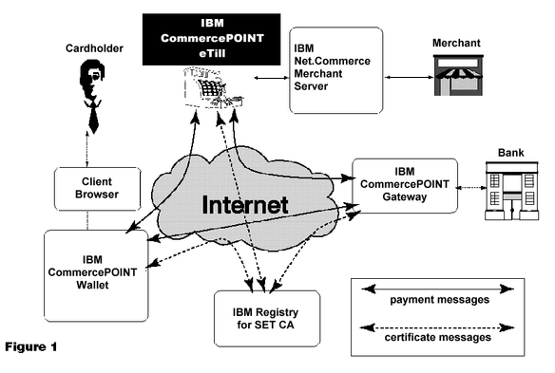
SET in Practice
SOURCE: http://www.software.ibm.com/commerce/payment/specsheetetill.html
Notes:
52

Slide 51
MasterCard Banknet
Closed TCP/IP network
Payment authorization in 130 milliseconds avg.
Capacity: 2.5M transactions/hour, 700/second
Busiest day: 36M authorizations, 40M debits
210 countries (more than SWIFT!)
25,000 issuing banks
650 service delivery points
  13 global hubs
  32 country hubs
SOURCE: MASTERCARD
Notes:
52

