Slide 1
GSM and 3G Security
Emmanuel Gadaix
Asia April 2001

Slide 2
Agenda
Brief introduction to GSM networking
Cryptography issues
Terminal and SIM
SS7 Signalling
GSM Data
Value-Added Services
Third generation
Lawful interception

Slide 3
GSM: Introduction
GSM is the most widely used cellular standard
Over 600 million users, mostly in Europe and Asia
Limited coverage and support in USA
Based on TDMA radio access and PCM trunking
Use SS7 signalling with mobile-specific extensions
Provides authentication and encryption capabilities
Today’s networks are 2G evolving to 2.5G
Third generation (3G) and future (4G)

Slide 4
Low-tech Fraud
Call forwarding to premium rate numbers
Bogus registration details
Roaming fraud
Terminal theft
Multiple forwarding, conference calls

Slide 5
Countermeasures for low-tech fraud
Fraud Management systems look for:
  Multiple calls at the same time,
  Large variations in revenue being paid to other parties,
  Large variations in the duration of calls, such as very short or long calls,
  Changes in customer usage, perhaps indicating that a mobile has been stolen or is being abused,
  Monitor the usage of a customer closely during a 'probationary period'

Slide 6
Problems with GSM security
Only provides access security – communications and signalling traffic in the fixed network are not protected.
Does not address active attacks, whereby some network elements (e.g. BTS: Base Station)
Only as secure as the fixed networks to which they connect
Lawful interception only considered as an after-thought
Terminal identity cannot be trusted
Difficult to upgrade the cryptographic mechanisms
Lack of user visibility (e.g. doesn’t know if encrypted or not)

Slide 7
Attacks on GSM networks
Eavesdropping. This is the capability that the intruder eavesdrops signalling and data connections associated with other users. The required equipment is a modified MS.
Impersonation of a user. This is the capability whereby the intruder sends signalling and/or user data to the network, in an attempt to make the network believe they originate from the target user. The required equipment is again a modified MS.
Impersonation of the network. This is the capability whereby the intruder sends signalling and/or user data to the target user, in an attempt to make the target user believe they originate from a genuine network. The required equipment is modified BTS.

Slide 8
Attacks on GSM networks
Man-in-the-middle. This is the capability whereby the intruder puts itself in between the target user and a genuine network and has the ability to eavesdrop, modify, delete, re-order, replay, and spoof signalling and user data messages exchanged between the two parties. The required equipment is modified BTS in conjunction with a modified MS.
Compromising authentication vectors in the network. The intruder possesses a compromised authentication vector, which may include challenge/response pairs, cipher keys and integrity keys. This data may have been obtained by compromising network nodes or by intercepting signalling messages on network links.
Notes:
The first capability is the easiest to achieve the following capabilities are gradually more complex and require more investment by the attacker. Therefore, in general, an intruder having a certain capability is assumed also to have the capabilities positioned above that capability in the list. The first two capabilities were acknowledged in the design of 2G systems. 3G security however should thwart all five types of attacks.

Slide 9
De-registration spoofing
An attack that requires a modified MS and exploits the weakness that the network cannot authenticate the messages it receives over the radio interface.
The intruder spoofs a de-registration request (IMSI detach) to the network.
The network de-registers the user from the visited location area and instructs the HLR to do the same. The user is subsequently unreachable for mobile terminated services.
3G: Integrity protection of critical signalling messages protects against this attack. More specifically, data authentication and replay inhibition of the de-registration request allows the serving network to verify that the de-registration request is legitimate.

Slide 10
Location update spoofing
An attack that requires a modified MS and exploits the weakness that the network cannot authenticate the messages it receives over the radio interface.
The user spoofs a location update request in a different location area from the one in which the user is roaming.
The network registers in the new location area and the target user will be paged in that new area.
The user is subsequently unreachable for mobile terminated services.
3G: Integrity protection of critical signalling messages protects against this attack. More specifically, data authentication and replay inhibition of the location update request allows the serving network to verify that the location update request is legitimate.

Slide 11
Camping on a false BTS
An attack that requires a modified BTS and exploits the weakness that a user can be enticed to camp on a false base station.
Once the target user camps on the radio channels of a false base station, the target user is out of reach of the paging signals of the serving network in which he is registered.
3G: The security architecture does not counteract this attack. However, the denial of service in this case only persists for as long as the attacker is active unlike the above attacks which persist beyond the moment where intervention by the attacker stops. These attacks are comparable to radio jamming which is very difficult to counteract effectively in any radio system.

Slide 12
Camping on false BTS/MS
An attack that requires a modified BTS/MS and exploits the weakness that a user can be enticed to camp on a false base station.
A false BTS/MS can act as a repeater for some time and can relay some requests in between the network and the target user, but subsequently modify or ignore certain service requests and/or paging messages related to the target user.
3G: The security architecture does not prevent a false BTS/MS relaying messages between the network and the target user, neither does it prevent the false BTS/MS ignoring certain service requests and/or paging requests.
Integrity protection of critical message may however help to prevent some denial of service attacks, which are induced by modifying certain messages.

Slide 13
Passive Identity Caching
A passive attack that requires a modified MS and exploits the weakness that the network may sometimes request the user to send its identity in cleartext.
3G: The identity confidentiality mechanism counteracts this attack. The use of temporary identities allocated by the serving network makes passive eavesdropping inefficient since the user must wait for a new registration or a mismatch in the serving network database before he can capture the user’s permanent identity in plaintext.
The inefficiency of this attack given the likely rewards to the attacker would make this scenario unlikely.

Slide 14
Active Identity Caching
An active attack that requires a modified BTS and exploits the weakness that the network may request the MS to send its permanent user identity in cleartext.
An intruder entices the target user to camp on its false BTS and subsequently requests the target user to send its permanent user identity in cleartext perhaps by forcing a new registration or by claiming a temporary identity mismatch due to database failure.
3G: The identity confidentiality mechanism counteracts this attack by using an encryption key shared by a group of users to protect the user identity in the event of new registrations or temporary identity database failure in the serving network.
Notes:
Note however that the size of the groups should be chosen carefully: too small and the group identify may compromise the user identity itself; too large and the group encryption key might be vulnerable to attack

Slide 15
Suppressing encryption between the target user and the intruder
An attack that requires a modified BTS and that exploits the weakness that the MS cannot authenticate messages received over the radio interface.
The target user is enticed to camp on the false BTS. When the intruder or the target user initiates a service, the intruder does not enable encryption by spoofing the cipher mode command.
The intruder maintains the call as long as it is required or as long as his attack remains undetected.
3G: A mandatory cipher mode command with message authentication and replay inhibition allows the mobile to verify that encryption has not been suppressed by an attacker.

Slide 16
Suppressing encryption between target user and the true network
An attack that requires a modified BTS/MS and that exploits the weakness that the network cannot authenticate messages received over the radio interface.
The target user is enticed to camp on the false BTS/MS. When a call is set-up the false BTS/MS modifies the ciphering capabilities of the MS to make it appear to the network that a genuine incompatibility exists between the network and the mobile station.
The network may then decide to establish an un-enciphered connection. After the decision not to cipher has been taken, the intruder cuts the connection with the network and impersonates the network to the target user.
3G: A mobile station classmark with message authentication and replay inhibition allows the network to verify that encryption has not been suppressed by an attacker.

Slide 17
Compromised cipher key
An attack that requires a modified BTS and the possession by the intruder of a compromised authentication vector and thus exploits the weakness that the user has no control upon the cipher key.
The target user is enticed to camp on the false BTS/MS. When a call is set-up the false BTS/MS forces the use of a compromised cipher key on the mobile user.
3G: The presence of a sequence number in the challenge allows the USIM to verify the freshness of the cipher key to help guard against forced re-use of a compromised authentication vector. However, the architecture does not protect against force use of compromised authentication vectors which have not yet been used to authenticate the USIM.
Thus, the network is still vulnerable to attacks using compromised authentication vectors which have been intercepted between generation in the authentication center and use or destruction in the serving network.

Slide 18
Eavesdropping on user data by suppressing encryption
An attack that requires a modified BTS/MS and that exploits the weakness that the MS cannot authenticate messages received over the radio interface.
The target user is enticed to camp on the false BTS. When the target user or the intruder initiates a call the network does not enable encryption by spoofing the cipher mode command.
The attacker however sets up his own connection with the genuine network using his own subscription. The attacker may then subsequently eavesdrop on the transmitted user data.
3G: A mandatory cipher mode command with message authentication and replay inhibition allows the mobile to verify that encryption has not been suppressed by an attacker.

Slide 19
Suppression of encryption between target user and true network
The target user is enticed to camp on the false BTS/MS. When the target user or the genuine network sets up a connection, the false BTS/MS modifies the ciphering capabilities of the MS to make it appear to the network that a genuine incompatibility exists between the network and the mobile station.
The network may then decide to establish an un-enciphered connection. After the decision not to cipher has been taken, the intruder may eavesdrop on the user data.
3G: Message authentication and replay inhibition of the mobile’s ciphering capabilities allows the network to verify that encryption has not been suppressed by an attacker.

Slide 20
Eavesdropping on user data by forcing the use of a compromised cipher key
An attack that requires a modified BTS/MS and the possession by the intruder of a compromised authentication vector and thus exploits the weakness that the user has no control the cipher key.
The target user is enticed to camp on the false BTS/MS. When the target user or the intruder set-up a service, the false BTS/MS forces the use of a compromised cipher key on the mobile user while it builds up a connection with the genuine network using its own subscription.
3G: The presence of a sequence number in the challenge allows the USIM to verify the freshness of the cipher key to help guard against forced re-use of a compromised authentication vector. However, the architecture does not protect against force use of compromised authentication vectors, which have not yet been used to authenticate the USIM. Thus, the network is still vulnerable to attacks using compromised authentication vectors.

Slide 21
User impersonation with compromised authentication vector
An attack that requires a modified MS and the possession by the intruder of a compromised authentication vector which is intended to be used by the network to authenticate a legitimate user.
The intruder uses that data to impersonate the target user towards the network and the other party.
3G: The presence of a sequence number in the challenge means that authentication vectors cannot be re-used to authenticate USIMs. This helps to reduce the opportunity of using a compromised authentication vector to impersonate the target user. However, the network is still vulnerable to attacks using compromised authentication vectors.

Slide 22
User impersonation through eavesdropped authentication response
An attack that requires a modified MS and exploits the weakness that an authentication vector may be used several times.
The intruder eavesdrops on the authentication response sent by the user and uses that when the same challenge is sent later on.
Subsequently, ciphering has to be avoided by any of the mechanisms described above. The intruder uses the eavesdropped response data to impersonate the target user towards the network and the other party
3G: The presence of a sequence number in the challenge means that authentication vectors cannot be re-used to authenticate USIMs

Slide 23
Hijacking outgoing calls in networks with encryption disabled
This attack requires a modified BTS/MS. While the target user camps on the false base station, the intruder pages the target user for an incoming call.
The user then initiates the call set-up procedure, which the intruder allows to occur between the serving network and the target user, modifying the signalling elements such that for the serving network it appears as if the target user wants to set-up a mobile originated call.
The network does not enable encryption. After authentication the intruder cuts the connection with the target user, and subsequently uses the connection with the network to make fraudulent calls on the target user’s subscription.
3G: Integrity protection of critical signalling messages protects against this attack. More specifically, data authentication and replay inhibition of the connection set-up request allows the serving network to verify that the request is legitimate.
In addition, periodic integrity protected messages during a connection helps protect against hijacking of un-enciphered connections after the initial connection establishment.

Slide 24
Hijacking outgoing calls in networks with encryption enabled
This attack requires a modified BTS/MS. In addition to the previous attack this time the intruder has to attempt to suppress encryption by modification of the message in which the MS informs the network of its ciphering capabilities.
3G: Integrity protection of critical signalling messages protects against this attack. More specifically, data authentication and replay inhibition of the MS station classmark and the connection set-up request helps prevent suppression of encryption and allows the serving network to verify that the request is legitimate.

Slide 25
Hijacking incoming calls in networks with encryption disabled
This attack requires a modified BTS/MS. While the target user camps on the false base station, an associate of the intruder makes a call to the target user’s number.
The intruder acts as a relay between the network and the target user until authentication and call set-up has been performed between target user and serving network. The network does not enable encryption.
After authentication and call set-up the intruder releases the target user, and subsequently uses the connection to answer the call made by his associate. The target user will have to pay for the roaming leg.
3G: Integrity protection of critical signalling messages protects against this attack. More specifically, data authentication and replay inhibition of the connection accept message allows the serving network to verify that the request is legitimate.
In addition, periodic integrity protected messages during a connection helps protect against hijacking of un-enciphered connections after the initial connection establishment.

Slide 26
Hijacking incoming calls in networks with encryption enabled
This attack requires a modified BTS/MS. In addition to the previous attack this time the intruder has to suppress encryption.
3G: Integrity protection of critical signalling messages protects against this attack. More specifically, data authentication and replay inhibition of the MS station classmark and the connection accept message helps prevent suppression of encryption and allows the serving network to verify that the connection accept is legitimate.

Slide 27
Cryptography
GSM consortium decide to go “security through obscurity”
A3/A5/A8 algorithms eventually leaked
Cryptanalysis attacks against A5
Attacks on COMP-128 algorithm
Evolution of security model
Key recovery allowing SIM cloning
Over-the-air interception using fake BTS

Slide 28
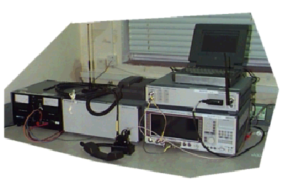
Fake BTS
IMSI catcher by Law Enforcement
Intercept mobile originated calls
Can be used for over-the-air cloning
Notes:
Our attack is a chosen-challenge attack. We form a number of specially-chosen challenges and query the SIM for each one; the SIM applies COMP128 to its secret key and our chosen challenge, returning a response to us. By analyzing the responses, we are able to determine the value of the secret key.
Mounting this attack requires physical access to the target SIM, an off-the-shelf smartcard reader, and a computer to direct the operation. The attack requires one to query the smartcard about 150,000 times; our smartcard reader can issue 6.25 queries per second, so the whole attack takes 8 hours. Very little extra computation is required to analyze the responses.
Though the COMP128 algorithm is supposed to be a secret, we pieced together information on its internal details from public documents, leaked information, and several SIMs we had access to. After a theoretical analysis uncovered a potential vulnerability in the algorithm, we confirmed that our reconstruction of the COMP128 algorithm was correct by comparing a software implementation to responses computed by a SIM known to implement COMP128.

Slide 29
Terminology
AKA Authentication and Key Agreement
AN Access Network
HE Home Environment
SN Serving Network
USIM User Services Identity Module

Slide 30
Terminal and SIM
SIM = Subscriber Identity Module
Terminal = subscriber’s handset
The SIM is a smartcard device containing cryptographic secrets
Hardware to copy SIM
Client-side security doesn’t work
Terminal is also a radio network monitoring tool, a signalling-aware RX/TX, a computer with lots of capabilities
Applications can run on the SIM

Slide 31
MExE: Mobile Execution Environment
The ability to remotely modify remote and run code on a mobile clearly introduces a security risk.
In the case of MExE it is up to the user to determine if a possible security risk is introduced, and stop the action from taking place.
It is to be expected that a smart attacker will be able to introduce code that will fool a user into setting up services or connection that will compromise them or result them in losing money

Slide 32
GSM Data
Initially designed to carry voice traffic
Data connections initially 9600 bps
No need for modems as there is a digital path from MS to MSC
Enhanced rates up to 14.4 kbps
GPRS provides speeds up to 150 kbps
UMTS (3G) promises permanent connections with up to 2 Mbps transfer rate

Slide 33
Signalling
GSM uses SS7 signalling for call control, mobility management, short messages and value-added services
MTP1-3: Message Transfer Part
SCCP: Signalling Connection Control Part
TCAP: Transaction Capabilities Application Part
MAP: Mobile Application Part
BSSAP: Base Station Subsystem Application Part
INAP: Intelligent Network Application Part
CAMEL: Customized Application for Mobile Enhanced Logic

Slide 34
Signalling Security
Mobile networks primarily use Signaling System no. 7 (SS7) for communication between networks for such activities as authentication, location update, and supplementary services and call control. The messages unique to mobile communications are MAP messages.
The security of the global SS7 network as a transport system for signaling messages e.g. authentication and supplementary services such as call forwarding is open to major compromise.
The problem with the current SS7 system is that messages can be altered, injected or deleted into the global SS7 networks in an uncontrolled manner

Slide 35
SS7: opening up to the world
In the past, SS7 traffic was passed between major PTO’s covered under treaty organization and the number of operators was relatively small and the risk of compromise was low.
Networks are getting smaller and more numerous. Opportunities for unintentional mishaps will increase, as will the opportunities for hackers and other abusers of networks.
With the increase in different types of operators and the increase in the number of interconnection circuits there is an ever-growing loss of control of security of the signaling networks.

Slide 36
SS7: waiting for disaster
There is also exponential growth in the use of interconnection between the telecommunication networks and the Internet .
The IT community now has many protocol converters for conversion of SS7 data to IP, primarily for the transportation of voice and data over the IP networks. In addition new services such as those based on IN will lead to a growing use of the SS7 network for general data transfers.
There have been a number of incidents from accidental action, which have damaged a network. To date, there have been very few deliberate actions

Slide 37
SS7: evolution
The availability of cheap PC based equipment that can be used to access networks and the ready availability of access gateways on the Internet will lead to compromise of SS7 signaling and this will effect mobile operators.
The risk of attack has been recognized in the USA at the highest level of the President’s office indicating concern on SS7. It is understood that the T1, an American group is seriously considering the issue.
For the network operator there is some policing of incoming signaling on most switches already, but this is dependent on the make of switch as well as on the way the switch is configured by operators.
Some engineering equipment is not substantially different from other advanced protocol analyzers in terms of its fraud potential, but is more intelligent and can be programmed more easily

Slide 38
SS7: what to do
Operators ensure that signaling screening of SS7 incoming messages takes place at the entry points to their networks and that operations and maintenance systems alert against unusual SS7 messages.
There are a number of messages that can have a significant effect on the operation of the network and inappropriate messages should be controlled at entry point.
Network operators network security engineers should on a regular basis carry out monitoring of signaling links for these inappropriate messages.
In signing agreements with roaming partners and carrying out roaming testing, review of messages and also to seek appropriate confirmation that network operators are also screening incoming SS7 messages their networks to ensure that no rogue messages appear

Slide 39
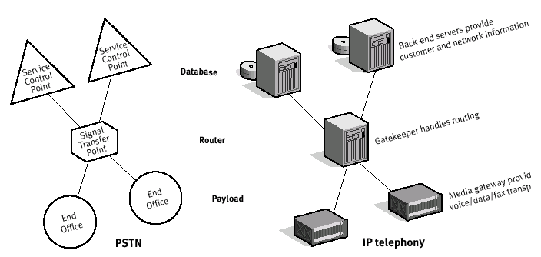
PSTN vs. VoIP

Slide 40
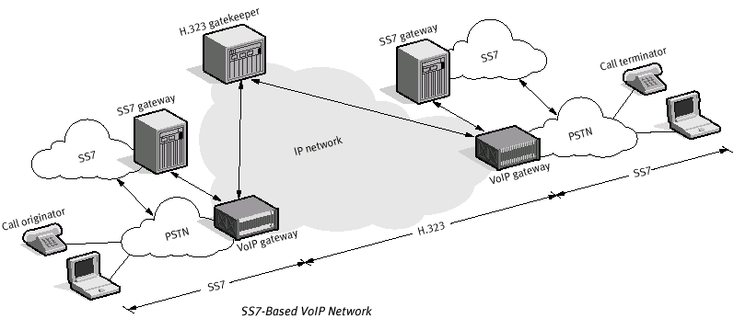
VoIP and SS7

Slide 41
GSM Network Elements
Operators must be concerned about unauthorized access to their Network Elements and their Operations Support Systems.
External access (e.g. through Internet or dialups) is a concern but also Internal fraud such as modification of billing records.
Unfortunately, very few operators really audit security logs or have capabilities to detect intrusions in their network.
Network Intelligence is transferred from switches to UNIX platforms, increasing their exposure to “traditional” security issues.

Slide 42
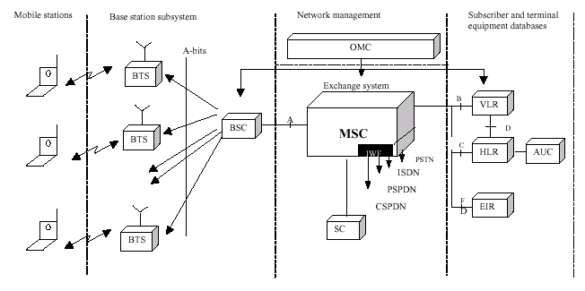
GSM architecture

Slide 43
HLR – Home Location Register
An unauthorized access to HLR could result in activating subscribers not seen by the billing system, thus not chargeable.
Services may also be activated or deactivated for each subscriber, thus allowing unauthorized access to services or denial of service attacks.
In certain circumstances it is possible to use Man-Machine Language (MML) commands to monitor other HLR user’s action - this would also often allow for unauthorized access to data.

Slide 44
HLR – Home Location Register
An operator should not rely on the fact that an intruder’s knowledge on particular vendor’s MML language will be limited. Those attacks can be performed both by external intruders and by operator’s employees.
Access control to HLRs should be based on user profiles, using at least a unique username and a password as authentication data.
Remote access to HLR should be protected from eavesdropping, source and destination spoofing and session hijacking. An operator may therefore wish to limit the range of protocols available for communication with HLR.

Slide 45
AuC: Authentication Center
Number of employees having physical and logical access to AuC should be limited. From security point of view it is then reasonable to use an AuC which is not integrated with HLR.
Operators should carefully consider the need for encryption of AuC data. Some vendors use default encryption, the algorithm being proprietary and confidential. It should be noted that strength of such encryption could be questionable.
If decided to use an add-on ciphering facility, attention should be paid to cryptographic key management. Careless use of such equipment could even lower AuC security.
Authentication triplets can be obtained from AuC by masquerading as another system entity (namely HLR). The threat is present when HLR and AuC are physically separated.

Slide 46
MSC: Mobile Switching Center
An MSC is one of the most important nodes of any 3GPP network. It handles all calls incoming to, or originating from subscribers visiting the given switch area. Unauthorized, local or remote, access to an MSC would likely result in the loss of confidentiality of user data, unauthorized access to services or denial of service for large numbers of subscribers.
It is strongly recommended that access to MSCs is restricted, both in terms of physical and logical access. It is also recommended that their physical location is not made public.
When co-located, several MSCs should be independent (i.e. separated power, transmission,) in order to limit the impacts from accidents on one particular MSC (e.g. fire).

Slide 47
CCBS: Customer Care and Billing System
Unauthorized access to the billing or customer care system could result in:
  loss of revenue due to manipulated CDRs (on the mediation device/billing system level) .
  unauthorized applying of service discounts (customer care system level), unauthorized access to services (false subscriptions).
  and even denial of service - by repeated launching of resource- consuming system jobs.

Slide 48
Value-Added Services
Classic: VMS, SMS (MO, MT, Fleet, Broadcast, push / pull)
Terminal-based: USSD, STK
IN-based: Prepaid, VPN, Advanced screening and forwarding, Universal number, …
Internet: GPRS, WAP
Location-based services
Users increasingly want control over their communications
Operators differentiate from competition with services, not any more with coverage or tariffs

Slide 49
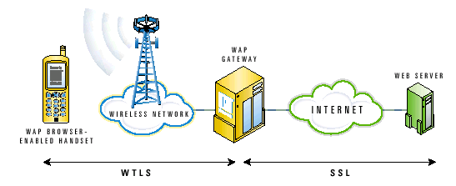
WAP Security Model
Internet / SSL security affects the WAP security
The WAP gateway ‘translates’ SSL messages into WTLS for transmission over the air interface

Slide 50
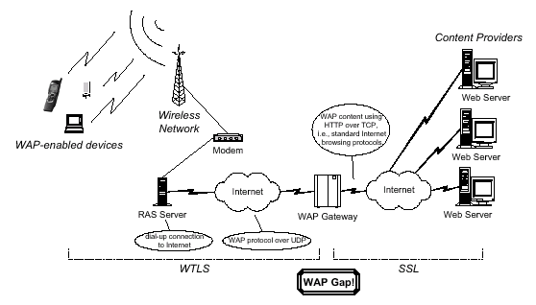
The WAP gap

Slide 51
WTLS security
Although the WTLS protocol is closely modeled on the well-studied TLS protocol, a number of security problems have been identified with WTLS:
  vulnerability to datagram truncation attack
  message forgery attack
  key-search shortcut for some exportable keys

Slide 52
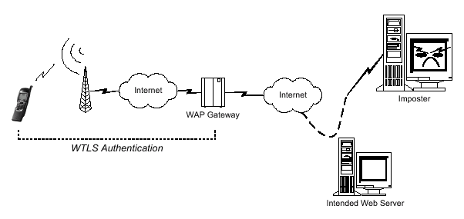
WAP: no end-to-end trust

Slide 53
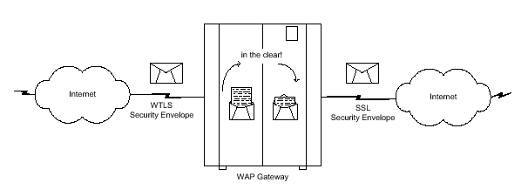
WAP: man-in-the-middle

Slide 54
Third Generation Wireless
Evolution from existing European and US digital cellular systems (W-CDMA, CDMA2000, UMTS).
Promises broadband multimedia on everyone’s handset and a multitude of related services.
Spectrum up for auctions in many countries, put many operators in financial debt.
Delays in 3G rollouts cast doubt over its success. Some talk about jumping to 4G directly.

Slide 55
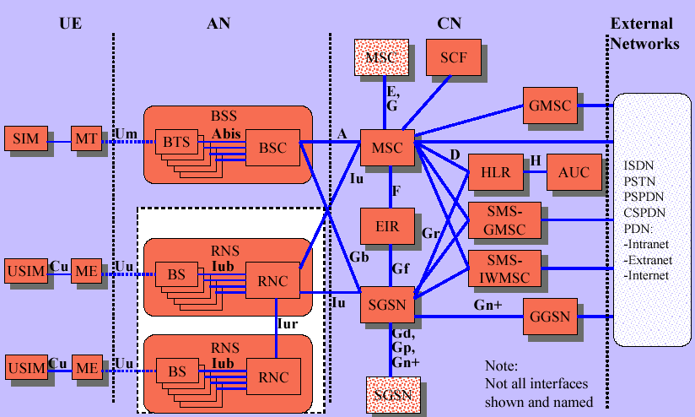
3G Security Architecture

Slide 56
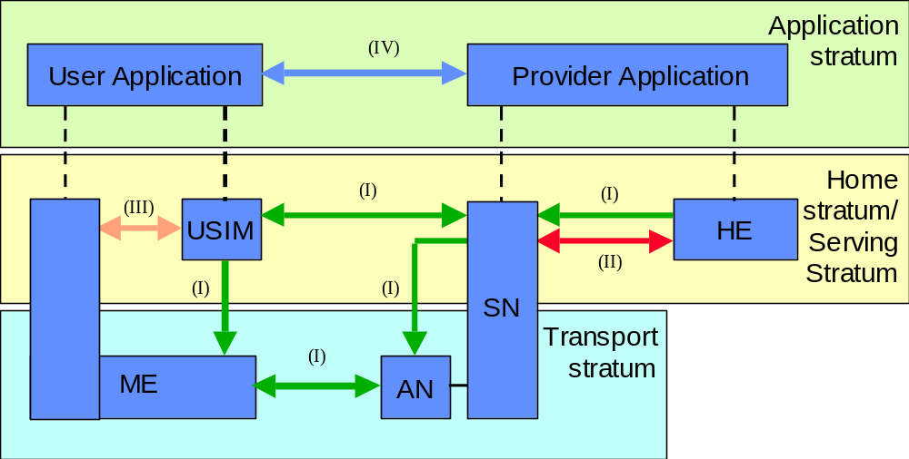
3G Security Model

Slide 57
3G Security Model
  Network access security (I): the set of security features that provide users with secure access to 3G services, and which in particular protect against attacks on the (radio) access link;
  Network domain security (II): the set of security features that enable nodes in the provider domain to securely exchange signalling data, and protect against attacks on the wireline network;
  User domain security (III): the set of security features that secure access to mobile stations
  Application domain security (IV): the set of security features that enable applications in the user and in the provider domain to securely exchange messages.
  Visibility and configurability of security (V): the set of features that enables the user to inform himself whether a security feature is in operation or not and whether the use and provision of services should depend on the security feature.

Slide 58
3G vs. GSM
A change was made to defeat the false base station attack. The security mechanisms include a sequence number that ensures that the mobile can identify the network.
Key lengths were increased to allow for the possibility of stronger algorithms for encryption and integrity.
Mechanisms were included to support security within and between networks.
Security is based within the switch rather than the base station as in GSM. Therefore links are protected between the base station and switch.
Integrity mechanisms for the terminal identity (IMEI) have been designed in from the start, rather than that introduced late into GSM.

Slide 59
3G vs. GSM
GSM authentication vector: temporary authentication data that enables an VLR/SGSN to engage in GSM AKA with a particular user. A triplet consists of three elements: a) a network challenge RAND, b) an expected user response SRES and c) a cipher key Kc.
UMTS authentication vector: temporary authentication data that enables an VLR/SGSN to engage in UMTS AKA with a particular user. A quintet consists of five elements: a) a network challenge RAND, b) an expected user response XRES, c) a cipher key CK, d) an integrity key IK and e) a network authentication token AUTN.

Slide 60
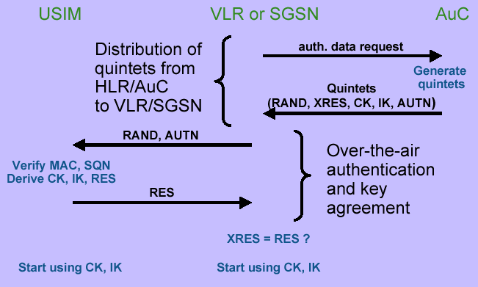
AKA Message Flow

Slide 61
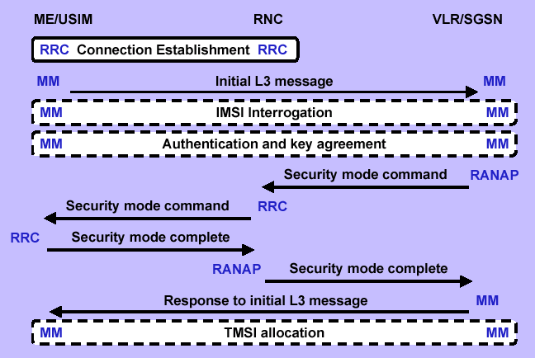
Connection Establishment Overview

Slide 62
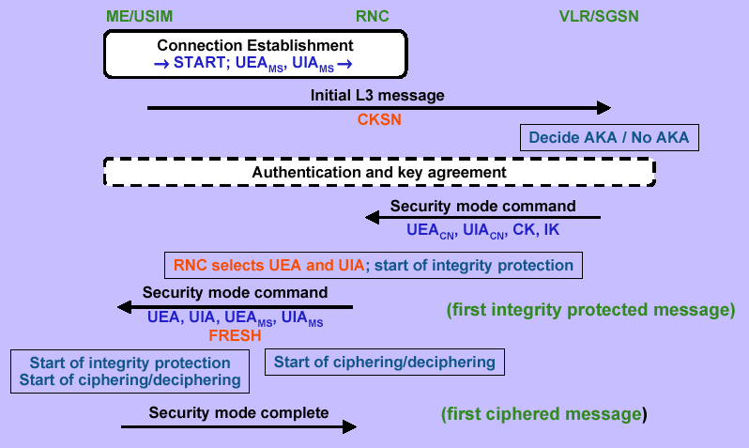
Ciphering and Integrity

Slide 63
Interception
CDR data always available to authorities, kept forever in operators’ data warehouses GSM monitoring facilities designed as an “after thought”.
System plugs onto MSC special interface and allows interception of signalling and speech traffic.
Monitoring and interception can be delocalized from the MSC
3G has done a much better job for big brother.
Any event can be intercepted in a very user-friendly way
Billing data can be intercepted in real-time.

Slide 64
Interception: terminology
Network Based Interception: Interception that is invoked at a network access point regardless of Target Identity.
Subject Based Interception: Interception that is invoked using a specific Target Identity
Target Identity: A technical identity that uniquely identifies a target of interception. One target may have one or several identities.
Interception Area: Subset of the network service area comprised of a set of cells which defines a geographical zone.
Location Dependent Interception: Interception of a target mobile within a network service area that is restricted to one or several Interception Areas (IA).

Slide 65
Interception: Definitions
ADMF: Administrative Function
  interfaces with all the LEAs that may require interception in the intercepting network
  keeps the intercept activities of individual LEAs separate
  interfaces to the intercepting network
LEA: Law Enforcement Agency
HI2: Distributes Intercept Related Information (IRI) to LEA
HI3: Distributes Content of Communication (CC) to LEA
PDP: Packet Data Protocol

Slide 66
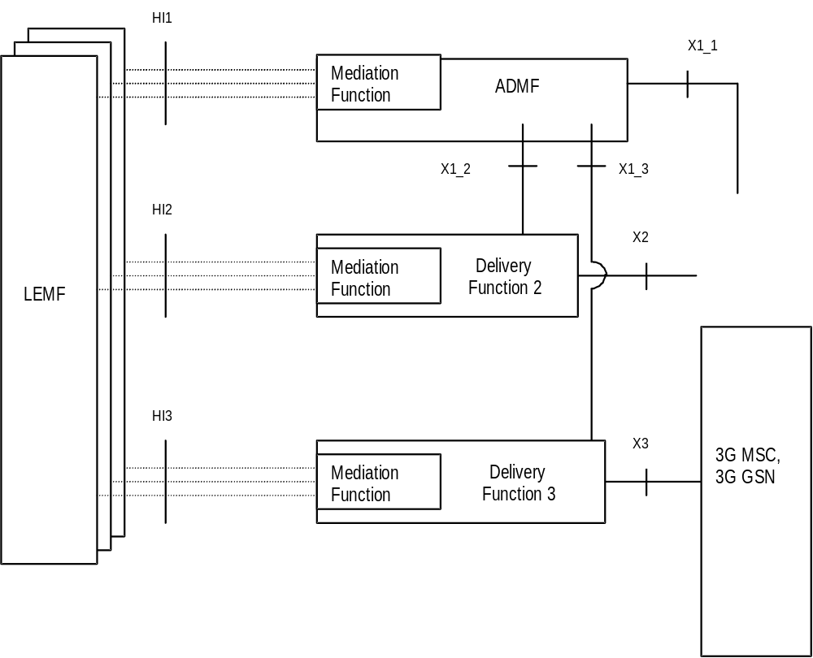
Logical configuration
Notes:
There is one Administration Function (ADMF) in the network. Together with the delivery functions it is used to hide from the 3G MSC and 3G GSN that there might be multiple activations by different Law Enforcement Agencies (LEAs) on the same target. The administration function may be partitioned to ensure separation of the provisioning data from different agencies.

Slide 67
Interception: Concepts
The target identities for interception can be at least on of the following: IMSI, MSISDN or IMEI.
The interception request is sent from the ADMF to the 3G MSC and 3G GSN (X1_1-interface) and specify
  target identities (MSISDN, IMSI or IMEI)
  information whether the Content of Communication shall be provided
  information whether the Intercept Related Information shall be provided
  address of Delivery Function 2 for the IRI
  address of Delivery Function 3 for the intercepted CC
  IA in case of location dependent interception.
Notes:
X1_2-interface (IRI)
For the activation of IRI the message sent from the ADMF to the DF contains:
- the target identity;
- the address for delivery of IRI (= LEMF address);
- which subset of information shall be delivered;
- a DF2 activation identity, which uniquely identifies the activation for DF2 and is used for further interrogation or deactivation, respectively;
- the IA in case of location dependent interception;
- the warrant reference number if required by national option.
X1_3-interface (CC)
For the activation of intercepted Content of Communications the message sent from the ADMF to the Delivery Function contains:
- the target identity;
- the address of delivery for CC (= LEMF address);
- a DF3 activation identity, which uniquely identifies the activation for DF3 and is used for further interrogation or deactivation, respectively;
- the IA in case of location dependent interception;
- the warrant reference number if required by national option.
If a target is intercepted by several LEAs and/or several identities simultaneously, a single activation of delivery is necessary for each combination of LEA and identity

Slide 68
Circuit Event Records
Observed MSISDN, IMSI or IMEI
Event type (Establishment, Answer, Supplementary service, Handover, Release, SMS, Location update, Subscriber controlled input )
Dialled #, connected #, other party address, forwarded #
Cell ID, Location Area Code
Basic service, supplementary services
SMS message (content and header)
Redirecting number (the number which invokes the call forwarding towards the target)
SCI (Non call related Subscriber Controlled Input which the 3G MSC receives from the ME)

Slide 69
Packet Data Event Records
Observed MSISDN, IMSI, IMEI
Event type (PDP attach, PDP detach, PDP context activation, PDP context deactivation, SMS, Cell and/or RA update)
PDP address, PDP type
Access Point Name, Routing Area Code
SMS (content and header, including SMSC centre address)
Cell Global Identity

Slide 70
Interception Security
  It shall be possible to configure the authorised user access within the serving network to Activate, Deactivate and Interrogate Lawful Interception separately for every physical or logical port at the 3G MSC and DF. It shall be possible to password protect user access.
  Only the ADMF is allowed to have access to the LI functionality in the 3G MSC, 3G GSN and DF.
  The communication links between ADMF, 3G GSN, 3G MSC and the various delivery functions may be required by national option to support security mechanisms, such as CUG, VPN, etc.

Slide 71
Thanks emmanuel@relaygroup.com

Slide 72
References
3rd Generation Partnership Project; A guide to 3rd generation security, Technical Specification Group and System Aspects
3rd Generation Partnership Project; Lawful Interception Architecture and Functions, Technical Specification Group Services and System Aspects
On the security of 3GPP networks, Michael Walker, Vodafone Airtouch & Royal Holloway, University of London
Closing the gap in WAP, Cylink Corporation

