Slide 1
Two Satellites Simulation Design

Slide 2
The goal of this exercise is to learn to implement a physics model in a Trick simulation in a clear and organized way.
“The computing scientist’s main challenge is not to get confused by the complexities of his own making.”
― Edsger W. Dijkstra

Slide 3
Project: 2 Satellites Simulation
Using Newton’s Second Law, the forces of gravity, and thrust force, described in the following pages, complete a Trick based simulation which continuously computes the position and velocity of two satellites. Utilize the Hohmann Transfer to transition one satellite’s orbit to the other
Simplifications
Both satellites move in circular orbit around the Earth.
The satellites’ vectors are in a 2-dimension plane (x, y)
Thrusters are fired in one direction at a time

Slide 4
General Strategy for Developing a Dynamic Simulation
“Dynamic” means “characterized by change”.
In a dynamic simulation things like position, and velocity, continuously change over time. Lots of other things might change as well depending on what you are simulating. The amount that something changes per unit of time is its rate of change, or time derivative.
For example:
Velocity is a rate of position change.
Acceleration is a rate of velocity change .
If we know the rate of change of something, then we can add up all the little
changes over time to keep track of its value. This “adding up the little pieces” is called “numerical integration”.
This is the basic strategy for designing Trick dynamic simulations. We calculate rates, and then we numerically integrate them.

Slide 5
General Strategy for Motion
To determine the motion of an object we generally start with Newton’s Second Law:
F = ma
That is, force equals mass times acceleration.
This allows us to determine the rates that effect motion, that is: acceleration and velocity.
Solving for acceleration, we get :
a = F/m
This is the form of Newton’s Law that we generally use.
So, if we have a force acting on a mass, we can determine its acceleration. Then, we can then numerically integrate that acceleration to get velocity and then integrate the velocity to get position.
In our simulation our rates will be acceleration, velocity, and power. For each time step (𝜹t) of our simulation, we’ll integrate our rates over the time period t → t + 𝜹t to get the next velocity, position, and energy state. A Trick integration job will calculate this for us.

Slide 6
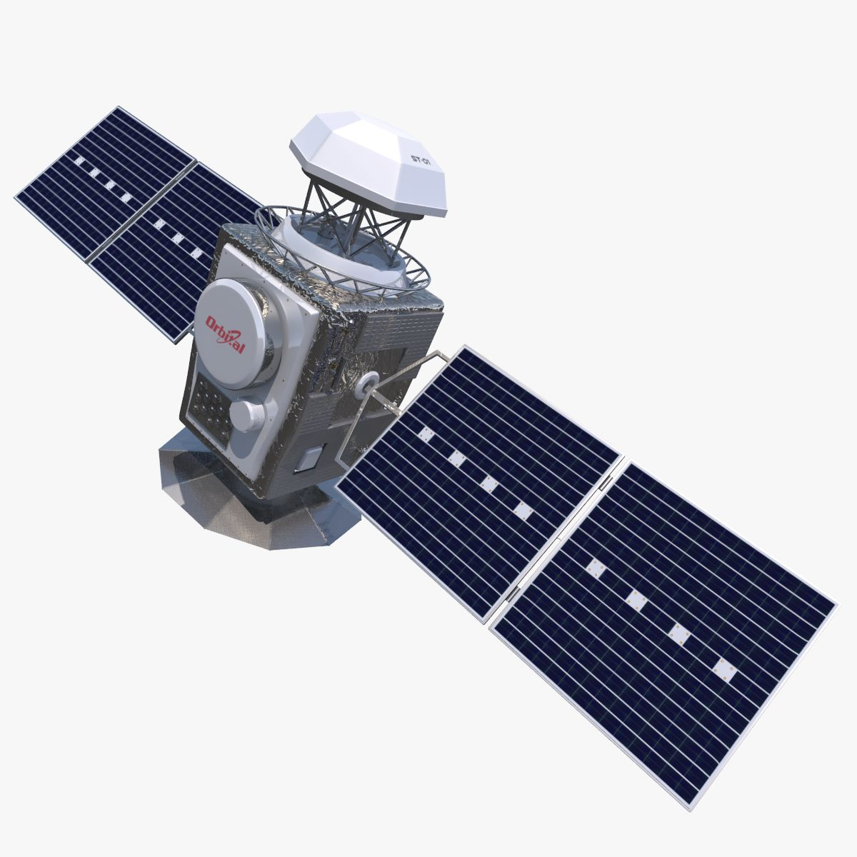
Specifications of Our Satellite Simulation
Each satellite has a mass of 100,000.00 grams
Satellite 1 orbits the Earth at radius 6578000.0 meters and a tangential velocity of 7784.40 m/s
Satellite 2 orbits the Earth at radius 8478000.0 meters and a tangential velocity of 6856.86 m/s

Slide 7
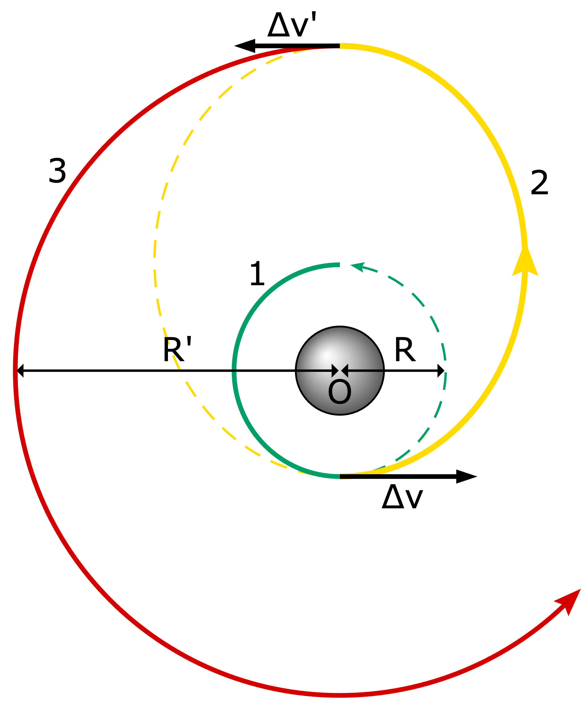
A Bit About the Hohmann Transfer Orbit
The Hohmann transfer orbit is an orbital maneuver used to transfer a spacecraft between two orbits of different altitudes around a central body.
The maneuver uses two impulsive engine burns: the first establishes the transfer orbit, and the second adjusts the orbit to match the target.

Slide 8




Calculating Forces
Centripetal Force
Centripetal Force
Gravitational Force
Thrust Force

Slide 9



Orbital Dynamics 101
Mechanical Energy = Kinetic Energy + Potential Energy
Kinetic Energy
Gravitational Potential Energy
Mechanical Energy of an orbit

Slide 10


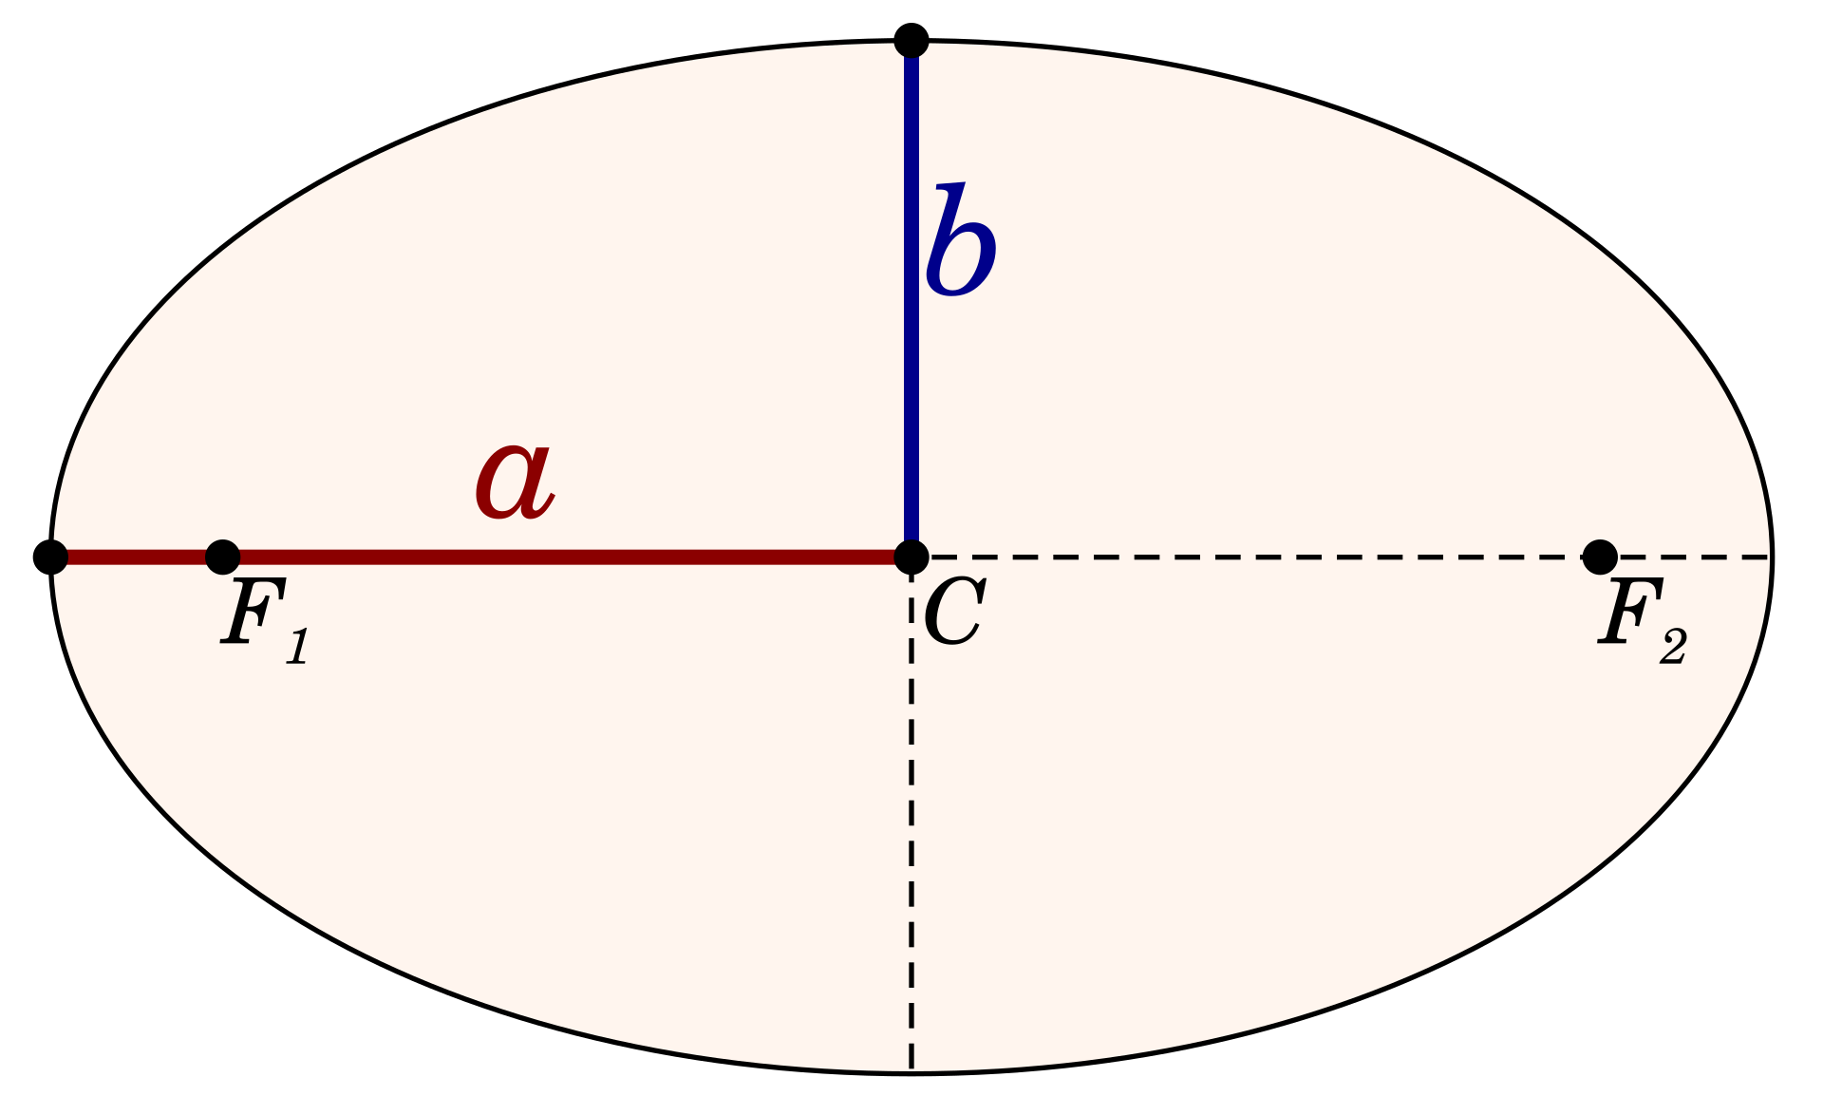

Orbital Dynamics 101 Cont.
Mechanical Energy of a circular orbit
Mechanical Energy of an elliptical orbit
Semi Major Axis (a)
12) Revisiting Eq. 5)

Slide 11


Acceleration
Centripetal acceleration for x, y combining eq. 1 and eq. 2
Acceleration of Thrusters using Newton’s 2nd law

Slide 12
Organizing Things
We now have the equations needed to calculate our acceleration, forces, velocities, so forth. On the next few pages, we’ll look at our variables in terms of computational dependencies. This exercise can give us some valuable insight as to how we organize our simulation.

Slide 13
Computational Dependencies
acc
F_{thrust}
Eq4
m_{satellite}
Delta t
Delta V
Eq12
_{Fcentripetal}
Eq2
ME_{elliptical}
U
Position_{satellite}
V_{satellitee}
Radius_{satellite}
Kinetic_{E}
Eq3
G
M_{E}
m_{satellite}
Radius_{satellite}

Slide 14
Two Satellite Simulation Goals
Verify both circular orbits with graphics
Verify both circular orbits with Trick Quick Plot
Verify Hohmann Transfer with graphics
Verify Hohmann Transfer with Trick Quick Plot

Slide 15

Default Values and Givens
Position of satellite 1 : (0.0, 6578000.0) m
Velocity of satellite 1 : (7784.40, 0.0) m/s
Position of satellite 2 : (0, 8478000.0) m
Velocity of satellite 2 : (7784.40, 0.0) m/s
Delta t for burn 1 : 3.331 x10⁻⁴ s
Delta t for burn 2 : 1.407 x 10⁻⁷ s
Mass of each satellite : 100,000.0 g
Gravitational Constant : 6.674 x 10⁻¹¹
Mass of the Earth : 5.9723 x 10²⁴ g
Radius of the Earth : 6367500.0 m
Period of orbit :
Notes:
hull_length = 3.0;

Slide 16
Credits
Satellite picture - https://www.turbosquid.com/3d-models/3d-model-generic-satellite-real/1094515
Earth picture - https://www.britannica.com/place/Earth
Hohmann Transfer picture - https://en.wikipedia.org/wiki/Hohmann_transfer_orbit#/media/File:Hohmann_transfer_orbit.svg
Semi major axis picture - https://en.wikipedia.org/wiki/Semi-major_and_semi-minor_axes#/media/File:Ellipse_semi-major_and_minor_axes.svg
Generated Formulas - https://editor.codecogs.com
Notes:
hull_length = 3.0;

