Slide 1
Retail Management System
Group Name:Group 2
Group Members:
· Semenu Leticia 10310307
· Naa Amerley Adom Laura 10309724
· Amihere Leticia 10309581
· Chima Kennedy Elorm 10306819
· Lawson Laud Willian 10306832

Slide 2

Meet PrimeTech Electronics Ghana
Company: PrimeTech Electronics Ghana. A typical small to medium-sized retail business in Ghana dealing with electronics. Relies on manual record-keeping using notebooks and simple spreadsheets.This outdated method is common among local businesses, leading to widespread inefficiencies.
Problem Statement
The Challenge: Manual Inefficiency· Difficulty tracking real-time product stock levels.· Frequent errors in sales calculations and receipts.· Time-consuming generation of daily sales reports.
Result: Stock-outs, overstocking, financial losses.

Slide 3

Project Objectives
Our Solution: The G2 QuickStock System
The system aims to:
1. Automate Sales Transactions for speed and accuracy.
2. Maintain Accurate Inventory in real-time.
3. Improve Data Management for products and sales.
4. Generate Basic Reports for key business insights.
5. Enhance User Experience with an intuitive GUI.

Slide 4
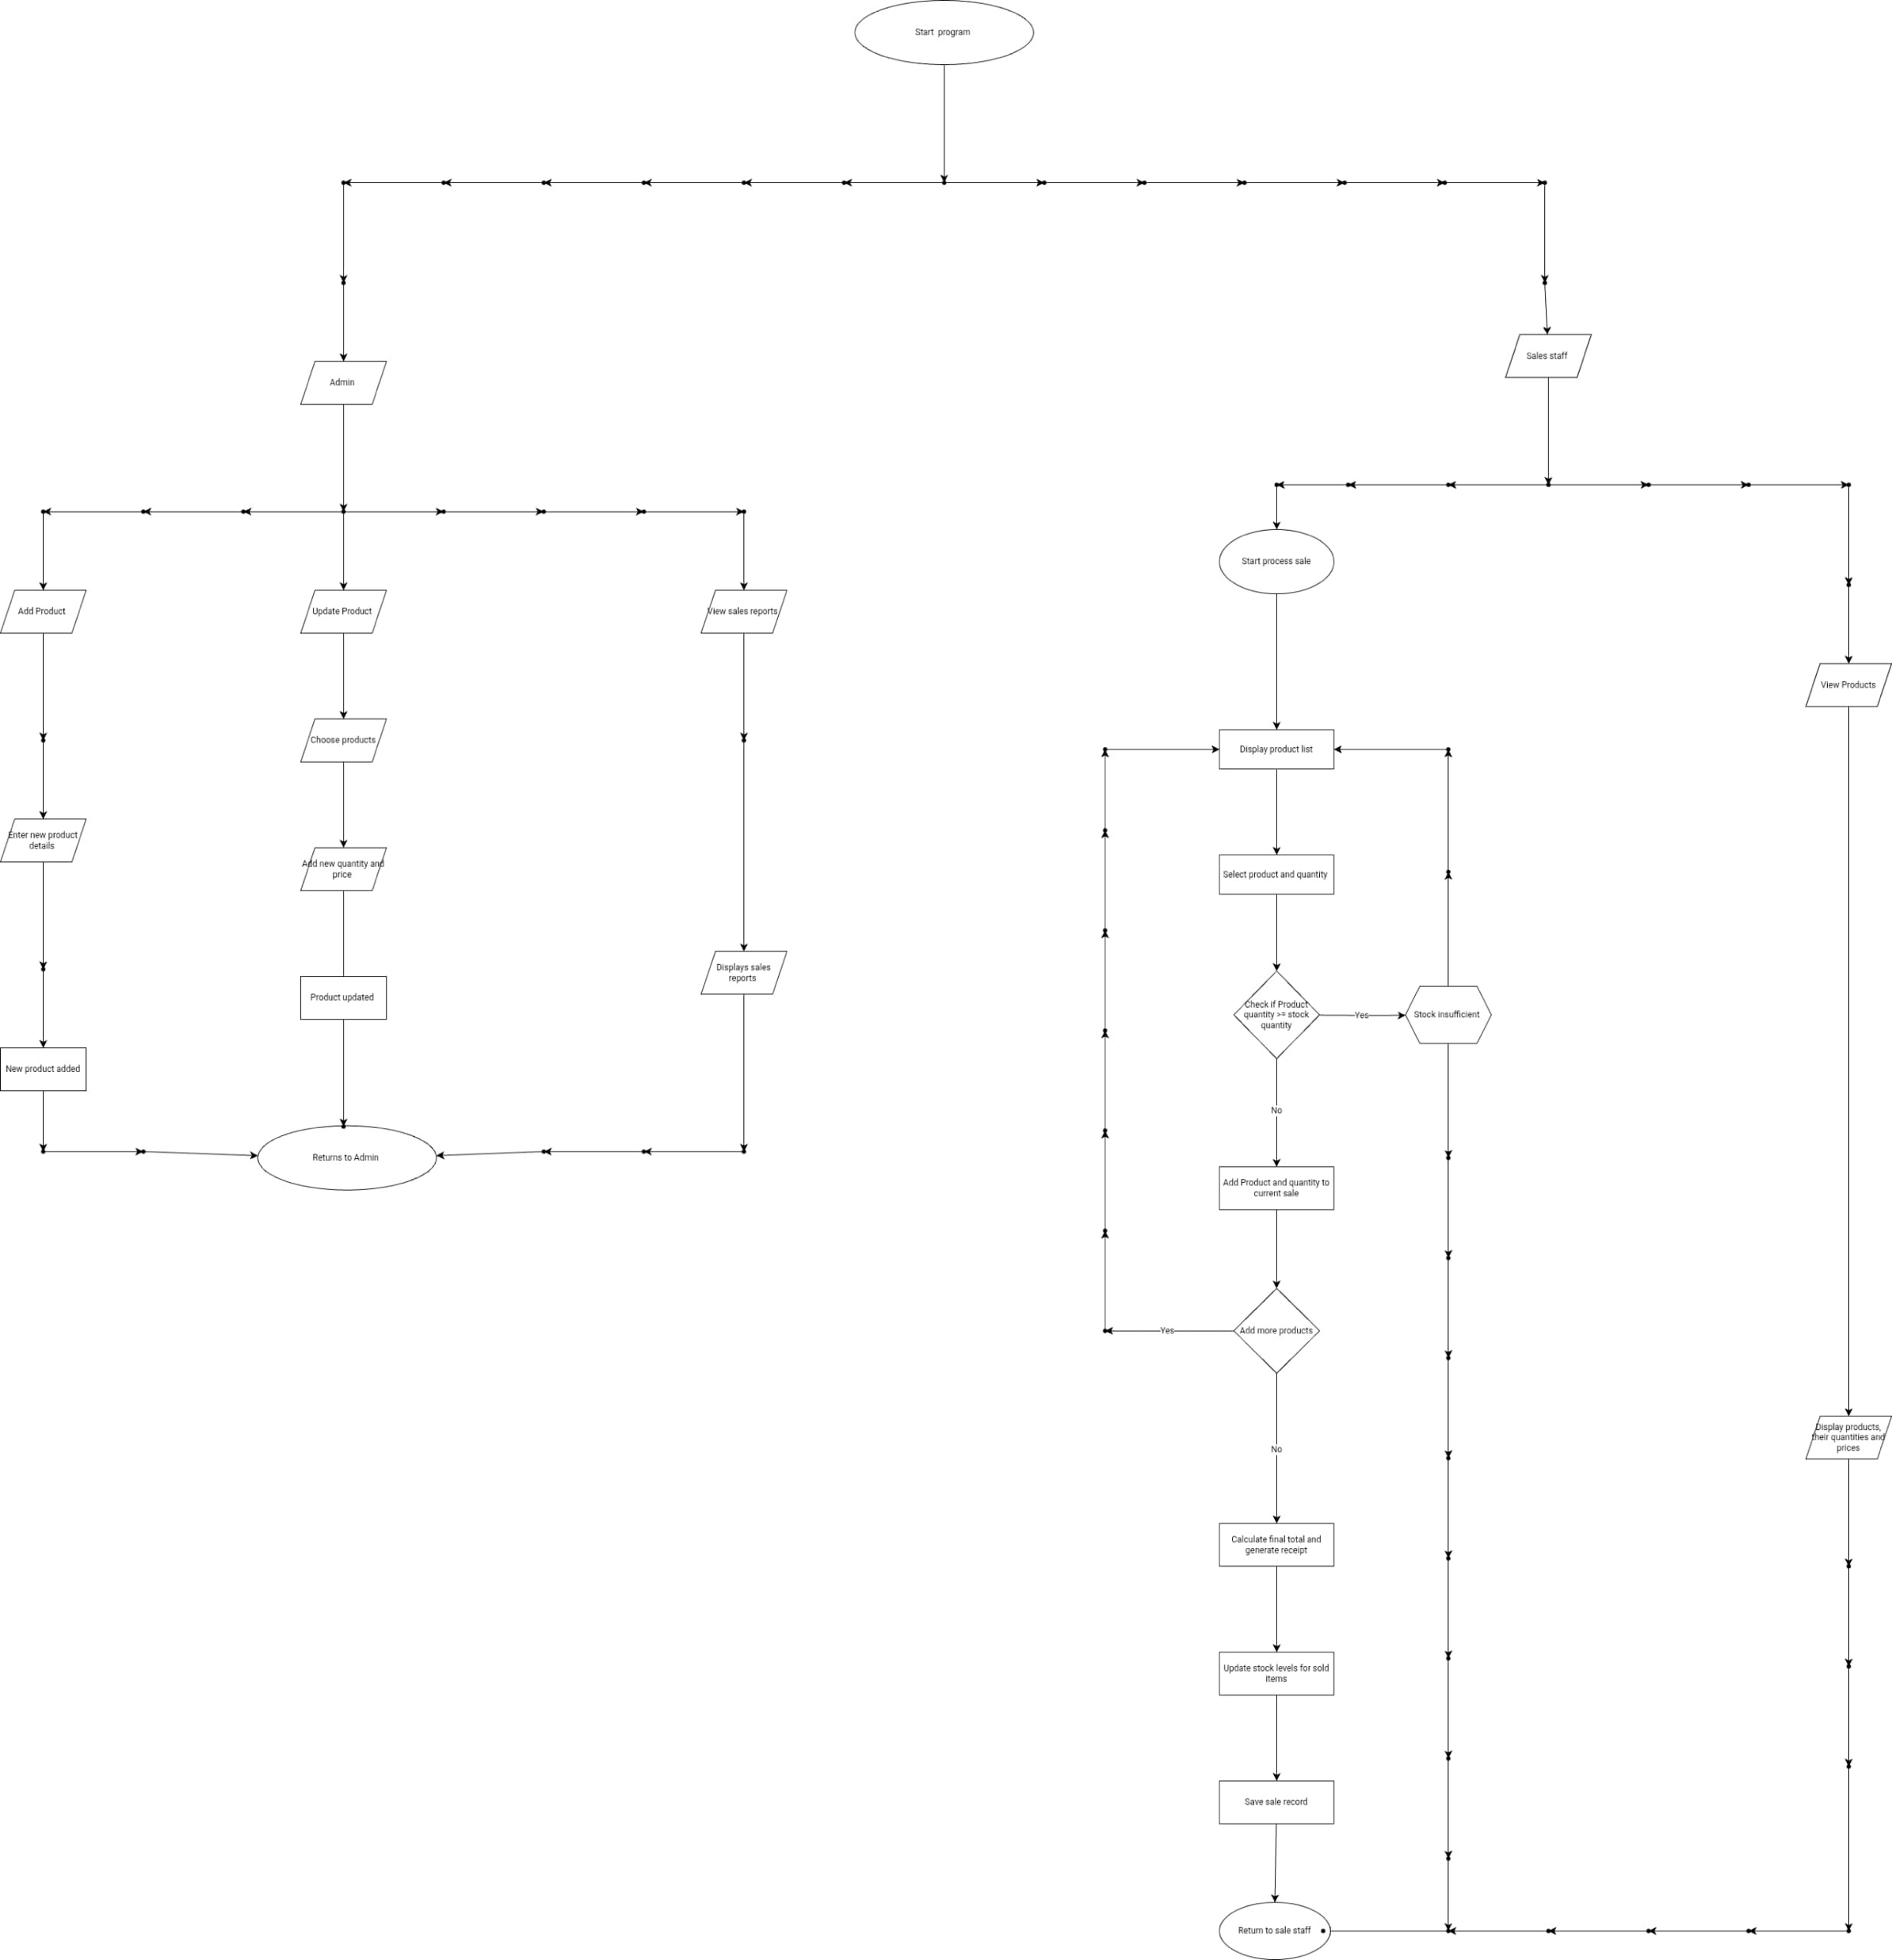
Flowchart

Slide 5
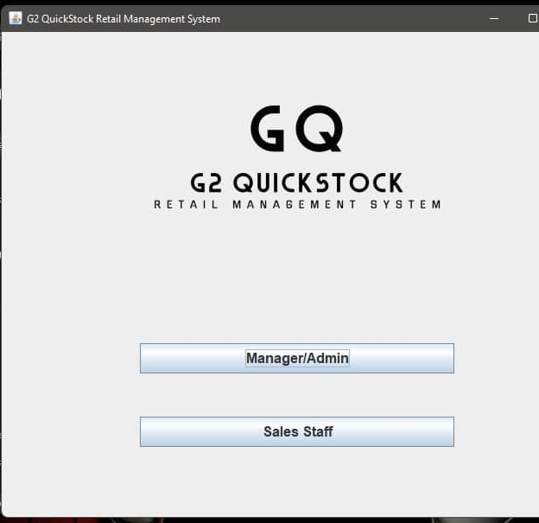
GUI Features Overview: An Intuitive User Interface
Main interface with logoAllows you to choose user role

Slide 6
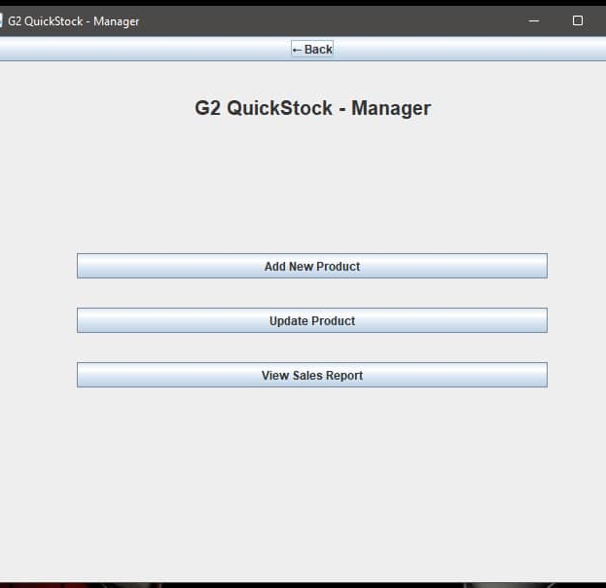
Manager interface
Allows managers to add and update product details and stock and also view sales reports

Slide 7
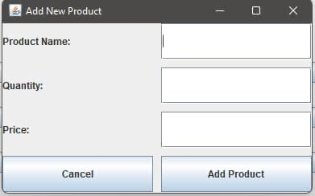
Add new product:
Allows manager to add a new product

Slide 8
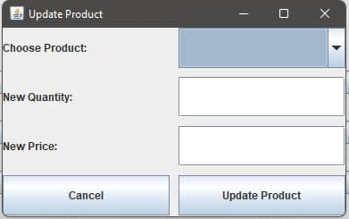
Update product
Allows managers to update product details and stock

Slide 9
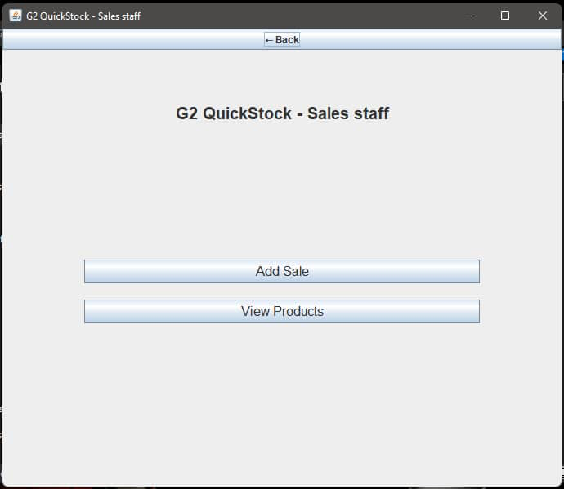
Sales staff interface:
Allows sales Staff to add and manage sales and also view available products and their prices.

Slide 10
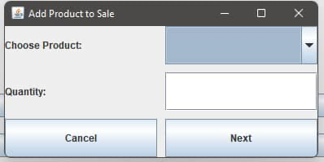
Add product to sales:
Allows sales Staff add and manage sales

Slide 11

Key Java Concepts Utilized
GUI Framework: Java Swing (JFrame, JTable, JButton) for a cross-platform interface.
Event Handling: ActionListener to make buttons responsive (e.g., "Add to Sale").
OOP Principles (Encapsulation): Used private fields with public getters/setters to protect data integrity and creation of methods to be called and access anywhere in code.
Data Structures: ArrayList for dynamic and flexible data storage.
Challenges & Lessons Learned
Choosing the Right Data Structure
Why ArrayList Over Regular Arrays?
We initially considered using regular arrays.
Challenges with Arrays:
Fixed Size: You must know the maximum number of products/sales in advance.

Slide 12
Benefits of ArrayLists:
Dynamic Sizing: It grows automatically as you add more items.
Convenience: Built-in methods like .add(), .remove(), and .get() make coding much simpler and cleaner.
Temporary Data Storage
Our initial design used ArrayLists stored in memory (RAM).
Problem: All product and sales data would be lost every time the application closed!
The Solution: File I/O. We implemented file handling to read product data from a file on startup.Sales and updated product information are saved back to files automatically and can be accessed anytime the application is opened.
Reading the Saved Data:
We saved the data in a simple text format, with commas between each piece of information (like Laptop,500.00,10). To get the data back, we learned to use line.split(","). This command takes a line of text from the file and cuts it into pieces wherever it sees a comma. This let us easily get the product name, price, and quantity back from the file to use in our program.

