Slide 1
DeepSimplex for Travelling Salesman Problem
Numerical Linear Algebra
RoboRangers team
Skoltech

Slide 2
Introduction
Linear Programs (LPs) - fundamental class of optimization problems.
A popular method to solve LPs is the Simplex method.
Pivoting rules play an important role.
Implementation of reinforcement learning techniques can be useful.
RoboRangers
Skoltech
2

Slide 3

LP general formulation
Find a vector $x$ that minimizes $c^{T}x$, subject to $Ax=b$ and $x≥0$, where:
$c∈R^{n}$;
$b ∈R^{m}$
$A ∈R^{m×n}$
$n>m$
RoboRangers
Skoltech
3

Slide 4
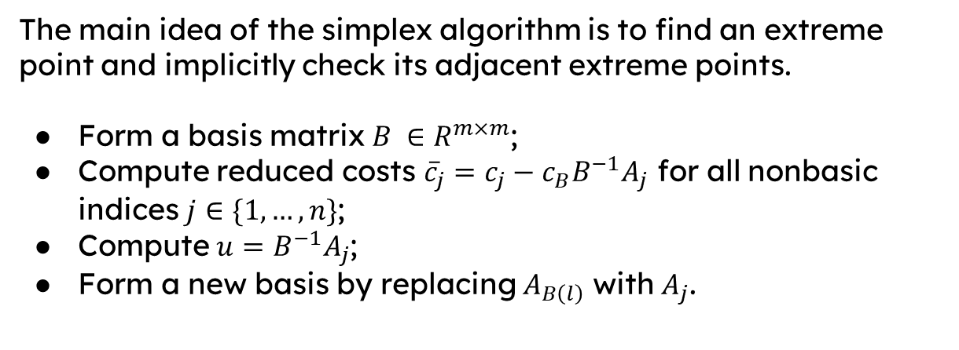
LP and simplex algorithm
The main idea of the simplex algorithm is to find an extreme point and implicitly check its adjacent extreme points.
Form a basis matrix $B ∈R^{m×m}$;
Compute reduced costs ${\overline{c}}_{j}=c_{j}−c_{B}B^{−1}A_{j}$ for all nonbasic indices $j∈\{1,…,n\}$;
Compute $u=B^{−1}A_{j}$;
Form a new basis by replacing $A_{B\left(l\right)}$ with $A_{j}$.
RoboRangers
Skoltech
4

Slide 5
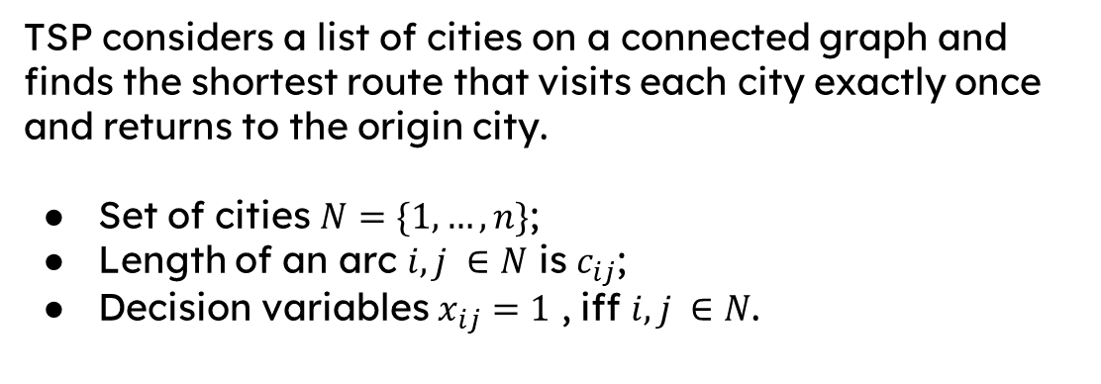
LP and travelling salesman problem (TSP)
TSP considers a list of cities on a connected graph and finds the shortest route that visits each city exactly once and returns to the origin city.
Set of cities $N=\{1,…,n\}$;
Length of an arc $i, j ∈N$ is $c_{ij}$;
Decision variables $x_{ij}=1$ , iff $i,j ∈N$.
RoboRangers
Skoltech
5

Slide 6
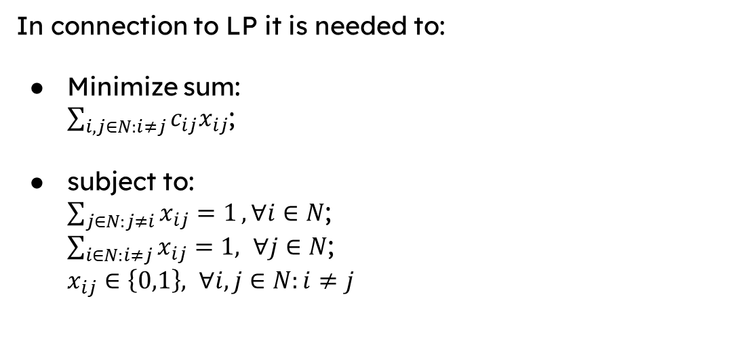
LP and travelling salesman problem (TSP)
In connection to LP it is needed to:
Minimize sum: $\sum_{i,j∈N:i≠j}{c_{ij}x_{ij}}$;
subject to: $\sum_{j∈N:j≠i}{x_{ij}=1}, ∀i∈N$; $\sum_{i∈N:i≠j}{x_{ij}=1, ∀j∈N}$; $x_{ij}∈\left\{0,1\right\}, ∀i,j∈N:i≠j$
RoboRangers
Skoltech
6

Slide 7
Learning approach
How to reduce the solution time of the LP relaxation for the TSP?
Main steps in an iteration:
Formulate the problem;
Use the phase one implementation of a linear programming solver to find a basic feasible solution;
Pass a reduced cost vector and the objective value to a ReLU NN to estimate the Q-value;
Based on the Q-value choose a pivoting rule.
RoboRangers
Skoltech
7

Slide 8
Experiment design
Generate coordinates and distances between them;
Picked two metrics (euclidean and cityblock) to check the difference;
Define a reward function, where the Dantzig’s rule is cheaper, than the steepest edge rule ;
Define a Q-value function as the total of expected discounted future rewards;
Choose a neural network architecture as 4 fully connected hidden layers.
RoboRangers
Skoltech
8

Slide 9
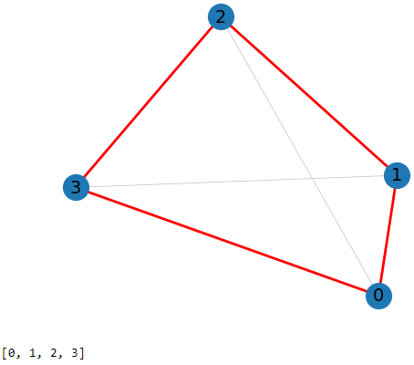
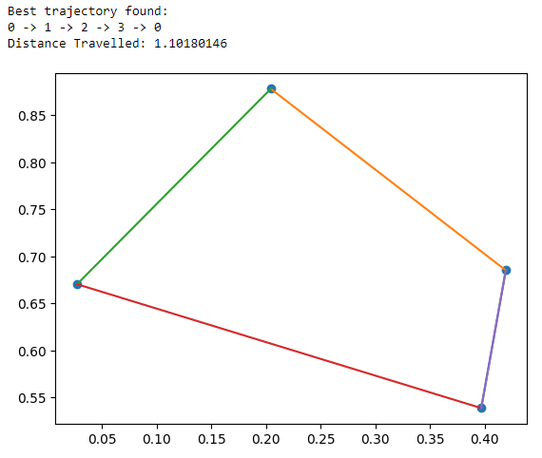
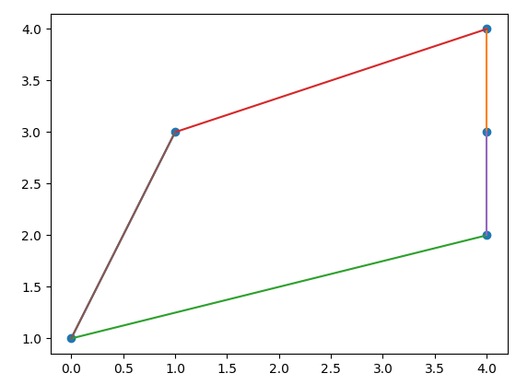
Results of the Q-function
Common approach
Manual realisation of the Q-function
Manual realisation of the Q-function (5 nodes)
https://github.com/GrikTad/NLA_Final_Project
RoboRangers
Skoltech
9

Slide 10
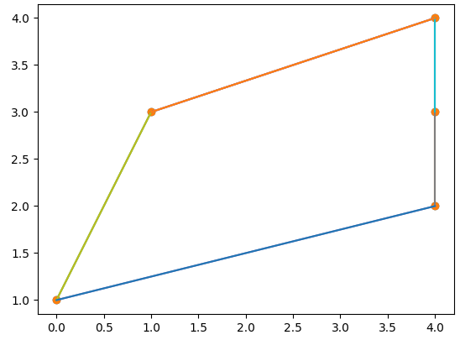
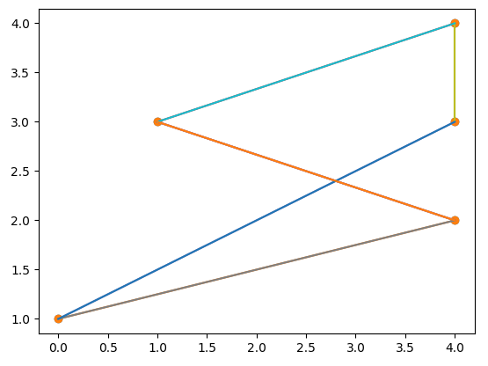
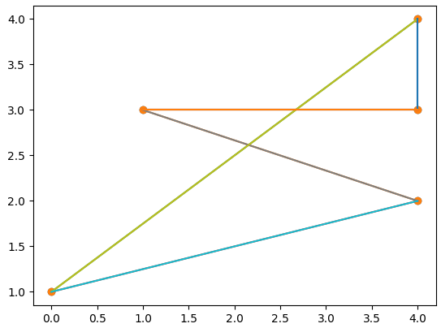
Results of the NN for 5 vertices
100 epochs
1000 epochs
8000 epochs
https://github.com/GrikTad/NLA_Final_Project
RoboRangers
Skoltech
10

Slide 11
Applications and future work
Applications:
Delivery, traveling, industrial drones.
Future work:
Increase a number of epochs;
Try out another approach with graph embeddings, encoders and decoders;
Conduct more experiments.
RoboRangers
Skoltech
11

Slide 12



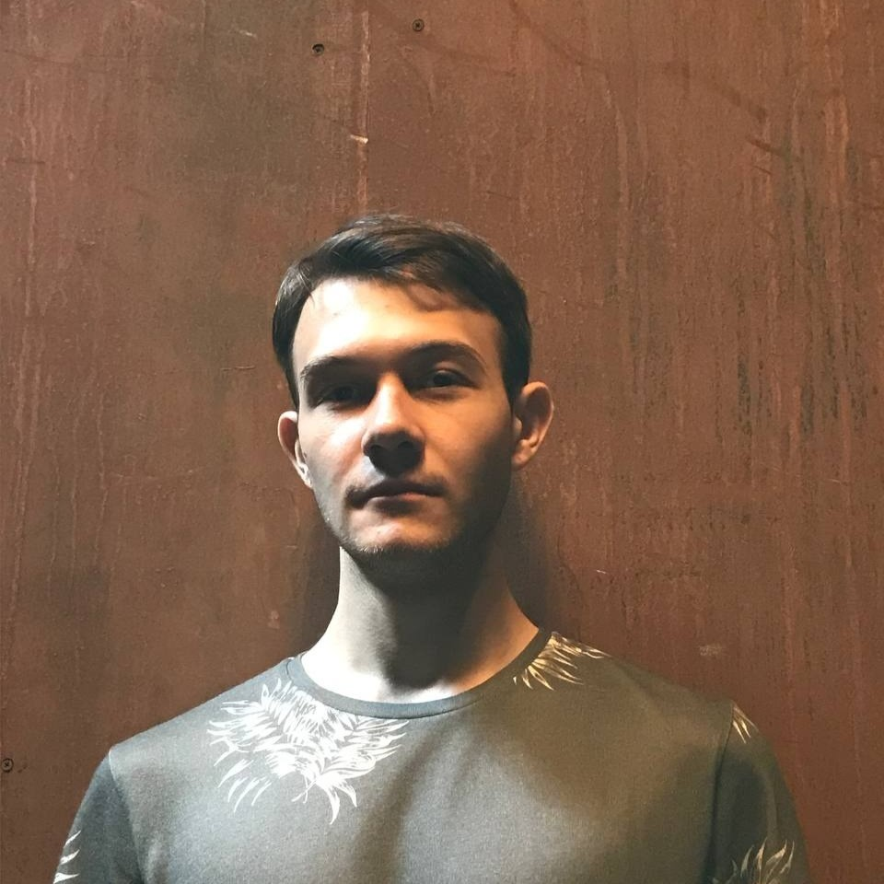
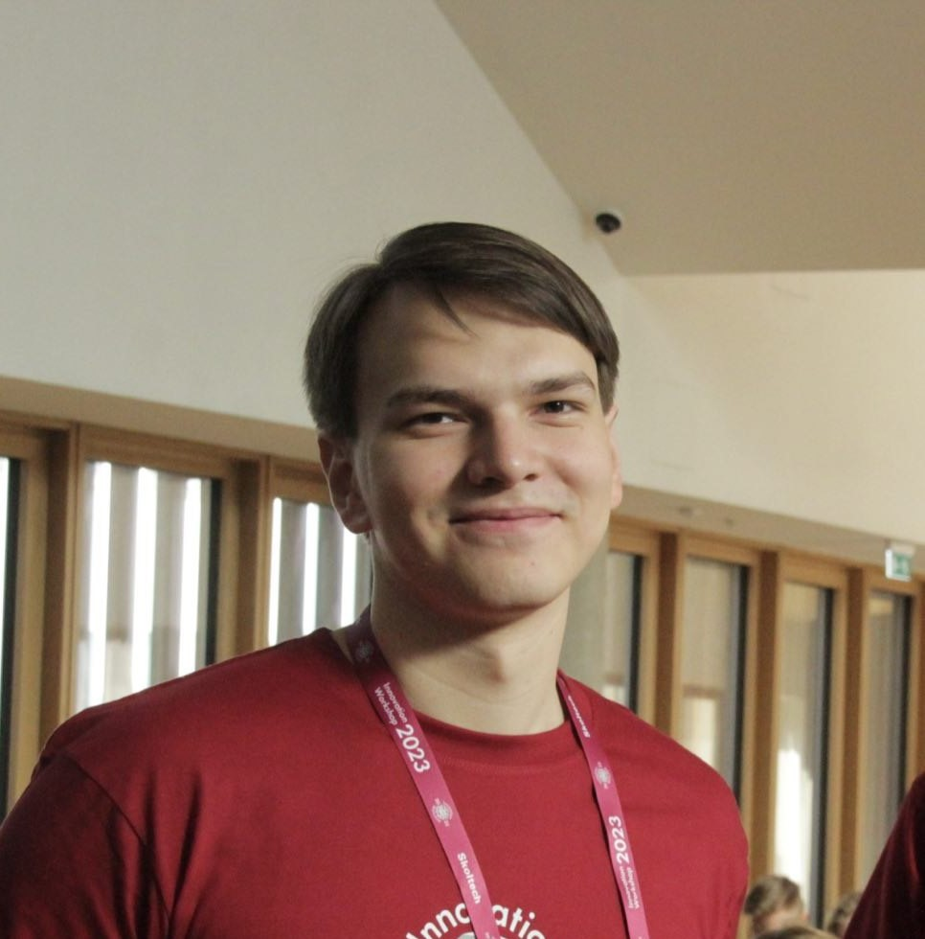
Our team
Grik
Tadevosyan
General algorithm principles
Ivan
Razvorotnev
Experiment design
and conduction
Nikita
Khoroshavtsev
Code refactoring,
graphics
Maksim
Osipenko
Examples generation,
experiment conduction,
presentation
Elvir
Karimov
Common approach
realization
RoboRangers
Skoltech
12

Slide 13
Thank you for your attention!

