Slide 1
CENTRE FOR DEVELOPMENT OF ADVANCE COMPUTING
(GOVERNMENT MINISTRY)
CDAC ATC NETCOM, JAIPUR
(authorized training center)

Slide 2


About C-DAC

Slide 3

Centre for Development of Advanced Computing (C-DAC) is the premier R&D organization of the Department of Electronics and Information Technology (DeitY), Ministry of Communications & Information Technology (MCIT) for carrying out R&D in IT, Electronics and associated areas.

Slide 4
About NETCOM

Slide 5

NETCOM is authorized training center of the C-DAC, which is known for its high class training methods in state of art infrastructure.

Slide 6

Project Title
Hi
ChatBot
Hello

Slide 7
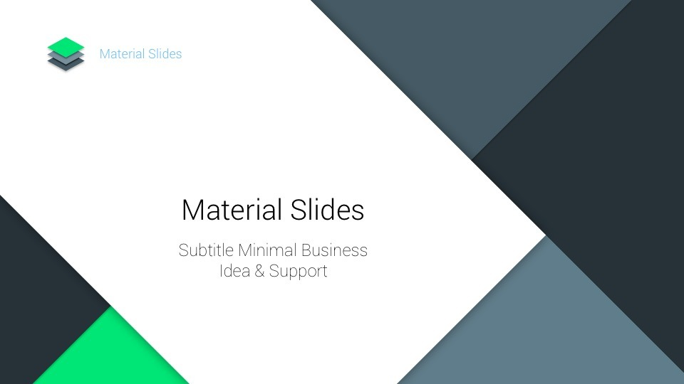
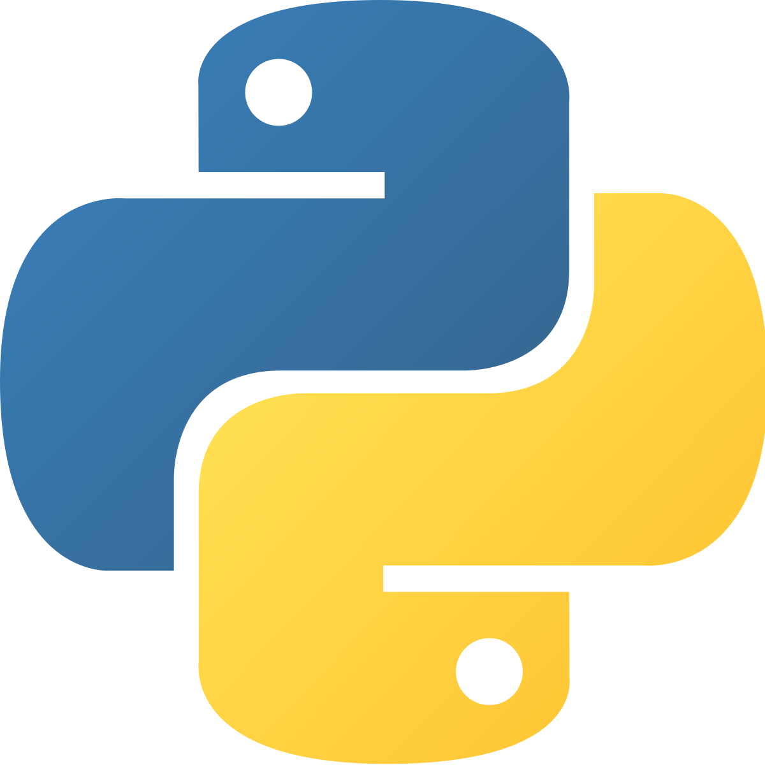
Introduction to Python

Slide 8
Python is an interpreted, high-level, general-purpose programming language.
Created by Guido van Rossum and first released in 1991.
Its language constructs and object-oriented approach aim to help programmers write clear, logical code for small and large-scale projects.

Slide 9
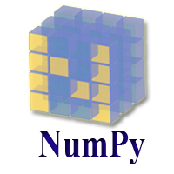
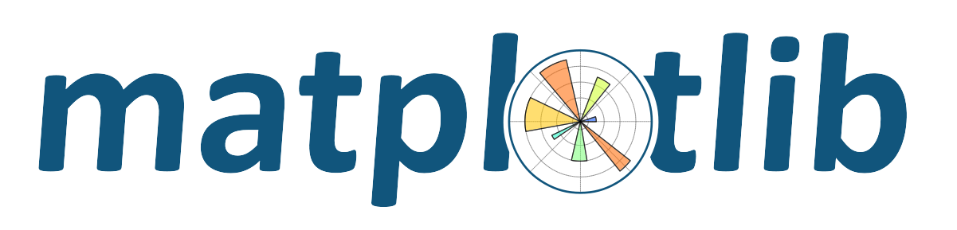

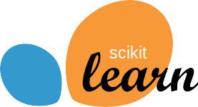
Why Python?
It has lot of Libraries to implement Machine Learning Algorithms.

Slide 10

Beginner Friendliness
Scalability
Large Community
Most used in Data Science Application
Short and Clear Code

Slide 11




Use of Python in Industries

Slide 12
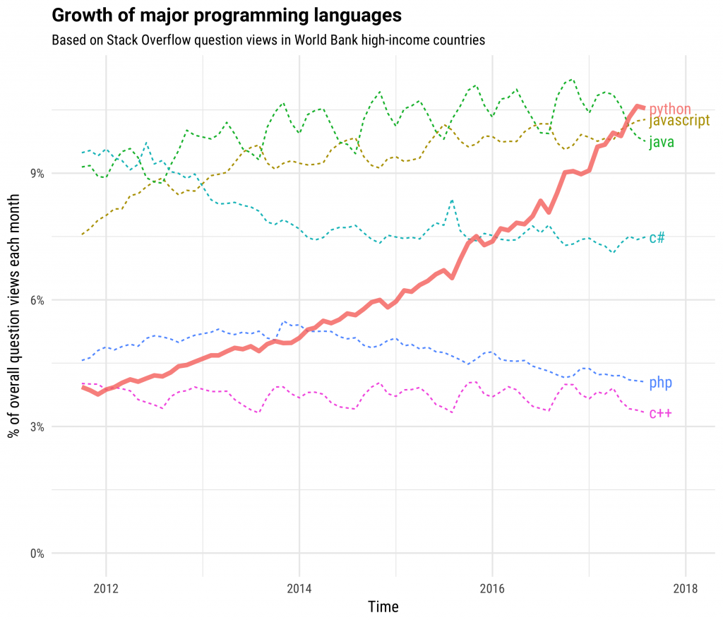
Trend of Python

Slide 13
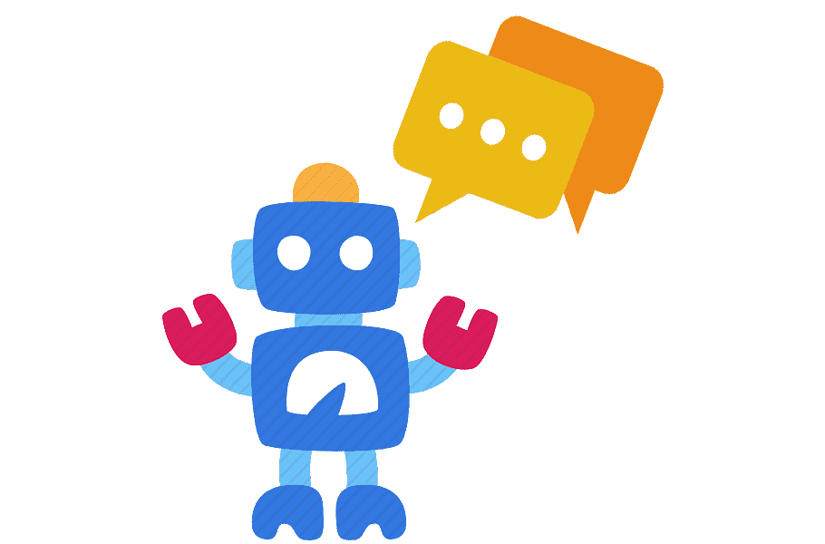
Introduction to ChatBot

Slide 14
A chatbot is a software application used to conduct an on-line chat conversation via text or text-to-speech, in lieu of providing direct contact with a live human agent.
Chatbots are typically used in dialog systems for various purposes including customer service, request routing, or for information gathering

Slide 15
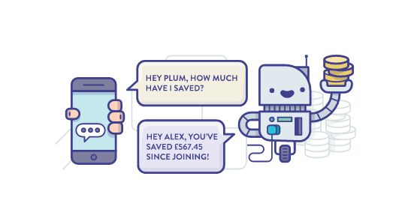
Objective and Purpose
A chatbot can communicate with a real person behaving like a human.

Slide 16
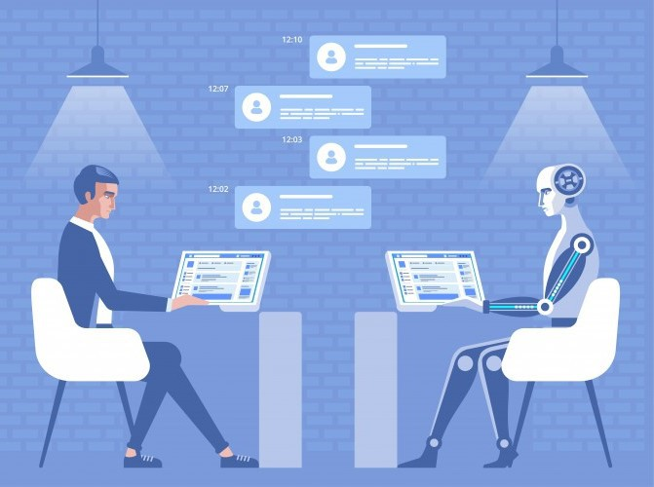
Why ChatBot
You can create chatbots for any business the same as you recruit a person for any department of your company.

Slide 17
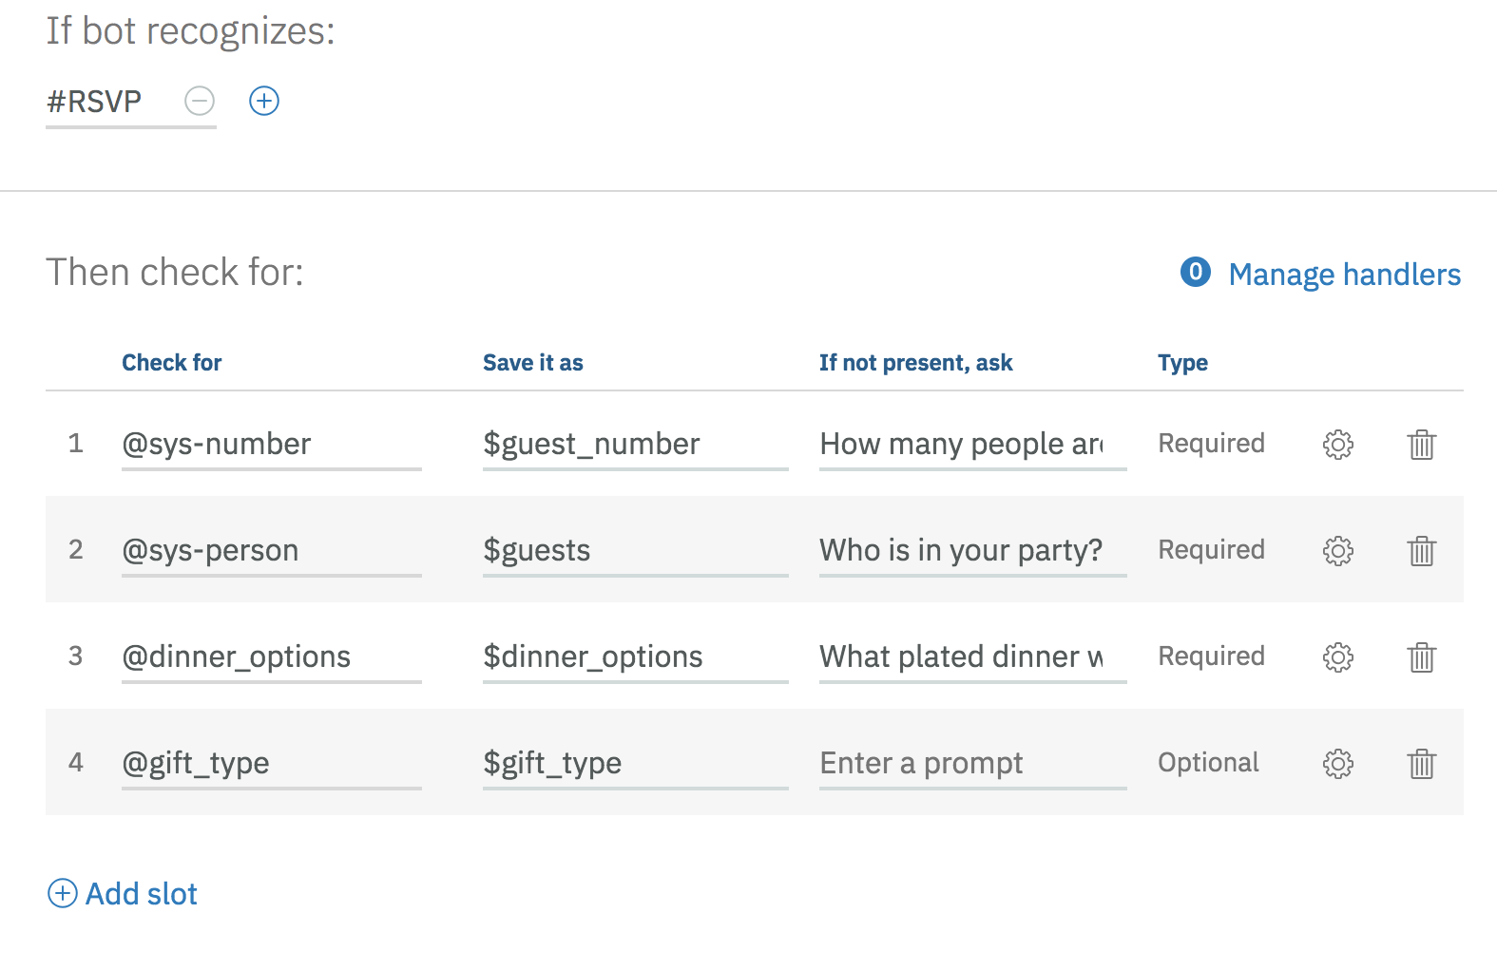
Wedding Planner

Slide 18
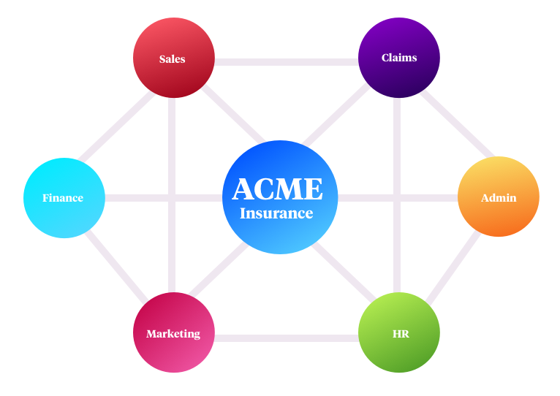
Insurance Assistant

Slide 19

Education Consultant

Slide 20

Personal Assistance

Slide 21

Hospital or a Beautician

Slide 22
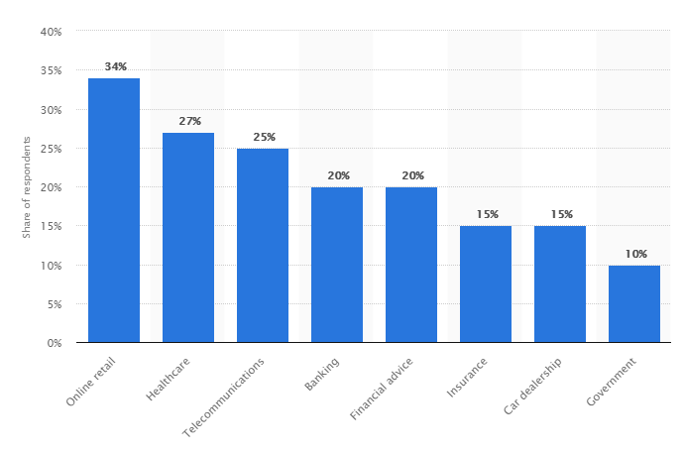
Trend of ChatBot

Slide 23

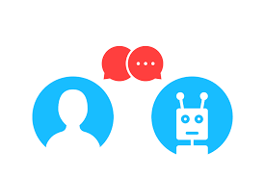
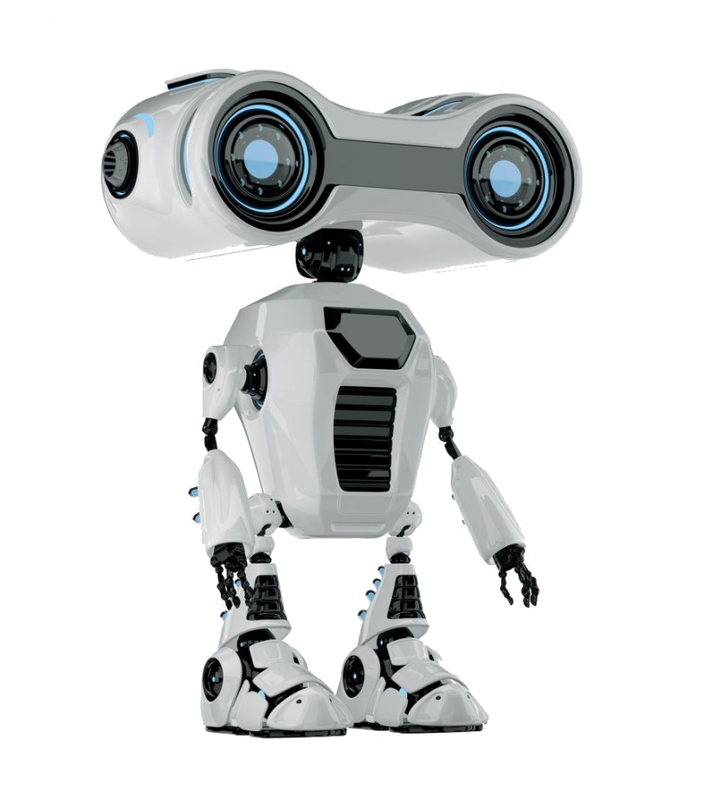
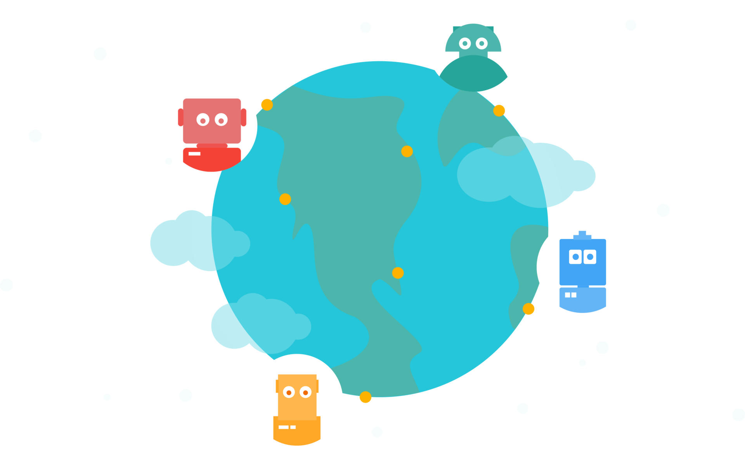
Types of ChatBots
Simple (Easy) | Rules-Based (Easiest)
Smart Machine (Hard) | General AI (Hardest)

Slide 24
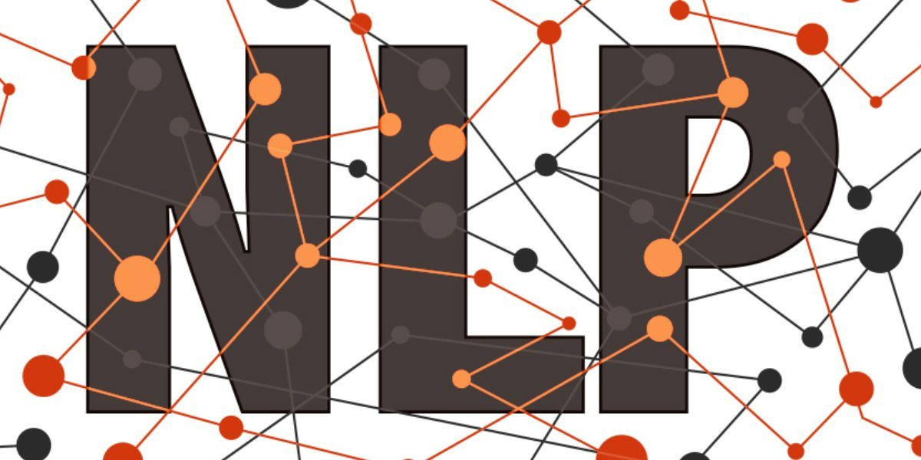
Problem Statement
chatbot is a technology that makes interactions between man and machines using natural language processing.

Slide 25
Natural language processing
NLU | NLG
Natural language understanding | Natural Language Generation
Natural text to structured Data | Data to Natural text
Hard | Easy

Slide 26
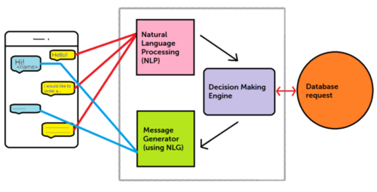
Flow Diagram of Chatbot

Slide 27
Popular Chatbots
 | Amazon | Google | IBM
VPA | Amazon Echo Line | Google Home Line | -
Dev Platform | Alexa voice service Alexa skill kit | Dialogflow | IBM Blue Fix
NLU | Lex | Dialogflow | Conversation API

Slide 28
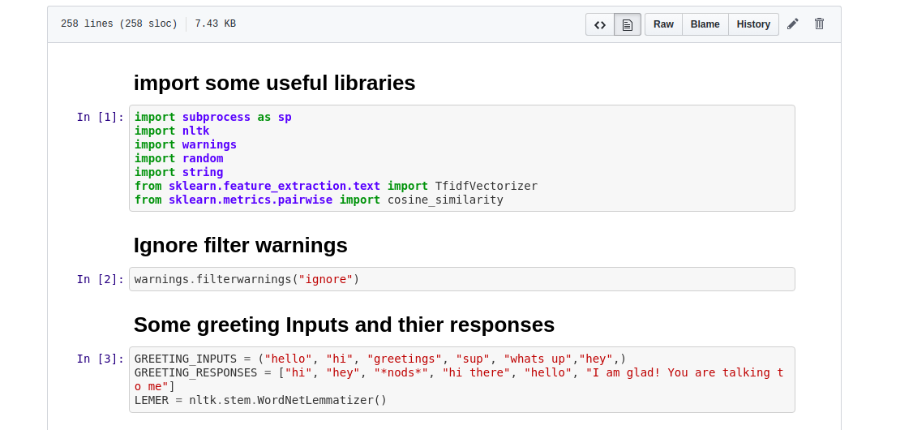
Snap of Code

Slide 29
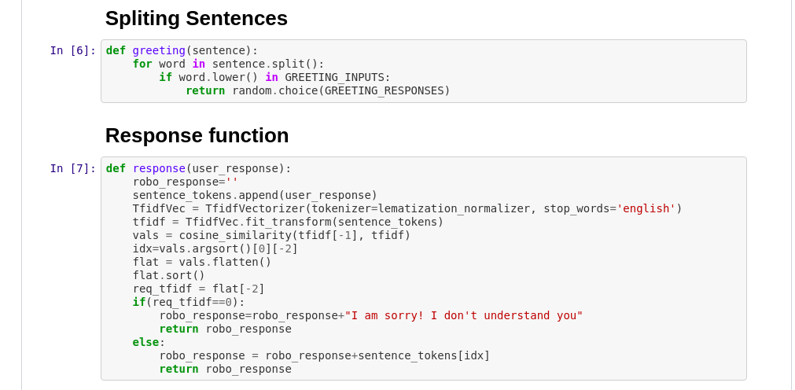

Slide 30
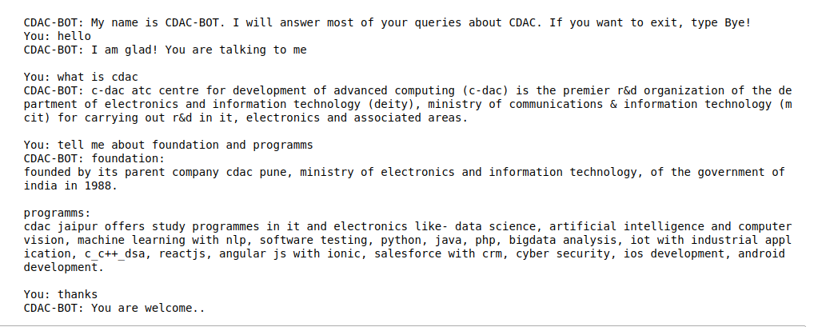
Output

Slide 31

Advantages of ChatBot
Support availability anytime
Managing possibilities
Low maintenance costs
Higher engagement and sales

Slide 32
Conclusion
Chatbots are changing online user experiences, moving users away from complex websites and apps with structured menus to a simplified command-line interface that are adjustable for everyone. This is more effective to engage if you have a tight small budget than Google Adwords, it is easy enough to build, take very little maintenance and will allow you to test different marketing messages for less money than any other channel.

Slide 33

Thank You
Guided By: Submitted By:
Mr. Ashvini Jangir Pradeep Kumar Yadav
(Corporate Trainer & (16TEC2CS018)
Software Developer, C-DAC, Jaipur)

