Slide 1
Conversational AI Chatbot
Members of Team 1
Jeshma Maria Veigas | jeshmamariaveigas@gmail.com | 9535320043/+971503480719
Sanjal P S | sanjalps03@gmail.com | 8431642531
Apeksha Sachin Gaikwad | apekshaa.gaikwad20@gmail.com | 9527731830

Slide 2
Building a Conversational AI Chatbot for Banking Customer Support
Objective:
- Develop a context-aware AI chat bot using transformer models for banking support.
Key features:
- Understands customer queries
- Retrieves relevant banking information
- Responds in natural language
- Handles multiple intents and entities
Tech stack:
- Python, hugging face transformers, pytorch
- Dataset: 50K labeled banking conversations
- Tools: jupyter notebook, cuda-enabled GPU

Slide 3
Data Preparation & Preprocessing
Step 1: Dataset Cleaning
- Removed null entries, special characters, and duplicates
- Lowercased all text
Step 2: Tokenization
- Used bert tokenizer, applied padding and truncation
Step 3: Intent & Entity Mapping
- Mapped intents to labels, used spacy for entities
For unknow intents we used Logistic Regression to classify the intent.

Slide 4
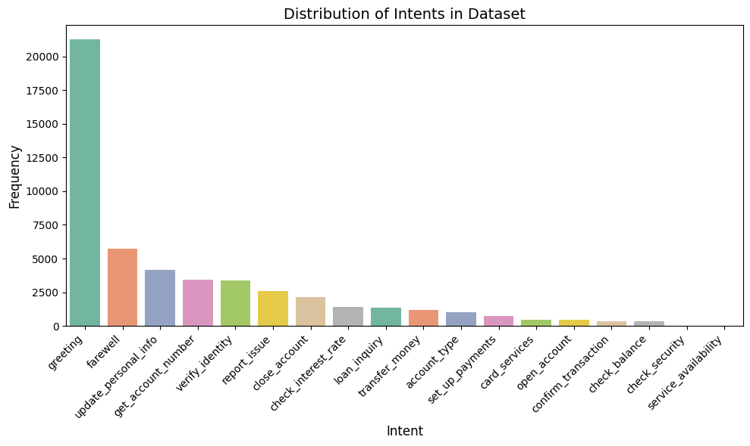
Data analysis
Distribution of intents in dataset

Slide 5
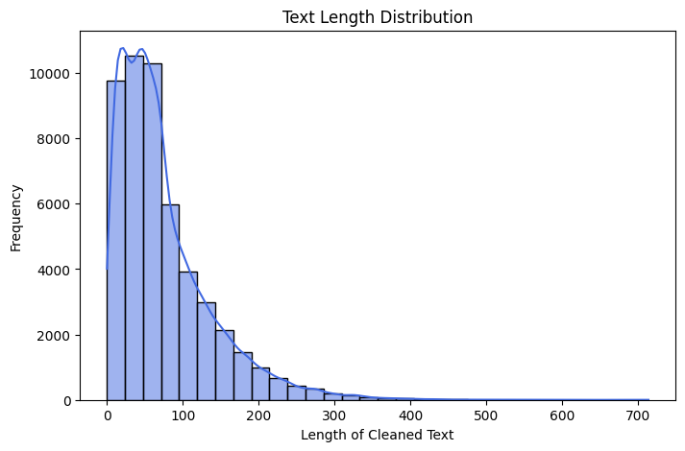
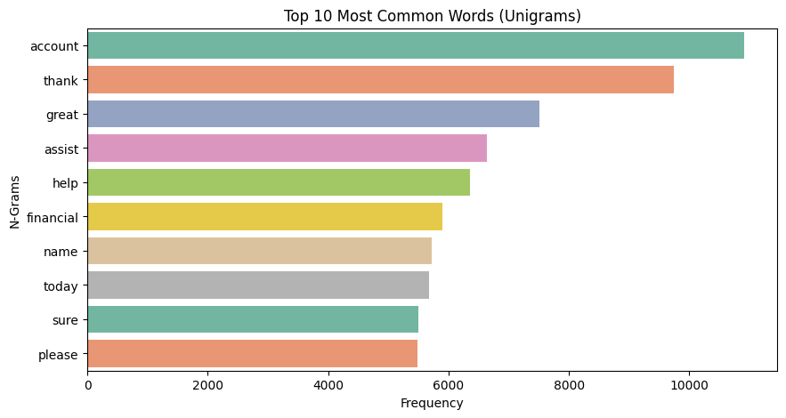
Text length distribution
Top 10 most common words(unigrams)

Slide 6
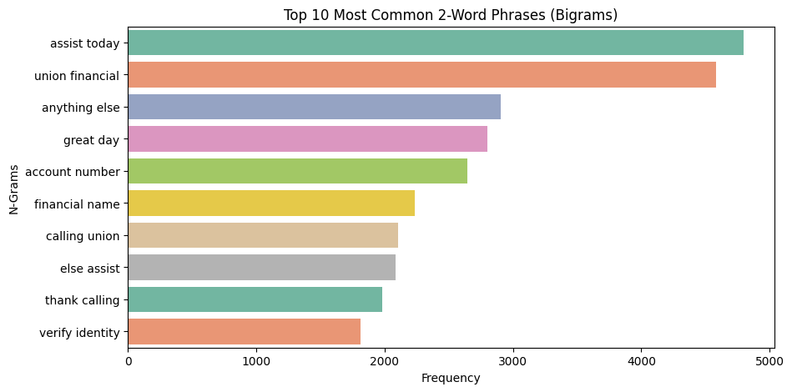
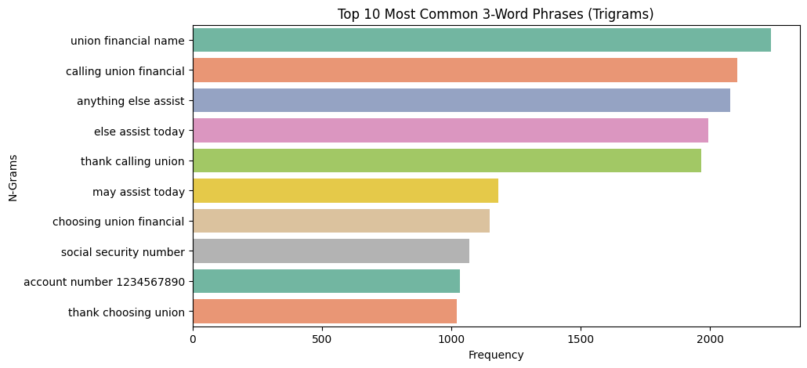
Top 10 most common 2-words phrases(bigrams)
Top 10 most common 3-words phrases(trigrams)

Slide 7
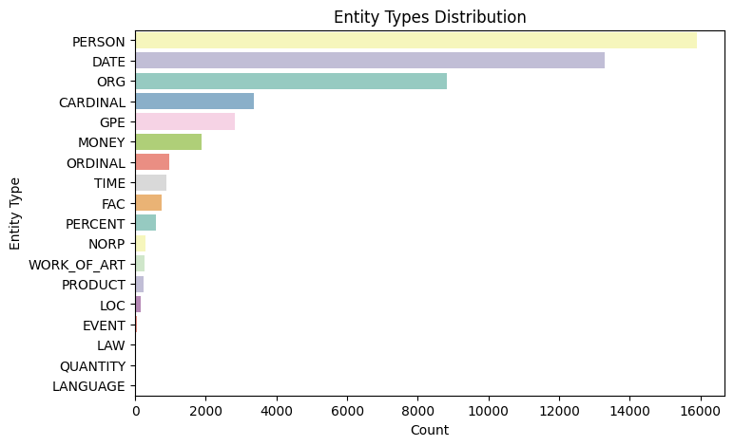
Entity types distribution

Slide 8
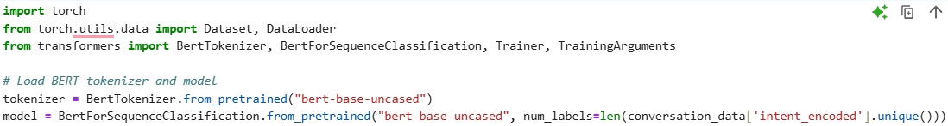
Model Building & Fine-Tuning
Model Used:
BERT: Used for classifying user intents
GPT-2: Utilized for generating responses
RoBERTa: Applied for intent classification
DistilBERT: Leveraged for identifying user intents
Common Errors:
- CUDA Out Of Memory
- Incorrect Label Count
Code Sample: Bert

Slide 9
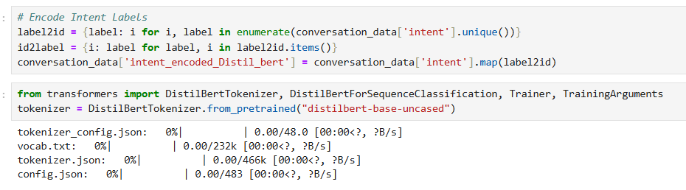
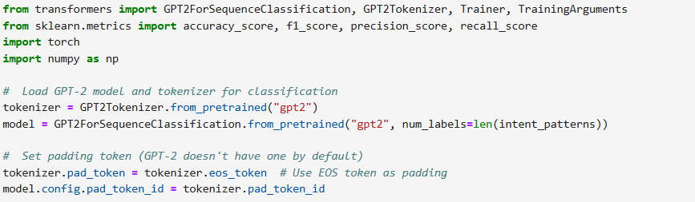
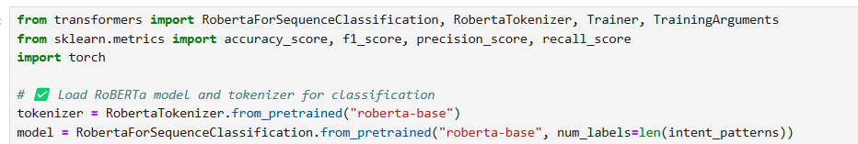
Code Sample: Fine-Tune DistilBert
Code Sample: Chat-GPT 2
Code Sample: Roberta

Slide 10
Evaluation & Metrics
Model Name | loss | accuracy | F1 Scores | precision | recall | latency | runtime | Samples/ second | Steps/second | Epoch
BERT | 0.063544 | 0.9837 | 0.983489 | 0.983425 | 0.9837 | 0.010713 | 71.7853 | 139.304 | 8.707 | 1.0
DistilBERT | 0.070151 | 0.9793 | 0.979069 | 0.979103 | 0.9793 | 0.021102 | 71.6437 | 139.580 | 8.724 | 1.0
ChatGPT-2 | 0.114259 | 0.9733 | 0.972986 | 0.973100 | 0.9733 | 0.010446 | 163.6402 | 61.110 | 7.639 | 1.0
RoBERTa | 0.245989 | 0.9559 | 0.955277 | 0.955431 | 0.9559 | 0.013138 | 44.1185 | 226.663 | 56.666 | 1.0
Evaluation Metrics:
Intent: Accuracy, F1-score
Entities: Precision, Recall
Response: BLEU Score, Coherence
Latency: Response Time Measurement
Common Errors:
Label Mismatch During Evaluation
Tokenization Inconsistency

Slide 11
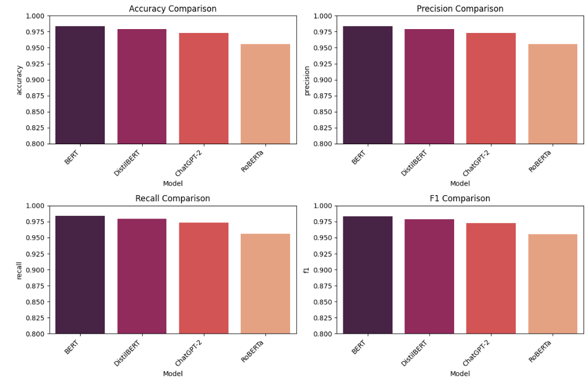

Slide 12
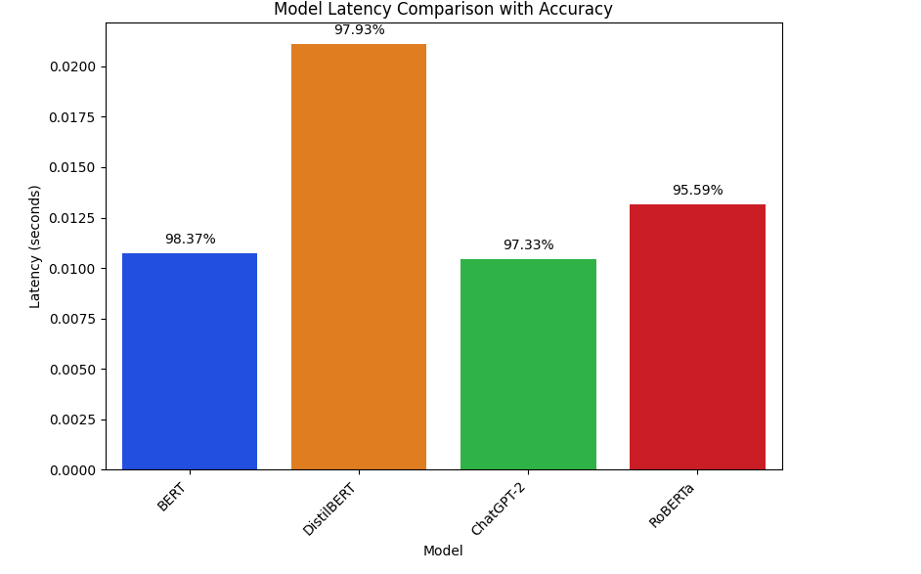

Slide 13
Deployment & Inference Pipeline
Architecture Overview:
- Web UI → Flask API → Model Inference
- Intent Routes To FAQ Or GPT Response
Inference Example:
Input_text = "I Lost My Debit Card"
Inputs = Tokenizer(input_text, Return_tensors='pt')outputs = Model(**inputs)
Common Errors:
- Flask Timeouts Due To Slow Inference
- Token Overflow For Long Queries

Slide 14
Key Takeaways & Future Work
Lessons Learned:
Ensure Consistent Preprocessing
Transformers Need GPU For Efficiency
Hugging Face Eases Model Usage
Future Improvements:
Add RAG For Better Retrieval
Multilingual Support
Improve Latency With Quantization
Final Thought:
Transformers Enable Scalable, Smart Banking Support

