Slide 1
Comparative Analysis of CNN and Vision Transformer Models on
Object Detection Problems
Final Presentation
Presented By-Team1

Slide 2
TEAM MEMBERS
1. Jeshma Maria Veigas
2. Sanjal PS
3. Morla Jahnavi
4. Prajwal AN
5. Karan Pandey

Slide 3
CONTENTS
01
02
03
04
05
Project Folw
Business Objective
Literature Review & Dataset Preparation
Model Implementation & Training
Model Evaluation & Comparative Analysis

Slide 4
01
Project Flow

Slide 5

Business Objective
Literature Review & Dataset Preparation
Model Implementation & Training
Model Evaluation & Comparative Analysis

Slide 6
02
Business Objective

Slide 7
To Explore and identify at least 5 CNN and Vision Transformer architectures/models that are commonly used for object detection problems.
Conduct Comparative Analysis using Object Detection Dataset.
Key Goals:
1. Identify at least five models used for object detection.
2. Compare performance in terms of accuracy, mean Average Precision (mAP), inference time, and computational efficiency.
3. Determine the most effective architecture for specific use cases.

Slide 8
03
Literature Review & Dataset Preparation

Slide 9
Literature Review:
Dataset : Pascal VOC Dataset
Studied CNN architectures: AlexNet, VGG, ResNet, MobileNet.
Studied Vision Transformer models: ViT.
Analyzed research papers and benchmarking studies on object detection models.
Pascal VOC is a widely used dataset for object detection tasks.
Contains annotated images with bounding boxes and class labels.
Includes 20 object categories such as person, car, dog, bicycle, etc.

Slide 10
Data Preprocessing
The dataset undergoes preprocessing before feeding into the model:
Images are resized to (300x300) for consistency.
Converted to tensors for deep learning compatibility.
Normalized using mean and standard deviation.

Slide 11
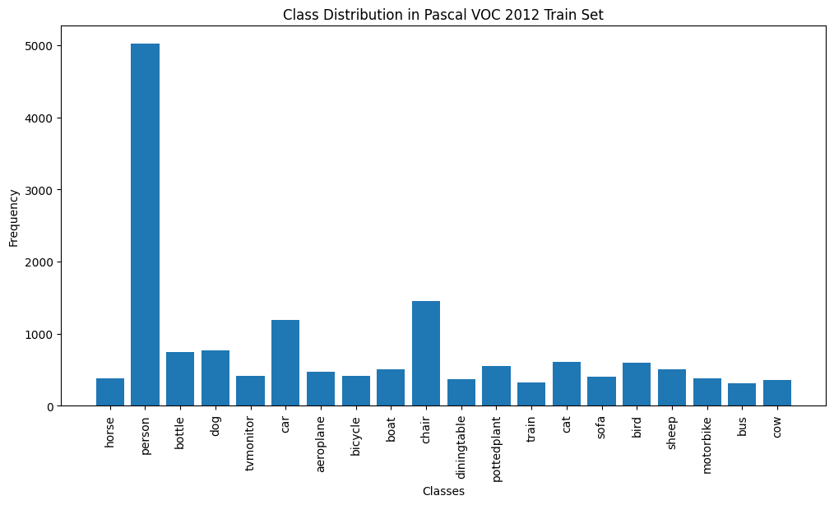
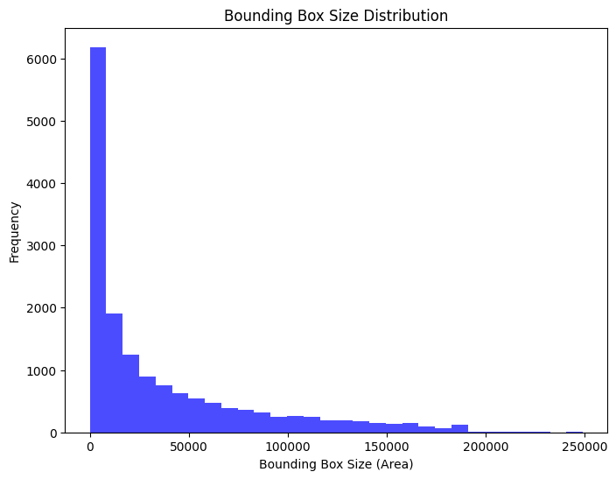
Figure 1. Class Distribution in Pascal VOC 2012 Train Set
Figure 2. Bounding Box Size Distribution

Slide 12
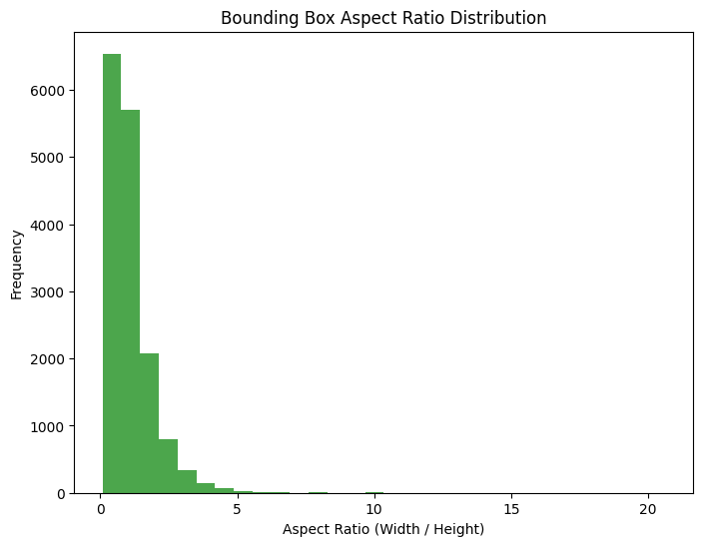
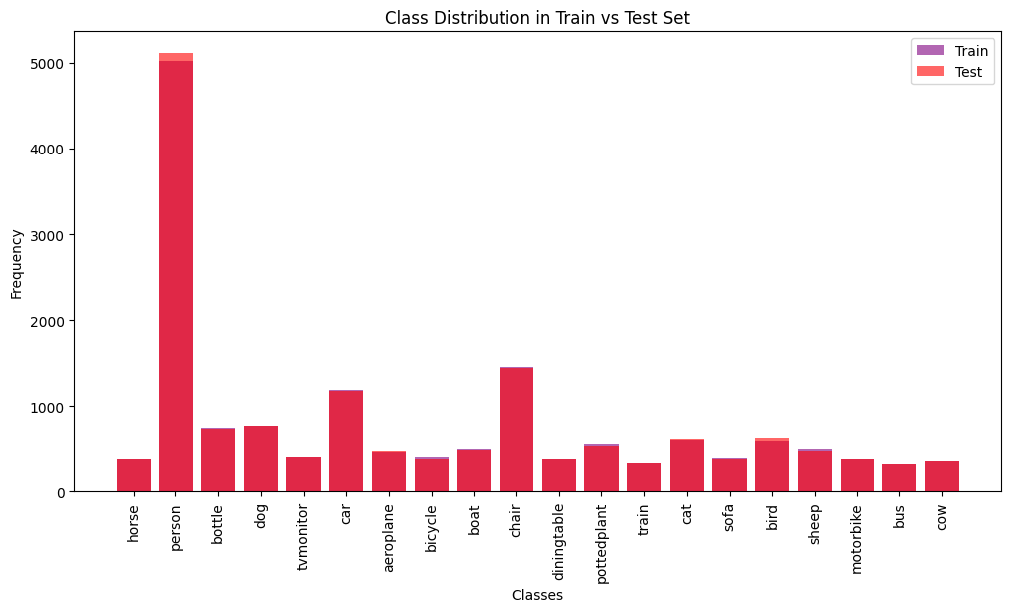
Figure 3. Bounding Box Aspect Ratio Distribution
Figure 4. Class Distribution in Train vs Test Set

Slide 13
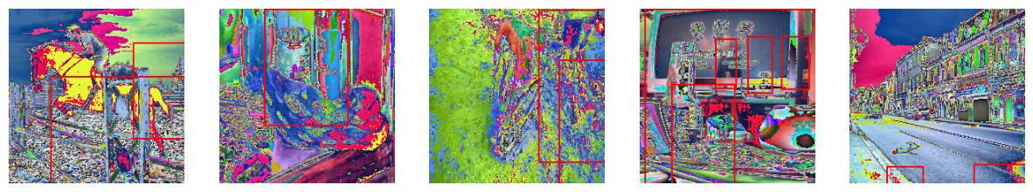
Figure 5. Sample Images with Bounding Boxes

Slide 14
04
Model Implementation & Training

Slide 15
Model Selection:
Training Setup:
CNN-based Models: AlexNet, VGG, ResNet, MobileNet.
Transformer-based Models: Vision Transformer (ViT).
Used pre-trained models and fine-tuned on Pascal VOC dataset.
Configured hyperparameters such as learning rate, batch size, and optimizer selection.
Used GPU acceleration to speed up training.

Slide 16
Challenges Encountered:
CNN models require extensive feature extraction and computational power.
Vision Transformers require a large amount of training data but provide better generalization.

Slide 17
05
Model Evaluation & Comparative Analysis

Slide 18
Model performance is evaluated using metrics like:
Accuracy: Measures the overall correctness of model predictions.
mAP (mean Average Precision): Evaluates precision-recall trade-off for object detection.
Inference Time: Assesses the time required for a single image prediction.
Key Comparison of CNN vs Vision Transformers:
CNNs are efficient for small datasets and real-time applications.
Vision Transformers provide better accuracy for complex datasets but require more computational power.
Trade-off between accuracy and inference speed determines the best model for a given use case.

Slide 19
Model Comparision
Model | Accuracy (%) | Inference Time (s/batch) | Model Size (MB) | mAP
vgg16 | 83.1874 | 0.00211227 | 512.476 | 0.0633932
alexnet | 83.1874 | 0.00118203 | 217.765 | 0.0633932
resnet50 | 84.2349 | 0.00749664 | 89.8324 | 0.0633932
mobilenet_v2 | 86.8109 | 0.00664937 | 8.58113 | 0.0633932
vit_b_16 | 83.1874 | 0.00647309 | 327.355 | 0.0633932

Slide 20
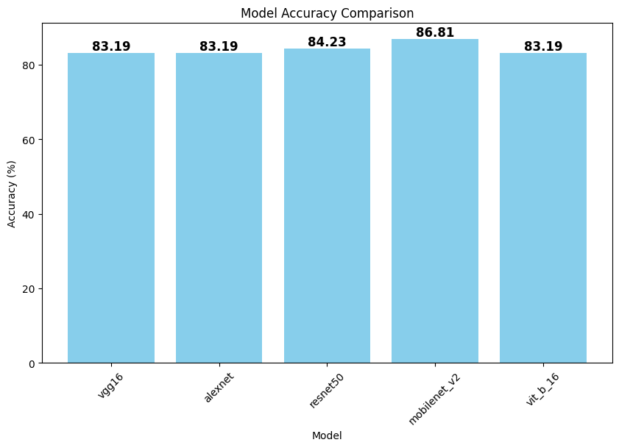
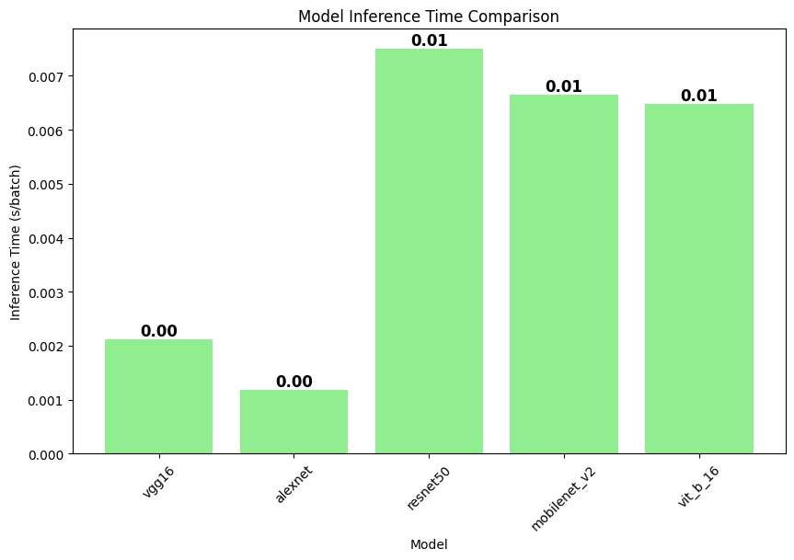
Figure 6. Model Accuracy Comparision
Figure 7. Model Inference Time Comparision

Slide 21
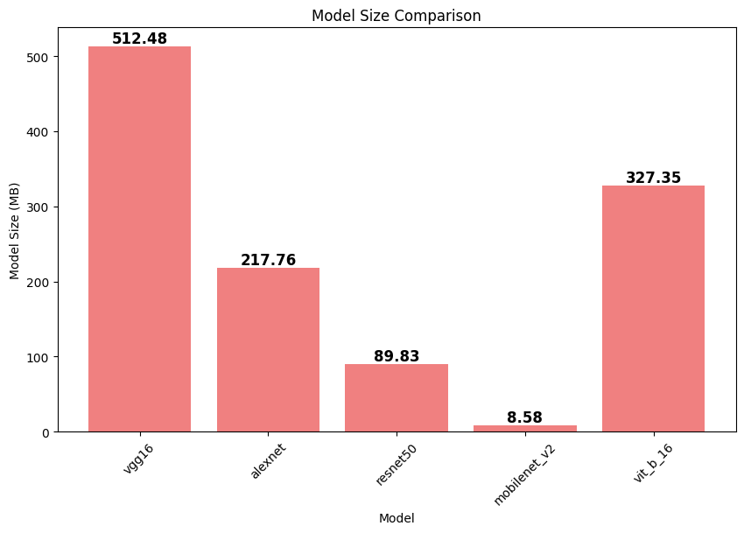
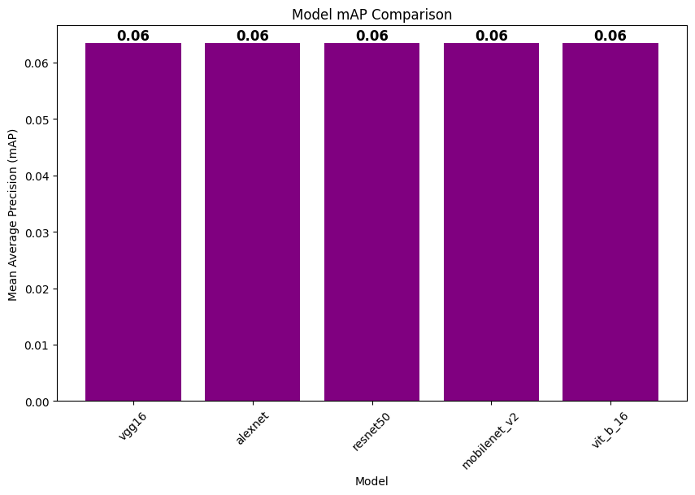
Figure 8. Model Size Comparision
Figure 9. Model mAP Comparision

Slide 22
Conclusion
We can observe the following key insights regarding the performance of different models in terms of accuracy, inference time, model size, and mean Average Precision (mAP):
Accuracy Trends:
MobileNetV2 achieved the highest accuracy (86.81%), making it the best-performing model in terms of classification accuracy.
Inference Time:
AlexNet has the fastest inference time (0.00118s/batch), making it the most efficient in real-time scenarios.
Model Size Considerations:
MobileNetV2 is the smallest model (8.58MB), making it highly efficient for deployment on edge devices.
mAP Consistency:
All models show the same mAP value of 0.0633, indicating that object detection performance is relatively similar across architectures in this specific task.
We can conclude that, MobileNetV2 is the most efficient model overall, offering the best trade-off between accuracy (86.81%), inference speed (0.00664s), and model size (8.58MB). For high accuracy tasks, ResNet50 is preferable, while AlexNet is the fastest option but lacks accuracy improvements.

Slide 23
THANK YOU

