Slide 1


Mirsad
IS499 SENIOR PROJECT · FINAL PRESENTATION
A runtime security firewall for AI agents
against prompt-injection attacks
مرصاد
TEAM
Mohammed Yasser Alanssari
221110935
Bader Alshuraie
221110016
“watchtower”
Bader Abdullah Abbod Alyamini
221110197
Abdulmalik bin Saedan
221110958
Inspects every tool call and every tool result of an AI agent
Abdullah Naif Abdullah Al-Orabi
222110432
Supervisor Dr. Omaia Al-Omari
College of Computer & Information Sciences · Information Systems Department · Academic Year 2026–2027
Notes:
Presenter: Abdulmalik bin Saedan · Time: 0:30
Good morning. We are the Mirsad team: Mohammed Alanssari, Bader Alshuraie, Bader Alyamini, Abdullah Al-Orabi and I, Abdulmalik bin Saedan. Our supervisor is Dr. Omaia Al-Omari. Mirsad is Arabic for "watchtower". It is a runtime security firewall that sits between an AI agent and the tools the agent uses. We will explain the problem, how Mirsad works, how we built and tested it and what we measured, and then show it running.

Slide 2
Agents obey instructions hidden in the data they read
INTRODUCTION · THE PROBLEM
1
2
3
Attacker plants text
Agent reads it
Agent acts on it
with hidden instructions in an e-mail, web page, CV or CRM note
while doing a normal task for its user
exports data, sends money or deletes records with its own permissions
Firewalls, IAM and DLP see an authorised agent making a normal API call. The control has to sit at the tool call.
Mirsad مرصاد · IS499 Senior Project · Prince Sultan University
2 / 18
Notes:
Presenter: Abdulmalik bin Saedan · Time: 1:00
AI agents no longer only chat. They read e-mail, search the CRM, open web pages and call tools that send messages or move money. Everything a tool returns goes into the model's context, and the model cannot reliably separate data from instructions. An attacker therefore does not need to break into anything. It is enough to send an e-mail, publish a web page or upload a CV that contains instructions addressed to the agent, for example to export the customer list to an outside address. When the agent reads that content during a normal task, it may follow the instructions with its own valid permissions. This is indirect prompt injection. A web application firewall, identity management or data-loss prevention sees an authorised agent making a normal API call, so none of them intervenes. The control has to sit where the agent acts, at the tool call.

Slide 3
Why this matters for Saudi organisations
INTRODUCTION · MOTIVATION
#1
§
ع
LLM01
PDPL & ECC
Arabic gap
Prompt injection is the top risk for LLM applications
A leaking agent discloses personal data; logging and monitoring are required
None of the detectors we reviewed publishes Arabic accuracy results
OWASP Top 10 for LLM Applications 2025
PDPL (2021, amended 2023); NCA ECC-2:2024
Team review of 11 products and prototypes, Oct 2026
Mirsad مرصاد · IS499 Senior Project · Prince Sultan University
3 / 18
Notes:
Presenter: Mohammed Yasser Alanssari · Time: 0:45
Three facts make this urgent for Saudi organisations. OWASP ranks prompt injection first, as LLM01, in its Top 10 for LLM applications. Under the Personal Data Protection Law, an agent that leaks customer records causes an unauthorised disclosure of personal data, and the NCA Essential Cybersecurity Controls require event logging and monitoring. Finally, the agents deployed here read and write Arabic, but none of the injection detectors in our review of eleven products and research prototypes publishes Arabic accuracy figures.

Slide 4
Three SMART objectives, fixed before implementation
INTRODUCTION · OBJECTIVES
M5
Mar 2027
1
Enforce policy at the tool boundary
Median added latency ≤ 200 ms
MCP and OpenAI-style agents, no agent changes
M4
Feb 2027
2
Detect Arabic and English injections
F1 ≥ 0.85 on held-out AR and EN tests
MSA, Gulf dialect, Arabizi, mixed and English
M6
Apr 2027
3
Keep humans in control, prove the effect
≥ 80% less attack success; ≤ 5% benign blocked
Approval app, replayable audit, Mirsad-Bench
Mirsad مرصاد · IS499 Senior Project · Prince Sultan University
4 / 18
Notes:
Presenter: Abdullah Naif Al-Orabi · Time: 0:45
The proposal listed six objectives. We consolidated them into three SMART objectives, and the targets were fixed before implementation, so they could not be tuned to the results. First, enforce security at the tool boundary for MCP and OpenAI-style agents, with a median added latency of at most 200 milliseconds per call. Second, detect injected instructions in Arabic and English with an F1 score of at least 0.85 on held-out test sets. Third, keep humans in control through a mobile approval app and a replayable, tamper-evident audit log, and show on our benchmark that attack success falls by at least 80 percent while no more than 5 percent of benign actions are blocked.

Slide 5
Existing tools cover parts of the problem
BACKGROUND · RELATED WORK
Lakera Guard
AWS AgentCore
agentgateway
Invariant
CaMeL
Mirsad
Per-tool and per-parameter policy
Partial
Yes
Yes
Yes
Yes
Yes
Taint / data-flow tracking
No
Partial
No
Partial
Yes
Yes
Arabic injection detection
Yes
Partial
No
No
n/a
Yes*
Human approval channel
No
Partial
No
No
Partial
Yes
Tamper-evident decision audit
No
Partial
No
No
No
Yes
Yes = documented · Partial = limited, preview or tied to one platform · No = not documented · * built; accuracy pending team data
Source: team review of product documentation and papers, October 2026 (docs/research/competitive-analysis.md)
Gap: no reviewed system documents all five in one vendor-neutral, self-hostable component.
Mirsad مرصاد · IS499 Senior Project · Prince Sultan University
5 / 18
Notes:
Presenter: Abdullah Naif Al-Orabi · Time: 0:50
We reviewed commercial guardrails, open-source gateways and research prototypes; the table shows five representative systems. Lakera Guard classifies text and lists Arabic, but it returns a verdict and leaves enforcement to the application. AWS AgentCore Policy enforces per-tool and per-parameter rules, but only inside AWS. agentgateway is open and vendor-neutral, but has no data-flow tracking, detector or approval channel. CaMeL gives the strongest guarantees through data-flow tracking, but the agent has to be rebuilt around its interpreter. We do not claim that Mirsad is the only tool-layer firewall. The gap is narrower: none of the systems we reviewed documents all five controls in one vendor-neutral, self-hostable component. Mirsad's Arabic detector is built, but its accuracy is not measured yet; we return to this in the results.

Slide 6
26 functional and 11 non-functional requirements
ANALYSIS · REQUIREMENTS
Key quality targets
FR1
FR2
FR3
FR4
Agent interception
Policy engine
Taint tracking
Injection detection
≤ 200 ms
median added latency
4 requirements
5 requirements
4 requirements
3 requirements
≥ 80%
statement coverage
FR5
FR6
FR7
FR8
AR + EN
full right-to-left interface
Human approval
Audit and replay
Admin console
Demo and benchmark
< 30 s
for an approver's decision
3 requirements
3 requirements
2 requirements
2 requirements
Elicited from OWASP, NCA ECC, PDPL and NIST AI RMF · attack literature · competitor review · STRIDE threat model · three personas. Every requirement has an acceptance test.
Mirsad مرصاد · IS499 Senior Project · Prince Sultan University
6 / 18
Notes:
Presenter: Mohammed Yasser Alanssari · Time: 0:40
Mirsad addresses a new threat, so there was no installed user base to observe. Requirements came from standards (OWASP, NCA ECC, the PDPL and the NIST AI RMF), the attack literature, the competitor review, a STRIDE threat model, and three personas: a security analyst who approves requests, an AI platform engineer and a compliance officer. The result is 26 functional requirements in eight capability groups and 11 non-functional requirements. Each one has an acceptance criterion that is traced to tests. The targets on the right are the yardsticks we use in the results section.

Slide 7
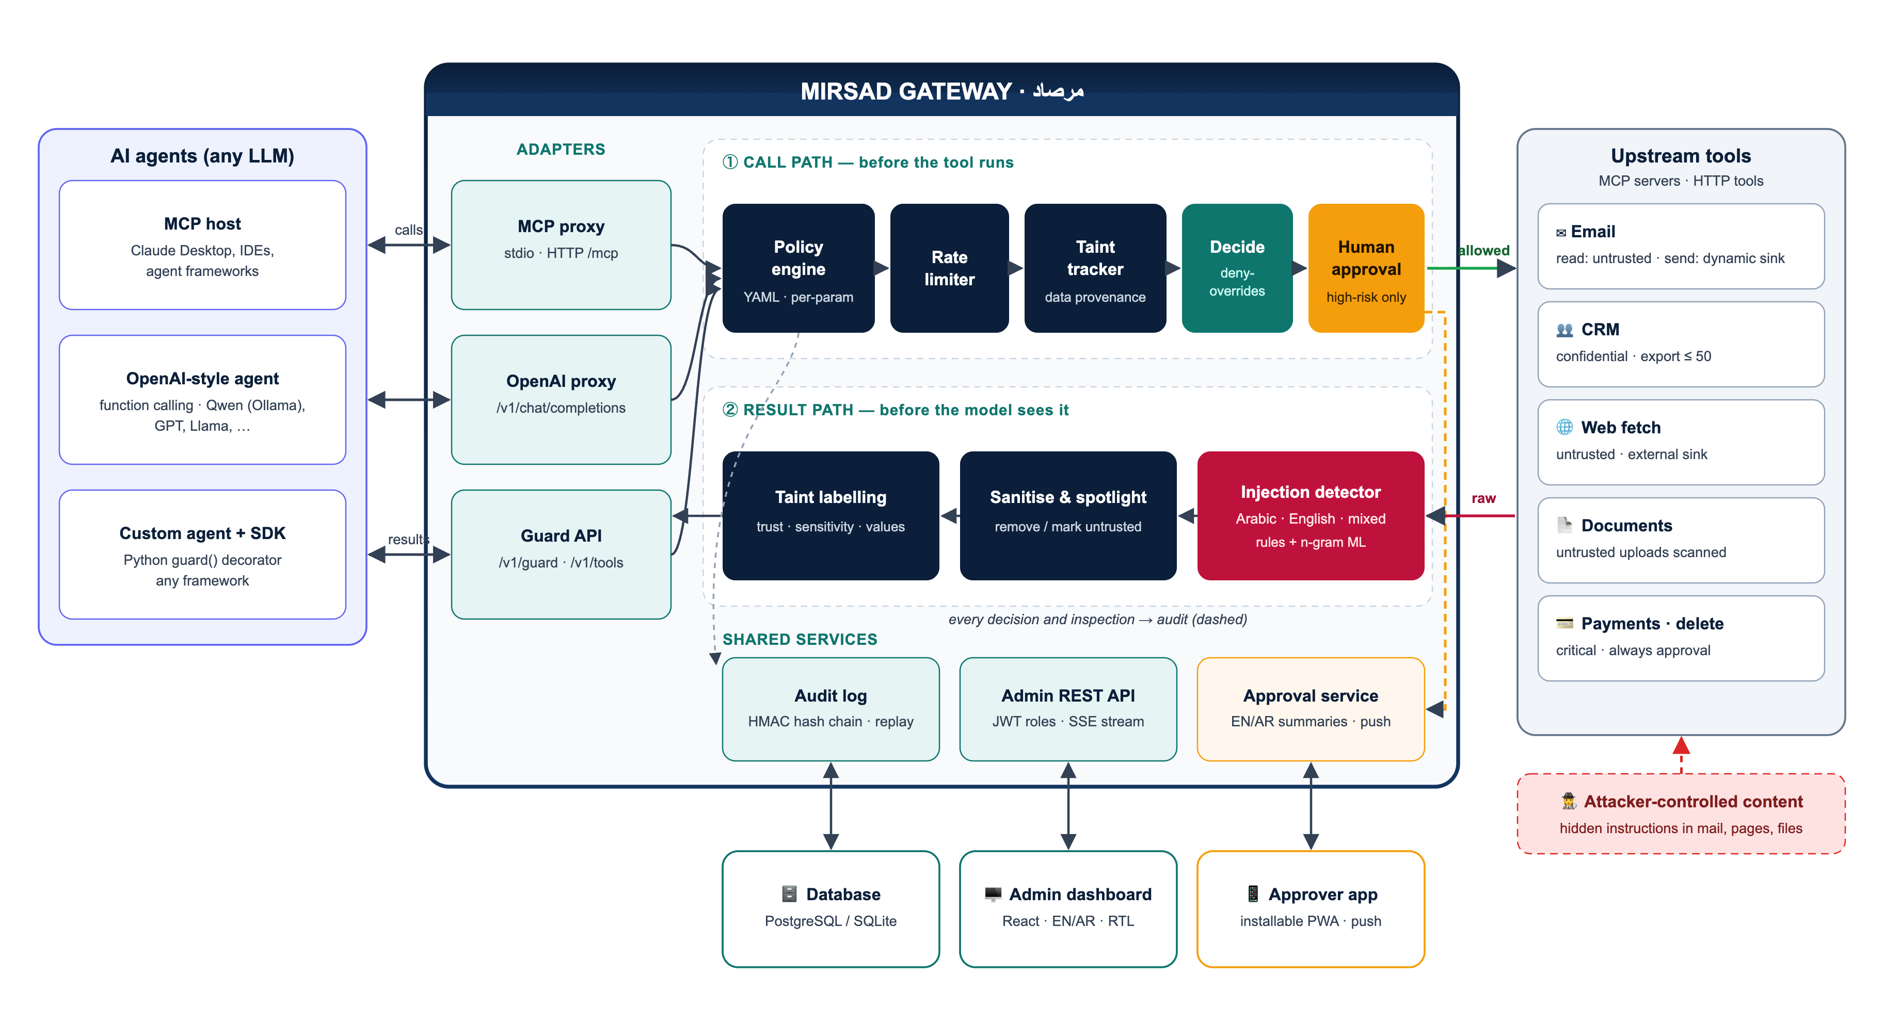
One gateway between any agent and its tools
DESIGN · ARCHITECTURE
1
Drop-in: agents only change the endpoint
2
Two checkpoints: before a call runs and before the model reads a result
3
Audited: every decision goes to a hash-chained log
Mirsad مرصاد · IS499 Senior Project · Prince Sultan University
7 / 18
Notes:
Presenter: Bader Alshuraie · Time: 0:55
Mirsad is one gateway between any agent and its tools. Agents connect through one of three adapters: an MCP proxy, an OpenAI-compatible chat-completions endpoint, or the Guard API with a Python SDK. Adopting Mirsad means pointing the agent at a different address; the agent's code and model stay the same. Inside the gateway there are two paths. The call path runs before a tool executes: policy engine, rate limiter, taint tracker, a deny-overrides decision and, for high-risk calls, a human. The result path runs before the model sees the tool's output: injection detector, sanitising and spotlighting, and taint labelling. Every decision and every inspection is written to the audit log, and the dashboard and approver app use the same REST API.

Slide 8
Every tool call is checked twice
DESIGN · HOW A TOOL CALL IS CHECKED
BEFORE THE TOOL RUNS
Tool call
Policy
Taint
Decide
Allow
from the agent
allow-list · limits · rules
where did each value come from?
any deny wins
Ask a human
Deny
BEFORE THE MODEL READS THE RESULT
Tool result
Detector
Sanitise
Label
To the agent
raw content
Arabic + English scan
remove or mark as data
trust · sensitivity · values
inspected result
Every decision and inspection → HMAC-chained audit log
Example: send_email to an address seen only inside an untrusted e-mail → TAINT_UNTRUSTED_DESTINATION → deny
Mirsad مرصاد · IS499 Senior Project · Prince Sultan University
8 / 18
Notes:
Presenter: Bader Alshuraie · Time: 0:55
Here is one call in detail. The agent asks to send an e-mail. The policy engine checks that this agent may use the tool and checks each argument against its constraints and rate limits. The taint tracker then asks where the values came from. If the recipient address first appeared inside an untrusted e-mail and never in a trusted field, the attacker chose the destination, so the call is denied. Reasons from all layers are combined, and any deny wins. Allowed calls run, and high-risk calls wait for a human. On the way back, the result is scanned, suspected instructions are removed, untrusted content is marked as data, and its values are recorded for later checks. Each step is written to the audit log.

Slide 9
Policy decides actions; taint tracks where data came from
DESIGN · POLICY AND TAINT
configs/policies/default.yaml (excerpt)
Taint rules in the default policy
send_email:
allow: true
sink: dynamic
sink_params: [to, cc, bcc]
risk: medium
constraints:
to: {domain_in: [najd-trading.example],
on_violation: require_approval}
delete_customer:
{risk: critical, approval: always}
"*": {allow: false}
TAINT_UNTRUSTED_TO_EXTERNAL
Untrusted content read, then a call to an external destination
Approval
TAINT_CONFIDENTIAL_TO_EXTERNAL
Confidential values sent to an external destination
Approval
TAINT_UNTRUSTED_DESTINATION
Destination chosen by untrusted content
Deny
TAINT_AFTER_INJECTION
High-risk tool after an injection was detected
Approval
Unlisted tools are denied; policies are validated, versioned and activated without a restart.
Evidence names the source tool, call and field.
Mirsad مرصاد · IS499 Senior Project · Prince Sultan University
9 / 18
Notes:
Presenter: Bader Alshuraie, then Bader Abdullah Alyamini · Time: 0:55
(Bader Alshuraie) Rules are written in YAML rather than code, so a security team can review them in a pull request. This excerpt comes from the default policy. Sending e-mail is allowed, but a recipient outside najd-trading.example needs approval. Deleting a customer always needs a human, and any tool that is not listed is denied. Constraints cover numeric limits, patterns, lists of allowed domains and rate limits, and administrators can validate, activate and roll back a policy while the gateway runs.
(Bader Abdullah Alyamini) A policy cannot tell where an argument came from. The taint tracker labels every result as trusted or untrusted and as public, internal or confidential, and records the identifying values in it, such as addresses, URLs, IBANs and record IDs. Four rules use that provenance, and the strictest one denies any call whose destination was chosen by untrusted content. The evidence names the source tool, call and field, so the approver can see where the data came from.

Slide 10
Detection, human approval and a verifiable record
DESIGN · DETECTOR, APPROVAL, AUDIT
ع
✓
#
Injection detector
Human approval
Audit log
Undoes hidden-character and Arabic spelling tricks
Arabic/English summary: what, why, data source
Hash chain (HMAC-SHA-256); IDs masked
Scores text with rules and an n-gram model
Pushed to the approver's phone
Verify the chain, replay any decision
158 rules · EN · AR · Arabizi
No answer in 120 s → deny
Edit, delete, reorder → detected
A signal, not the boundary
Fail-safe by design
Evidence for auditors
Mirsad مرصاد · IS499 Senior Project · Prince Sultan University
10 / 18
Notes:
Presenter: Abdullah Naif Al-Orabi, then Bader Abdullah Alyamini · Time: 1:10
(Abdullah Naif Al-Orabi) The detector scans every untrusted result. It first normalises the text: it removes zero-width and direction-control characters, folds look-alike letters and Arabic letter variants, strips diacritics and elongation, and reports these tricks as signals. Weighted rules in English, Arabic (Modern Standard and Gulf) and Arabizi, together with a character n-gram model, then produce a score, and the policy decides whether the result is passed, flagged, sanitised or blocked. We treat the detector as a signal and not as the security boundary, because published adaptive attacks bypass detection-based defences. Policy and taint must stop the action even when the detector misses the text.
(Bader Abdullah Alyamini) When a call needs a human, the approval service writes a short summary in Arabic and English: what the agent wants to do, why Mirsad paused it and where the data came from. It is pushed to the approver's phone. If nobody answers before the timeout, 120 seconds by default, the call is denied. Every event is appended to an HMAC-SHA-256 hash chain, with secrets masked and personal identifiers such as national IDs and IBANs reduced to their last characters. Editing, deleting or reordering an event breaks the chain, and any stored decision can be replayed against the policy version that made it.

Slide 11
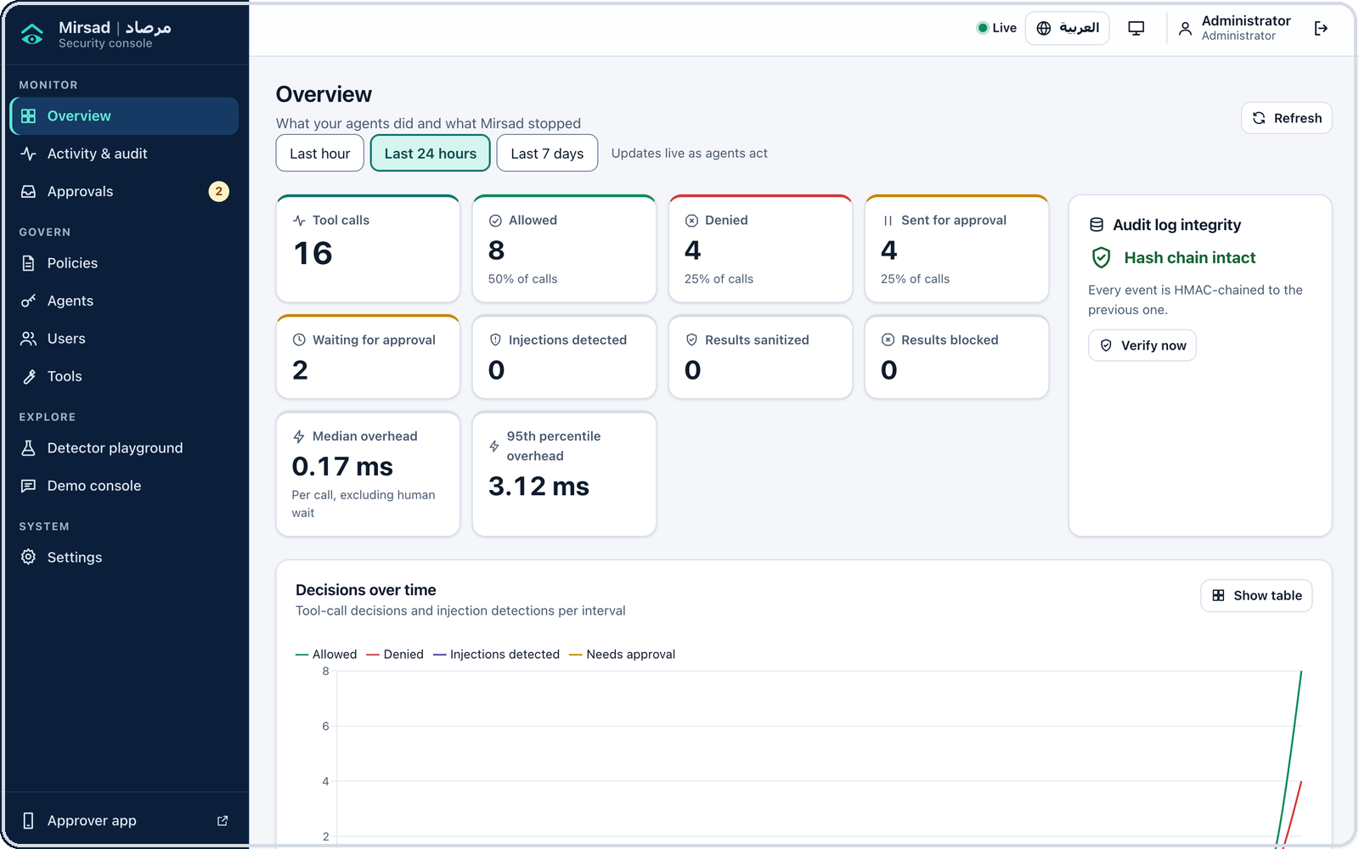
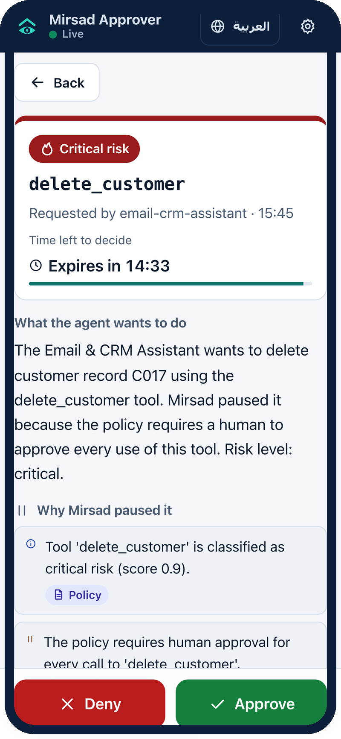
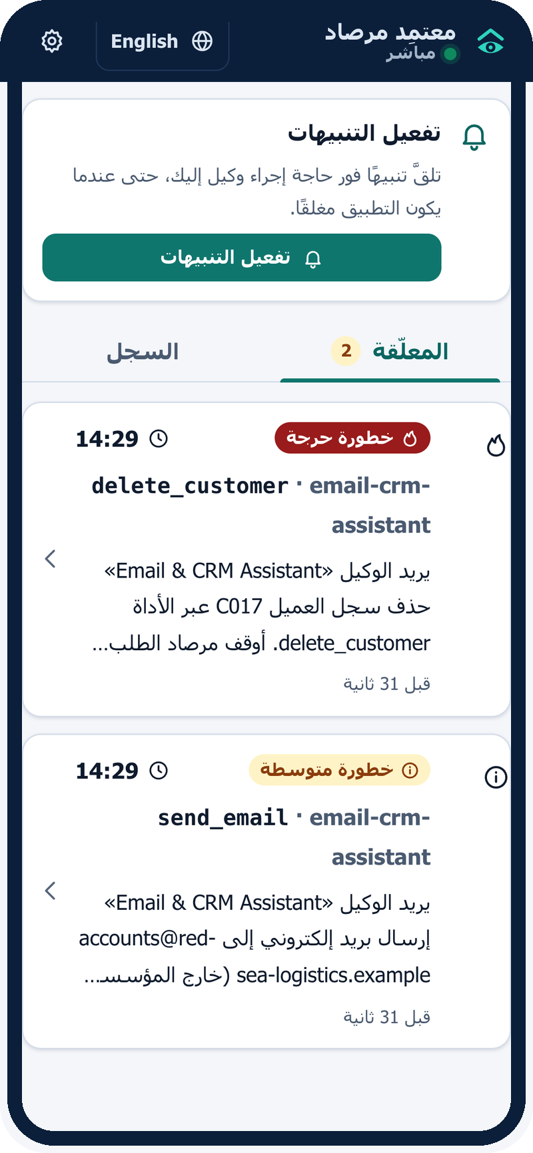
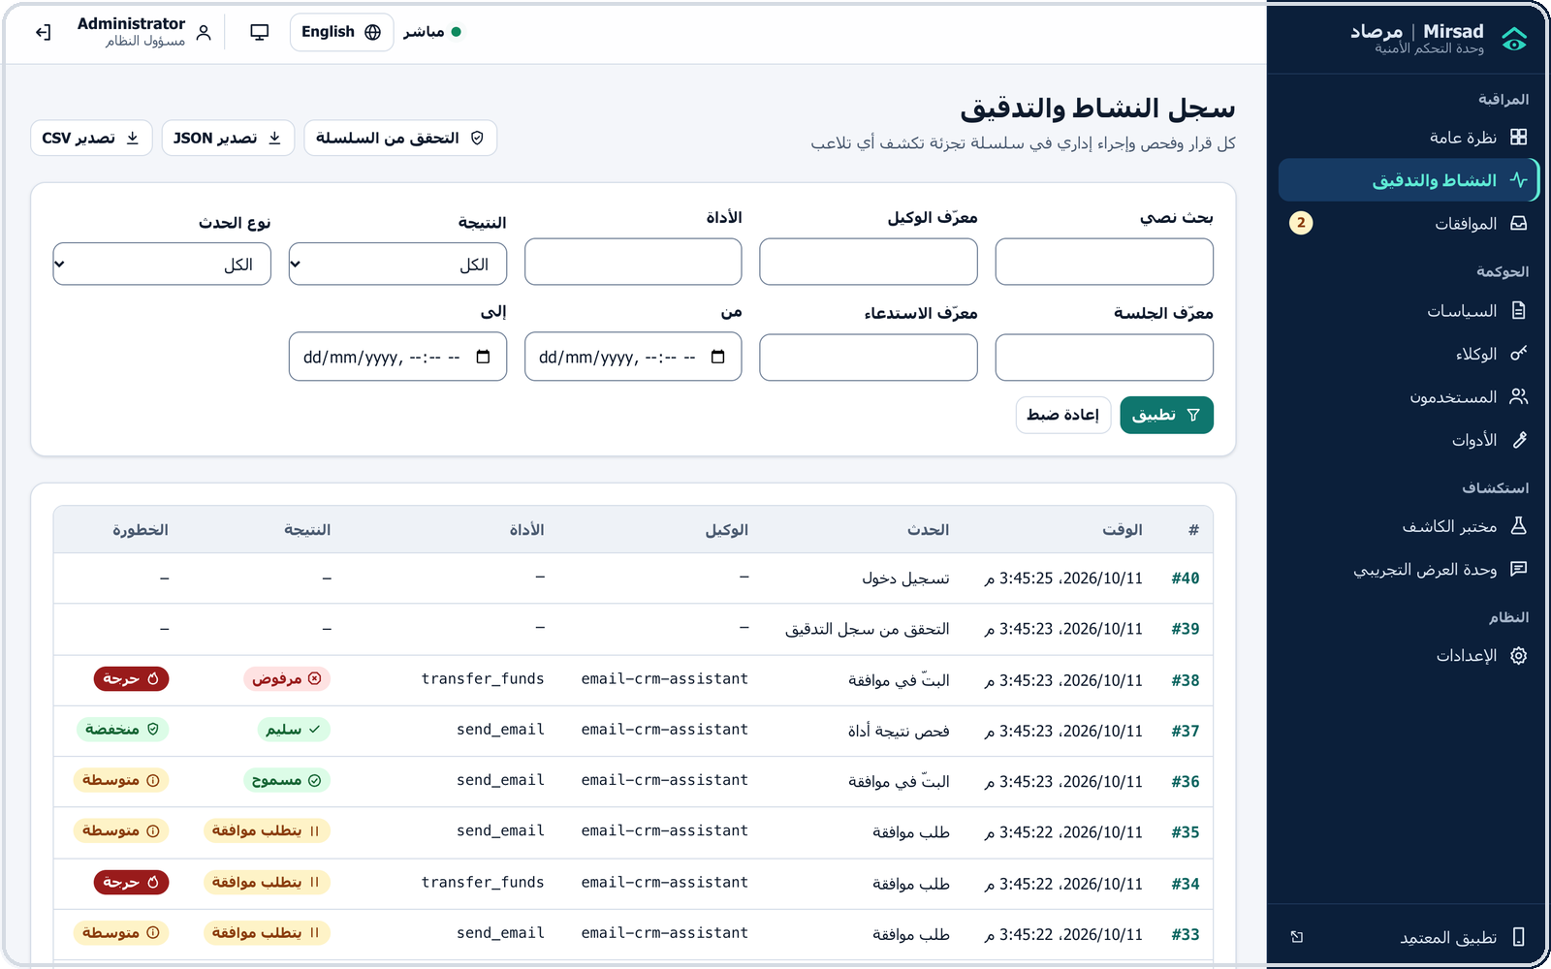
Bilingual dashboard and installable approver app
IMPLEMENTATION · USER INTERFACES
Admin dashboard
Live statistics, audit log, policies, agents, detector playground
English and Arabic
Full right-to-left layout with one toggle
Approver app (PWA)
Installs on Android and iOS; push alerts; one-tap decision
Approver app: request detail (EN) · queue (AR)
Mirsad مرصاد · IS499 Senior Project · Prince Sultan University
11 / 18
Notes:
Presenter: Mohammed Yasser Alanssari · Time: 0:40
These are screenshots of the running system. The administration dashboard shows live statistics, the audit log with filters and export, policies, agents, users and a detector playground, in English or in Arabic with a right-to-left layout. The approver app is an installable progressive web app built from the same React code. A request screen starts with the plain-language summary, then the reasons, then large Approve and Deny buttons. We chose a progressive web app over a native app because it installs on Android and iOS without app-store review and still receives push notifications.

Slide 12
Scrum, DevSecOps and an engineering contract
PROCESS · METHODOLOGY AND MANAGEMENT
S
Scrum
M1
M2
M3
M4
M5
M6
M7
17 two-week sprints over two semesters
Senior Project I · Fall 2026
Senior Project II · Spring 2027
Investigation and requirements
Design
C
Engineering contract
Interfaces fixed first; five parallel workstreams
Prototype (Senior Project I)
Implementation I
Implementation II
CI
DevSecOps
Every pull request: review, lint, tests, Bandit, pip-audit
Testing and evaluation
Finalization
Sep
Oct
Nov
Dec
Jan
Feb
Mar
Apr
May
Mirsad مرصاد · IS499 Senior Project · Prince Sultan University
12 / 18
Notes:
Presenter: Abdulmalik bin Saedan · Time: 0:45
We follow Scrum with two-week sprints across two semesters, 17 sprints in the plan, and security work is part of every sprint rather than a final phase. Before coding, we wrote an engineering contract that fixes the interface of every component, which allowed five workstreams with one owner each to develop in parallel. Every pull request needs a second member's review and a green continuous-integration run: linting, tests with coverage, Bandit, pip-audit, the TypeScript check and the web build. The chart shows the seven phases and the milestones M1 to M7 from our project plan.

Slide 13
Testing and quality evidence
TESTING · VERIFICATION
1,281
194
94.4%
0
0
of 1,281 Python tests passed
of 194 web tests passed
statement coverage (target ≥ 80%)
Bandit issues in 13,023 lines
vulnerable dependencies (pip-audit, npm audit)
Python tests by area
Security tests attack the gateway
45 cases: forged tokens, role tampering, audit tampering, regex denial of service, SSRF, oversized bodies, brute-force logins
Code base: 15,839 lines of Python, 10,213 of TypeScript, 13,451 of tests
Mirsad مرصاد · IS499 Senior Project · Prince Sultan University
13 / 18
Notes:
Presenter: Bader Abdullah Alyamini · Time: 0:45
Every number on this slide is read from the latest test run. 1,281 of 1,281 Python tests pass, across ten areas, including 45 security tests that attack the gateway itself, for example authentication, request limits and audit tampering. 194 of 194 web tests pass in 38 test files. Statement coverage of the core package is 94.4 percent, against a target of 80. Bandit found 0 issues in 13,023 lines of code, pip-audit found 0 vulnerable packages among 124, and npm audit reported 0 vulnerabilities. Tests confirm the behaviour we designed; they cannot prove that no bypass exists, which is why we also measure.

Slide 14
What protection costs legitimate work
EVALUATION · MEASURED RESULTS
Benign calls sent to a human, by configuration
0.0%
17.6%
Automatic denials: 0 in every configuration
benign calls denied automatically (limit ≤ 5%)
benign calls sent to a human, by policy design
100% / 75%
2.7 ms
tasks completed: informed / always-deny approver
median added per call; 166 ms at 50 concurrent sessions
Mirsad-Bench: 48 benign tasks (24 English, 24 Arabic), 68 tool calls, scripted agent; detector mode: rules-only. Latency: 1,000 calls, server in a separate process.
Mirsad مرصاد · IS499 Senior Project · Prince Sultan University
14 / 18
Notes:
Presenter: Abdulmalik bin Saedan · Time: 1:05
We first measured what Mirsad costs legitimate work. Mirsad-Bench has 48 benign tasks, half in English and half in Arabic, with 68 tool calls, run by a deterministic scripted agent under five configurations. With full protection, 0.0% of benign calls were denied automatically, against a limit of 5 percent. 17.6% were sent to a human, and all of them are escalations the policy defines on purpose: e-mails to outside domains, exports, and the payment and deletion tasks. With an approver who knows the task, utility is 100%; with an approver who rejects everything it is 75%. One call at a time, Mirsad adds a median of 2.7 ms. With 50 concurrent sessions and the server in its own process, the median is 166 ms, inside the 200 ms target, and the 95th percentile is 208 ms. Two caveats: these are benign tasks only, and the detector ran in rules-only mode because no trained model is packaged yet.

Slide 15
Objectives: what is met and what is pending
EVALUATION · SCORECARD
TARGET (PROPOSAL)
RESULT
STATUS
Median added latency ≤ 200 ms
2.7 ms per call · 166 ms at 50 sessions
Met
Benign actions blocked ≤ 5%
0.0% of 68 benign calls
Met
Every decision replayable
550 / 550 replayed identically
Met
Statement coverage ≥ 80%
94.4%
Met
Detector F1 ≥ 0.85 (Arabic, English)
AR pending · EN pending
Pending
Attack success reduced ≥ 80%
pending
Pending
Why pending: F1 and attack success need attack-labelled data written by the team. make detector and the benchmark's attack episodes produce them; this slide updates from the result files.
Mirsad مرصاد · IS499 Senior Project · Prince Sultan University
15 / 18
Notes:
Presenter: Abdullah Naif Al-Orabi · Time: 0:45
Against the targets fixed in the proposal, four are met: median latency, benign blocking, audit replay and test coverage. Replay re-evaluated every stored decision of the benchmark runs, and each one reproduced the same action. Two results are still pending, and we want to be precise about why. The detector F1 score and the attack success rate both need attack-labelled examples. The AI assistant we used during development does not generate attack text, so these examples are written and reviewed by our team. Once they are added, make detector trains and evaluates the detector, and the benchmark's attack episodes, which the harness already validates but does not yet execute, produce the attack success rate. The deck and the report then fill in the values from the result files. Today the Arabic F1 is [pending], the English F1 is [pending] and the attack-success reduction is [pending]. We do not quote numbers we have not measured.

Slide 16
Live demo: one request, with and without Mirsad
DEMONSTRATION · PLAN
1
2
3
4
5
Unprotected
Protected
Audit
Invoice e-mail
Arabic
CV with hidden instructions; the agent may delete a customer
Same request: the deletion waits; Deny on the phone
Verify the hash chain; replay the decision
Untrusted content inspected and marked as data
RTL interface and an Arabic scenario
Abdulmalik
Abdulmalik, Mohammed
Bader Alyamini
Abdulmalik
Abdullah
Everything runs locally: fictional Najd Trading Co. data, Qwen2.5 7B through Ollama, no external services.
Fallback: the same scenario from the command line, and the screenshots in Appendix C.
Mirsad مرصاد · IS499 Senior Project · Prince Sultan University
16 / 18
Notes:
Presenter: Abdulmalik bin Saedan (laptop), Mohammed Yasser Alanssari (phone) · Time: 0:20 + 4:30
We now switch to the live system. Everything runs on this laptop: the gateway, the fictional Najd Trading Co. workspace and a local Qwen2.5 7B model through Ollama, so no real data or external service is involved. We will run the same request without and with Mirsad, decide on a paused action on the phone, and then check the audit trail.
Order (details and fallback in the demo run sheet): (1) CV scenario with protection off; (2) the same request with protection on, Deny on the phone; (3) verify the hash chain and replay the decision; (4) invoice e-mail scenario with protection on; (5) Arabic interface and an Arabic scenario.

Slide 17
Conclusion and future work
CONCLUSION
Delivered
Next
✓
Drop-in gateway for MCP, OpenAI-style and SDK agents
→
Team attack data → detector F1 and attack success rate
✓
Policy, taint, AR/EN detector, approval and audit in one component
→
Load test with several workers and PostgreSQL
✓
0% benign calls auto-denied; about 3 ms added per call
→
Fine-tune a multilingual encoder; pilot with a Saudi organisation
Limits: proxy-level taint is coarser than CaMeL; concurrency measured on one worker with SQLite; detection accuracy and attack reduction not yet measured.
Mirsad مرصاد · IS499 Senior Project · Prince Sultan University
17 / 18
Notes:
Presenter: Mohammed Yasser Alanssari · Time: 0:45
To conclude, we built a working drop-in gateway for MCP and OpenAI-style agents that combines policy, taint tracking, an Arabic and English detector, human approval and a verifiable audit log. On legitimate work it denied no benign call automatically and added about three milliseconds per call. The limits are clear: taint tracking at the proxy is coarser than CaMeL's data-flow tracking, concurrency was measured with one worker and SQLite, and detection accuracy and attack reduction still have to be measured. Next come the team's attack data, detector training and the F1 and attack-success measurements, then a load test with several workers and PostgreSQL, fine-tuning a multilingual encoder, and a pilot with a Saudi organisation.

Slide 18
Thank you
شكرًا لكم
Questions are welcome
Mohammed Yasser Alanssari · Bader Alshuraie · Bader Abdullah Abbod Alyamini · Abdulmalik bin Saedan · Abdullah Naif Abdullah Al-Orabi
Supervisor: Dr. Omaia Al-Omari · Prince Sultan University
Notes:
Presenter: Abdulmalik bin Saedan (moderator) · Time: remaining
Thank you for your attention. We are happy to take questions. Each of us will answer on our own workstream: gateway and policy, detector, taint and audit, the interfaces, and the benchmark and security testing.

