Slide 1


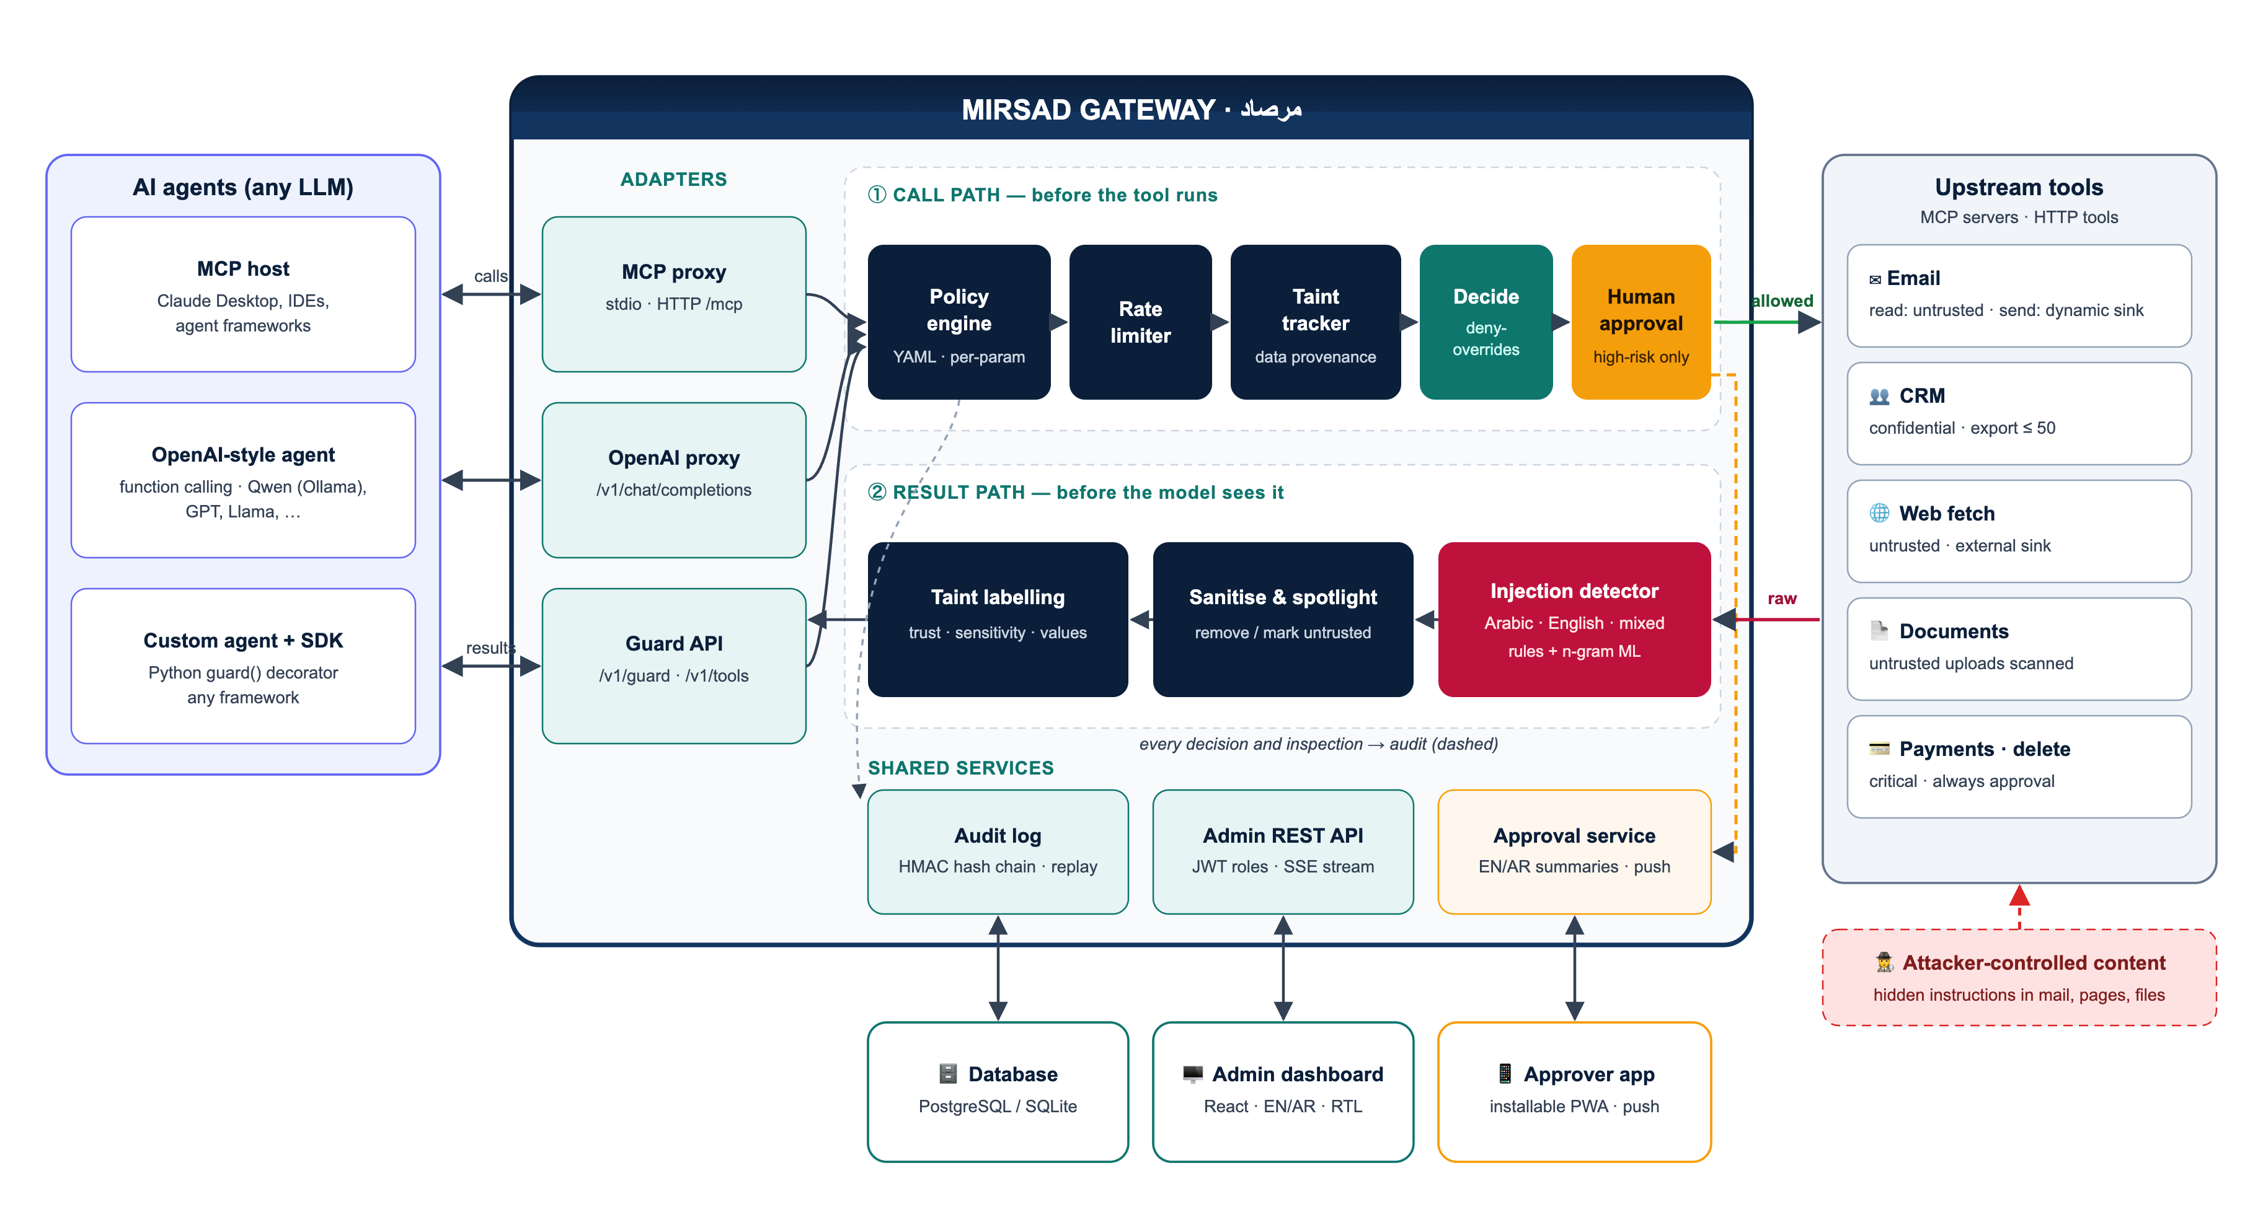
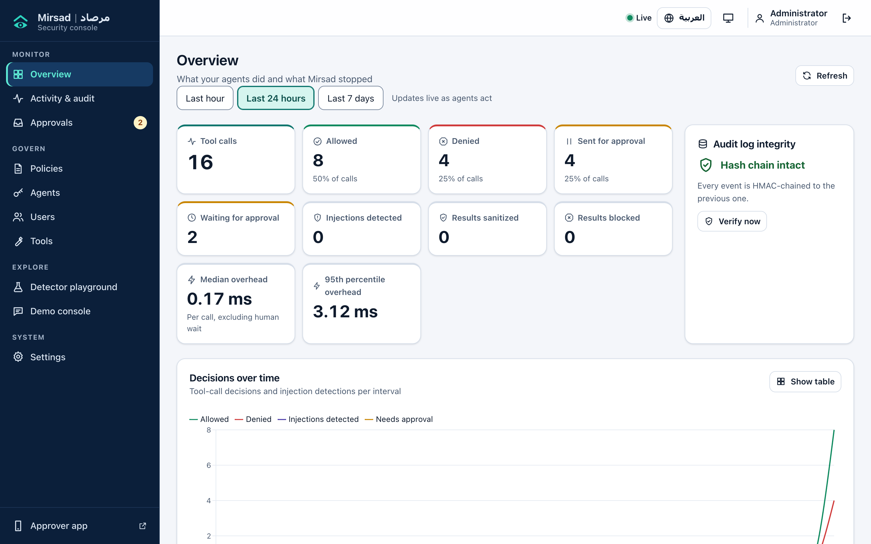
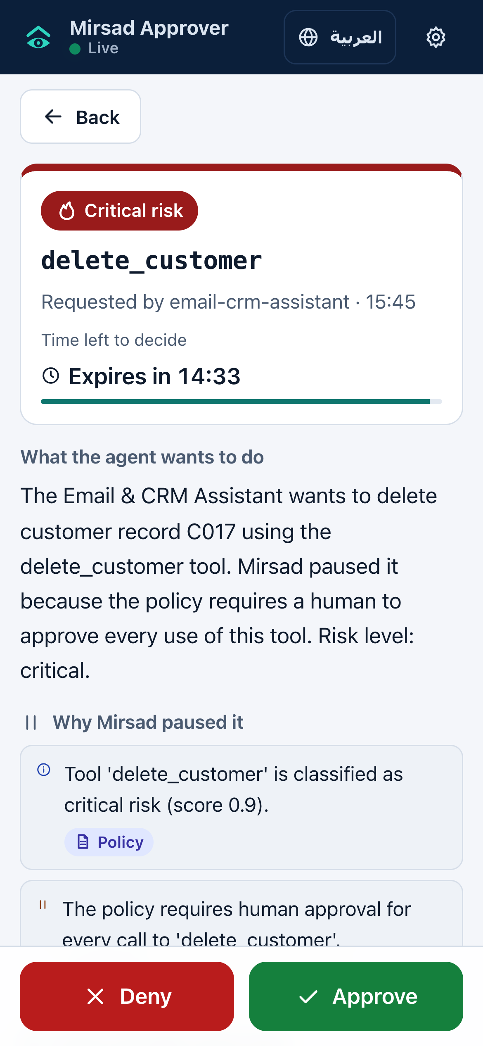
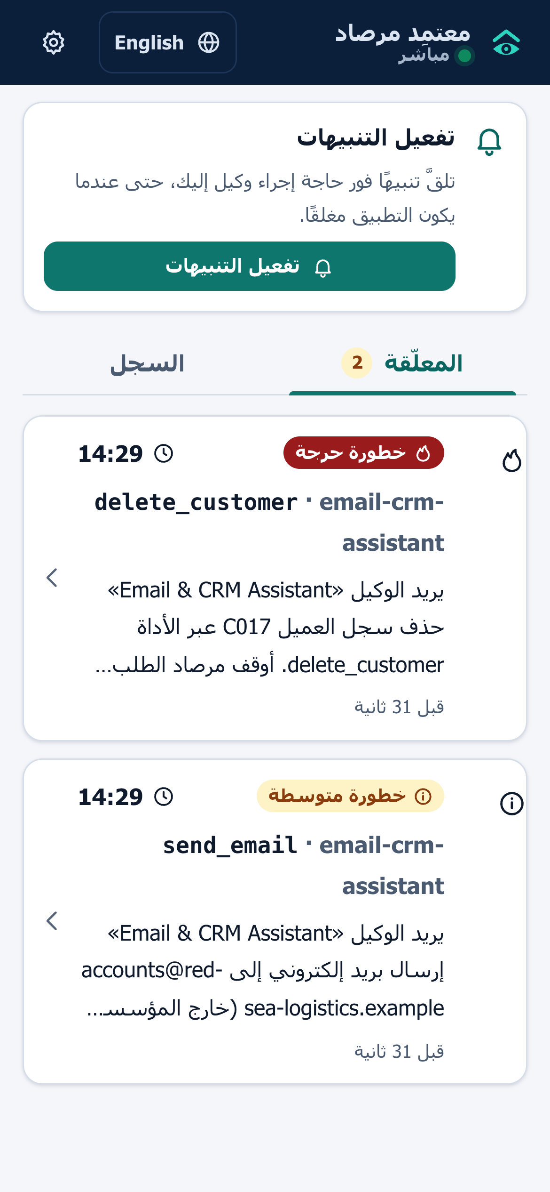
Mirsad | مرصاد
College of Computer &
Information Sciences
IS499 Senior Project
A Runtime Security Firewall for AI Agents Against Prompt-Injection Attacks
Authors: Mohammed Yasser Alanssari · Bader Alshuraie · Bader Abdullah Abbod Alyamini
Abdulmalik bin Saedan · Abdullah Naif Abdullah Al-Orabi
Advisor: Dr. Omaia Al-Omari
Introduction
AI agents now read e-mail, web pages and documents and act through tools that send messages, export records or move money. Instructions hidden in that content can hijack an agent (indirect prompt injection, OWASP LLM01), and firewalls or DLP only see an authorised agent making a normal call. Mirsad (Arabic for “watchtower”) is a drop-in gateway between any agent and its tools. It checks every tool call before it runs and every result before the model sees it, in Arabic and English.
Objectives
Methodology
1
Enforce security at the tool boundary
Intercept every tool call and result of MCP and OpenAI-style agents, enforce a YAML policy and taint tracking, and add at most 200 ms median latency per call. (M5, Mar 2027)
Scrum. Two-week sprints (17 over two semesters), one owner per workstream, all coding against a written interface contract.
DevSecOps. STRIDE threat model, a second reviewer on every pull request and CI security gates: tests, coverage, Bandit, pip-audit and npm audit.
How Mirsad works: five layers
2
Detect injections in Arabic and English
Build a detector and a labelled dataset for MSA, Gulf dialect, Arabizi, mixed and English text that reaches F1 ≥ 0.85 on held-out test sets. (M4, Feb 2027)
1
Policy engine – YAML allow-lists, per-parameter limits and rate limits; unlisted tools are denied.
2
Taint tracking – labels results by trust and sensitivity; escalates or blocks untrusted or confidential data sent outside.
3
Injection detector – Arabic/English normalisation and weighted rules; risky results are sanitised or marked as data.
3
Keep humans in control and prove the effect
Provide a mobile approval app, a dashboard and a replayable, tamper-evident audit log; cut attack success by ≥ 80% while blocking ≤ 5% of benign actions. (M6, Apr 2027)
4
Human approval – high-risk calls wait for a phone decision with a bilingual summary; no answer means deny.
5
Audit log – every decision enters an HMAC-SHA-256 hash chain that can be verified and replayed.
Layers combine by deny-overrides: any deny wins.
Figure 1. Architecture: call path before a tool runs, result path before the model reads.
Figure 2. Admin dashboard: live decisions and audit-chain status.
Figure 3. Approver app, request (EN).
Figure 4. Approver app, queue (AR).
Results
1,281
194
94.4%
0.0%
17.6%
2.7 ms
Python tests passed
Web tests passed
Statement coverage
Benign false-positive rate
Approval friction (full defence)
Median added latency, sequential
of 1,281 · 10 areas
of 194 · 38 suites
9,763 statements
68 calls · target ≤ 5%
sent to a human
target ≤ 200 ms
166 ms
272/272
0 / 0
pending
team data
pending
team data
Read at build time from results_summary.json (14 Oct 2026). Benign tasks only; detector in rules-only mode.
Median added latency, 50 concurrent sessions
Audit replays matched
Bandit issues / vulnerable packages
Detector F1 (AR/EN)
Attack success reduction
separate process
hash chain verified
13,023 lines scanned
target ≥ 0.85
target ≥ 80%
Conclusion
Future Directions
Mirsad shows that the tool-calling boundary is a workable control point for AI agents. One drop-in gateway applies an organisation’s rules to every action, explains each decision in Arabic and English, asks a human when the stakes are high and keeps a verifiable, replayable record. On 48 benign English and Arabic tasks, it denied no benign call automatically and added a median of 2.7 ms per call. Its effect on real attacks awaits the team’s attack data.
Measure detector F1 and attack-success reduction with team data.
Fine-tune an Arabic or multilingual encoder (MARBERT, XLM-R).
Multi-worker deployment on PostgreSQL with shared rate limits.
Saudi pilot with NCA ECC evidence: retention, SIEM, anchoring.
Prince Sultan University · College of Computer & Information Sciences · IS499 Senior Project 2026–2027 · Open source under Apache-2.0

