Slide 1
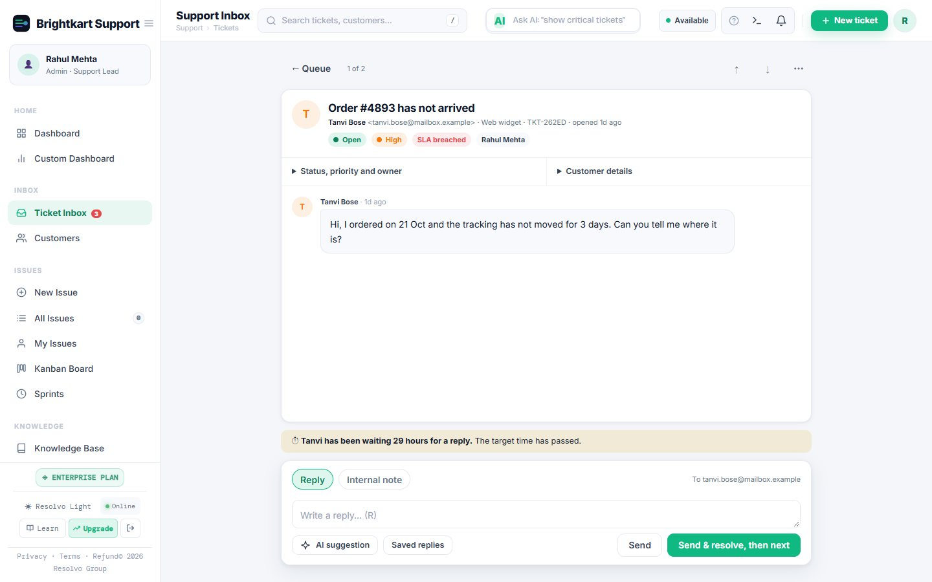
Support that stays calm
PRODUCT TOUR · OCTOBER 2026
One shared inbox for email, WhatsApp and your website. See what needs you, answer it, move on.
Try the live demo
app.resolvogroup.com/demo
Notes:
Open with the problem in one sentence: small teams answer customers from three places and lose track. This tour is four minutes. Everything shown comes from a made-up store called Brightkart.

Slide 2
Small support teams drown in noise
1
2
3
Messages everywhere
Noise in the queue
No clear next step
Email, WhatsApp and web chat in three places. Two people answer one customer, or nobody does.
Newsletters and system alerts become tickets, so the counts stop meaning anything.
Everything looks equally urgent. Tickets near their target time hide among the rest.
Notes:
These are the three things we hear from founders and small teams. The rest of the deck shows how each is handled.

Slide 3
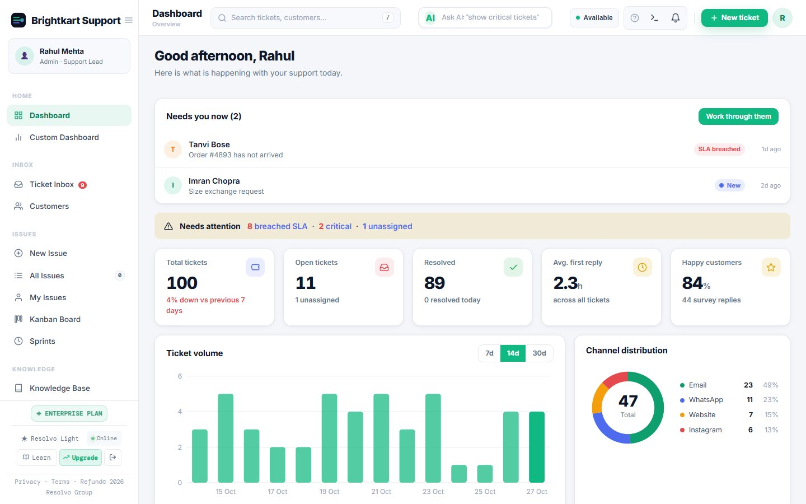
Start with what needs you
TODAY
A short list of the tickets waiting on you, closest to their target time first
One click opens the ticket; one more starts Focus mode
Numbers match the inbox exactly, with newsletters and alerts left out
Notes:
Click Needs you now to show the list. The count at the top equals the inbox count, which is deliberate.

Slide 4
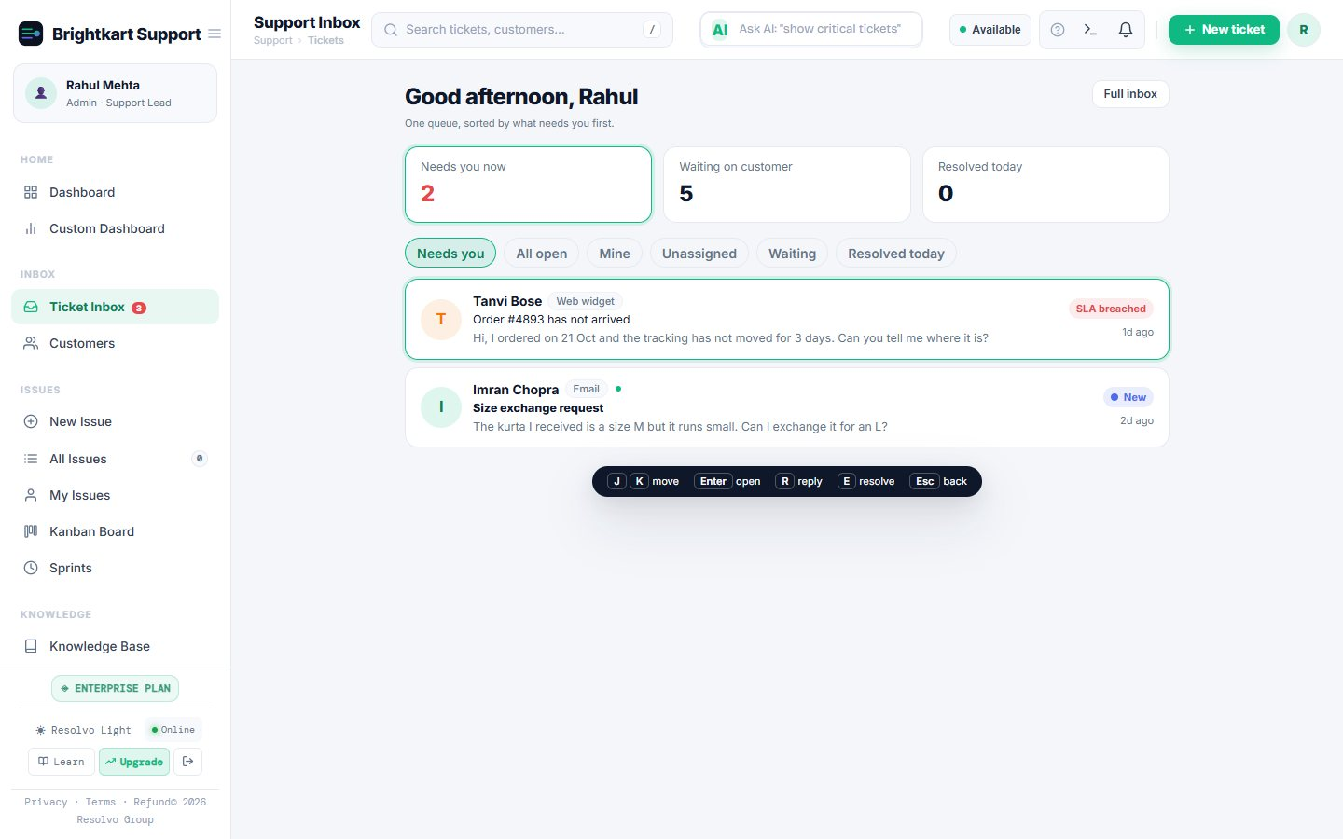
One ticket at a time
FOCUS MODE
One calm queue, one conversation at full width
Send & resolve, then next: it only moves on after the reply really sent
J and K to move, R to reply, E to resolve, Esc to go back
Notes:
This is the default on phones. If a send fails, the text stays and nothing is resolved.

Slide 5
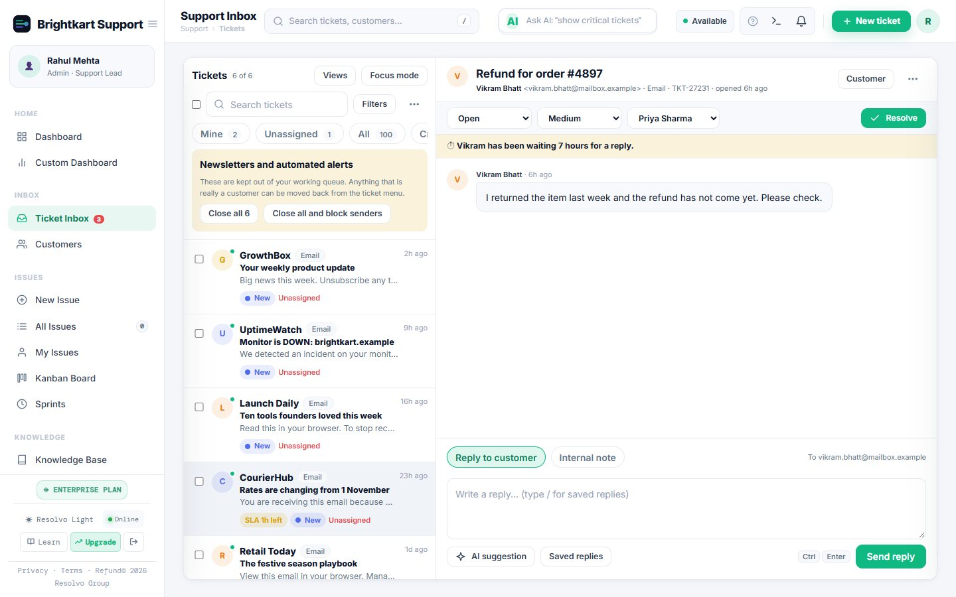
Newsletters and alerts stay out of your queue
A CLEAN INBOX
Spotted automatically and kept in their own view
Close them all in one click, or close and block the senders
A real customer caught by mistake moves back for good
Notes:
Nothing is deleted and nobody is emailed when you close them.

Slide 6
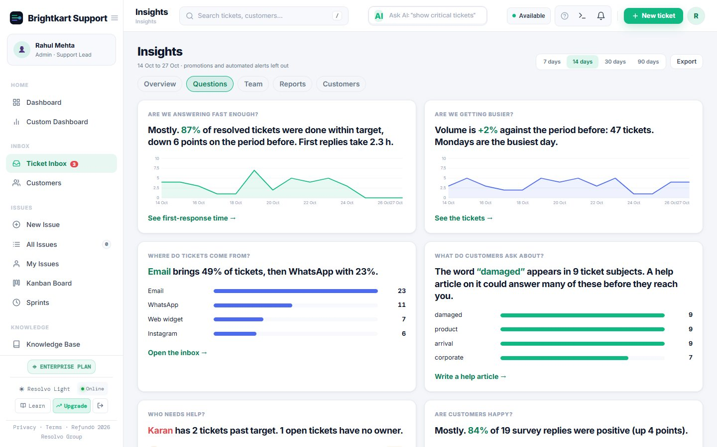
Answers, not just charts
INSIGHTS
Plain answers: are we answering fast enough, who needs help
Overview with compare-to-previous, and a team scorecard
Reports and customer health under the same tab bar
Notes:
The sentences are generated from the numbers, so they are always current.

Slide 7
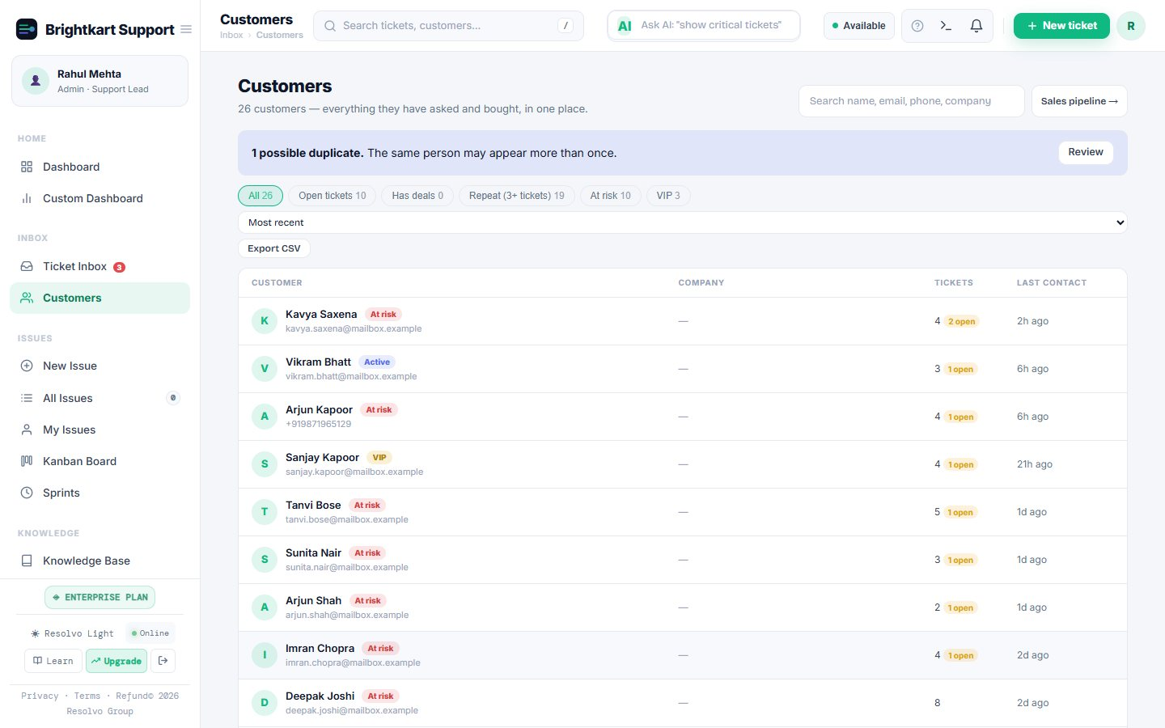
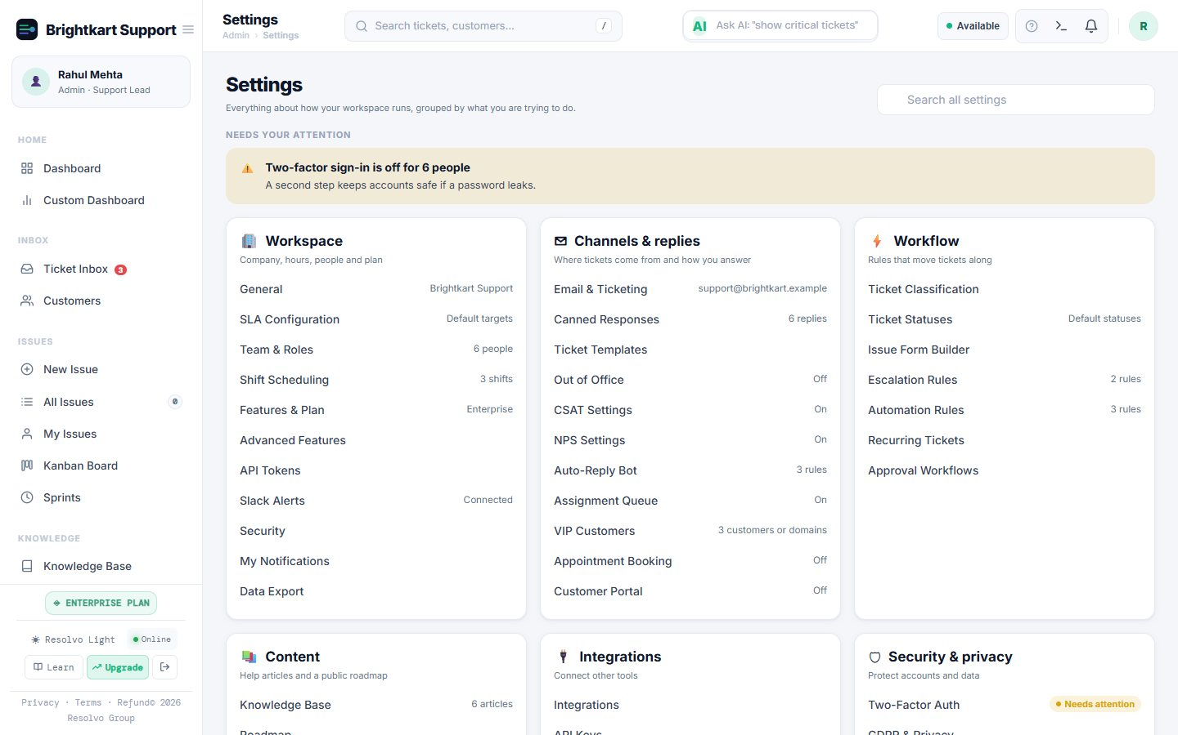
Know your customers, know your setup
Customers: health badges, last contact, and one-click merging of the same person on email and WhatsApp
Settings: what is on, off or needs attention, with search and a side list inside every section
Notes:
Merging keeps every address, ticket and deal. Settings opens on a list of what needs attention, such as email not connected.

Slide 8
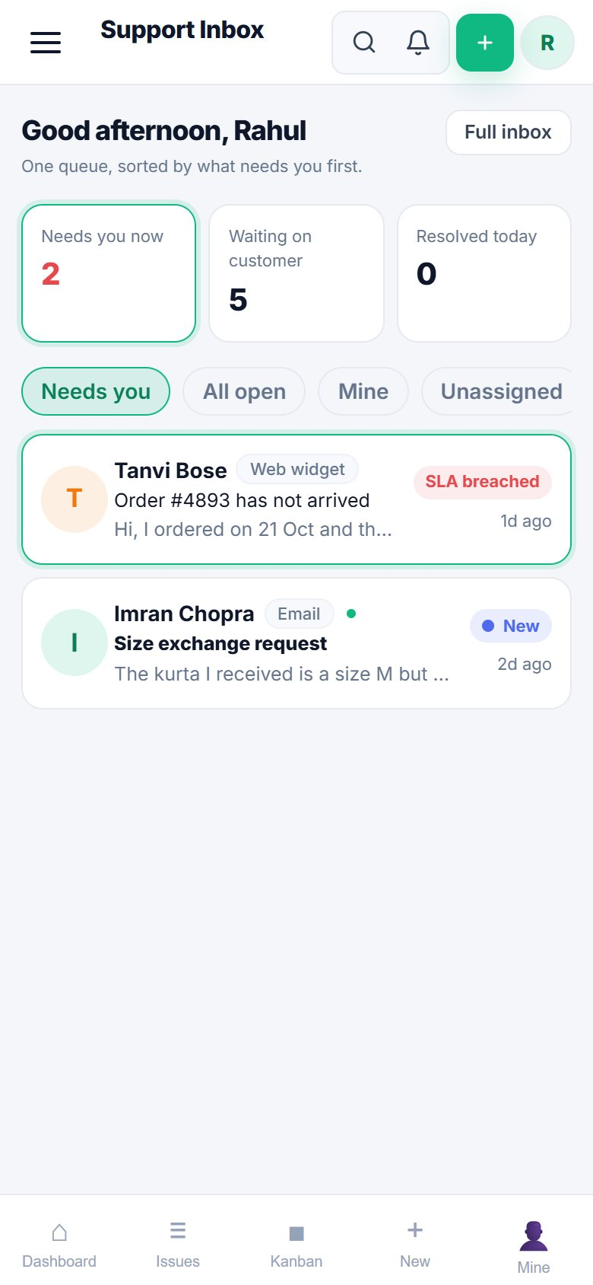
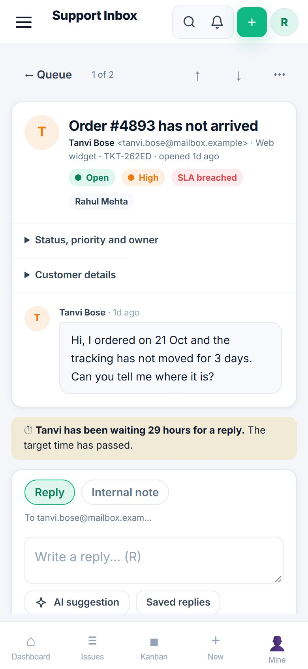
Runs in your pocket
ON YOUR PHONE
Install it from the browser. No app store
Alerts when a ticket is yours, or close to or past its target time
Swipe right to take a ticket, left to snooze it until tomorrow
Notes:
On iPhone, add it to the Home Screen first; alerts need the installed app.

Slide 9
One price per brand, not per seat
Free
Pro
Enterprise
₹0
₹999
₹2,499
per brand / month
per brand / month
per brand / month
Issue and ticket tracking
Search, watchers, audit trail
1 brand, no per-seat fees
Email ticketing inbox
AI reply drafts and triage
Insights, SLA and workload
Knowledge base, Kanban, sprints
Everything in Pro
Customer portal and booking
Jira / ServiceNow sync, API keys
GDPR data tools
14-day free trial on Pro. No credit card. Prices in INR.
Notes:
Pricing is per brand, so adding agents costs nothing extra. Always check the pricing page for the latest.

Slide 10
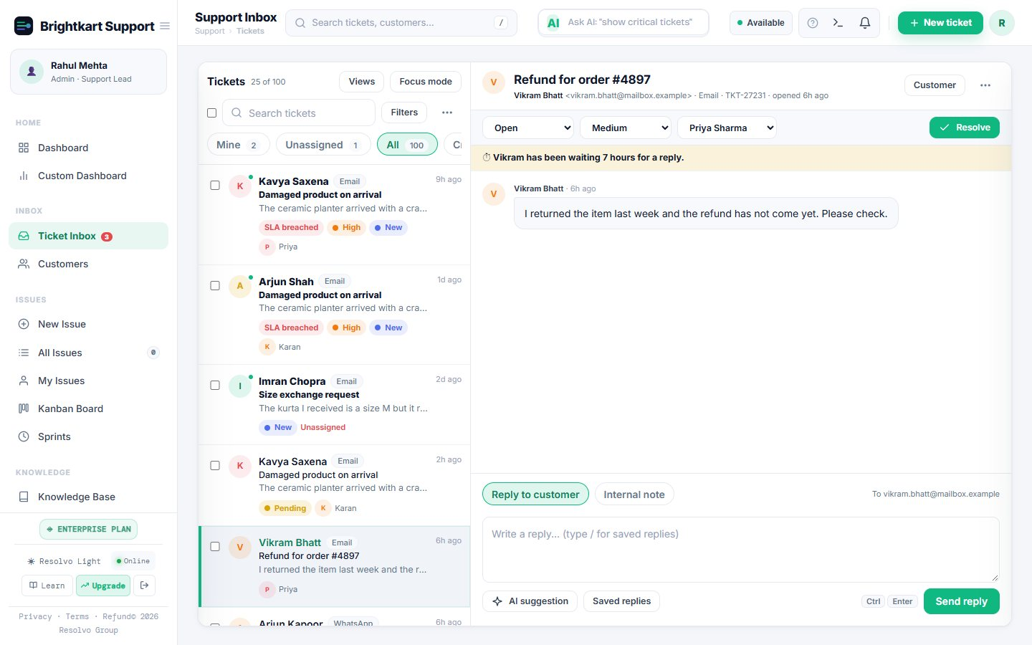
Try it on your own inbox
14 days free. Connect your support email and be live in an afternoon. Tell us what is missing; we are building with our first teams.
Live demo
app.resolvogroup.com/demo
Start free
app.resolvogroup.com/signup
Talk to us
contact@resolvogroup.com
Notes:
End on the demo. It needs no signup and uses made-up data.

