Slide 1

INTRODUCTION TO MACHINE LEARNING
Machine Learning: What’s The Challenge?

Slide 2
Goals of the course
Introduction to Machine Learning
Identify a machine learning problem Use basic machine learning techniques Think about your data/results
●
●
●

Slide 3
What is Machine Learning?
Introduction to Machine Learning
●
Construct/use algorithms that learn from data
●
More information
Higher performance
●
Previous solutions
Experience

Slide 4







Example
Introduction to Machine Learning
●
Label squares: size and edge
color
●
Earlier observations (labeled by humans):
●
Task for computer = label unseen square:
?
●
Result: right or wrong!

Slide 5

Input Knowledge
Introduction to Machine Learning
Features
Label
In example: pre-labeled squares
size | edge | color
small | do5ed | green
big | striped | yellow
medium | normal | green
Observations
In R - use data.frame()
> squares
size edge color
<- data.frame(
= c("small", "big",
=
"medium"),
c("dotted",
= c("green",
"striped",
"normal"),
"yellow",
"green"))

Slide 6
Data Frame Functions
Introduction to Machine Learning
> dim(squares)
#Observations, #Features
> str(squares)
Structured Overview
> summary(squares)
Distribution Measures

Slide 7
Formulation
Introduction to Machine Learning
FUNCTION
INPUT
OUTPUT
ESTIMATED FUNCTION
COLOR

Slide 8
ML: What It Is Not
Introduction to Machine Learning
Determining most occurring color Calculating average size
}
●
NOT Machine Learning
●
Goal: Building models for prediction!

Slide 9
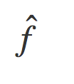

Regression
Introduction to Machine Learning
Regression
INPUT: Weight OUTPUT: Height
Estimated function:
Weight
Height

Slide 10
More Applications!
Introduction to Machine Learning
●
Shopping basket analysis
Movie recommendation systems Decision making for self-driving cars and many more!
●
●
●

Slide 11
INTRODUCTION TO MACHINE LEARNING
Let’s practice!

Slide 12
INTRODUCTION TO MACHINE LEARNING
Classification Regression Clustering

Slide 13
Common ML Problems
Introduction to Machine Learning
Classification Regression Clustering
●
●
●

Slide 14
Classification Problem
Introduction to Machine Learning
Goal: predict category of new observation
Estimate
Earlier Observations
CLASSIFIER
CLASSIFIER
Unseen Data
Class

Slide 15
Classification Applications
Introduction to Machine Learning
Medical Diagnosis Animal Recognition
●
Sick and Not Sick
●
Dog, Cat and Horse
Important:
Qualitative Output Predefined Classes
●
●

Slide 16
Regression
Introduction to Machine Learning
REGRESSION FUNCTION
PREDICTORS
RESPONSE
Relationship: Height - Weight? Linear?
●
●
●
Predict: Weight
Height

Slide 17




Regression Model
Introduction to Machine Learning
Fi5ing a linear function
Predictor: Response: Coeﬃcients:
●
●
●
Estimate on previous input-output
> lm(response ~ predictor)

Slide 18
Regression Applications
Introduction to Machine Learning
Payments Time
●
Credit Scores
●
Subscriptions
●
Grades
Landing a Job
●
Quantitative Output
Previous input-output observations
●

Slide 19
Clustering
Introduction to Machine Learning
●
Clustering: grouping objects in clusters
●
Similar within cluster
Dissimilar between clusters
●
●
Example: Grouping similar animal photos
●
No labels
No right or wrong
Plenty possible clusterings
●
●

Slide 20

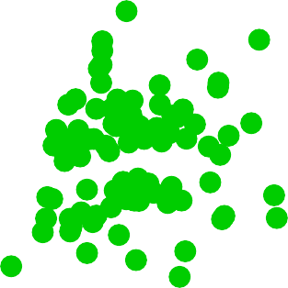



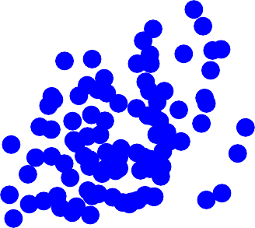
k-Means
Introduction to Machine Learning
Cluster data in k clusters!
5
5
y
y
0
0
−5
−5
0
5
10
0
5
10
x
x

Slide 21
INTRODUCTION TO MACHINE LEARNING
Let’s Practice

Slide 22
INTRODUCTION TO MACHINE LEARNING
Supervised vs.
Unsupervised

Slide 23

Machine Learning Tasks
Introduction to Machine Learning
Classification Regression Clustering
●
quite similar
●
●

Slide 24

Supervised Learning
Introduction to Machine Learning
Find: function f ̂which can be used to assign a
class or value to unseen observations.
Given: a set of labeled observations
Supervised Learning

Slide 25
Unsupervised Learning
Introduction to Machine Learning
Labeling can be tedious, oken done by humans Some techniques don’t require labeled data Unsupervised Learning
●
●
●
Clustering: find groups observation that are similar Does not require labeled observations
●
●

Slide 26
Performance of the model
Introduction to Machine Learning
●
Supervised Learning
●
Compare real labels with predicted labels
Predictions should be similar to real labels
●
●
Unsupervised Learning
●
No real labels to compare
Techniques will be explained in this course
●

Slide 27






Semi-Supervised Learning
Introduction to Machine Learning
●
A lot of unlabeled observations
A few labeled
Group similar observations using clustering
Use clustering information and classes of labeled observations to assign a class to unlabelled observations
More labeled observations for supervised learning
●
●
●
●

Slide 28
INTRODUCTION TO MACHINE LEARNING
Let’s practice!

