Slide 1
Properties of
Regular Languages
Costas Busch - LSU

Slide 2




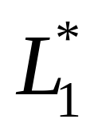
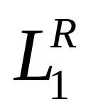


For regular languages and
we will prove that:
Union:
Concatenation:
Are regular
Languages
Star:
Reversal:
Complement:
Intersection:
Costas Busch - LSU

Slide 3
We say Regular languages are closed under
Union:
Concatenation:
Star:
Reversal:
Complement:
Intersection:
Costas Busch - LSU

Slide 4




A useful transformation: use one accept state
NFA
2 accept states
Equivalent
NFA
1 accept state
Costas Busch - LSU

Slide 5


In General
NFA
Equivalent NFA
Single
accepting
state
Costas Busch - LSU

Slide 6
Extreme case
NFA without accepting state
Add an accepting state
without transitions
Eğer final state yoksa dışarıda belirtiriz
Costas Busch - LSU

Slide 7
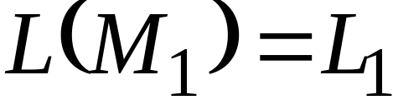
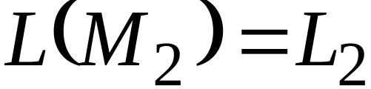


Take two languages
Regular language
Regular language
NFA
NFA
Single accepting state
Single accepting state
Costas Busch - LSU

Slide 8

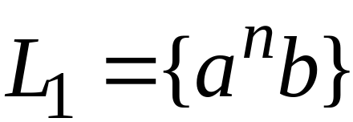
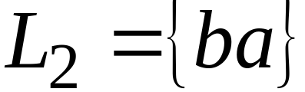
Example
Costas Busch - LSU

Slide 9

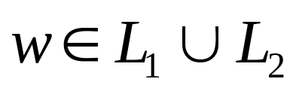
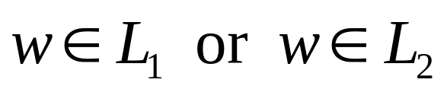
Union
NFA for
Costas Busch - LSU

Slide 10
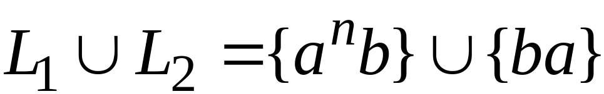
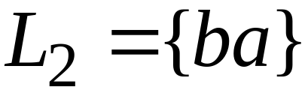
Example
NFA for
Sonucu yine regular bir dildir
Costas Busch - LSU

Slide 11

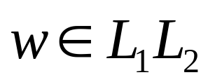
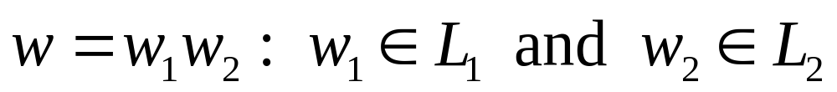
Concatenation
NFA for
change to
regular state
Costas Busch - LSU

Slide 12
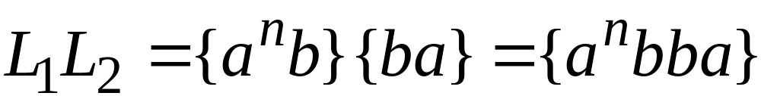

Example
NFA for
Epsilon kullanarak concat işi yapmış olurum. Birincinin final state’i artık final state değil.
Costas Busch - LSU

Slide 13
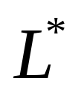




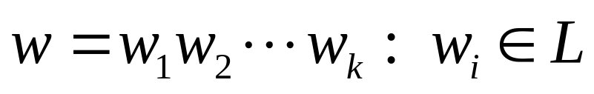
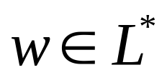

Star Operation
İstenilen kadar tekrar ederiz. Bir nevi döngüye alırız
NFA for
Star olduğu için epsilon’u da kabul eder
change to
regular state
or
Costas Busch - LSU

Slide 14
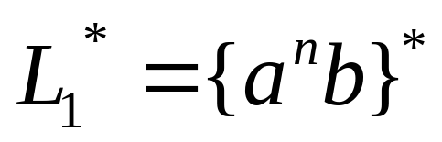


Example
NFA for
Costas Busch - LSU

Slide 15
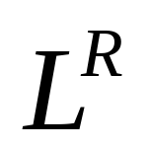




Reverse
Her şey ters şekilde alınır final state giriş olur.
NFA for
1. Reverse all transitions
2. Make the initial state accept state
and the accept state initial state
Costas Busch - LSU

Slide 16
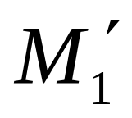
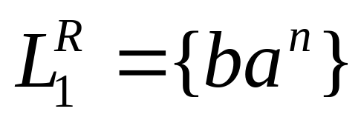
Example
Costas Busch - LSU

Slide 17
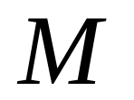
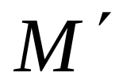
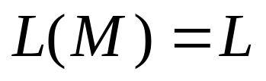
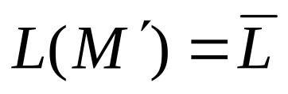

Complement
Final state’leri normal, normal stateleri final state haline getiririz
Önce NFA’yı DfA’ya çeviririz sonra complement’ini alırız.
1. Take the DFA that accepts
2. Make accept states regular
and vice-versa
Costas Busch - LSU

Slide 18

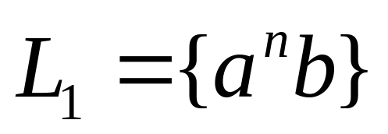
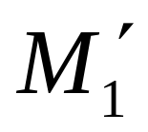
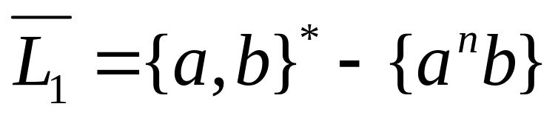
Example
Costas Busch - LSU

Slide 19
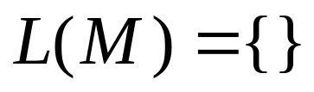
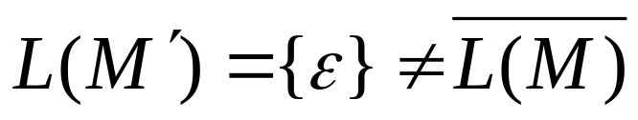
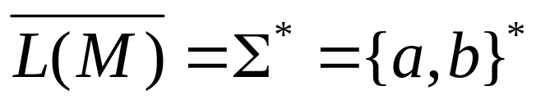
NFAs cannot be used for complement
Make accept states regular
and vice-versa
NFA
NFA
it is not the
complement
Costas Busch - LSU

Slide 20
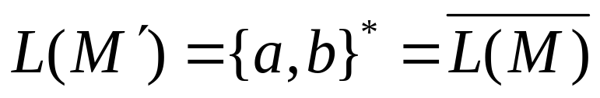
Same example with DFAs
Make accept states regular
and vice-versa
DFA
DFA
it is the
complement
Costas Busch - LSU

Slide 21
Intersection
regular
we show
regular
regular
Costas Busch - LSU

Slide 22




DeMorgan’s Law:
regular, regular
regular, regular
regular
regular
regular
Costas Busch - LSU

Slide 23
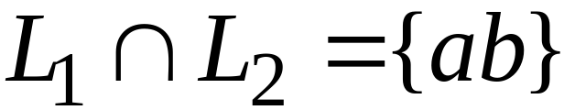
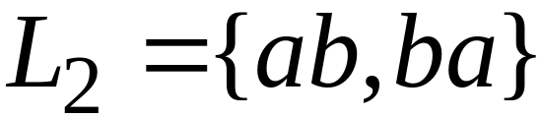
Example
regular
regular
regular
Costas Busch - LSU

Slide 24

Another Proof for Intersection Closure
Machine
Machine
DFA
for
DFA
for
Construct a new DFA that accepts
simulates in parallel and
Costas Busch - LSU

Slide 25

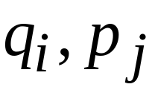
States in
State in
State in
Costas Busch - LSU

Slide 26




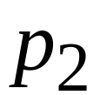
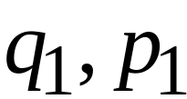
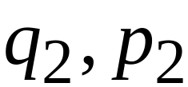
DFA
DFA
transition
transition
DFA
New transition
Costas Busch - LSU

Slide 27

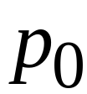
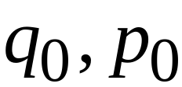
DFA
DFA
initial state
initial state
DFA
New initial state
Costas Busch - LSU

Slide 28



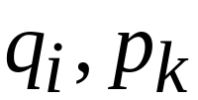
DFA
DFA
accept state
accept states
DFA
New accept states
Both constituents must be accepting states
Costas Busch - LSU

Slide 29

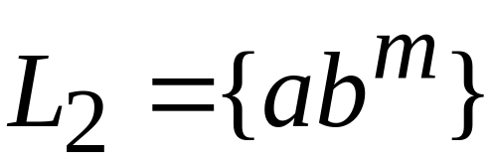








Example:
Costas Busch - LSU

Slide 30

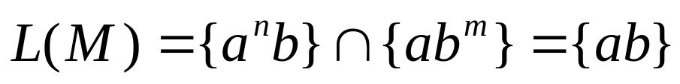







DFA for intersection
Costas Busch - LSU

Slide 31
Construction procedure for intersection
Burası önemli
1. Build Initial State
2. For each new state and for each symbol
add transition to either an existing state
or create a new state and point to it
3. Repeat step 2 until no new states
are added
4. Designate accept states
Costas Busch - LSU

Slide 32
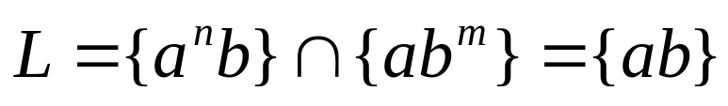
Automaton for intersection
initial state
Costas Busch - LSU

Slide 33






Automaton for intersection
add transition and new state
for symbol a
Costas Busch - LSU

Slide 34





Automaton for intersection
add transition and new state
for symbol b
Costas Busch - LSU

Slide 35
Automaton for intersection
Repeat until no new states can be added
Costas Busch - LSU

Slide 36




Automaton for intersection
accept state for
accept state for
add Accept state
Costas Busch - LSU

Slide 37


Intersection DFA :
simulates in parallel and
accepts string
if and only if:
accepts string
and accepts string
Costas Busch - LSU

