Slide 1
Non-regular languages
(Pumping Lemma)
Costas Busch - LSU

Slide 2

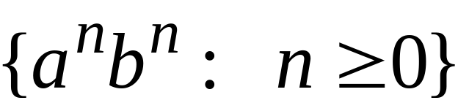


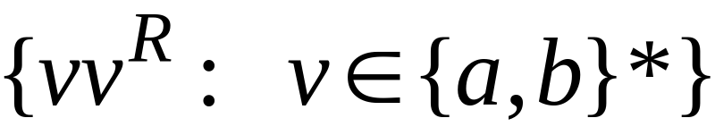


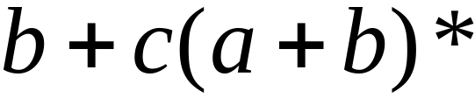

Non-regular languages
Regular languages
Costas Busch - LSU

Slide 3




How can we prove that a language
is not regular?
Prove that there is no DFA or NFA or RE
that accepts
Difficulty: this is not easy to prove
(since there is an infinite number of them)
Solution: use the Pumping Lemma !!!
Costas Busch - LSU

Slide 4

The Pigeonhole Principle
Costas Busch - LSU

Slide 5


pigeons
pigeonholes
Costas Busch - LSU

Slide 6
A pigeonhole must
contain at least two pigeons
Costas Busch - LSU

Slide 7



pigeons
...........
pigeonholes
...........
Costas Busch - LSU

Slide 8
The Pigeonhole Principle
pigeons
pigeonholes
There is a pigeonhole
with at least 2 pigeons
...........
Costas Busch - LSU

Slide 9
The Pigeonhole Principle and
DFAs
Costas Busch - LSU

Slide 10






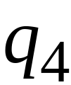


5 uzunlukta bir string gönderirsem mecburen bazı yerlerde tekrar etmeli
Consider a DFA with states
Costas Busch - LSU

Slide 11




Consider the walk of a “long’’ string:
(length at least 4)
A state is repeated in the walk of
2. Durumda tekrar etti.
Costas Busch - LSU

Slide 12

The state is repeated as a result of
the pigeonhole principle
Walk of
Pigeons:
(walk states)
Are more than
Nests:
(Automaton states)
Repeated
state
Repeated
state
Costas Busch - LSU

Slide 13


Consider the walk of a “long’’ string:
(length at least 4)
Due to the pigeonhole principle:
A state is repeated in the walk of
Costas Busch - LSU

Slide 14
The state is repeated as a result of
the pigeonhole principle:
Walk of
Pigeons:
(walk states)
Are more than
Nests:
(Automaton states)
Automaton States
Repeated
state
Costas Busch - LSU

Slide 15
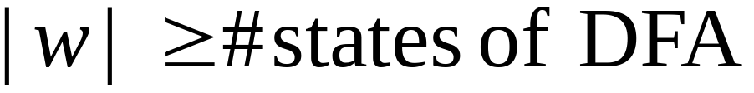

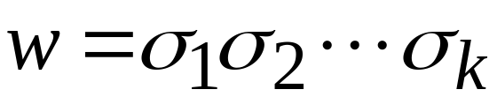












In General:
If ,
by the pigeonhole principle,
a state is repeated in the walk
Eğer string’in uzunluğu
durum sayısından fazla ise
mutlaka döngü olmalı
Walk of
....
....
....
Arbitrary DFA
......
......
Repeated state
Costas Busch - LSU

Slide 16
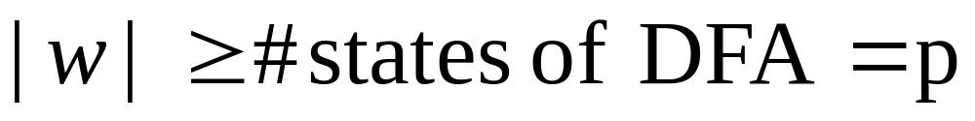
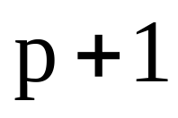




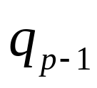
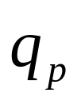
Number of states in walk is at least
Walk of
Pigeons:
(walk states)
....
....
....
Are
more
than
....
....
Nests:
(Automaton states)
A state is
repeated
Costas Busch - LSU

Slide 17
The Pumping Lemma
Costas Busch - LSU

Slide 18


Take an infinite regular language
(contains an infinite number of strings)
There exists a DFA that accepts
states
Costas Busch - LSU

Slide 19

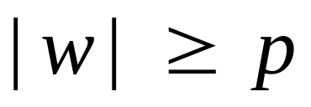
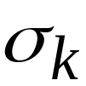

Take string with
(number of
states of DFA)
then, at least one state is repeated
in the walk of
Walk in DFA of
......
......
Repeated state in DFA
Costas Busch - LSU

Slide 20

There could be many states repeated
Take to be the first state repeated
One dimensional projection of walk :
First
occurrence
Second
occurrence
....
....
....
Unique states
Costas Busch - LSU

Slide 21


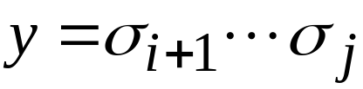
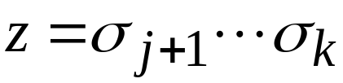
We can write
One dimensional projection of walk :
First
occurrence
Second
occurrence
....
....
....
Costas Busch - LSU

Slide 22





In DFA:
Where corresponds to substring
between first and second occurrence of
...
...
...
...
Costas Busch - LSU

Slide 23
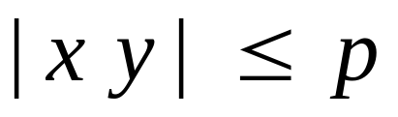

Observation:
length
number
of states
of DFA
...
Because of
unique states in
...
Since, in no
state is repeated
(except q)
Costas Busch - LSU

Slide 24

Observation:
length
Since there is at least one transition in loop
...
Costas Busch - LSU

Slide 25
We do not care about the form of string
may actually overlap with the paths of and
...
...
Costas Busch - LSU

Slide 26

Additional string:
The string
is accepted
Do not follow loop
...
...
...
...
Costas Busch - LSU

Slide 27

Additional string:
The string
is accepted
Follow loop
2 times
...
...
...
...
Costas Busch - LSU

Slide 28

Additional string:
The string
is accepted
Follow loop
3 times
...
...
...
...
Costas Busch - LSU

Slide 29
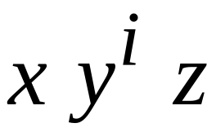


In General:
The string
is accepted
Follow loop
times
...
...
...
...
Costas Busch - LSU

Slide 30
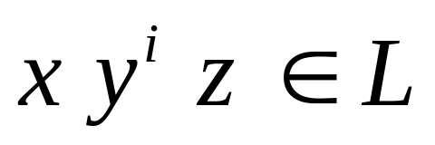
Therefore:
Language accepted by the DFA
...
...
...
...
Costas Busch - LSU

Slide 31
In other words, we described:
The Pumping Lemma !!!
Costas Busch - LSU

Slide 32

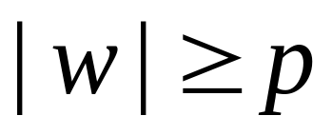
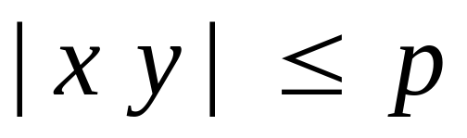

The Pumping Lemma:
Given a infinite regular language
there exists an integer
(critical length)
for any string with length
we can write
with and
such that:
Costas Busch - LSU

Slide 33
Applications of the Pumping Lemma
Costas Busch - LSU

Slide 34
Observation:
Every language of finite size has to be regular
(we can easily construct an NFA
that accepts every string in the language)
Therefore, every non-regular language
has to be of infinite size
(contains an infinite number of strings)
Costas Busch - LSU

Slide 35

Suppose you want to prove that
αn infinite language is not regular
1. Assume the opposite: is regular
2. The pumping lemma should hold for
3. Use the pumping lemma to obtain a
contradiction
4. Therefore, is not regular
Costas Busch - LSU

Slide 36


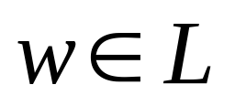
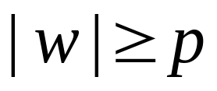
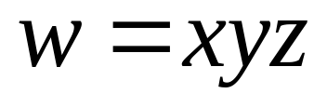
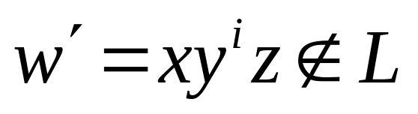
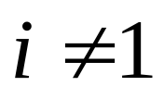
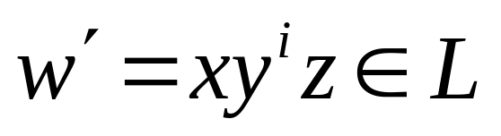
Explanation of Step 3: How to get a contradiction
1. Let be the critical length for
2. Choose a particular string which satisfies
the length condition
3. Write
4. Show that
for some
5. This gives a contradiction, since from
pumping lemma
Costas Busch - LSU

Slide 37

Note:
It suffices to show that
only one string
gives a contradiction
You don’t need to obtain
contradiction for every
Costas Busch - LSU

Slide 38

Example of Pumping Lemma application
Theorem:
The language
is not regular
Proof:
Use the Pumping Lemma
Costas Busch - LSU

Slide 39
Assume for contradiction
that is a regular language
Since is infinite
we can apply the Pumping Lemma
Costas Busch - LSU

Slide 40




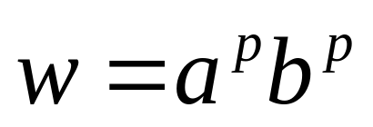
Let be the critical length for
Pick a string such that:
and length
We pick
Costas Busch - LSU

Slide 41
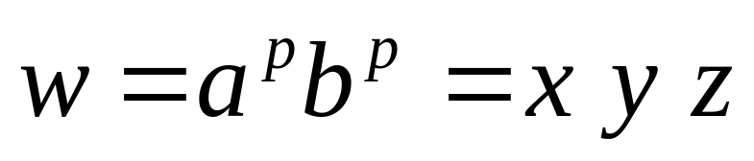
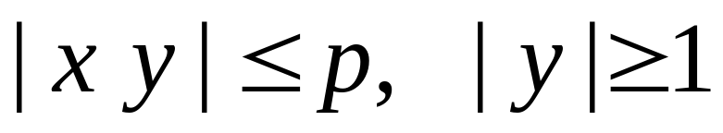

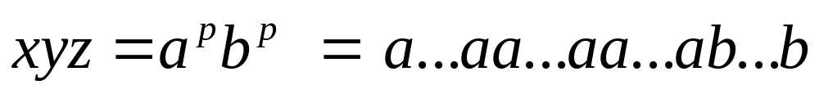

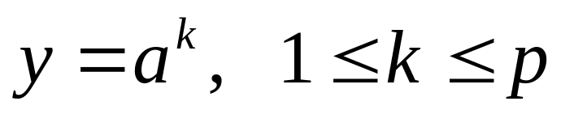
From the Pumping Lemma:
we can write
with lengths
Thus:
Costas Busch - LSU

Slide 42
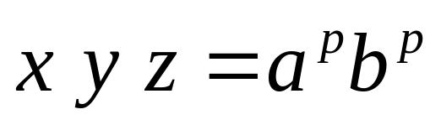

From the Pumping Lemma:
Thus:
Costas Busch - LSU

Slide 43
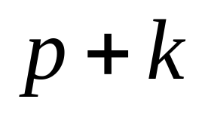

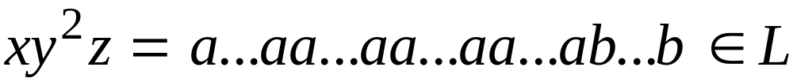
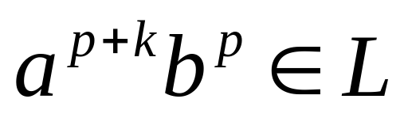
From the Pumping Lemma:
Thus:
Costas Busch - LSU

Slide 44

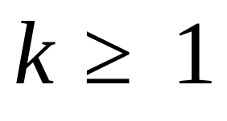
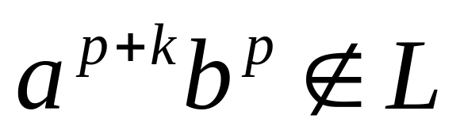
BUT:
CONTRADICTION!!!
Costas Busch - LSU

Slide 45
Therefore:
Our assumption that
is a regular language is not true
Conclusion:
is not a regular language
END OF PROOF
Costas Busch - LSU

Slide 46
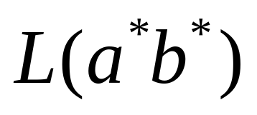

Non-regular language
Regular languages
Costas Busch - LSU

