Slide 1
More Applications of the Pumping Lemma
Costas Busch - LSU

Slide 2



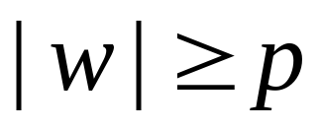

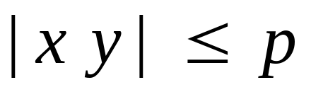



The Pumping Lemma:
Given a infinite regular language
there exists an integer (critical length)
for any string with length
we can write
with and
such that:
Costas Busch - LSU

Slide 3
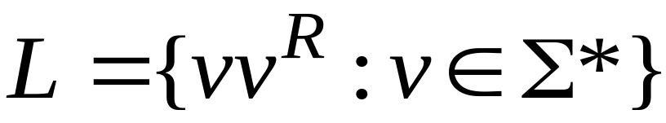
Non-regular languages
Regular languages
Costas Busch - LSU

Slide 4

Theorem:
The language
is not regular
Proof:
Use the Pumping Lemma
Costas Busch - LSU

Slide 5
Assume for contradiction
that is a regular language
Since is infinite
we can apply the Pumping Lemma
Costas Busch - LSU

Slide 6
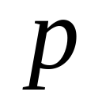




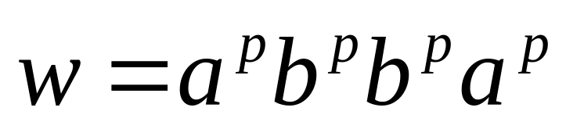
Let be the critical length for
Pick a string such that:
and
length
We pick
Costas Busch - LSU

Slide 7
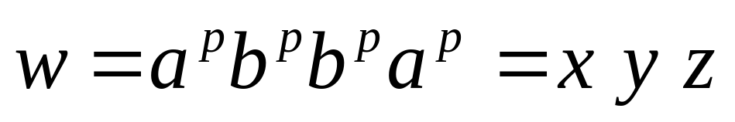
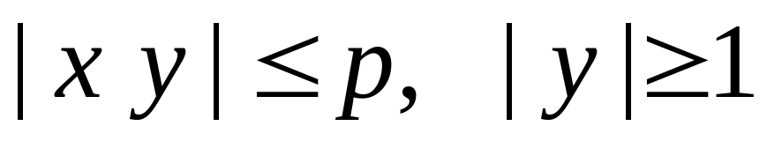




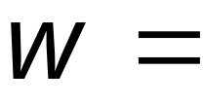



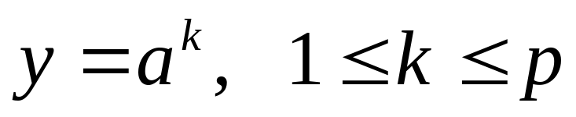
From the Pumping Lemma:
we can write:
with lengths:
Thus:
Costas Busch - LSU

Slide 8
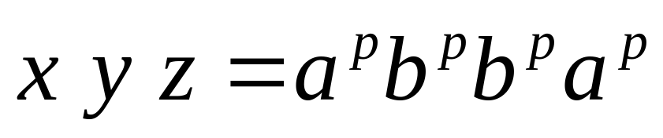


From the Pumping Lemma:
Thus:
Costas Busch - LSU

Slide 9
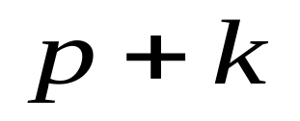


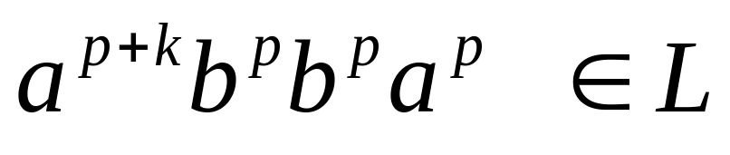
From the Pumping Lemma:
Thus:
Costas Busch - LSU

Slide 10


BUT:
CONTRADICTION!!!
Costas Busch - LSU

Slide 11
Therefore:
Our assumption that
is a regular language is not true
Conclusion:
is not a regular language
END OF PROOF
Costas Busch - LSU

Slide 12

Non-regular languages
Regular languages
Costas Busch - LSU

Slide 13
Theorem:
The language
is not regular
Proof:
Use the Pumping Lemma
Costas Busch - LSU

Slide 14
Assume for contradiction
that is a regular language
Since is infinite
we can apply the Pumping Lemma
Costas Busch - LSU

Slide 15



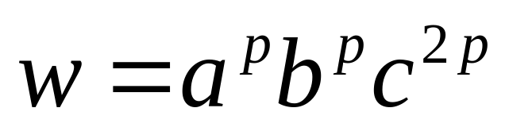
Let be the critical length of
Pick a string such that:
and
length
We pick
Costas Busch - LSU

Slide 16
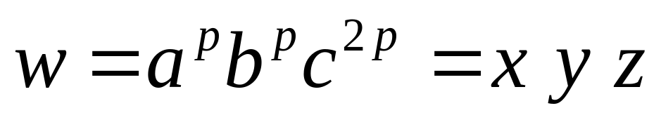



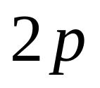

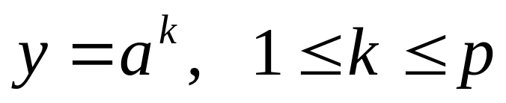
From the Pumping Lemma:
We can write
With lengths
Thus:
Costas Busch - LSU

Slide 17
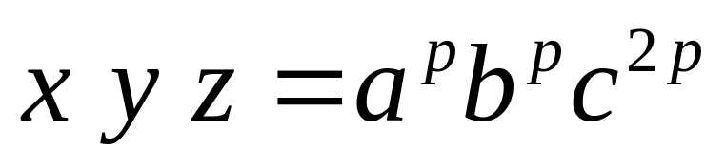
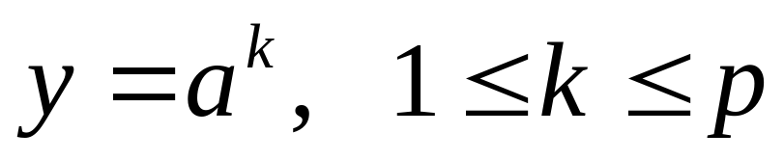
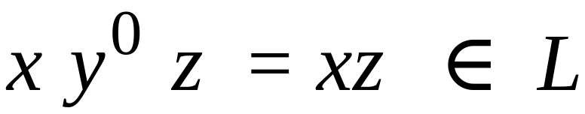
From the Pumping Lemma:
Thus:
Costas Busch - LSU

Slide 18
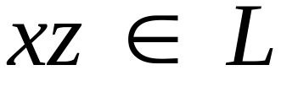
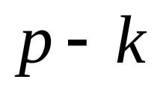


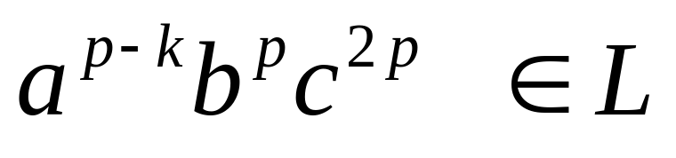
From the Pumping Lemma:
Thus:
Costas Busch - LSU

Slide 19
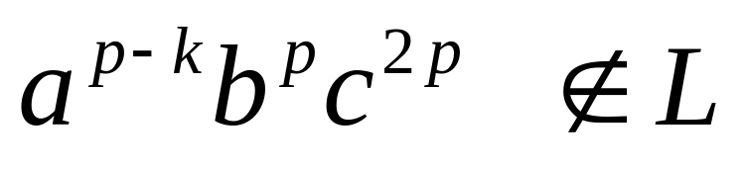
BUT:
CONTRADICTION!!!
Costas Busch - LSU

Slide 20
Therefore:
Our assumption that
is a regular language is not true
Conclusion:
is not a regular language
END OF PROOF
Costas Busch - LSU

Slide 21
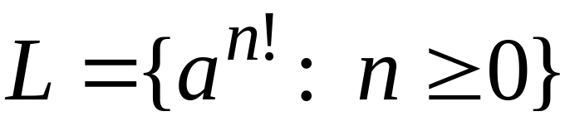
Non-regular languages
Regular languages
Costas Busch - LSU

Slide 22
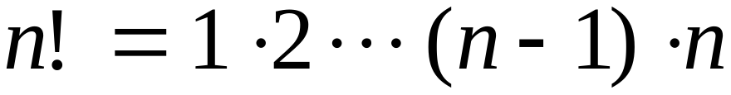
Theorem:
The language
is not regular
Proof:
Use the Pumping Lemma
Costas Busch - LSU

Slide 23
Assume for contradiction
that is a regular language
Since is infinite
we can apply the Pumping Lemma
Costas Busch - LSU

Slide 24

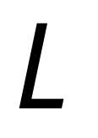

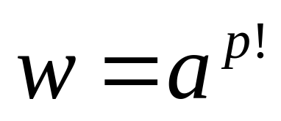
Let be the critical length of
Pick a string such that:
length
We pick
Costas Busch - LSU

Slide 25
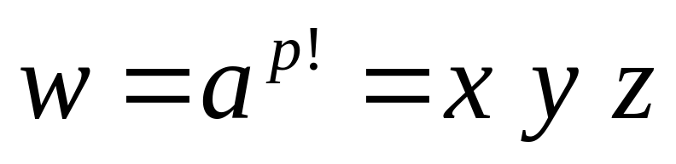

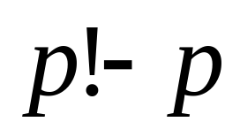
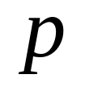
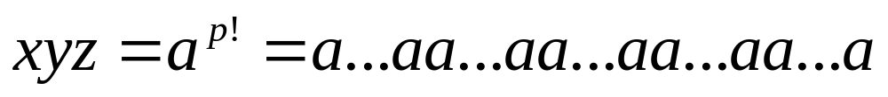


From the Pumping Lemma:
We can write
With lengths
Thus:
Costas Busch - LSU

Slide 26
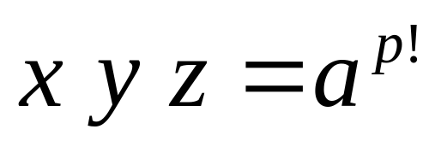

From the Pumping Lemma:
Thus:
Costas Busch - LSU

Slide 27
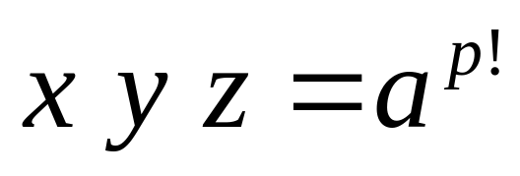
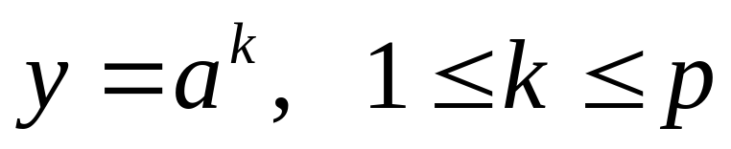
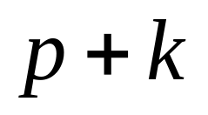

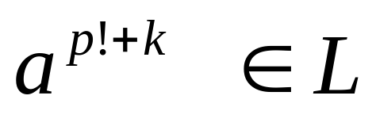
From the Pumping Lemma:
Thus:
Costas Busch - LSU

Slide 28
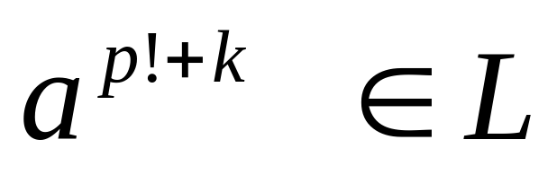
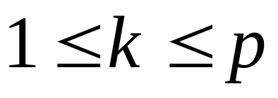

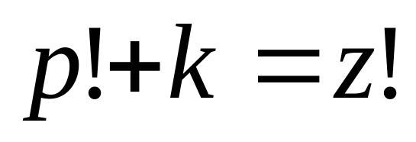
Since:
There must exist such that:
Costas Busch - LSU

Slide 29
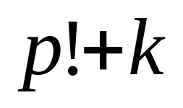
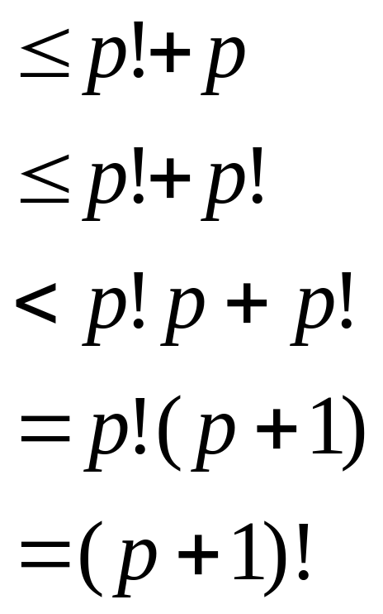
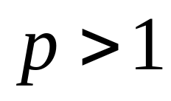
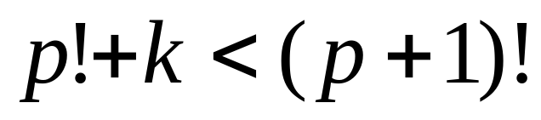
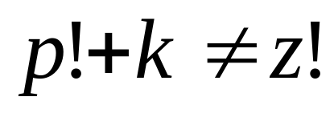
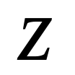
However:
for
for any
Costas Busch - LSU

Slide 30
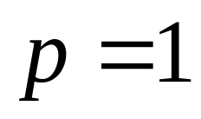
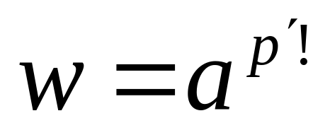
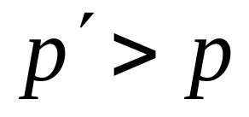
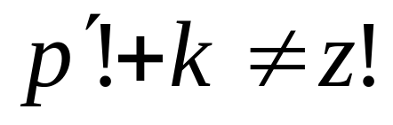
for
we could pick string
where
and we would obtain the same conclusion:
for any
Costas Busch - LSU

Slide 31
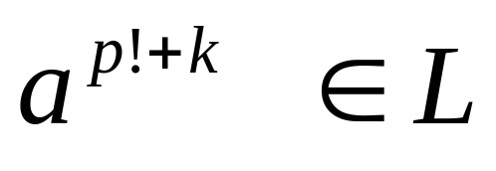

BUT:
CONTRADICTION!!!
Costas Busch - LSU

Slide 32
Therefore:
Our assumption that
is a regular language is not true
Conclusion:
is not a regular language
END OF PROOF
Costas Busch - LSU

