Slide 1
PDAs Accept
Context-Free Languages
Costas Busch - LSU

Slide 2

Theorem:
Context-Free
Languages
(Grammars)
Languages
Accepted by
PDAs
Costas Busch - LSU

Slide 3
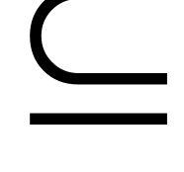



Proof - Step 1:
Context-Free
Languages
(Grammars)
Languages
Accepted by
PDAs
Convert any context-free grammar
to a PDA with:
Costas Busch - LSU

Slide 4

Proof - Step 2:
Context-Free
Languages
(Grammars)
Languages
Accepted by
PDAs
Convert any PDA to a context-free
grammar with:
Costas Busch - LSU

Slide 5
Convert
Context-Free Grammars to
PDAs
Proof - step 1
Costas Busch - LSU

Slide 6


Take an arbitrary context-free grammar
We will convert to a PDA such that:
Costas Busch - LSU

Slide 7


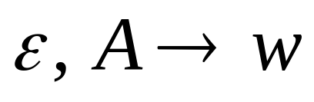
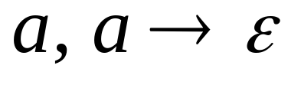
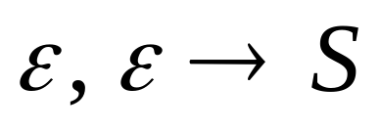
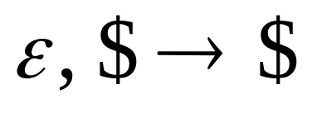



Conversion Procedure:
For each
For each
production in
terminal in
Add transitions
Costas Busch - LSU

Slide 8
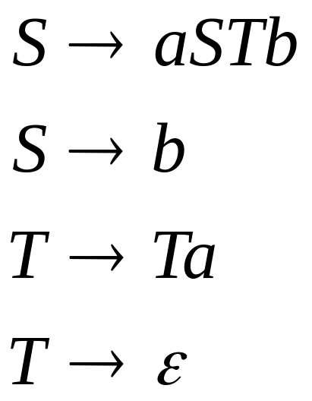
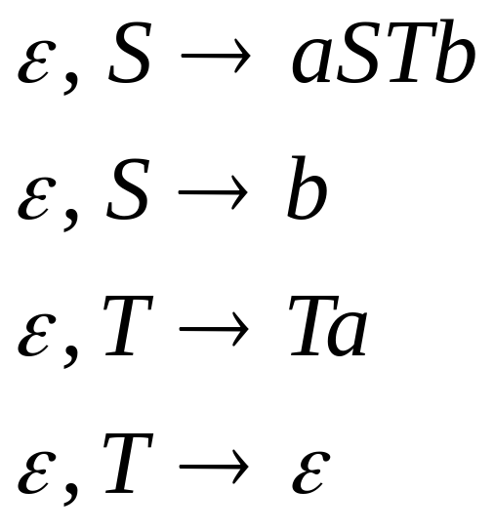
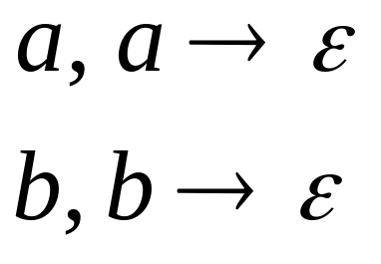
Example
Grammar
PDA
Costas Busch - LSU

Slide 9
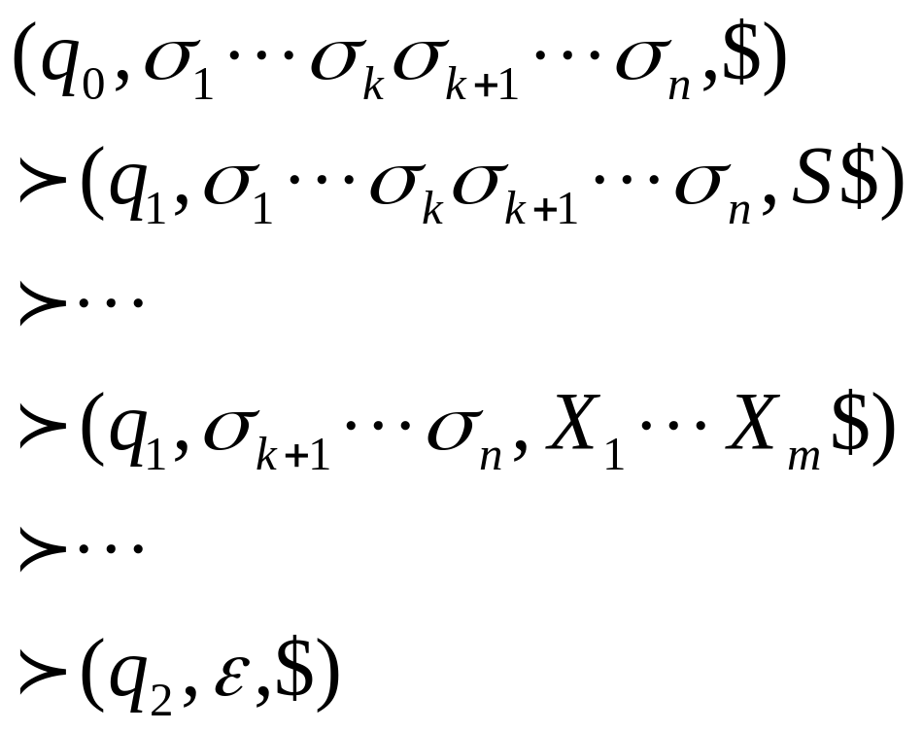
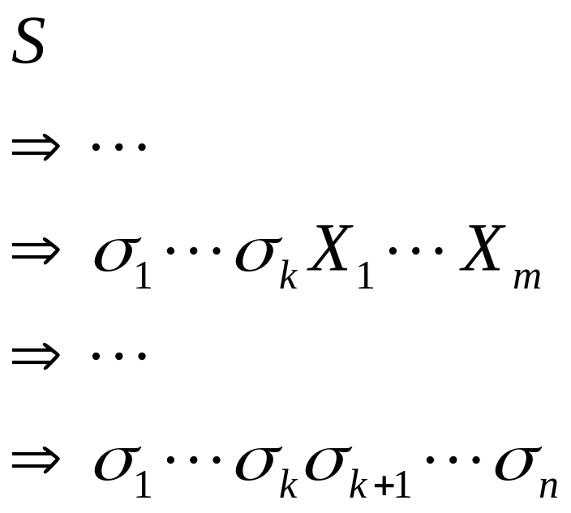
PDA simulates leftmost derivations
Grammar
Leftmost Derivation
PDA Computation
Scanned
symbols
Stack
contents
Costas Busch - LSU

Slide 10
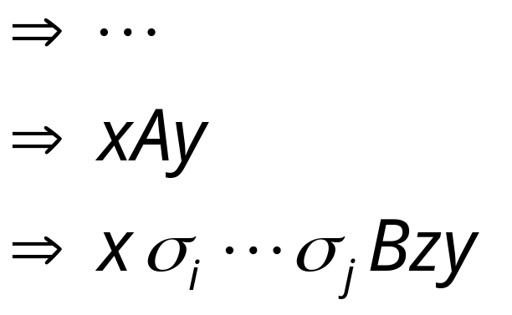
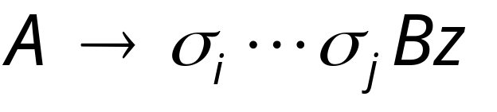
Grammar
Leftmost Derivation
Leftmost
variable
Variables
or terminals
Terminals
Production applied
Variables
or terminals
Terminals
Variable
Costas Busch - LSU

Slide 11
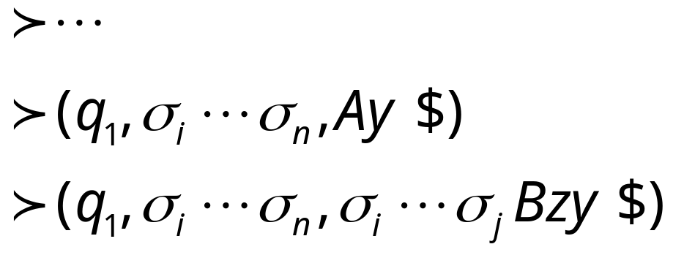
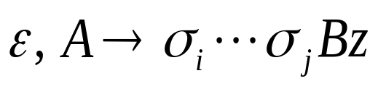
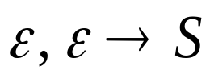
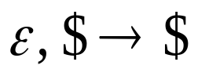
Grammar
Leftmost Derivation
PDA Computation
Production applied
Transition applied
Costas Busch - LSU

Slide 12

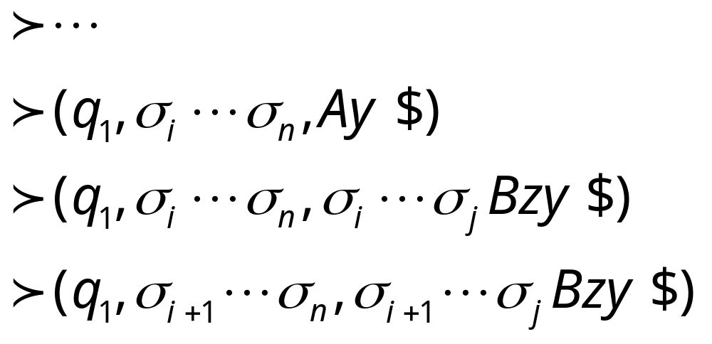
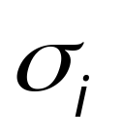
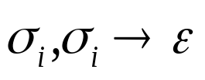
Grammar
Leftmost Derivation
PDA Computation
Transition applied
Read from input
and remove it from stack
Costas Busch - LSU

Slide 13

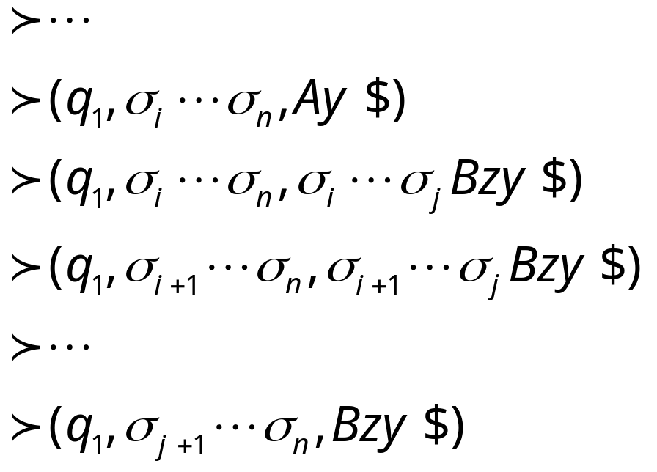
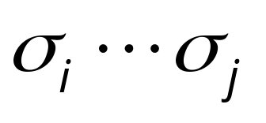
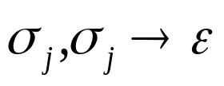
Grammar
Leftmost Derivation
PDA Computation
Last Transition applied
All symbols
have been removed from top of stack
Costas Busch - LSU

Slide 14
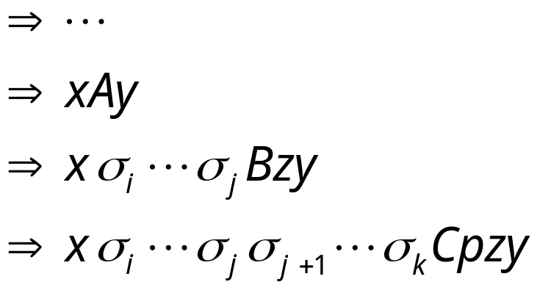
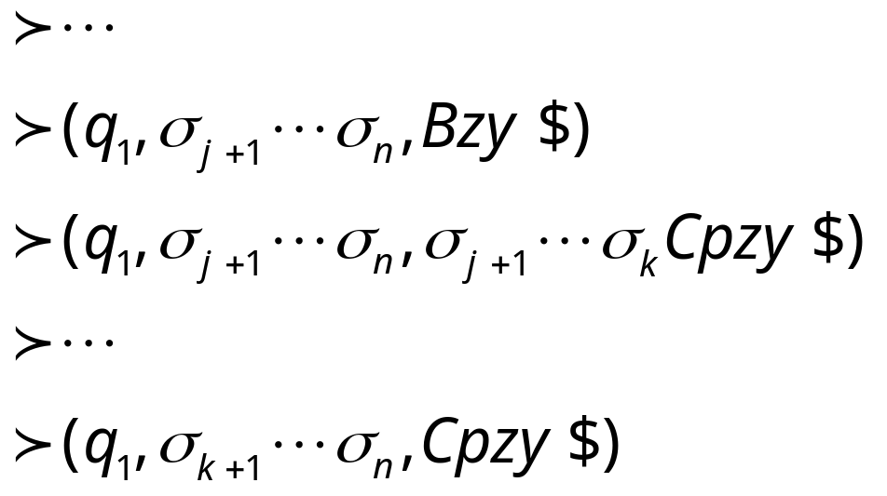
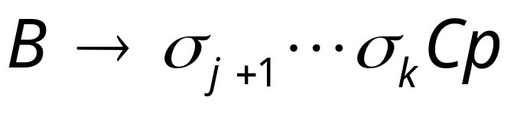
The process repeats with the next
leftmost variable
Production applied
And so on……
Costas Busch - LSU

Slide 15




Example:
Input
Time 0
Stack
Costas Busch - LSU

Slide 16


Derivation:
Input
Time 1
Stack
Costas Busch - LSU

Slide 17


Derivation:
Input
Time 2
Stack
Costas Busch - LSU

Slide 18
Derivation:
Input
Time 3
Stack
Costas Busch - LSU

Slide 19

Derivation:
Input
Time 4
Stack
Costas Busch - LSU

Slide 20
Derivation:
Input
Time 5
Stack
Costas Busch - LSU

Slide 21
Derivation:
Input
Time 6
Stack
Costas Busch - LSU

Slide 22
Derivation:
Input
Time 7
Stack
Costas Busch - LSU

Slide 23
Derivation:
Input
Time 8
Stack
Costas Busch - LSU

Slide 24
Derivation:
Input
Time 9
Stack
Costas Busch - LSU

Slide 25
Derivation:
Input
Time 10
Stack
accept
Costas Busch - LSU

Slide 26
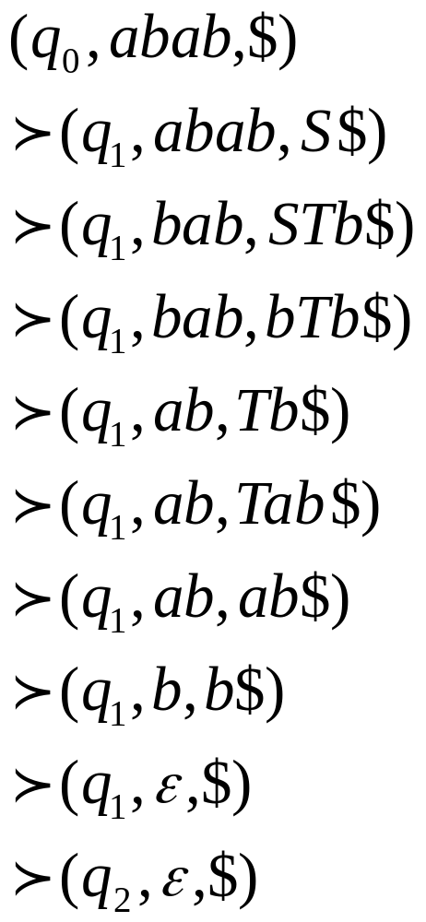
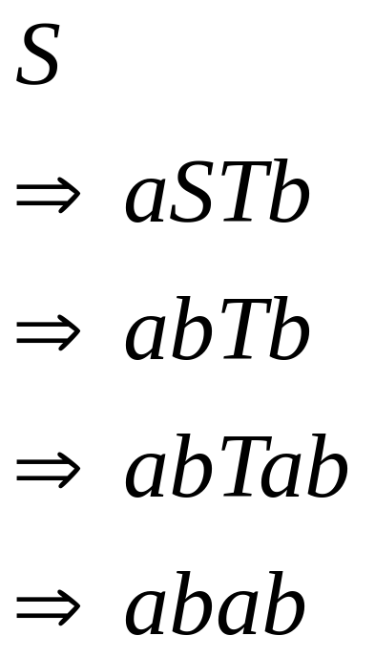
Grammar
Leftmost Derivation
PDA Computation
Costas Busch - LSU

Slide 27

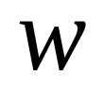
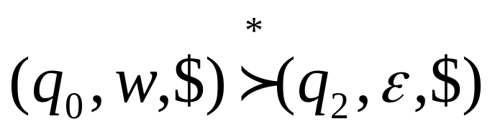
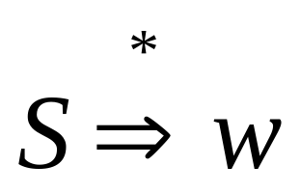
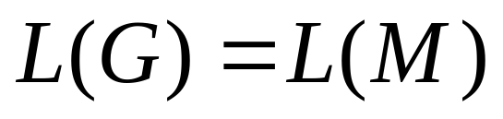
In general, it can be shown that:
Grammar
generates
string
If and
Only if
PDA
accepts
Therefore
Costas Busch - LSU

Slide 28
Convert
PDAs to
Context-Free Grammars
Proof - step 2
Costas Busch - LSU

Slide 29
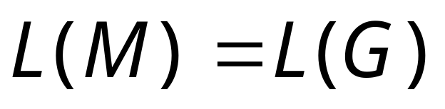
Take an arbitrary PDA
We will convert
to a context-free grammar such that:
Costas Busch - LSU

Slide 30
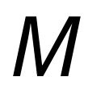
First modify PDA so that:
1. The PDA has a single accept state
2. Use new initial stack symbol #
3. On acceptance the stack contains only
stack symbol # (this symbol is not used in any transition)
4. Each transition either pushes a symbol
or pops a symbol but not both together
Costas Busch - LSU

Slide 31
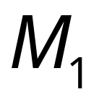
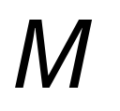
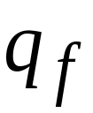
1. The PDA has a single accept state
PDA
Old
accept
states
New
accept
state
PDA
ε
,
ε
→
ε
ε
,
ε
→
ε
→
ε
ε
,
ε
Costas Busch - LSU

Slide 32
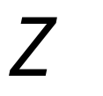


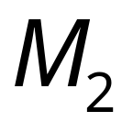
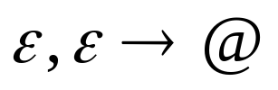
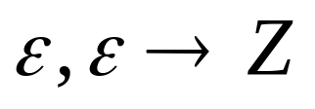
2. Use new initial stack symbol #
Top of stack
initial stack symbol of M
auxiliary stack symbol
new initial stack symbol
PDA
PDA
still thinks that Z is the initial stack
Costas Busch - LSU

Slide 33
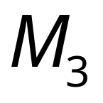



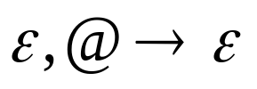
3. On acceptance the stack contains only
stack symbol #
(this symbol is not used in any transition)
PDA
Empty stack
Old
accept
state
New
accept
state
PDA
Costas Busch - LSU

Slide 34
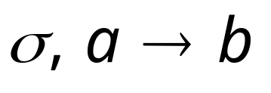


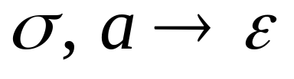
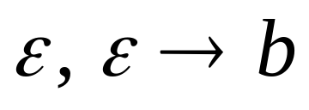
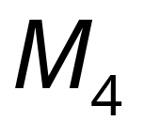
4. Each transition either pushes a symbol
or pops a symbol but not both together
PDA
PDA
Costas Busch - LSU

Slide 35

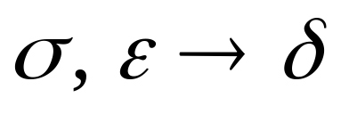
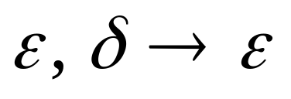
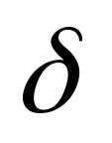
PDA
PDA
Where is a symbol of the stack alphabet
Costas Busch - LSU

Slide 36
PDA is the final modified PDA
Note that the new initial stack symbol #
is never used in any transition
Costas Busch - LSU

Slide 37
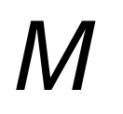

















Example:
Costas Busch - LSU

Slide 38

Grammar Construction
Variables:
States of PDA
Costas Busch - LSU

Slide 39

PDA
Kind 1: for each state
Grammar
Costas Busch - LSU

Slide 40



PDA
Kind 2: for every three states
Grammar
Costas Busch - LSU

Slide 41




PDA
Kind 3: for every pair of such transitions
Grammar
Costas Busch - LSU

Slide 42


PDA
Initial state
Accept state
Grammar
Start variable
Costas Busch - LSU

Slide 43
Example:
PDA
Costas Busch - LSU

Slide 44

Grammar
Kind 1: from single states
Costas Busch - LSU

Slide 45


Kind 2: from triplets of states
Start variable
Costas Busch - LSU

Slide 46








Kind 3: from pairs of transitions
Costas Busch - LSU

Slide 47




Suppose that a PDA is converted
to a context-free grammar
We need to prove that
or equivalently
Costas Busch - LSU

Slide 48



We need to show that if has derivation:
(string of terminals)
Then there is an accepting computation in :
with input string
Costas Busch - LSU

Slide 49


We will actually show that if has derivation:
Then there is a computation in :
Costas Busch - LSU

Slide 50


Therefore:
Since there is no transition
with the # symbol
Costas Busch - LSU

Slide 51




Lemma:
If (string of terminals)
then there is a computation
from state to state on string
which leaves the stack empty:
Costas Busch - LSU

Slide 52



Proof Intuition:
Type 2
Case 1:
Type 3
Case 2:
Costas Busch - LSU

Slide 53





Type 2
Case 1:
Stack
height
Input string
Generated by
Generated by
Costas Busch - LSU

Slide 54




Type 3
Case 2:
Stack
height
Input string
Generated by
Costas Busch - LSU

Slide 55
Formal Proof:
We formally prove this claim
by induction on the number
of steps in derivation:
number of steps
Costas Busch - LSU

Slide 56





Induction Basis:
(one derivation step)
A Kind 1 production must have been used:
Therefore, and
This computation of PDA trivially exists:
Costas Busch - LSU

Slide 57


Induction Hypothesis:
derivation steps
suppose it holds:
Costas Busch - LSU

Slide 58

Induction Step:
derivation steps
We have to show:
Costas Busch - LSU

Slide 59
derivation steps
Type 2
Case 1:
Type 3
Case 2:
Costas Busch - LSU

Slide 60




Type 2
Case 1:
steps
We can write
At most steps
At most steps
Costas Busch - LSU

Slide 61


At most steps
At most steps
From induction
hypothesis, in PDA:
From induction
hypothesis, in PDA:
Costas Busch - LSU

Slide 62


since
Costas Busch - LSU

Slide 63


Type 3
Case 2:
steps
We can write
At most steps
Costas Busch - LSU

Slide 64

At most steps
From induction hypothesis,
the PDA has computation:
Costas Busch - LSU

Slide 65

Type 3
Grammar contains production
And PDA Contains transitions
Costas Busch - LSU

Slide 66


Costas Busch - LSU

Slide 67




We know
We also know
Therefore:
Costas Busch - LSU

Slide 68

since
END OF PROOF
Costas Busch - LSU

Slide 69



So far we have shown:
With a similar proof we can show
Therefore:
Costas Busch - LSU

