Slide 1
Parsing
Costas Busch - LSU

Slide 2
Machine Code
Program File
Add v,v,5
cmp v,5
jmplt ELSE
THEN:
add x, 12,v
ELSE:
WHILE:
cmp x,3
...
v = 5;
if (v>5)
x = 12 + v;
while (x !=3) {
x = x - 3;
v = 10;
}
......
Compiler
Costas Busch - LSU

Slide 3
Compiler
Lexical
analyzer
parser
Input String
Output
Program
file
machine
code
Costas Busch - LSU

Slide 4
Lexical analyzer:
Recognizes the lexemes of the
input program file:
Keywords (if, then, else, while,…),
Integers,
Identifiers (variables), etc
It is built with DFAs (based on the
theory of regular languages)
Costas Busch - LSU

Slide 5
Parser:
Knows the grammar of the
programming language to be compiled
Constructs derivation (and derivation tree)
for input program file (input string)
Converts derivation to machine code
Costas Busch - LSU

Slide 6

Example Parser
PROGRAM STMT_LIST
STMT_LIST STMT; STMT_LIST | STMT;
STMT EXPR | IF_STMT | WHILE_STMT
| { STMT_LIST }
EXPR EXPR + EXPR | EXPR - EXPR | ID
IF_STMT if (EXPR) then STMT
| if (EXPR) then STMT else STMT
WHILE_STMT while (EXPR) do STMT
Costas Busch - LSU

Slide 7
The parser finds the derivation
of a particular input file
Example
Parser
derivation
E => E + E
=> E + E * E
=> 10 + E*E
=> 10 + 2 * E
=> 10 + 2 * 5
Input string
E -> E + E
| E * E
| INT
10 + 2 * 5
Costas Busch - LSU

Slide 8
derivation
derivation tree
b
E
E => E + E
=> E + E * E
=> 10 + E*E
=> 10 + 2 * E
=> 10 + 2 * 5
a
E
+
E
10
E
*
E
2
5
machine code
Derivation trees
are used to build
Machine code
mult a, 2, 5
add b, 10, a
Costas Busch - LSU

Slide 9
A simple (exhaustive) parser
Costas Busch - LSU

Slide 10
We will build an exhaustive search parser
that examines all possible derivations
Exhaustive Parser
input
string
grammar
derivation
Costas Busch - LSU

Slide 11

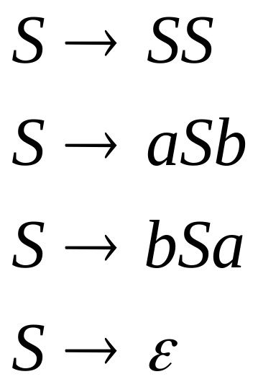
Example:
Find derivation of string
Exhaustive Parser
derivation
Input string
?
Costas Busch - LSU

Slide 12
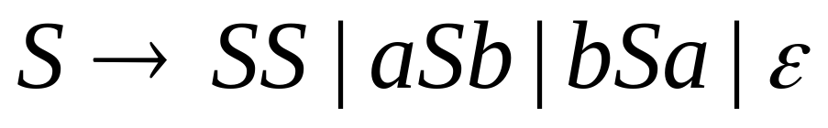
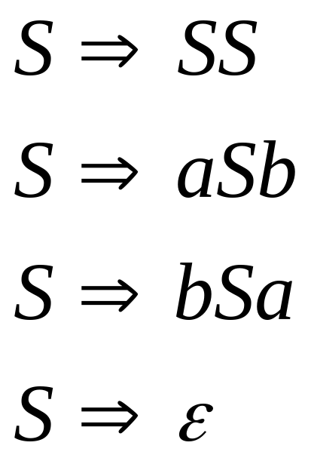
Exhaustive Search
Phase 1:
Find derivation
of
All possible derivations of length 1
Costas Busch - LSU

Slide 13
Phase 1:
Find derivation
of
Cannot possibly produce
Costas Busch - LSU

Slide 14
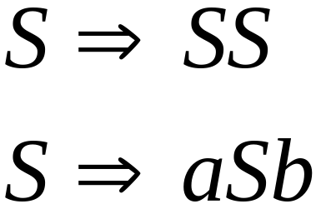
In Phase 2,
explore the next step
of each derivation
from Phase 1
Phase 1
Costas Busch - LSU

Slide 15
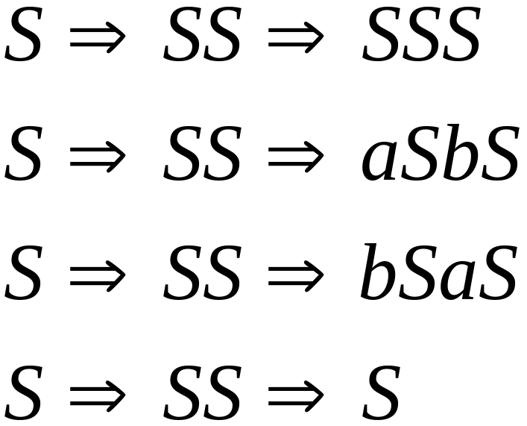
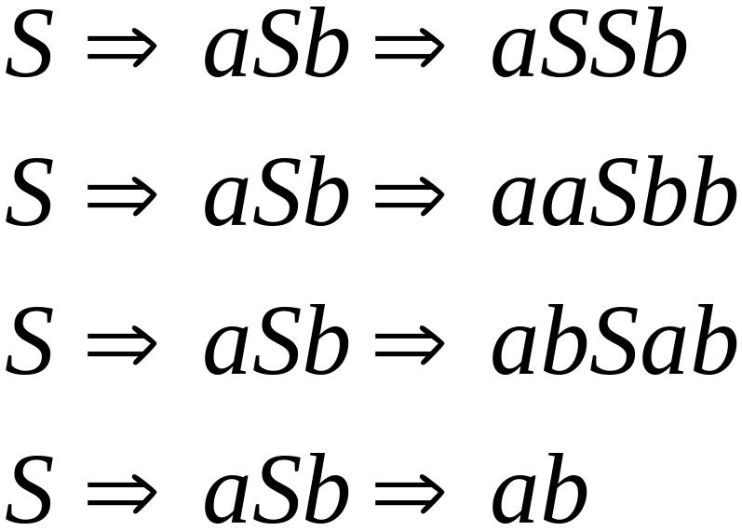
Phase 2
Phase 1
Find derivation
of
Costas Busch - LSU

Slide 16
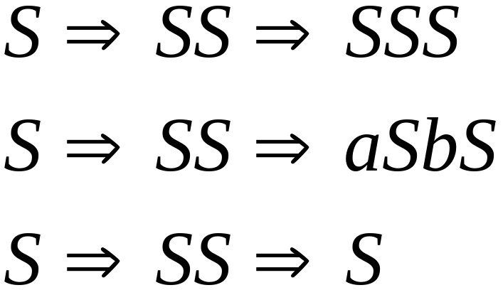
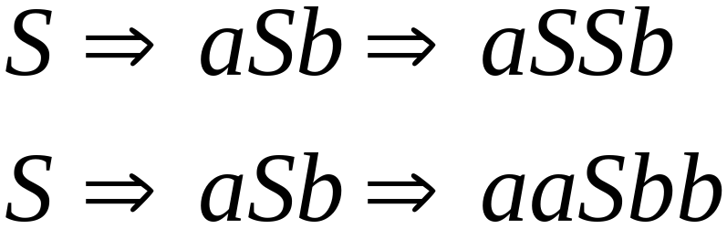
Phase 2
Find derivation
of
In Phase 3 explore
all possible derivations
Costas Busch - LSU

Slide 17
Phase 2
Find derivation
of
A possible derivation
of Phase 3
Costas Busch - LSU

Slide 18

Final result of exhaustive search
Exhaustive Parser
Input
string
derivation
Costas Busch - LSU

Slide 19
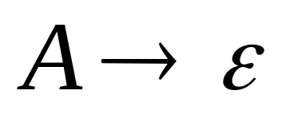


Time Complexity
Suppose that the grammar does not have
productions of the form
( -productions)
(unit productions)
Costas Busch - LSU

Slide 20

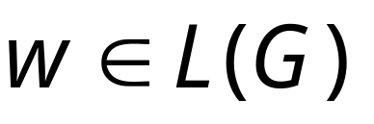
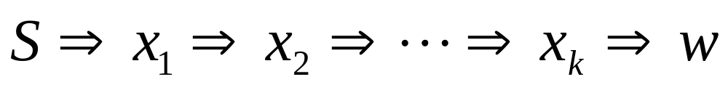
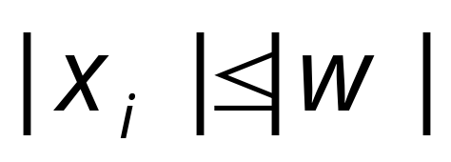

Since the are no -productions
For any derivation of a
string of terminals
it holds that
for all
Costas Busch - LSU

Slide 21

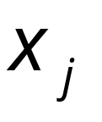

Since the are no unit productions
1. At most derivation steps are needed
to produce a string with at most
variables
2. At most derivation steps are needed
to convert the variables of to the
string of terminals
Costas Busch - LSU

Slide 22
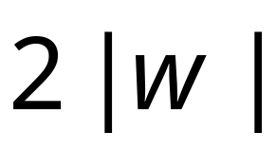

Therefore, at most derivation
steps are required to produce
The exhaustive search requires at most
phases
Costas Busch - LSU

Slide 23


Suppose the grammar has productions
Possible derivation choices
to be examined in phase 1:
at most
Costas Busch - LSU

Slide 24
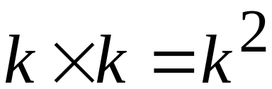
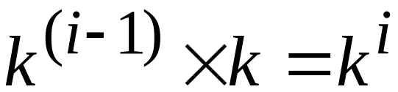
Choices for phase 2: at most
Choices of
phase 1
Number of
Productions
In General
Choices for phase i: at most
Choices of
phase i-1
Number of
Productions
Costas Busch - LSU

Slide 25

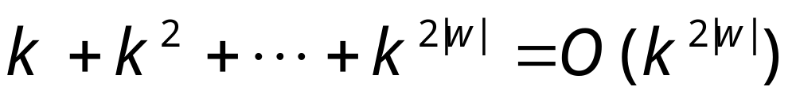
Total exploration choices for string :
phase 1
phase 2
phase 2|w|
Exponential to the string length
Extremely bad!!!
Costas Busch - LSU

Slide 26
Faster Parsers
Costas Busch - LSU

Slide 27



There exist faster parsing algorithms
for specialized grammars
S-grammar:
Symbol
String of variables
Each pair of variable, terminal
appears once in a production
(a restricted version of Greinbach Normal form)
Costas Busch - LSU

Slide 28
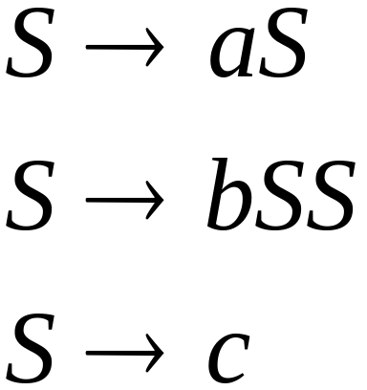
S-grammar example:
Each string has a unique derivation
Costas Busch - LSU

Slide 29


For S-grammars:
In the exhaustive search parsing
there is only one choice in each phase
Steps for a phase:
Total steps for parsing string :
Costas Busch - LSU

Slide 30
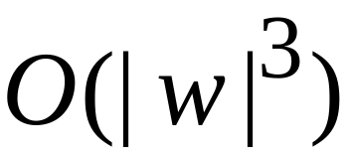

For general context-free grammars:
Next, we give a parsing algorithm
that parses a string in time
(this time is very close to the worst case
optimal since parsing can be used to solve
the matrix multiplication problem)
Costas Busch - LSU

Slide 31


The CYK Parsing Algorithm
Input:
Arbitrary Grammar
in Chomsky Normal Form
String
Output:
Determine if
Number of Steps:
Can be easily converted to a Parser
Costas Busch - LSU

Slide 32

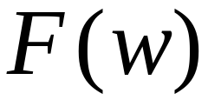
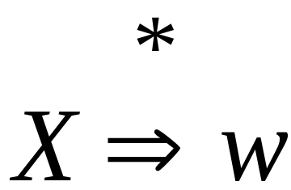
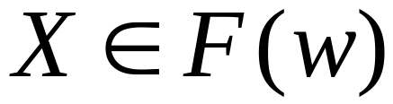
Basic Idea
Consider a grammar
In Chomsky Normal Form
Denote by the set of variables
that generate a string
if
Costas Busch - LSU

Slide 33
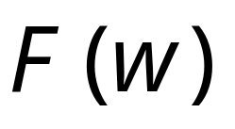
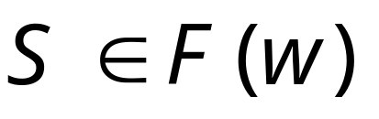
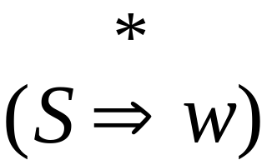
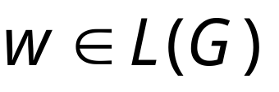
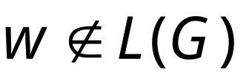
Suppose that we have computed
Check if :
YES
NO
Costas Busch - LSU

Slide 34

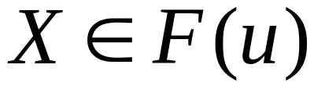
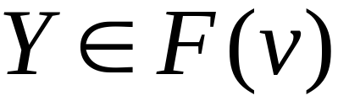
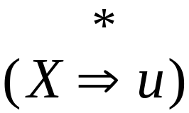
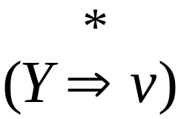

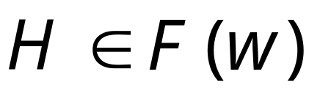
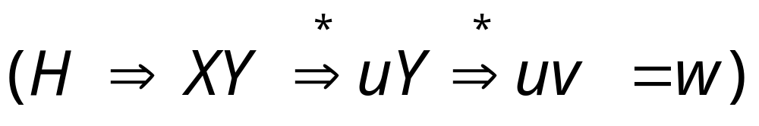
can be computed recursively:
prefix
suffix
Write
If
and
and there is production
Then
Costas Busch - LSU

Slide 35
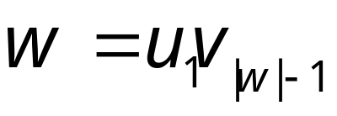

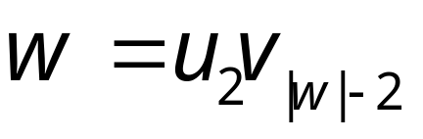

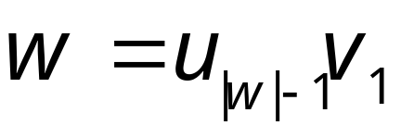
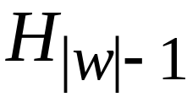
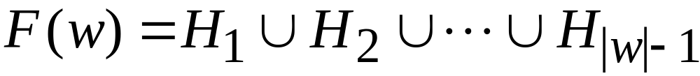
Examine all prefix-suffix
decompositions of
Length
Set of Variables
that generate
1
2
|w|-1
Result:
Costas Busch - LSU

Slide 36

At the basis of the recursion
we have strings of length 1
symbol
Very easy to find
Costas Busch - LSU

Slide 37
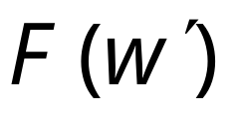
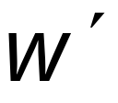
Remark:
The whole algorithm can be implemented
with dynamic programming:
First compute for smaller
substrings and then use this
to compute the result for larger
substrings of
Costas Busch - LSU

Slide 38
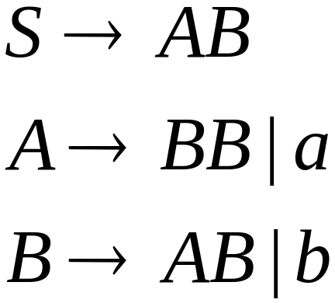
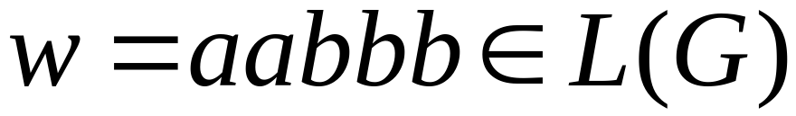
Example:
Grammar :
Determine if
Costas Busch - LSU

Slide 39

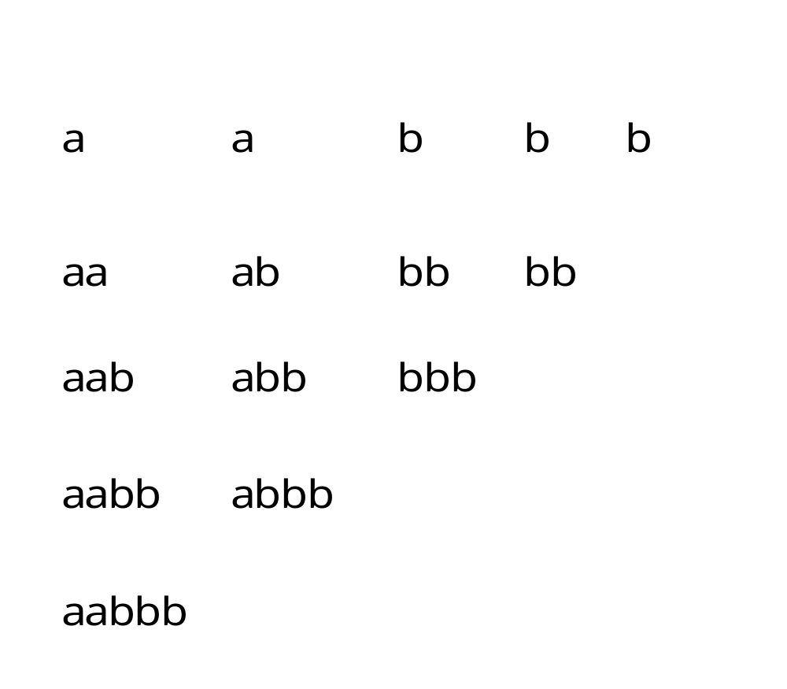
Decompose the string
to all possible substrings
Length
1
2
3
4
5
Costas Busch - LSU

Slide 40
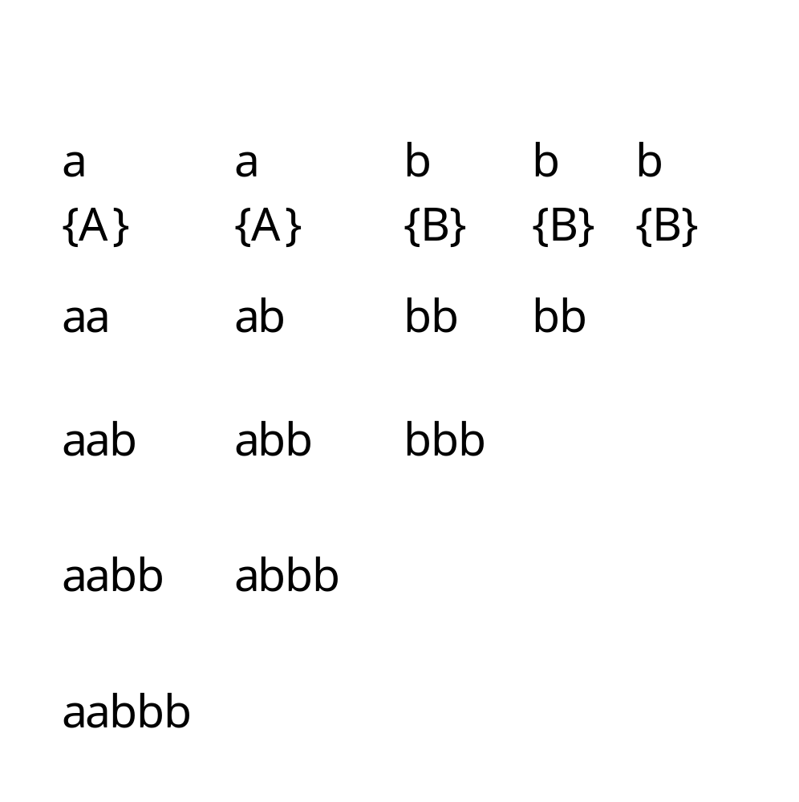

Costas Busch - LSU

Slide 41
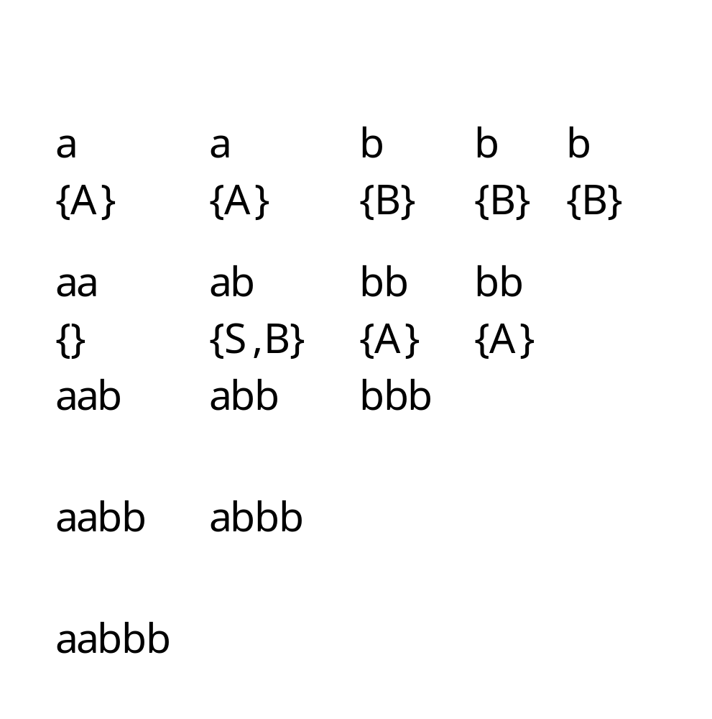
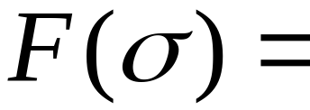
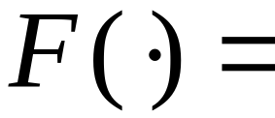
Costas Busch - LSU

Slide 42











prefix
suffix
There is no production of form
Thus,
prefix
suffix
There are two productions of form
Thus,
Costas Busch - LSU

Slide 43
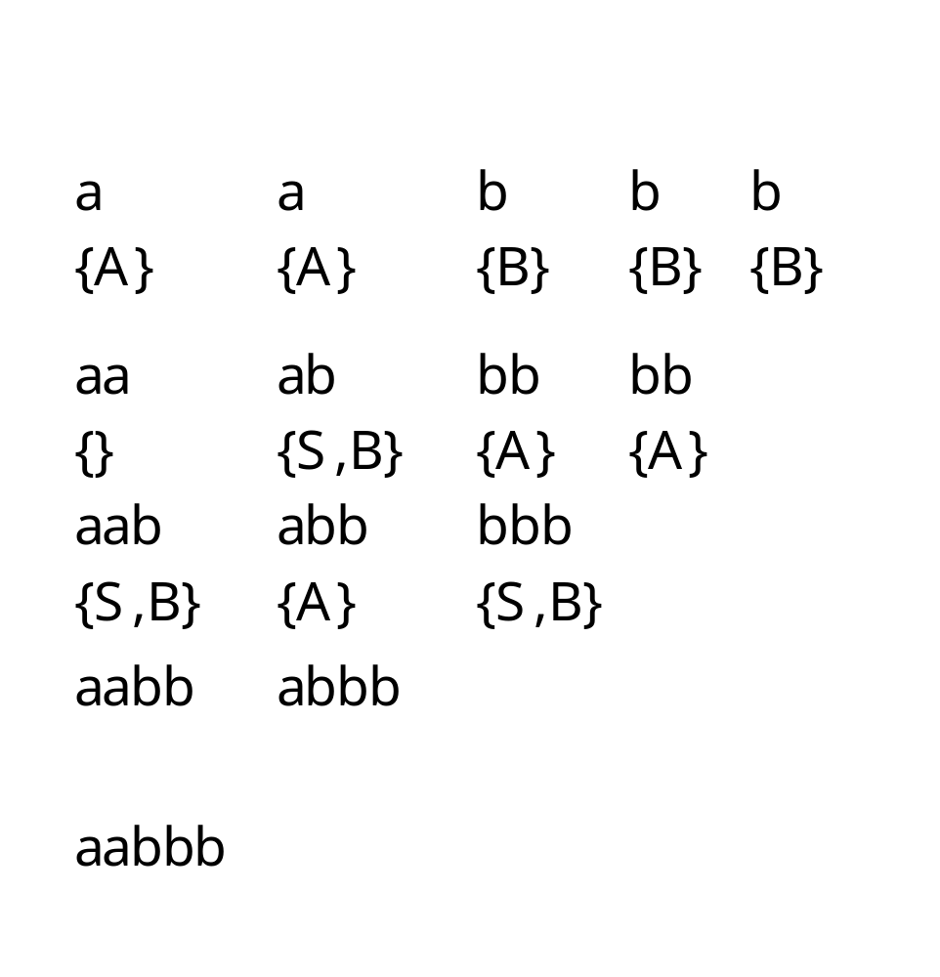
Costas Busch - LSU

Slide 44
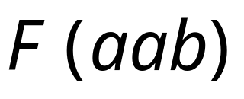
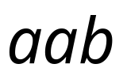





Decomposition 1
prefix
suffix
There is no production of form
There are 2 productions of form
Costas Busch - LSU

Slide 45




Decomposition 2
prefix
suffix
There is no production of form
Costas Busch - LSU

Slide 46




Since
Costas Busch - LSU

Slide 47

Approximate time complexity:
Number of
substrings
Number of
Prefix-suffix
decompositions
for a string
Costas Busch - LSU

