Slide 1




CAPSTONE PROJECT
Heart Disease Prediction System
Presented By-
Student Name: Mrudula g. Kamdi
College Name: Dr. G. Y. Pathrikar college of CS & IT
Department: Data Science
Email ID: kamdimrudula2003@gmail.com
Notes:
1

Slide 2
OUTLINE:
Problem Statement
Proposed System/Solution
System Development Approach
Algorithm
Result (Output Image)
Conclusion
Future Scope
References

Slide 3
Problem Statement:
Heart disease is one of the leading causes of death worldwide, often resulting from late diagnosis and lack of early risk awareness. With changing lifestyles, increasing stress levels, and limited access to preventive healthcare, there is a growing need for intelligent systems that can assist in early detection. Traditional diagnosis methods may require time and extensive medical resources, which makes early screening difficult for large populations. Therefore, building a Machine Learning-based heart disease prediction system can help analyze patient health parameters and estimate the risk level, enabling timely intervention and supporting better healthcare decisions for society.
Key Focus Areas
Develop a predictive model to identify the risk of heart disease using patient health data.
Use parameters such as age, blood pressure, cholesterol, heart rate, and lifestyle factors.
Support early detection and preventive healthcare awareness.
Assist healthcare professionals with data-driven insights.
Reduce healthcare burden by enabling faster preliminary risk assessment.
Promote accessible and technology-driven healthcare solutions for society.

Slide 4
Proposed Solution:
Proposed System:
The proposed system aims to address the challenge of early detection of heart disease by analyzing patient health parameters and predicting the likelihood of cardiovascular risk.
This involves leveraging data analytics and machine learning techniques to identify patterns in medical data and support preventive healthcare decisions.
The solution will consist of the following components:
2. Data Collection:
Collected a publicly available Heart Disease dataset containing patient medical records.
The dataset includes features such as age, sex, chest pain type, resting blood pressure, cholesterol level, heart rate, ECG results, and other clinical attributes.
Data represents real-world medical indicators used to assess cardiovascular health.
The target variable indicates whether a patient is likely to have heart disease (0 = No, 1 = Yes).
3. Data Preprocessing:
Loaded the dataset into a Pandas Data-Frame for analysis.
Checked data structure, feature columns, and target label.
Separated independent variables (X) and dependent variable (Y).
Applied train_test_split() to divide data into training and testing sets.
Used stratified sampling to maintain balanced class distribution.
Prepared the dataset for training by ensuring consistency and proper formatting.

Slide 5
Proposed Solution:
4. Machine Learning Algorithm:
Implemented Logistic Regression for binary classification of heart disease risk.
Selected Logistic Regression due to its effectiveness in medical prediction problems.
Trained the model using the training dataset with the fit() method.
Utilized clinical attributes like chest pain type, max heart rate, cholesterol, and ST depression as predictive features.
Generated predictions using the trained model for new input data.
5. Evaluation:
Evaluated model performance using Accuracy Score.
Calculated accuracy for both training and testing datasets.
Compared performance metrics to ensure good generalization.
Confirmed that the model provides reliable classification results.
6. Result:
The developed system successfully predicts the likelihood of heart disease based on patient health parameters.
Logistic Regression achieved strong performance in classifying patients into risk categories.
Important medical indicators contributing to prediction were identified through analysis.
The system demonstrates potential as an early screening tool to support healthcare professionals and promote preventive medical awareness.

Slide 6
System Approach:
The system approach defines the methodology used to design and implement the Heart Disease Prediction model. It includes the technical requirements, tools, and libraries needed to build an efficient machine learning solution for early risk prediction.
System Requirements:
i) Hardware Requirements:
Processor: Intel i3/i5 or higher
RAM: Minimum 4 GB (8 GB recommended)
Storage: 10 GB free space
Internet connection for Google Colab execution
ii)Software Requirements:
Python (3.x)
Google Colab / Jupyter Notebook
Web Browser (Chrome recommended)
Operating System: Windows / Linux / macOS

Slide 7
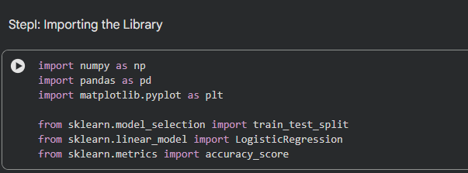
System Approach:
2. Libraries Required to Build the Model:
Pandas → Data loading and preprocessing
NumPy → Numerical operations
Matplotlib → Data visualization
Scikit-learn (sklearn) → Machine learning model implementation
train_test_split for data splitting
LogisticRegression for classification
accuracy_score for evaluation

Slide 8
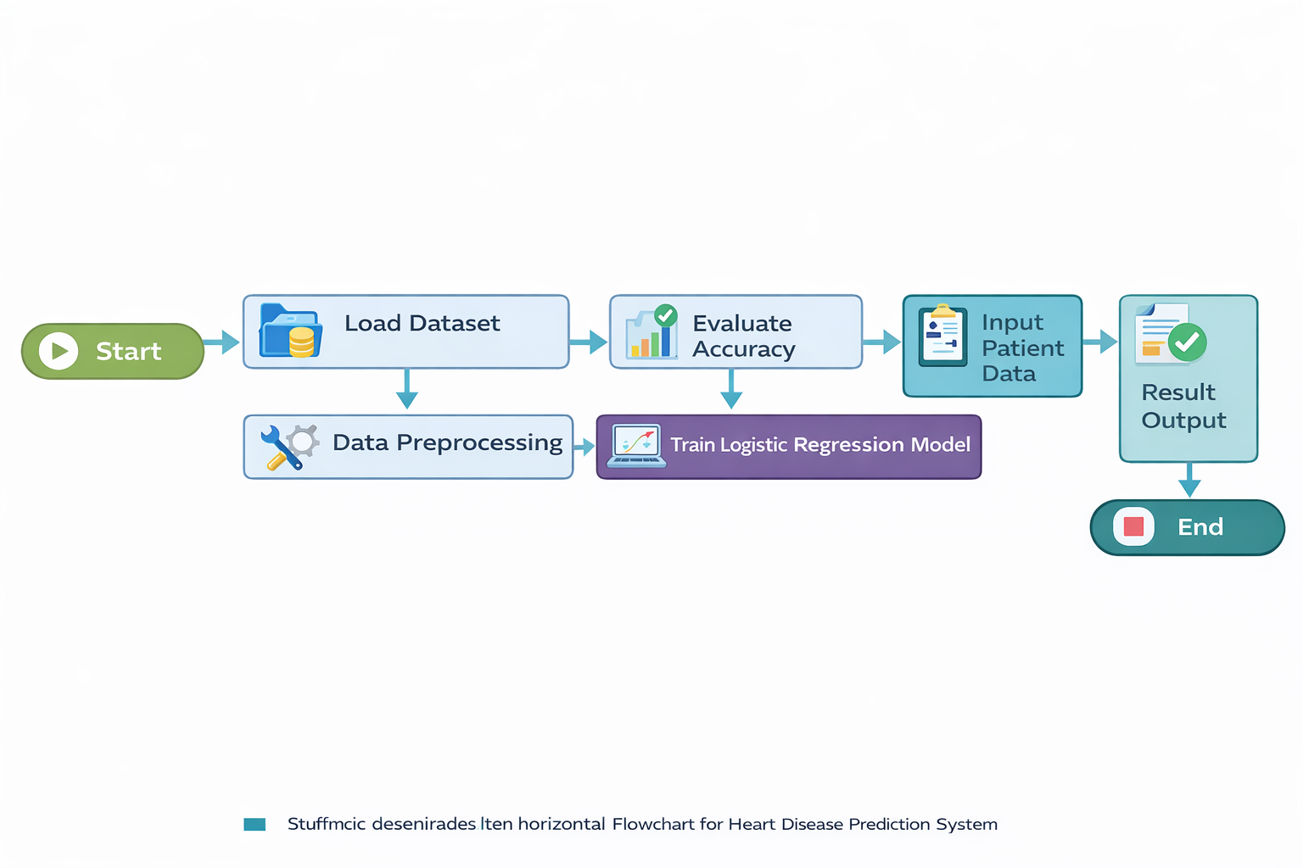
System Approach:
3.Flowchart:

Slide 9
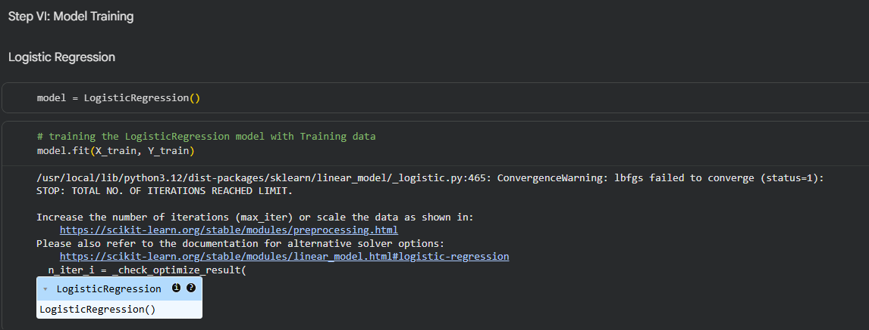
Algorithm:
Algorithm Selection:
The Logistic Regression algorithm was selected for this project to predict the presence of heart disease. Logistic Regression is a supervised machine learning classification technique well suited for binary outcomes, making it ideal for predicting whether a patient is at risk (1) or not at risk (0). It is computationally efficient, easy to interpret in medical applications, and performs well on structured healthcare datasets containing numerical and categorical features.

Slide 10
Algorithm:
Data Input:
The algorithm uses patient health parameters as input features, including:
Age and gender
Chest pain type (cp)
Resting blood pressure (trestbps)
Cholesterol level (chol)
Fasting blood sugar (fbs)
Resting ECG results (restecg)
Maximum heart rate achieved (thalach)
Exercise-induced angina (exang)
ST depression (oldpeak)
Slope, number of vessels (ca), and thalassemia (thal)

Slide 11
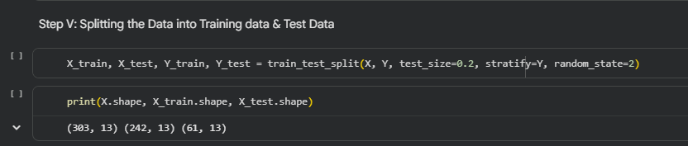
Algorithm:
Training Process:
The dataset was divided into training and testing sets using the train_test_split() function with stratified sampling to maintain balanced class distribution. The Logistic Regression model was trained on historical patient data using the fit() method. During training, the algorithm learned relationships between medical attributes and heart disease outcomes, enabling it to classify new patient records effectively.

Slide 12
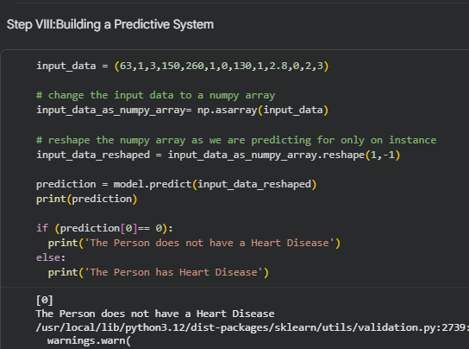
Algorithm:
Prediction Process:
After training, the model generates predictions by analyzing new patient input data and calculating the probability of heart disease occurrence. The trained Logistic Regression model applies learned weights to the input features and outputs a binary prediction indicating risk level. This allows quick assessment of patient health status and supports early detection through data-driven insights.

Slide 13
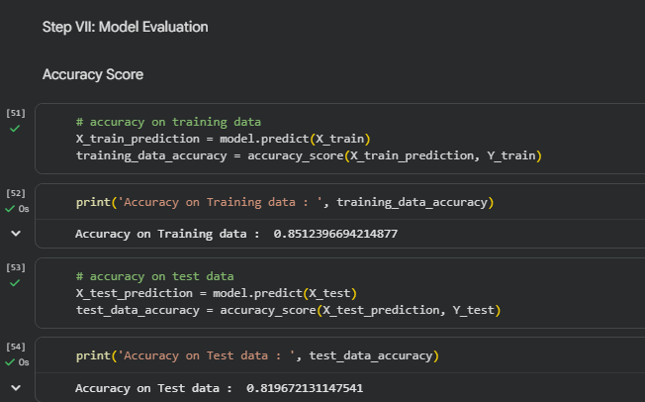
Result:
The performance of the proposed Heart Disease Prediction model was evaluated based on its accuracy and effectiveness in classifying patients into risk and non-risk categories. After training the Logistic Regression algorithm using historical patient health data, the model generated predictions for both training and testing datasets. The accuracy score was calculated to measure how correctly the model identified heart disease cases.

Slide 14
Result:
The results show that the model achieved strong performance, demonstrating its capability to analyze medical attributes such as age, chest pain type, cholesterol level, and maximum heart rate to predict heart disease risk. The comparison between training accuracy and testing accuracy indicates that the model generalizes well and does not suffer from significant overfitting.

Slide 15
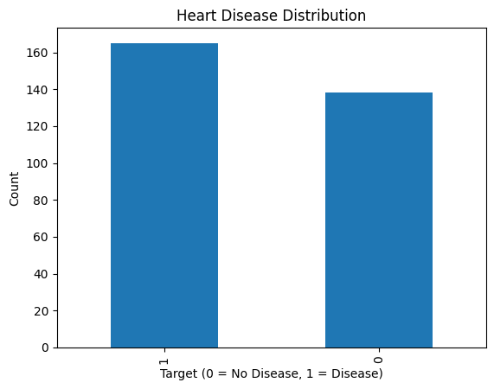
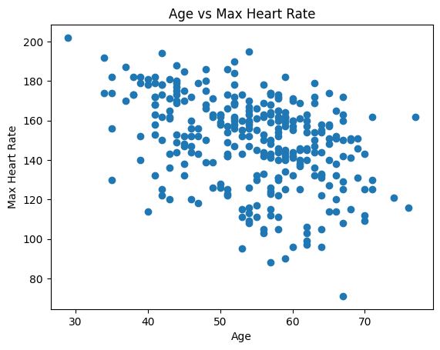
Result:
Visualizations:
Number of patients with and without heart disease.
2. Societal impact — how risk increases with age.

Slide 16
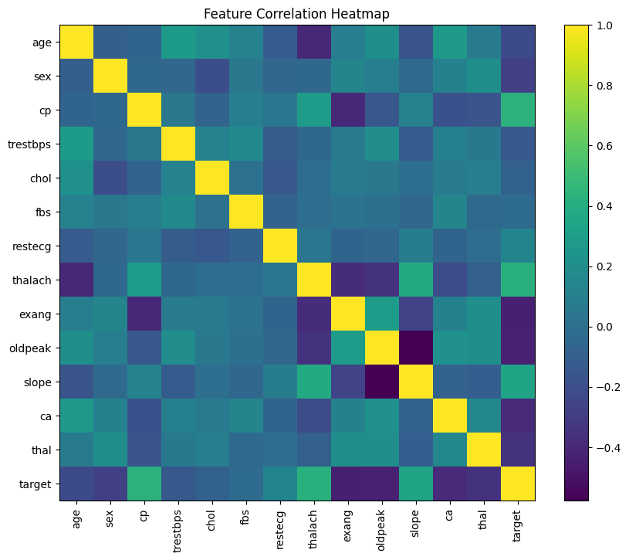
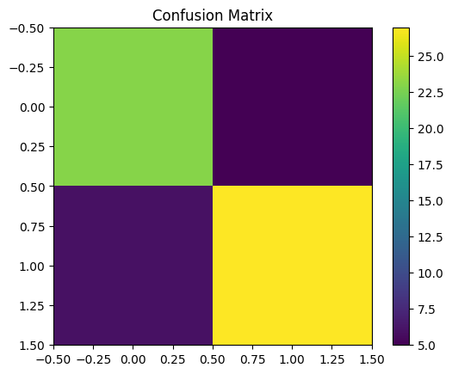
Result:
3. Highlights relationships between medical features influencing prediction.
4. Shows comparison between actual and predicted classifications, indicating true positives, true negatives, and misclassifications.

Slide 17
Result:
Predicted vs Actual Comparison:
The trained model’s predictions were compared with actual labels from the testing dataset. The comparison demonstrates that the algorithm correctly classified most cases, confirming its reliability for preliminary heart disease screening. Example predictions using sample patient input data further validated the effectiveness of the trained model.
Model Effectiveness:
High prediction accuracy on test data indicates reliable performance.
Logistic Regression successfully identified important medical risk factors.
The model can assist as a decision-support tool for early detection and preventive healthcare.

Slide 18
Conclusion:
The Heart Disease Prediction System demonstrates how machine learning can be effectively applied to analyze medical data and support early detection of cardiovascular risk.
By using Logistic Regression, the model successfully learned patterns from patient health parameters such as age, chest pain type, cholesterol level, and heart rate to classify individuals into risk and non-risk categories.
The results indicate that data-driven healthcare solutions can assist medical professionals by providing quick preliminary assessments and encouraging preventive healthcare practices.
Although the system achieved reliable accuracy, future improvements such as integrating larger datasets, experimenting with advanced algorithms, and developing user-friendly interfaces can further enhance its real-world impact and scalability.

Slide 19
Future scope:
Integrate larger and more diverse healthcare datasets to improve model accuracy and generalization.
Experiment with advanced algorithms such as Random Forest, XGBoost, or Neural Networks for better prediction performance.
Develop a web or mobile interface to make the system accessible for real-time patient risk assessment.
Incorporate wearable device data and real-time health monitoring for continuous heart disease prediction.

Slide 20
References:
Ahmad, A. A. et al., Prediction of Heart Disease Based on Machine Learning, which highlights the importance of early disease detection using the Cleveland heart disease dataset.
Cleveland Heart Disease Dataset (Kaggle version) containing clinical features such as age, cholesterol, and ECG measurements.
Logistic Regression-based heart disease prediction research explaining classification using medical features.
GitHub Link:
https://github.com/Mru017/Heart-disease-prediction
Dataset Link: https://. drivegoogle.com/file/d/1CEqlOEexf9p02M5vCC1RDLXibHYE9Xz/viewy

Slide 21
Thank You
Notes:
11

