Slide 1

MUSIC STORE DATA ANALYSIS USING SQL
Project Associates
Shahbaaz Shaik
Pulugu Mrudhula

Slide 2

Introduction
In today’s data-driven environment, organizations rely on data analysis to understand customer behavior and improve business decisions. This project focuses on analyzing a digital music store database using Structured Query Language (SQL) to extract meaningful insights from transactional data.
The dataset contains multiple relational tables including customers, invoices, tracks, artists, albums, genres, and employees. By writing SQL queries and performing relational joins, aggregation, filtering, and window functions, various business questions were answered related to customer spending, popular music genres, top artists, and revenue distribution.
The objective of this project is to demonstrate how SQL can be used to analyze structured data and generate insights that help businesses understand their customers, identify high-performing artists and genres, and make data-driven strategic decisions.

Slide 3
Problem Statement
Music retailers collect large volumes of transactional and customer data, but often face challenges in converting this raw information into meaningful business intelligence. Without proper analysis, it becomes difficult to identify valuable customers, understand regional revenue patterns, or determine which artists and genres are driving sales.
By applying SQL-based analysis, this project aims to transform raw data into actionable insights that can support strategic decision-making.
Using SQL queries, the project aims to identify key metrics such as top customers, best-selling artists, popular genres, and revenue distribution across countries and cities.
These insights can help the company improve marketing strategies, customer targeting, and promotional activities.

Slide 4


Slide 5
Objectives

Slide 6
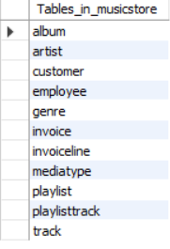
Tables

Slide 7


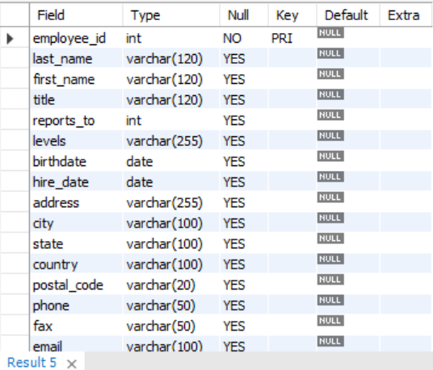
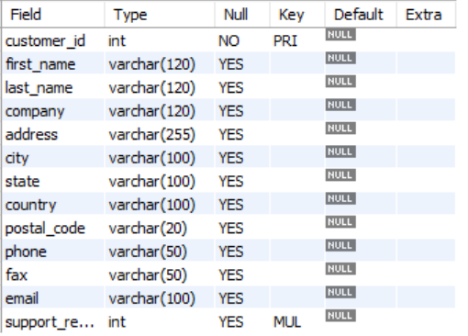
Tables Structures
1. Genre Table
2. MediaType Table
3. Employee Table
4. Customer Table

Slide 8


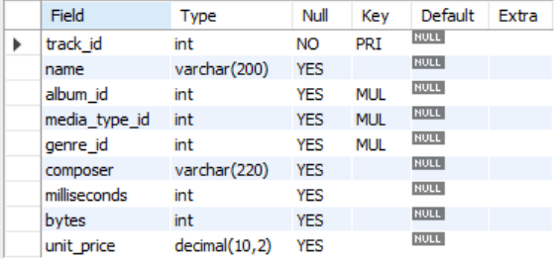
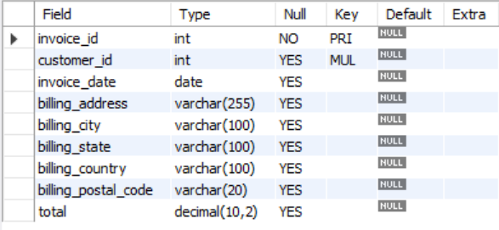
5. Artist Table
6. Album Table
7. Track Table
8. Invoice Table

Slide 9
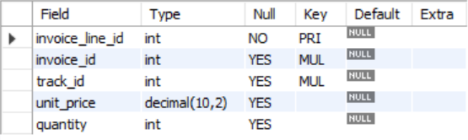


9. Invoiceline Table
10. Playlist Table
11. Playlist track Table

Slide 10
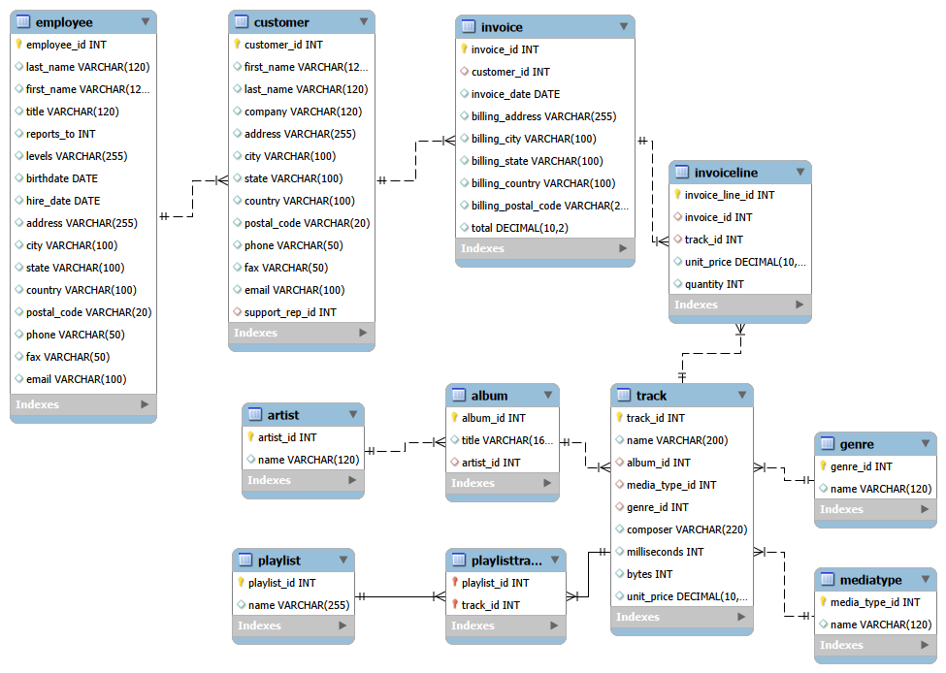
ER Diagram

Slide 11
Who is the senior most employee based on job title?
Which countries have the most Invoices?
What are the top 3 values of total invoice?
Which city has the best customers? - We would like to throw a promotional Music Festival in the city we made the most money. Write a query that returns one city that has the highest sum of invoice totals. Return both the city name & sum of all invoice totals
Who is the best customer? - The customer who has spent the most money will be declared the best customer. Write a query that returns the person who has spent the most money
Write a query to return the email, first name, last name, & Genre of all Rock Music listeners. Return your list ordered alphabetically by email starting with A
Let's invite the artists who have written the most rock music in our dataset. Write a query that returns the Artist name and total track count of the top 10 rock bands
Return all the track names that have a song length longer than the average song length.- Return the Name and Milliseconds for each track. Order by the song length, with the longest songs listed first
Find how much amount is spent by each customer on artists? Write a query to return customer name, artist name and total spent
We want to find out the most popular music Genre for each country. We determine the most popular genre as the genre with the highest amount of purchases. Write a query that returns each country along with the top Genre. For countries where the maximum number of purchases is shared, return all Genres
Write a query that determines the customer that has spent the most on music for each country. Write a query that returns the country along with the top customer and how much they spent. For countries where the top amount spent is shared, provide all customers who spent this amount
Analysis

Slide 12


1. Who is the senior most employee based on job title? (Senior Most Employee → Madhan Mohan [S.G.M])
Insight: The analysis shows that Madhan Mohan holds the highest position (Senior General Manager), making him the most senior employee in the organization.

Slide 13
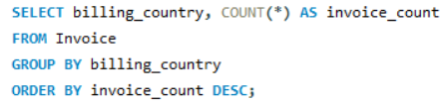
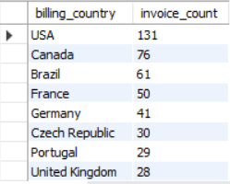
2. Which countries have the most invoices? (Countries with most invoice → USA,Canada,Brazil)
Insight: The USA, Canada, and Brazil generate the highest number of invoices, indicating these countries contribute the most sales transactions.

Slide 14


3. What are the top 3 values of total invoices?
Insight: The highest invoice value is 23.76 (Customer ID 42), followed by 19.80 from Customer IDs 32 and 3, indicating the top invoice transactions in the dataset.

Slide 15
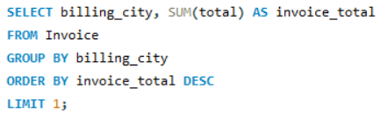

4. Which city that has the highest sum of invoice totals. Return both the city name & sum of all invoice totals? (City with highest invoice totals → Prague )
Insight: Prague generates the highest total invoice revenue (273.24), making it the top-performing city in sales.

Slide 16
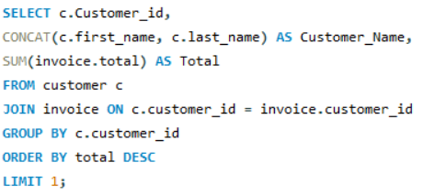

5. Who is the best customer? Write a query that returns the person who has spent the most money? (Best Customer = Highest Spending → FrantiAiek WichterovAi)
Insight: František Wichterlová is the best customer, having spent the highest total amount of 144.54 in the store.

Slide 17
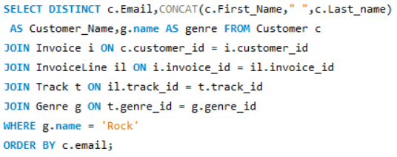
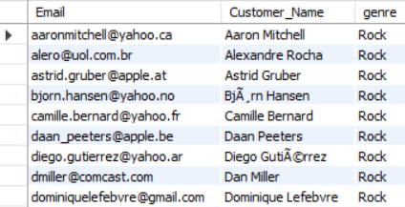
6. Write a query to return the email, first name, last name, & Genre of all Rock Music listeners in alphabetical order? (Rock genre music listeners)
Insight: The analysis identifies customers who listen to Rock music, helping the store understand genre preferences and target Rock music fans effectively.

Slide 18
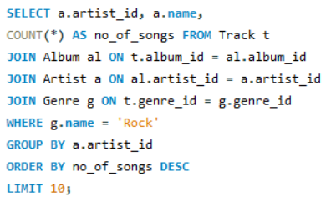
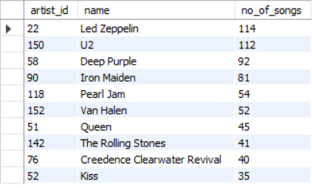
7. Write a query that returns the Artist name and total track count of the top 10 rock bands ? (Top 10 Rock genre artists)
Insight: The analysis identifies the top 10 Rock artists based on the number of tracks, with Led Zeppelin having the highest track count.

Slide 19
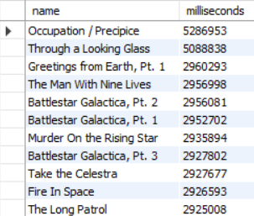
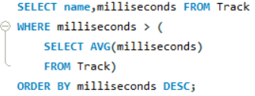
8. Return all the track names that have a song length longer than the average song length.- Return the Name and Milliseconds for each track. Order by the song length, with the longest songs listed first? (Tracks longer than average song length)
Insight: The query identifies tracks that are longer than the average song length, highlighting the longest songs in the music store database.

Slide 20
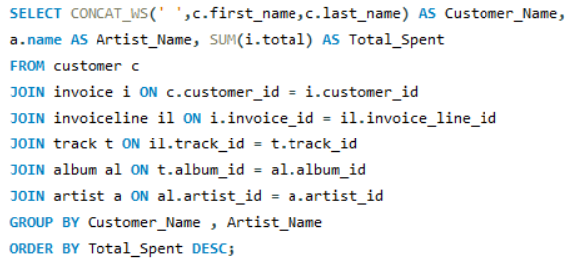
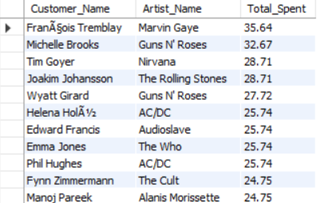
9. Find how much amount is spent by each customer on artists? Write a query to return customer name, artist name and total spent? (Customer spending on artist)
Insight: This analysis shows how much each customer spends on different artists, helping identify popular artists and customer purchasing patterns.

Slide 21
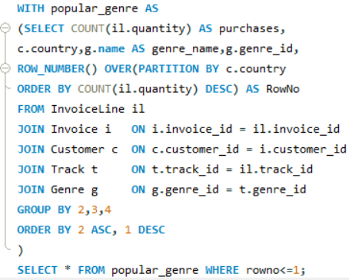
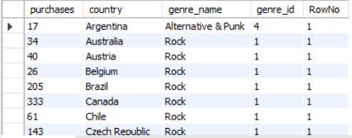
10. Write a query that returns each country along with the top Genre. For countries where the maximum number of purchases is shared, return all Genres? (Most popular genre by country)
Insight: The analysis identifies the most popular music genre in each country based on the highest number of purchases.

Slide 22
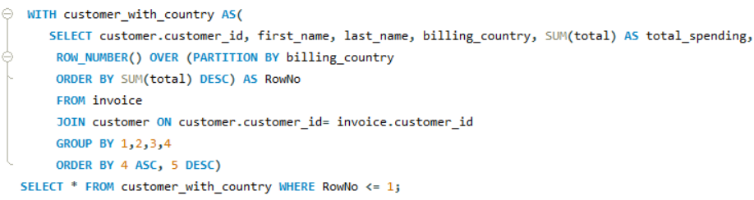
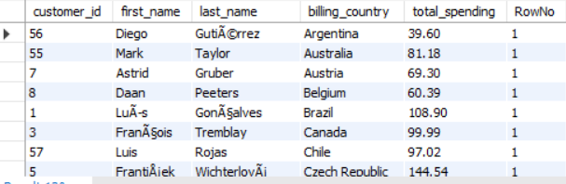
11. Write a query that returns the country along with the top customer and how much they spent. For countries where the top amount spent is shared, provide all customers who spent this amount? (Top customer per country)
Insight: The analysis identifies the top-spending customer in each country, helping understand customer value across different regions.

Slide 23
Key Insights
Top-performing employees and customers are identifiable for rewards.
Revenue hotspots (countries & cities) can guide marketing campaigns and events.
Genre & artist popularity informs stocking decisions, playlist curation, and event planning.
High-value invoices and loyal customers provide opportunities for VIP programs and upselling.
Data reveals patterns in customer spending behavior and music preferences, which can fuel data-driven marketing strategies.

Slide 24
Conclusion
This initiative demonstrates how SQL can be harnessed to transform raw transactional data into actionable business insights. Through the analysis:
Customer behavior patterns were uncovered, revealing high-value customers and genre preferences.
Revenue performance was tracked and evaluated, identifying top-performing cities, countries, and invoices.
Market and music preferences were analyzed, highlighting popular genres and top artists in the catalog.
Strategic opportunities were identified, providing a foundation for targeted marketing, promotions, and event planning.

Slide 25
THANK YOU

