Slide 1


Inventory Management

Slide 2
Prepared By:-
===========================================
Name:- Songade Mrudani
Roll No:- 39
Enrollment No:-21002170510032
Batch:- B2
Branch:- AIDS
====================================
====================================
===========================================

Slide 3
Big concept

Slide 4
* Abstract *
In this problem, we are given a set of items, each with a weight and a value. We are also given a knapsack with a maximum capacity. The objective is to fill the knapsack with items such that the total value of the items is maximized, without exceeding the maximum capacity of the knapsack. In the Fractional Knapsack Problem, we can break items into smaller pieces to maximize the total value of the knapsack

Slide 5
* Functions and libraries *
I am using Django, Python Functions to make this project.
I have made some important functions for each user. Namely, an inventory in which they can add products. They can also compare products in the fractional knapsack basis .

Slide 6

Result of my project
6

Slide 7
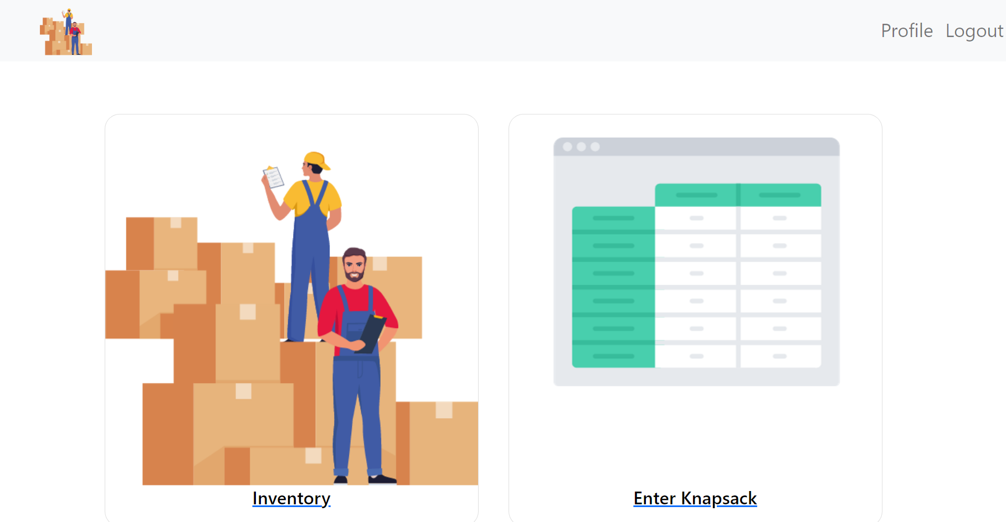

Slide 8
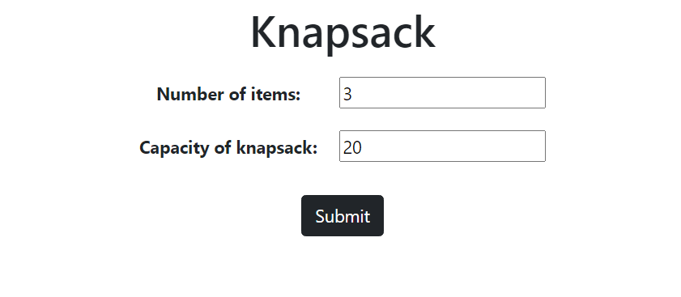
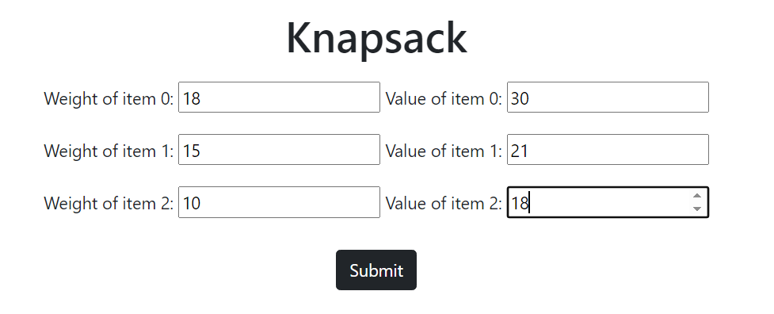
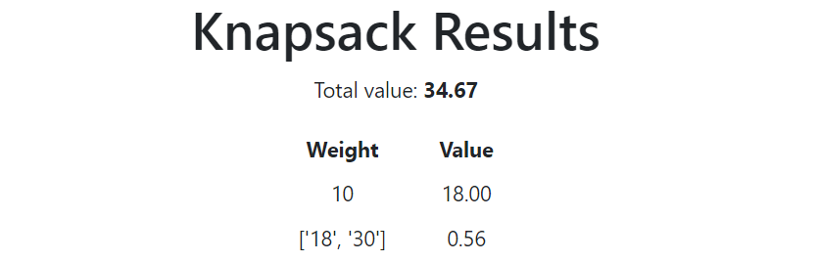

Slide 9
Thank You

